Slide 1
Chapter 1
Thinking Like an Economist

Slide 2
Chapter Outline
The Cost-Benefit Approach to Decisions
The Role of Economic Theory
Common Pitfalls in Decision Making
Using Marginal Benefit and Marginal Cost Graphically
The Invisible Hand
Would Parents want their Daughter or Son to Marry Homo Economicus?
The Economic Naturalist
Positive Questions and Normative Questions
Microeconomics and Macroeconomics

Slide 3
The Cost-Benefit Approach
If the benefit of an activity exceeds its cost, do it.
Reservation price of activity x: the price at which a person would be indifferent between doing x and not doing x.

Slide 4
Common Pitfalls in Decision Making
Ignoring Implicit Costs
Failing to Ignore Sunk Costs
Measuring Costs and Benefits as Proportions Rather than Absolute Dollar Amounts
Failure to Understand the Average-Marginal Distinction

Slide 5
Pitfall #1: Ignoring Implicit Costs
If doing activity x means not being able to do activity y, then the value to you of doing y is an opportunity cost of doing x.
In other words, the opportunity cost is the value of all that must be sacrificed to do the activity.

Slide 6
Pitfall #2: Failing to Ignore Sunk Costs
An opportunity cost may not seem to be a relevant cost when in reality it is.
On the other hand, sometimes an expenditure may seem relevant when in reality it is not.
Sunk costs: costs that are beyond recovery at the moment a decision is made.
These costs should be ignored.

Slide 7
Pitfall #3: Measuring Costs and Benefits as Proportions Rather Than Absolute Dollar Amounts
When comparing costs and benefits, always use absolute dollar amounts, not proportions.

Slide 8
Pitfall #4: Failure to Understand the Average-Marginal Distinction
Compare the benefit and cost of an additional unit of activity.
Marginal cost: the increase in total cost that results from carrying out one additional unit of activity
Marginal benefit: the increase in total benefit that results from carrying out one additional unit of activity
Keep increasing the level of an activity as long as its marginal benefit exceeds its marginal cost.

Slide 9
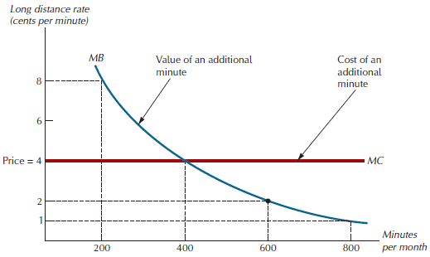
Figure 1.1: The Optimal Quality of Conversation

Slide 10
The Invisible Hand
Unaware of the effects of their actions, self-interested consumers often act as if driven by what Adam Smith called an invisible hand to produce the greatest social good.
External cost of an activity: a cost that falls on people who are not directly involved in the activity.

Slide 11
Would Parents Want Their Daughter or Son to Marry Homo Economicus?
The stereotypical decision maker in the self-interest model is given the label Homo Economicus, or “economic man”
Homo Economicus only cares about personal material costs and benefits.
Self-interest is one of the most important human motives, but it is not the only important motive.

Slide 12
The Economic Naturalist
An economic naturalist sees the mundane details of ordinary existence in a sharp new light—economics is around us everywhere.

Slide 13
Positive Questions and Normative Questions
Normative question: a question about what policies or institutional arrangements lead to the best outcomes.
Positive question: a question about the consequences of specific policies or institutional arrangements.

Slide 14
Microeconomics and Macroeconomics
Microeconomics: the study of individual choices and the study of group behavior in individual markets
Macroeconomics: the study of broader aggregations of markets

