Slide 1
Chapter 2
Supply and Demand

Slide 2
Chapter Outline
Supply and Demand Curves
Equilibrium Quantity and Price
Adjustment to Equilibrium
Some Welfare Properties of Equilibrium
Free Markets and The Poor
  Rent Controls
  Price Supports
  The Rationing and Allocative Function of Prices
Determinants of Supply and Demand
  Changes in Demand Versus changes in the Quantity Demanded
  Predicting and Explaining Changes in Price and Quantity
The Algebra of Supply and Demand
Appendix
  How do Taxes Affect Equilibrium Prices and Quantities

Slide 3
Supply and Demand Curves
A Market: consists of the buyers and sellers of a good or service.
Law of Demand: the empirical observation that when the price of a product falls, people demand larger quantities of it.
Law of Supply: the empirical observation that when the price of a product rises , firms offer more of it for sale.

Slide 4
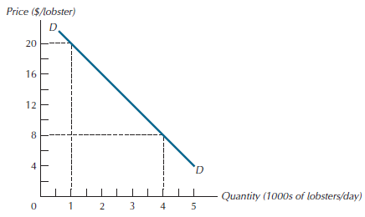
Figure 2.1: The Demand Curve for Lobsters in Hyannis, MA., July 20, 2014

Slide 5
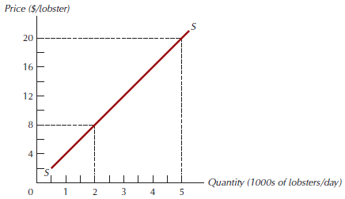
Figure 2.2: A Supply Schedule for Lobsters in Hyannis, MA., July 20, 2014

Slide 6
Equilibrium Quantity and Price
Equilibrium quantity and price: it is the price-quantity pair at which both buyers and sellers are satisfied.
Excess supply: the amount by which quantity supplied exceeds quantity demanded.
Excess demand: the amount by which quantity demanded exceeds quantity supplied.

Slide 7
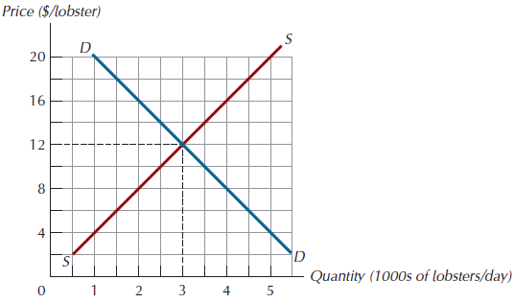
Figure 2.3: Equilibrium in the Lobster Market

Slide 8
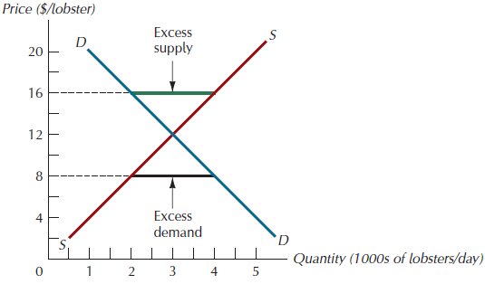
Figure 2.4: Excess Supply and Excess Demand

Slide 9
Some Welfare Properties of Equilibrium
If price and quantity take anything other than their equilibrium values, however, it will always be possible to reallocate so as to make at least some people better off without harming others.

Slide 10
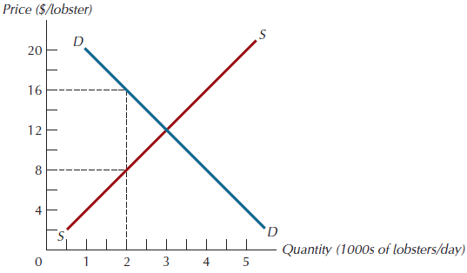
Figure 2.5: An Opportunity for Improvement in the Lobster Market

Slide 11
Free Markets and the Poor
Efficiency says that given the low incomes of the poor, free exchange enables them to do the best they can.

Slide 12
Rent Controls
A price ceiling for rents is a level beyond which rents are not permitted to rise.
Example: Figure 2.6
  The price ceiling creates an excess demand of 40,000 units.

Slide 13
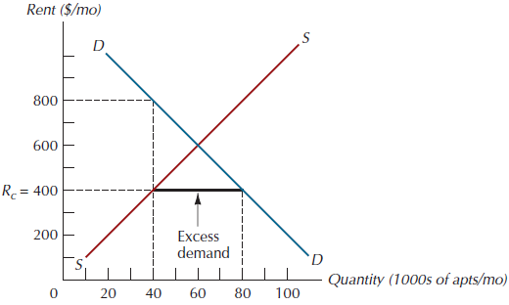
Figure 2.6: Rent Controls

Slide 14
Price Supports
A price support (or price floor) keep prices above their equilibrium levels.
Require the government to become an active buyer in the market.
Purpose of farm price supports is to ensure prices high enough to provide adequate incomes for farm families.

Slide 15
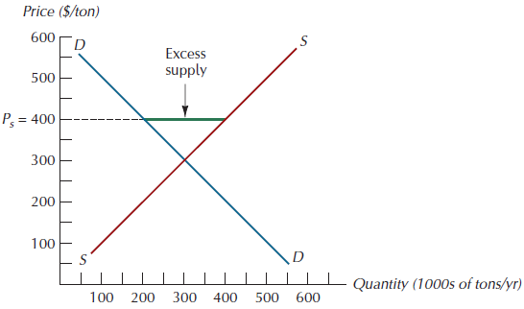
Figure 2.7: A Price Support in the Soybean Market

Slide 16
The Rationing and Allocative Functions of Prices
Rationing function of price: the process whereby price directs existing supplies of a product to the users who value it most highly.
Allocative function of price: the process whereby price acts as a signal that guides resources away from the production of goods whose prices lie below cost toward the production of goods whose prices exceed cost.

Slide 17
Factors the Shift the Demand Curve
Incomes
  Normal goods: the quantity demanded at any price rises with income.
  Inferior goods: the quantity demanded at any price falls with income.
Tastes
Price of Substitutes and Complements
  Complements - an increase in the price of one good decreases demand for the other good.
  Substitutes - an increase in the price of one will tend to increase the demand for the other.
Expectations
Populations

Slide 18
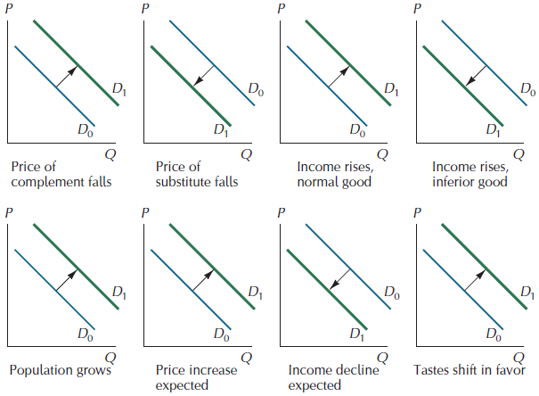
Figure 2.8: Factors that Shift
Demand Curves

Slide 19
Factors the Shift the Supply Curve
Technology
Factor Prices
The Number of Suppliers
Expectations
Weather

Slide 20
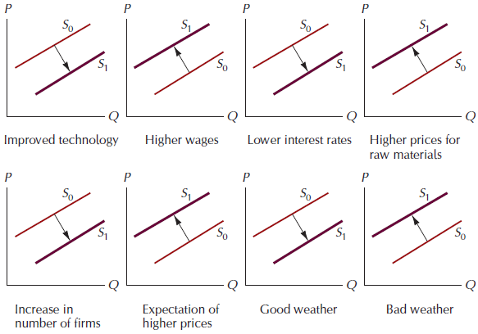
Figure 2.9: Factors that Shift Supply Schedules

Slide 21
Predicting Changes in Price and Quantity
An increase in demand → an increase in both the equilibrium price and quantity.
A decrease in demand → a decrease in both the equilibrium price and quantity.
An increase in supply → a decrease in the equilibrium price and an increase in the equilibrium quantity.
A decrease in supply → an increase in the equilibrium price and a decrease in the equilibrium quantity.

Slide 22
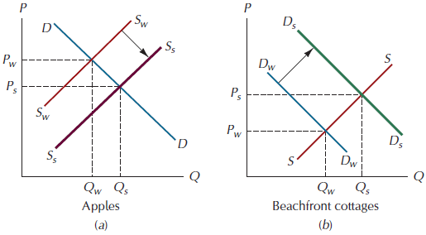
Figure 2.10: Two Sources of Seasonal Variation

Slide 23
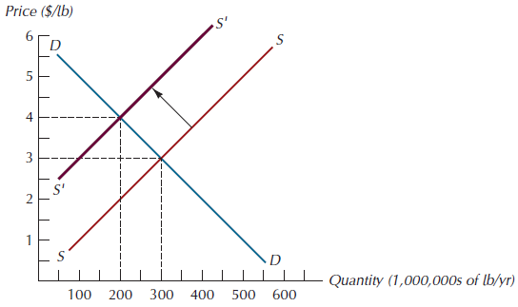
Figure 2.11: The Effect of Soybean Price Supports on the Equilibrium Price and Quantity of Beef

Slide 24
The Algebra of Supply and Demand
For computing numerical values, it is more convenient to find equilibrium prices and quantities algebraically
  The supply schedule is: P= 2 + 3Q^{s}
  Its demand schedule is: P = 10 – Q^{d}
  In equilibrium we know that Q^{s =} Q^{d}, denoting this common value as Q*, we arrive at: 2 + 3Q* = 10 – Q*
  Which gives Q* = 2, substituting this back into either the supply or demand equation gives the equilibrium price, P* = 8

Slide 25
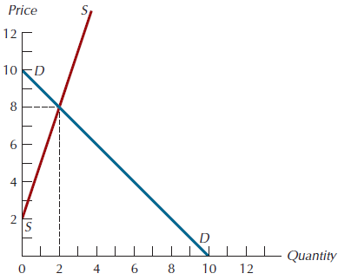
Figure 2.12: Graphs of the Supply and Demand Equations

Slide 26
Figure A2.1: A Tax of T=10 Levied on the Seller Shifts the Supply Schedule Upward by T Units

Slide 27
Figure A2.2: Equilibrium Prices and Quantities When a Tax of T = 10 is Levied on the Seller

Slide 28
Figure A2.3: The Effect of a Tax of
T = 10 Levied on the Buyer

Slide 29
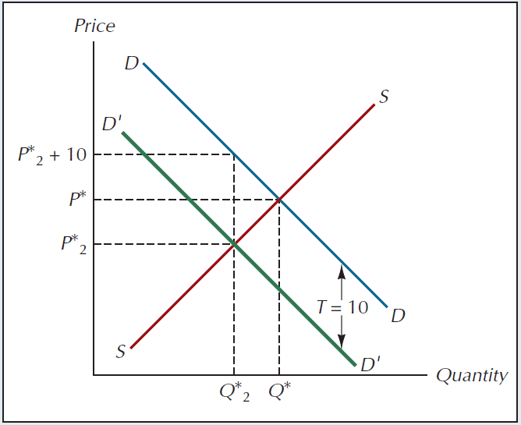
Figure A2.4: Equilibrium Prices and Quantities after Imposition of a Tax of a Tax of T = 10 Paid by the Buyer

Slide 30
Figure A2.5: A Tax on the Buyer Leads to the Same Outcome as a Tax on the Seller

