Slide 1
Chapter 3
Rational Consumer Choice

Slide 2
Chapter Outline
The Opportunity Set or Budget Constraint
Budget Shifts Due to Price or Income Changes
Consumer Preferences
The Best Feasible Bundle
Appendix:
The Utility Function Approach to the Consumer Choice
Cardinal versus Ordinal Utility
Generating Indifference Curves Algebraically

Slide 3
Budget Limitation
A bundle: a particular combination of two or more goods.
Budget constraint: the set of all bundles that exactly exhaust the consumer’s income at given prices.
Its slope is the negative of the price ratio of the two goods.

Slide 4
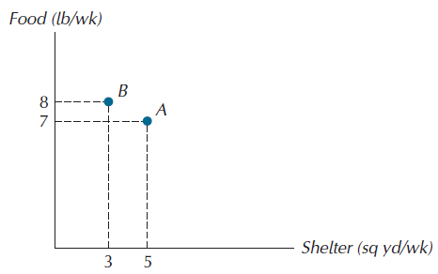
Figure 3.1: Two Bundles of Goods

Slide 5
Affordable vs. Unaffordable
Affordable set, or feasible set: bundles on or below the budget constraint; bundles for which the required expenditure at given prices is less than or equal to the income available.
Unaffordable set, or unfeasible set: bundles that lie outside the budget constraint

Slide 6
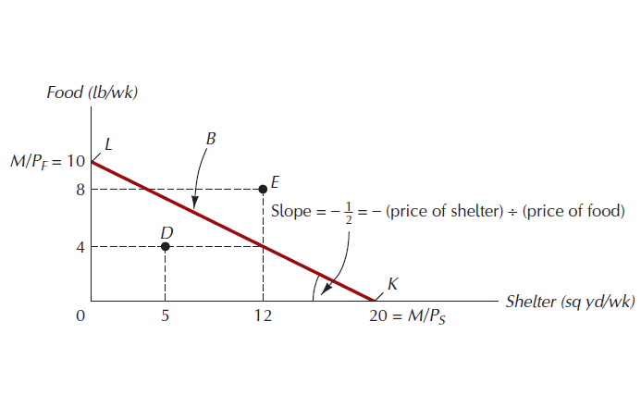
Figure 3.2: The Budget Constraint, or Budget Line

Slide 7
Budget Shifts Due to Price and Income Changes
If the price of ONLY one good changes…
The slope of the budget constraint changes.
If the price of both goods change by the same proportion…
The budget constraint shifts parallel to the original one.
If income changes ….
The budget constraint shifts parallel to the original one.

Slide 8
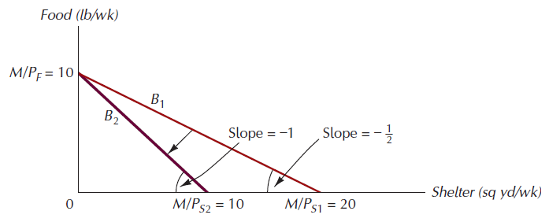
Figure 3.3: The Effect of a Rise in the Price of Shelter

Slide 9
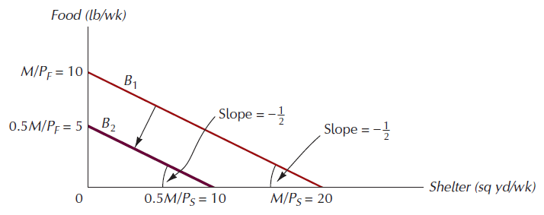
Figure 3.4: The Effect of Cutting Income by Half

Slide 10
Budgets Involving More Than Two Goods
When we have more than 3 goods, the budget constraint becomes a hyperplane, or multidimensional plane.
In this case, view the consumer’s choice as one between a good, X, and an amalgam of other goods, Y. This amalgam is called the composite good.
The amount of income left after buying good X
The amount the consumer spends on goods other than good X

Slide 11
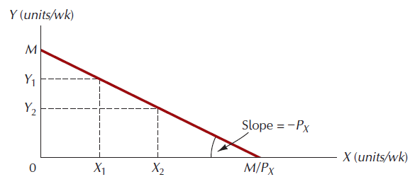
Figure 3.5: The Budget Constraints with the Composite Good

Slide 12
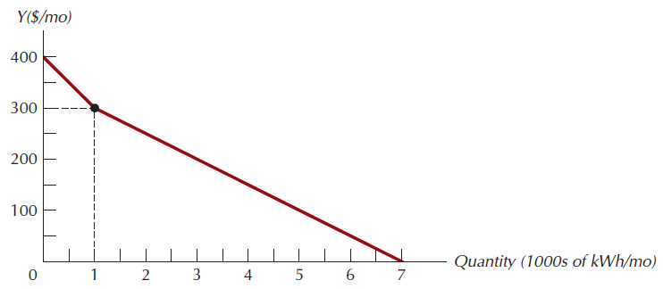
Figure 3.6: A Quantity Discount Gives Rise to a Nonlinear Budget Constraint

Slide 13
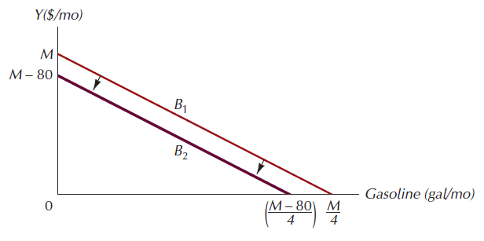
Figure 3.7: Budget Constraints Following Theft of Gasoline, Loss of Cash

Slide 14
Preference Ordering
Preference ordering: a ranking of all possible consumption bundles in order of preference.
Differ widely among consumers
Four simple properties of preference ordering

Slide 15
Properties of Preference Orderings
Completeness: the consumer is able to rank all possible combinations of goods and services.
More-Is-Better: other things equal, more of a good is preferred to less.
Transitivity: for any three bundles A, B, and C, if he prefers A to B and prefers B to C, then he always prefers A to C.
Convexity: mixtures of goods are preferable to extremes.

Slide 16
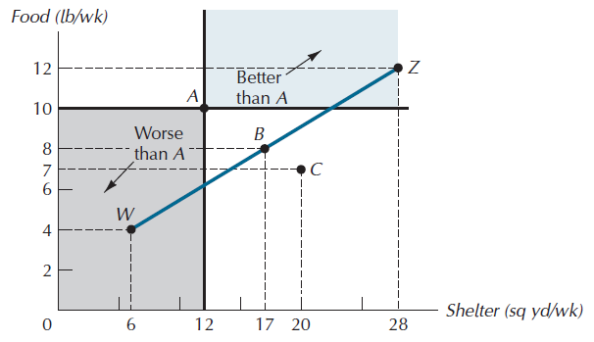
Figure 3.8: Generating Equally Preferred Bundles

Slide 17
Indifference Curves
Indifference curve: a set of bundles among which the consumer is indifferent.
Indifference map: a representative sample of the set of a consumer’s indifference curves, used as a graphical summary of her preference ordering.

Slide 18
Properties of Indifference Curves
Indifference curves …
Are Ubiquitous.
Any bundle has an indifference curve passing through it.
Are Downward-sloping.
This comes from the “more-is-better” assumption.
Cannot cross.
Become less steep as we move downward and to the right along them.
This property is implied by the convexity property of preferences.

Slide 19
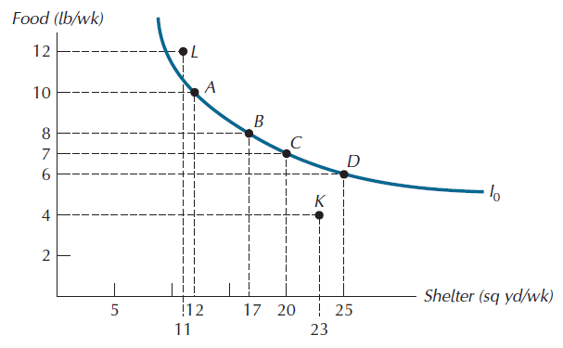
Figure 3.9: An Indifference Curve

Slide 20
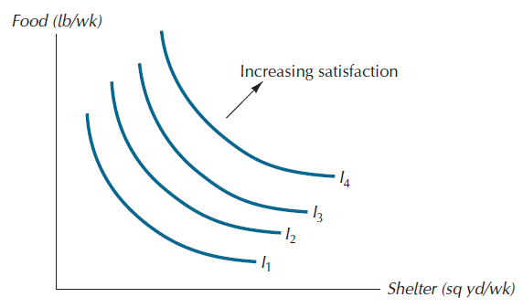
Figure 3.10: Part of an Indifference Map

Slide 21
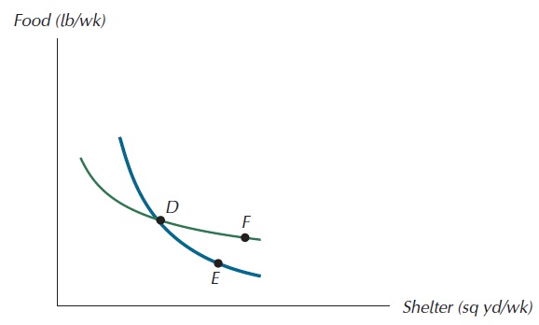
Figure 3.11: Why Two Indifference Curves Do Not Cross

Slide 22
Trade-offs Between Goods
Marginal rate of substitution (MRS): the rate at which the consumer is willing to exchange the good measured along the vertical axis for the good measured along the horizontal axis.
Equal to the absolute value of the slope of the indifference curve.

Slide 23
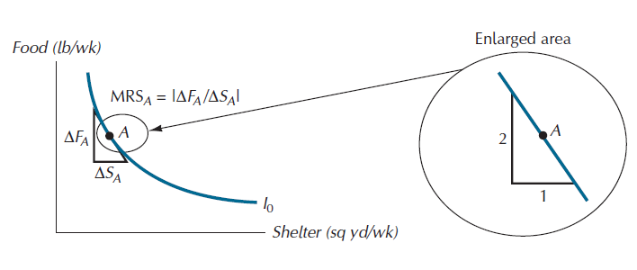
Figure 3.12: The Marginal Rates of Substitution

Slide 24
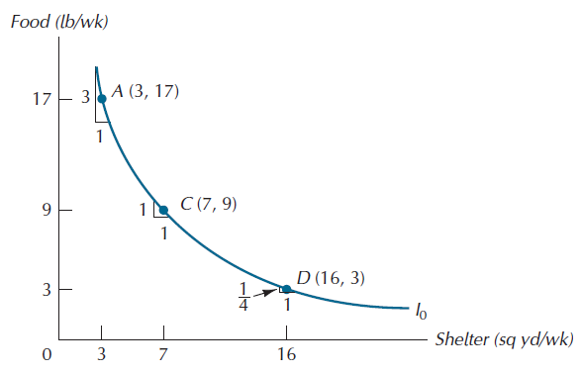
Figure 3.13: Diminishing Marginal Rate of Substitution

Slide 25
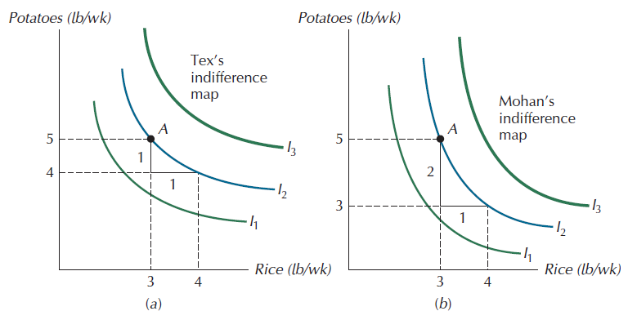
Figure 3.14: People with Different Tastes

Slide 26
The Best Feasible Bundle
Consumer’s Goal: to choose the best affordable bundle.
The same as reaching the highest indifference curve she can, given her budget constraint.
For convex indifference curves..
the best bundle will always lie at the point of tangency.

Slide 27
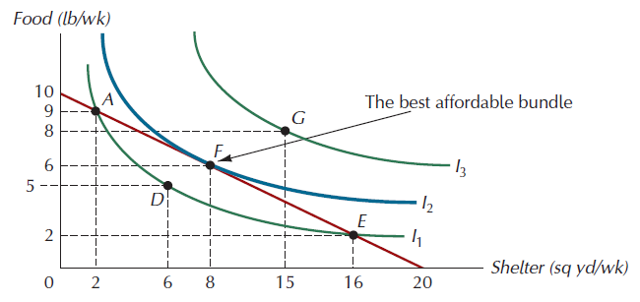
Figure 3.15: The Best Affordable Bundle

Slide 28
Corner Solutions
Corner solution: in a choice between two goods, a case in which the consumer does not consume one of the goods.

Slide 29
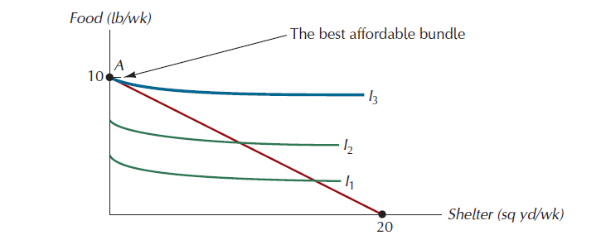
Figure 3.16: A Corner Solution

Slide 30
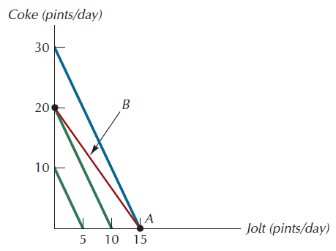
Figure 3.17: Equilibrium with Perfect Substitutes

Slide 31
Cash or Food Stamps?
Food Stamp Program
Objective - to alleviate hunger.
How does it work?
People whose incomes fall below a certain level are eligible to receive a specified quantity of food stamps.
Stamps cannot be used to purchase cigarettes, alcohol, and various other items.
The government gives food retailers cash for the stamps they accept.

Slide 32
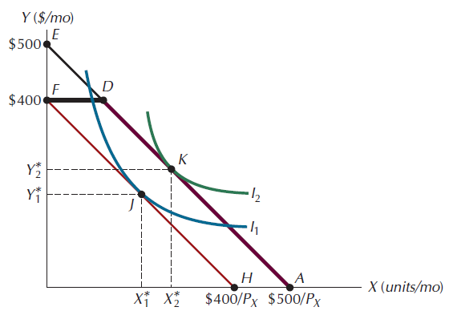
Figure 3.18: Food Stamp Program vs. Cash Grant Program

Slide 33
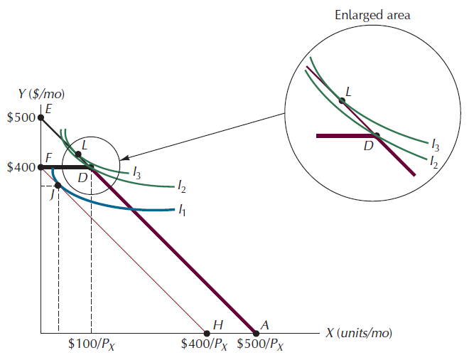
Figure 3.19: Where Food Stamps and Cash Grants Yield Different Outcomes

Slide 34
The Utility Function Approach to Consumer Choice
Finding the highest attainable indifference curve on a budget constraint is just one way to analyze the consumer choice problem
In this second approach, we represent the consumer’s preference not with an indifference map, but with a utility function.

Slide 35
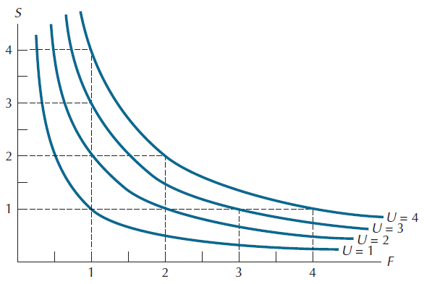
Figure A3.1: Indifference Curves for the Utility Function U=FS

Slide 36
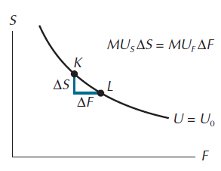
Figure A3.2: Utility Along an Indifference Curve Remains Constant

Slide 37
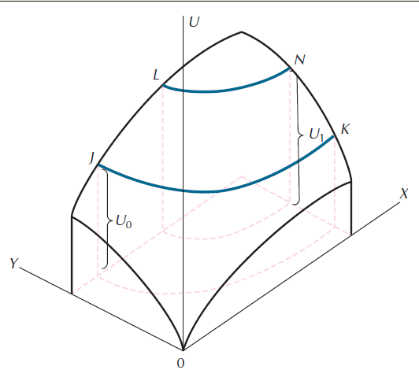
Figure A3.3: A Three-Dimensional Utility Surface

Slide 38
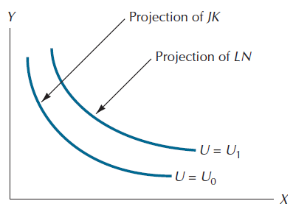
Figure A3.4: Indifference Curves as Projections

Slide 39
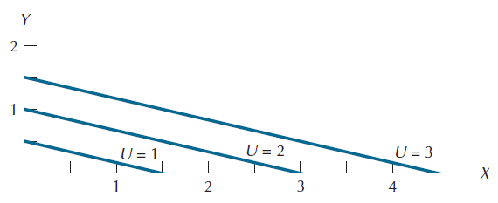
Figure A3.5: Indifference Curves for the Utility Function U(X,Y)=(2/3)X + 2Y

Slide 40
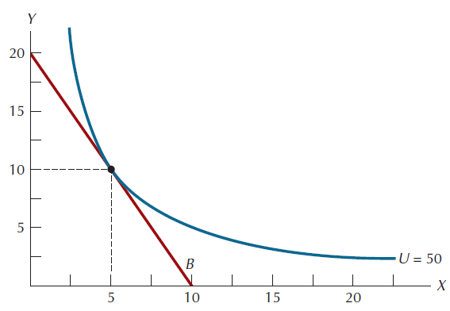
Figure A3.6: The Optimal Bundle when U=XY, P_{x}=4, P_{y}=2, and M=40

