Slide 1
Chapter 4
Individual and Market Demand

Slide 2
Chapter Outline
The Effects of Changes in the Price
The Effects of Changes in Income
The Income and Substitution Effects of a Price Change
Consumer Responsiveness to Changes in Price
Market Demand: Aggregating Individual Demand Curves
Price Elasticity of Demand
The Dependence of Market Demand on Income
Application: Forecasting Economic Trends
Cross-price Elasticities of Demand
Appendix
The Constant elasticity of demand
The Income-Compensated Demand Curve

Slide 3
The Effect of Changes in Price
Price-consumption curve (PCC): for a good X is the set of optimal bundles traced on an indifference map as the price of X varies (holding income and the price of Y constant).

Slide 4
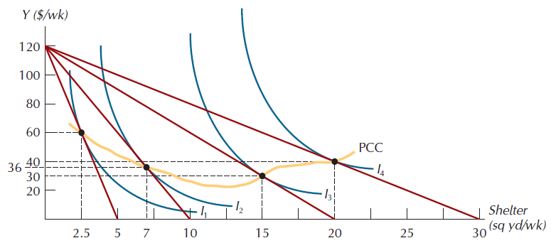
Figure 4.1: The Price-Consumption Curve

Slide 5
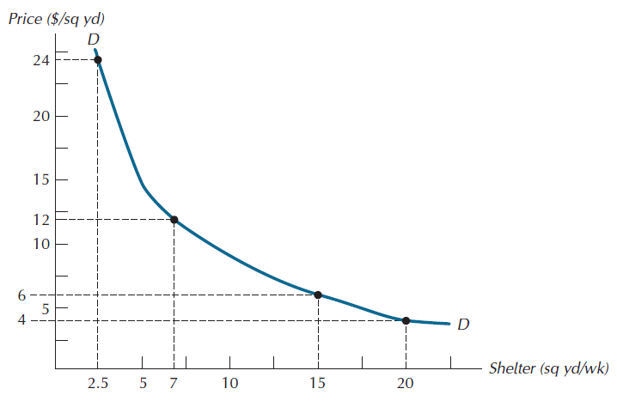
Figure 4.2: An Individual Consumer’s Demand Curve

Slide 6
The Effects of Changes in Income
Income-consumption curve (ICC): for a good X is the set of optimal bundles traced on an indifference map as income varies (holding the prices of X and Y constant).
Engel curve: curve that plots the relationship between the quantity of X consumed and income.

Slide 7
The Effects of Changes in Income
Normal good: one whose quantity demanded rises as income rises.
Inferior good: one whose quantity demanded falls as income rises.

Slide 8
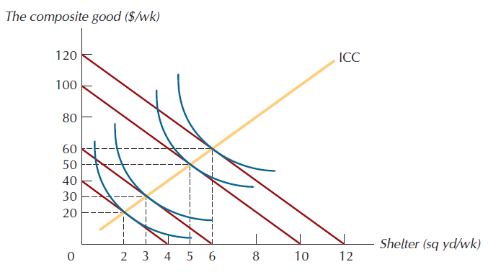
Figure 4.3: An Income-Consumption Curve

Slide 9
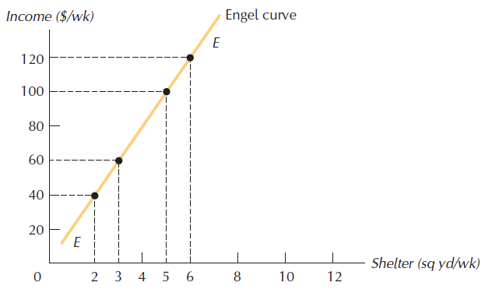
Figure 4.4: An Individual Consumer’s Engel Curve

Slide 10
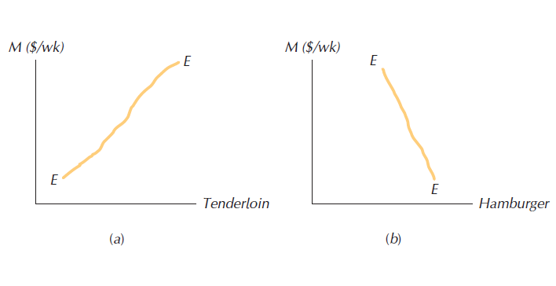
Figure 4.5: The Engel Curve for Normal and Inferior Goods

Slide 11
Income and Substitution Effects of a Price Change
Substitution effect: that component of the total effect of a price change that results from the associated change in the relative attractiveness of other goods.
Income effect: that component of the total effect of a price change that results from the associated change in real purchasing power.
Total effect: the sum of the substitution and income effects.

Slide 12
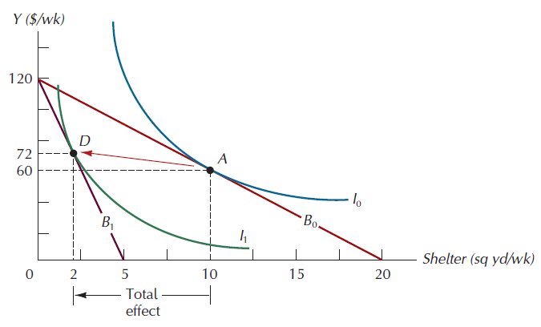
Figure 4.6: The Total Effect of a Price Increase

Slide 13
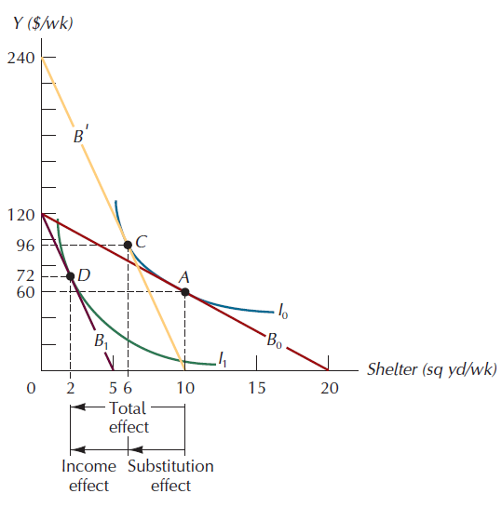
Figure 4.7: The Substitution and Income Effects of a Price Change

Slide 14
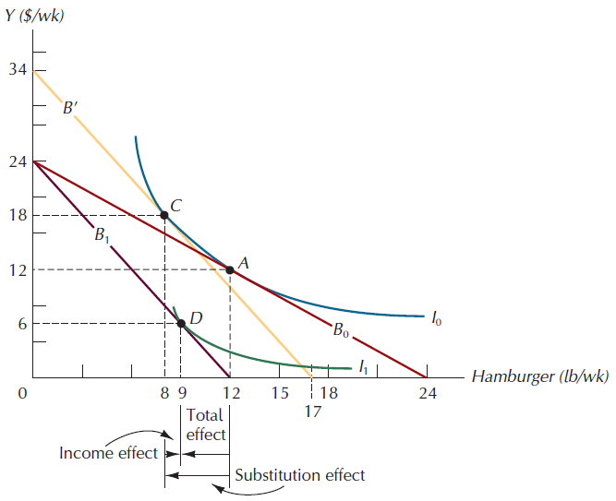
Figure 4.8: Income and Substitution Effects for an Inferior Good

Slide 15
Giffen Goods
Giffen good: one for which the quantity demanded rises as its price rises.
The Giffen good must be an inferior good

Slide 16
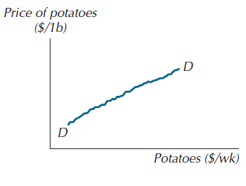
Figure 4.9: The Demand Curve for a Giffen Good

Slide 17
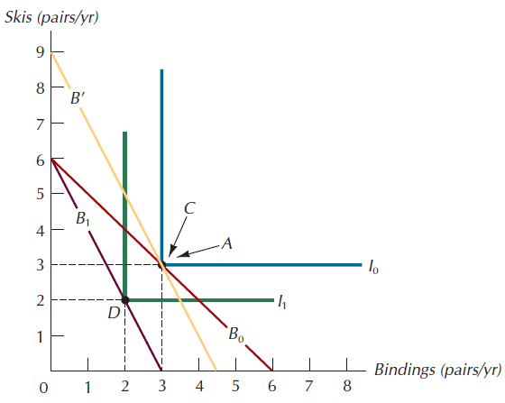
Figure 4.10: Income and Substitution Effects for Perfect Complements

Slide 18
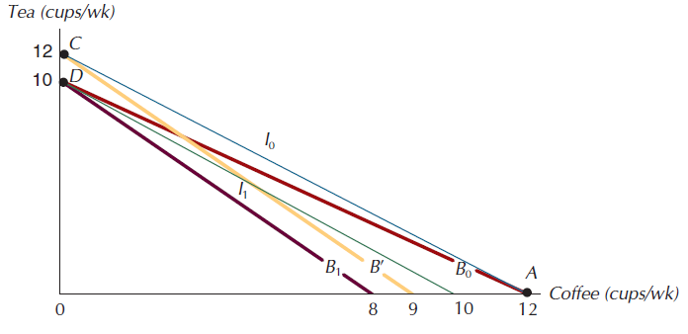
Figure 4.11: Income and Substitution Effects for Perfect Substitutes

Slide 19
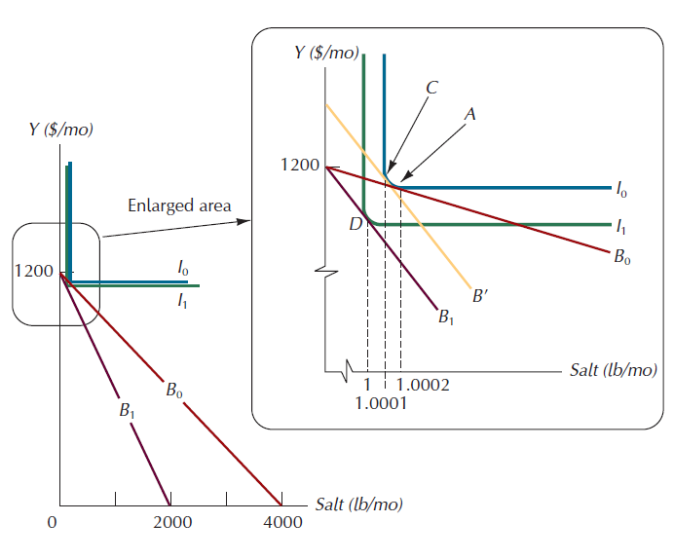
Figure 4.12: Income and Substitution Effects of a Price Increase for Salt

Slide 20
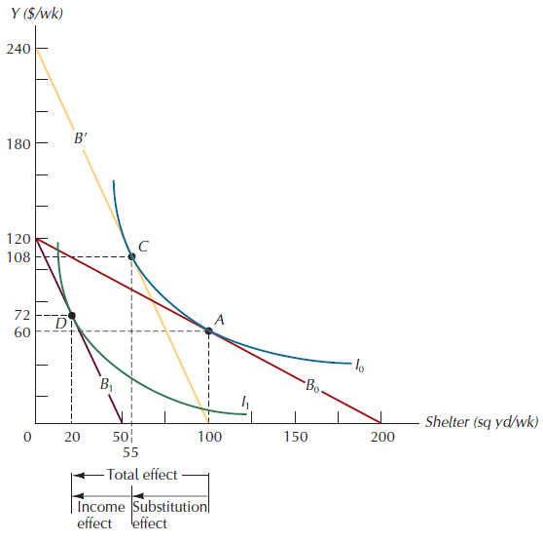
Figure 4.13: Income and Substitution Effects for a Price-Sensitive Good

Slide 21
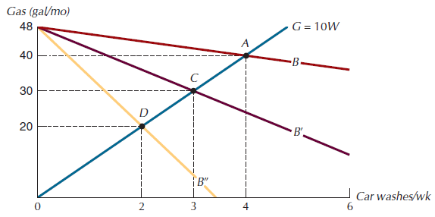
Figure 4.14: A Price Increase for Car Washes

Slide 22
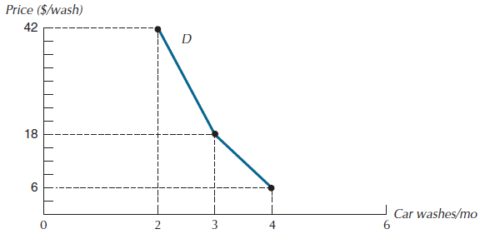
Figure 4.15: James’ Demand for Car Washes

Slide 23
Market Demand Curves
Market demand curve: the horizontal summation of the individual demand curves.
.

Slide 24
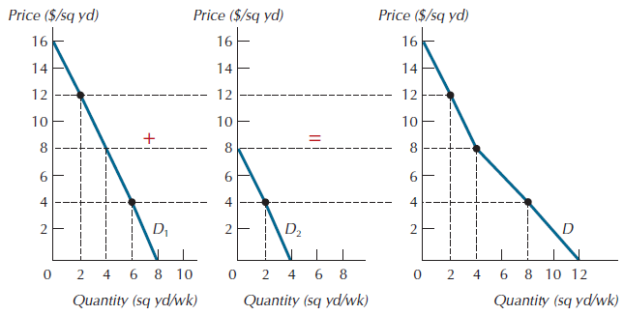
Figure 4.16: Generating Market Demand from Individual Demands

Slide 25
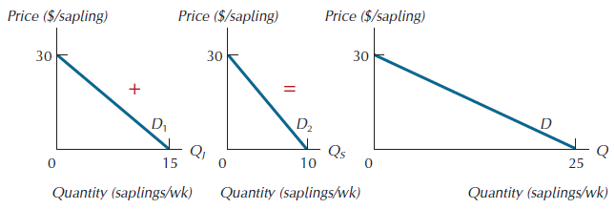
Figure 4.17: The Market Demand Curve for Beech Saplings

Slide 26
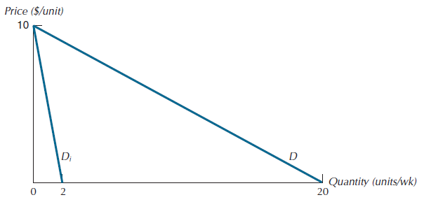
Figure 4.18: Market Demand with Identical Consumers

Slide 27
Price Elasticity of Demand
Price elasticity of demand: the present age change in the quantity of a good demanded that result from a 1 present change in its price.price

Slide 28
Three Categories of Price Elasticity
Elastic → € < -1
Inelastic → € > -1
Unit elastic → € = 1

Slide 29
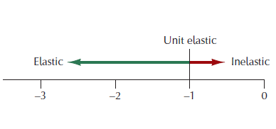
Figure 4.19: Three Categories of Price Elasticity

Slide 30
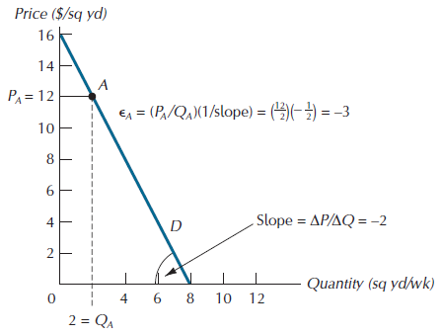
Figure 4.20: The Point-Slope Method

Slide 31
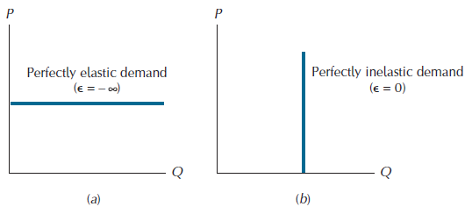
Figure 4.21: Two Important Polar Cases

Slide 32
The Unit-Free Property of Elasticity
When weighing costs and benefits, always compare absolute dollar amounts, not proportions.
When describing how quantity demanded responds to changes in price, it’s generally best to speak in terms of proportions.

Slide 33
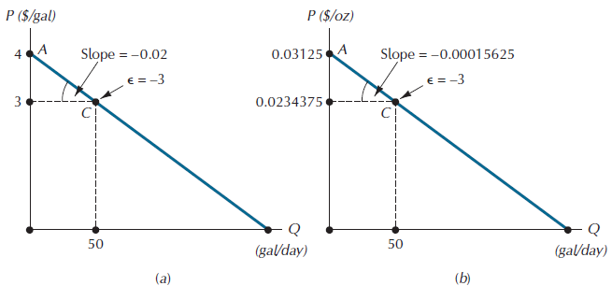
Figure 4.22: Elasticity is Unit-Free

Slide 34
Elasticity and Total Revenue
A price reduction will increase total revenue if and only if the absolute value of the price elasticity of demand is greater than 1.
An increase in price will increase total revenue if and only if the absolute value of the price elasticity is less than 1.

Slide 35
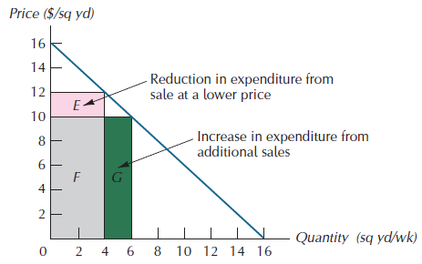
Figure 4.23: The Effect on Total Expenditure of a Reduction in Price

Slide 36
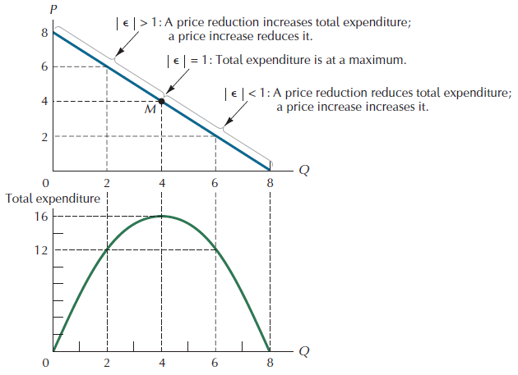
Figure 4.24: Demand and Total Expenditure

Slide 37
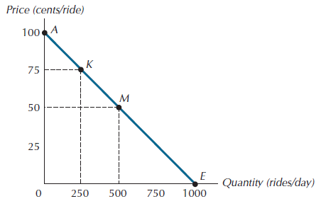
Figure 4.25: The Demand for Bus Rides

Slide 38
Determinants of Price Elasticity of Demand
Substitution possibilities: the substitution effect of a price change tends to be small for goods with no close substitutes.
Budget share: the larger the share of total expenditures accounted for by the product, the more important will be the income effect of a price change.
Direction of income effect: a normal good will have a higher price elasticity than an inferior good.
Time: demand for a good will be more responsive to price in the long-run than in the short-run.

Slide 39
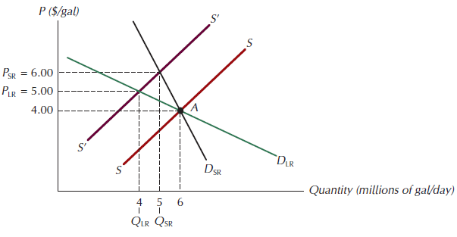
Figure 4.26: Price Elasticity Is Greater in the Long Run than in the Short Run

Slide 40
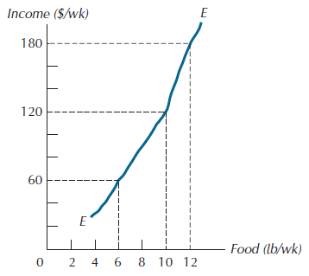
Figure 4.27: The Engel Curve for Food of A and B

Slide 41
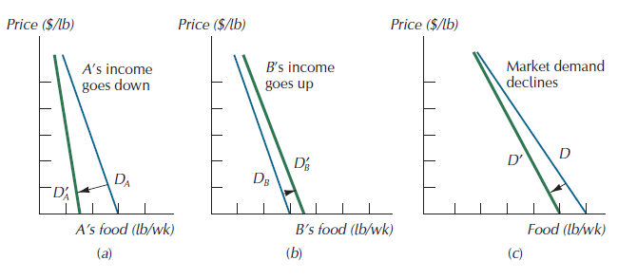
Figure 4.28: Market Demand Sometimes Depends on the Distribution of Income

Slide 42
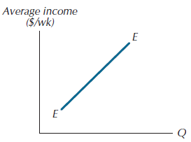
Figure 4.29: An Engel Curve at the Market Level

Slide 43
Income Elasticity of Demand
If a good exhibits a stable Engle curve, we can define its income elasticity of demand, the percentage change in the quantity of a good demanded that results from a 1 percent change in income.

Slide 44
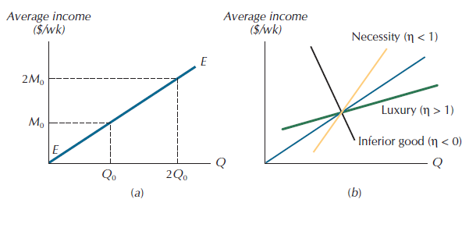
Figure 4.30: Engel Curves for Different Types of Goods

Slide 45
Cross-Price Elasticities of Demand
Cross-price elasticity of demand: the percentage change in the quantity of one good demanded that results from a 1 percent change in the price of the other good.

Slide 46
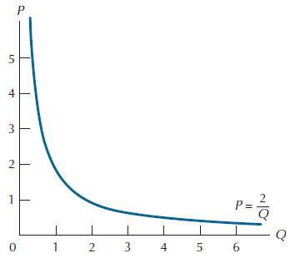
Figure A4.1: A Constant Elasticity Demand Curve

Slide 47
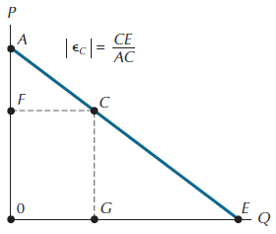
Figure A4.2: The Segment-Ratio Method

Slide 48
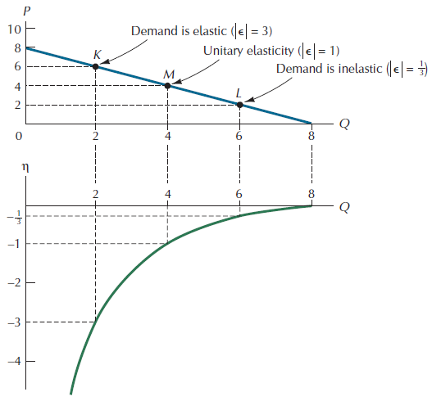
Figure A4.3: Elasticity at Different Positions Along a Straight-Line Demand Curve

Slide 49
Income-Compensated Demand Curve
Income-compensated demand curve: a demand curve that tells how much consumers would buy at each price if they were fully compensated for the income effects of price changes.

Slide 50
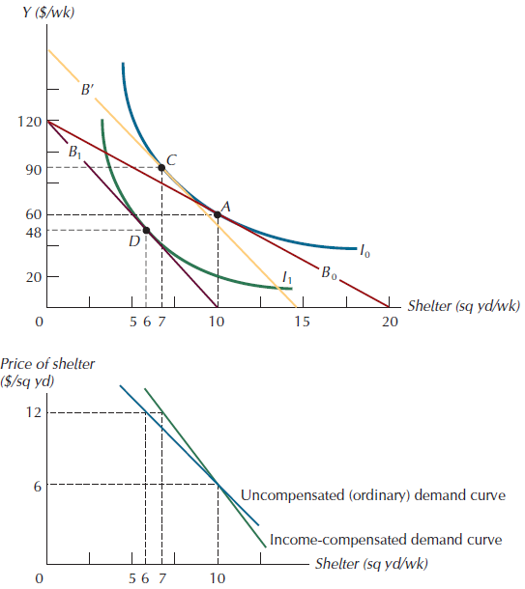
Figure A4.4: Ordinary vs. Income-Compensated Demand Curves for a Normal Good

Slide 51
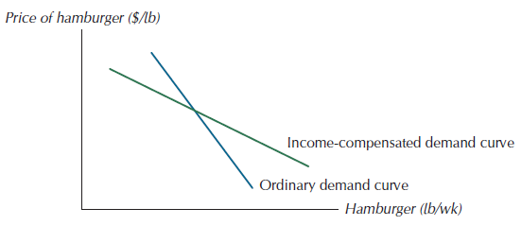
Figure A4.5: Ordinary vs. Income-Compensated Demand Curves for an Inferior Good

