Slide 1
Chapter 8
Production

Slide 2
Chapter Outline
The Input-Output Relationship of The Production Function
Production In The Short Run
Total, Marginal, and Average Products
Production In The Long Run
Returns To Scale

Slide 3
The Production Function
Production function: the relationship that describes how inputs like capital and labor are transformed into output.
Mathematically, Q = F (K, L)
  K = Capital
  L = Labor

Slide 4
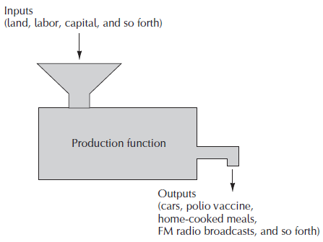
Figure 8.1: The Production Function

Slide 5
Fixed and Variable Inputs
Long run: the shortest period of time required to alter the amounts of all inputs used in a production process.
Short run: the longest period of time during which at least one of the inputs used in a production process cannot be varied.
Variable input: an input that can be varied in the short run.
Fixed input: an input that cannot vary in the short run.

Slide 6
Production in the Short Run
Three properties:
  It passes through the origin
  Initially the addition of variable inputs augments output an increasing rate
  beyond some point additional units of the variable input give rise to smaller and smaller increments in output.

Slide 7
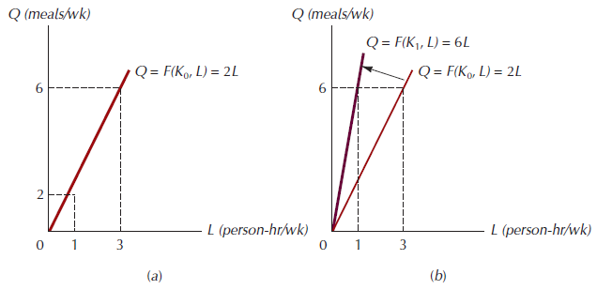
Figure 8.2: A Specific Short-Run Production Function

Slide 8
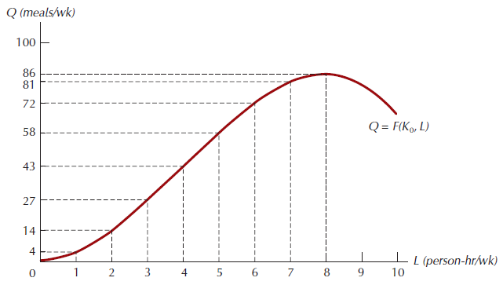
Figure 8.3: Another Short-Run Production Function

Slide 9
An Important Characteristic of Short-Run Production Functions
Law of diminishing returns: if other inputs are fixed, the increase in output from an increase in the variable input must eventually decline.

Slide 10
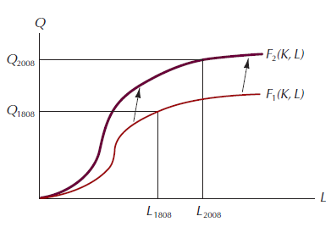
Figure 8.4: The Effect of Technological Progress in Food Production

Slide 11
Short-Run Production Function Components
Total product curve: a curve showing the amount of output as a function of the amount of variable input.
Marginal product: change in total product due to a 1-unit change in the variable input.
Average product: total output divided by the quantity of the variable input.

Slide 12
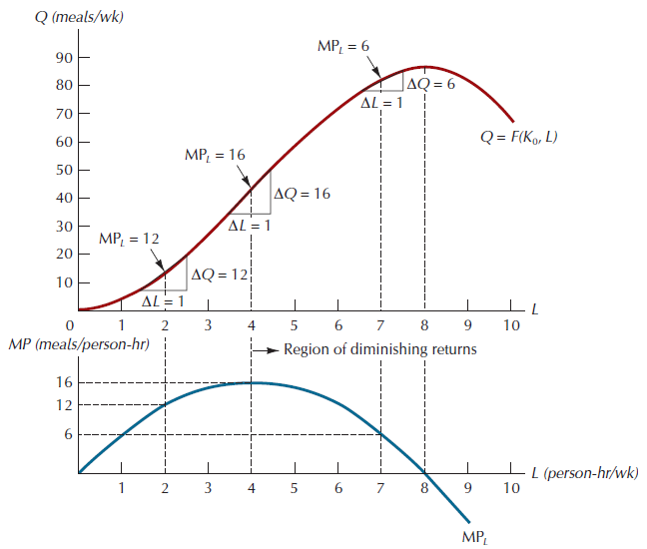
Figure 8.5: The Marginal Product of a Variable Input

Slide 13
Relationships Among Total, Marginal and Average Product Curves
When the marginal product curve lies above the average product curve, the average product curve must be rising
When the marginal product curve lies below the average product curve, the average product curve must be falling.
The two curves intersect at the maximum value of the average product curve.

Slide 14
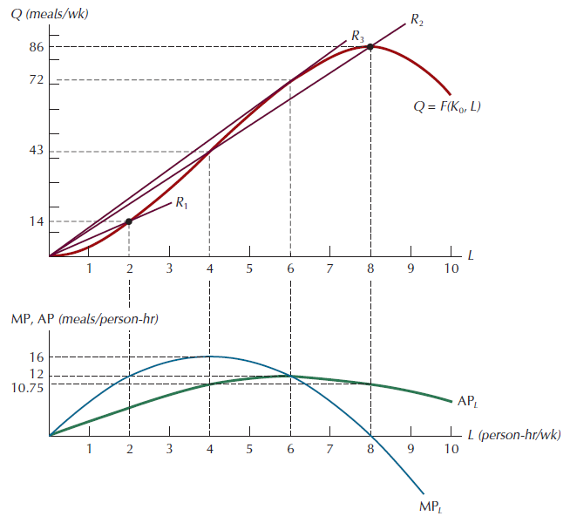
Figure 8.6: Total, Marginal, and
Average Product Curves

Slide 15
The Practical Significance of the Average Marginal Distinction
Suppose you own a fishing fleet consisting of a given number of boats, and can send your boats in whatever numbers you wish to either of two ends of an extremely wide lake, east or west. Under your current allocation of boats, the ones fishing at the east end return daily with 100 pounds of fish each, while those in the west return daily with 120 pounds each. The fish populations at each end of the lake are completely independent, and your current yields can be sustained indefinitely.
Should you alter your current allocation of boats?

Slide 16
The Practical Significance Of The Average Marginal Distinction
The general rule for allocating an input efficiently in such cases is to allocate the next unit of the input to the production activity where its marginal product is highest.

Slide 17
Production In The Long Run
Isoquant: the set of all input combinations that yield a given level of output.
Marginal rate of technical substitution (MRTS): the rate at which one input can be exchanged for another without altering the total level of output.

Slide 18
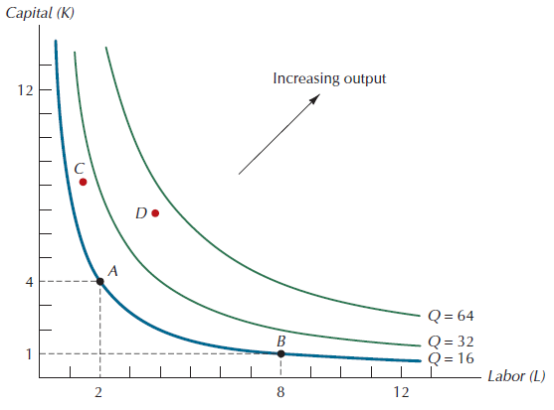
Figure 8.7: Part of an Isoquant Map for the Production Function

Slide 19
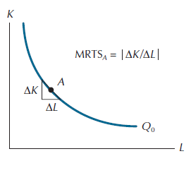
Figure 8.8: The Marginal Rate of Technical Substitution

Slide 20
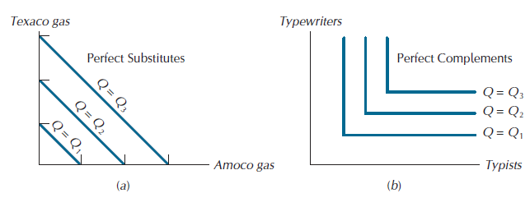
Figure 8.9: Isoquant Maps for Perfect Substitutes and Perfect Complements

Slide 21
Returns To Scale
Increasing returns to scale: the property of a production process whereby a proportional increase in every input yields a more than proportional increase in output.
Constant returns to scale: the property of a production process whereby a proportional increase in every input yields an equal proportional increase in output.
Decreasing returns to scale: the property of a production process whereby a proportional increase in every input yields a less than proportional increase in output.

Slide 22
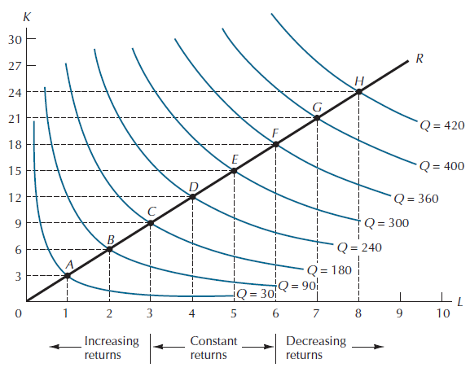
Figure 8.10: Returns to Scale Shown on the Isoquant Map

Slide 23
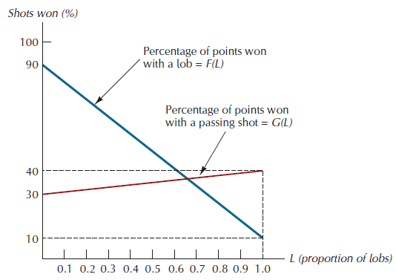
Figure 8.A.1: Effectiveness vs. Use: Lobs and Passing Shots

Slide 24
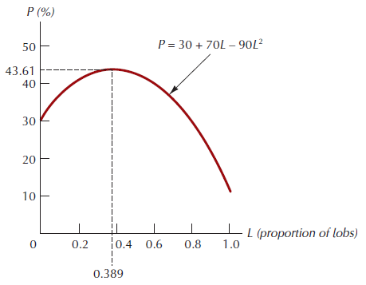
Figure 8A2: The Optimal Proportion of Lobs

Slide 25
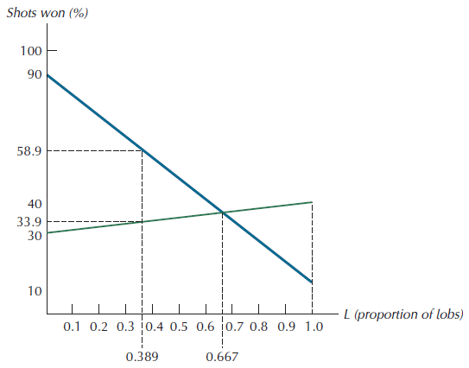
Figure 8A.3: At the Optimizing Point, the Likelihood of Winning with a Lob is Much Greater than of Winning with a Passing Shot

Slide 26
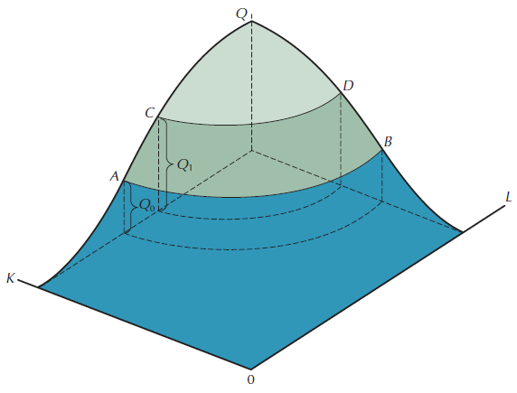
Figure 8A.4: The Production Mountain

Slide 27
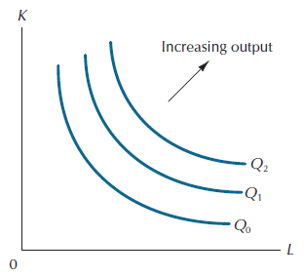
Figure 8A.5: The Isoquant Map Derived from the Production Mountain

Slide 28
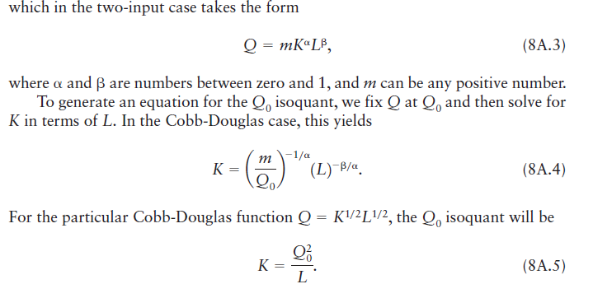
Some Examples of Production Functions
The Cobb-Douglas Production Function

Slide 29

Some Examples of Production Functions
The Leontief, or Fixed-Proportions, Production Function

Slide 30
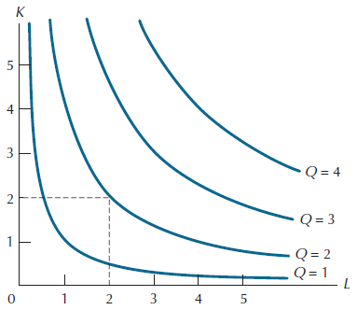
Figure 8A6: Isoquant Map for the Cobb-Douglas Production Function Q = K½L½

Slide 31
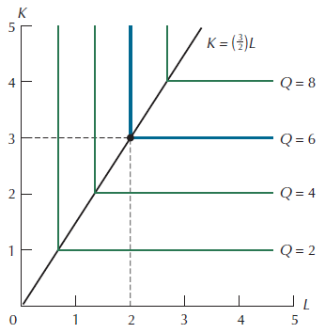
Figure 8A.7: Isoquant Map for the Leontief Production Function Q = min (2K,3L)

Slide 32



A Mathematical Definition of Returns to Scale

