Slide 1
Chapter 9
Costs

Slide 2
Chapter Outline
Costs In The Short Run
Graphing the Total, Variable, and Fixed Cost Curves
Average Fixed, Average Variable, Average Total and Marginal Costs
Allocating Production Between Two Processes
The Relationship Among MP, AP,MC, And AVC
Costs In The Long Run
Long-Run Costs And The Structure Of Industry
The Relationship Between Long-run And Short-run Cost Curves

Slide 3
Costs In the Short Run
Fixed cost (FC): cost that does not vary with the level of output in the short run (the cost of all fixed factors of production).
Variable cost (VC): cost that varies with the level of output in the short run (the cost of all variable factors of production).
Total cost (TC): all costs of production: the sum of variable cost and fixed cost.

Slide 4
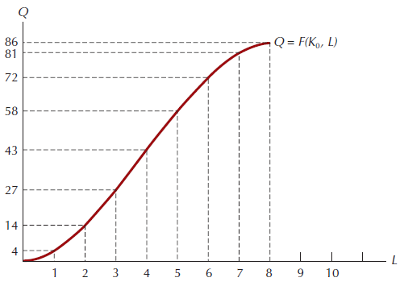
Figure 9.1: Output as a Function of One Variable Input

Slide 5
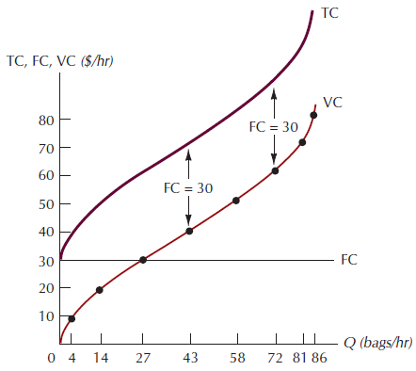
Figure 9.2: The Total, Variable, and Fixed Cost Curves

Slide 6
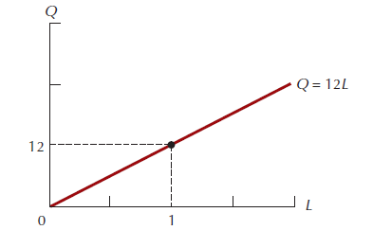
Figure 9.3: The Production Function Q = 3KL, with K = 4

Slide 7
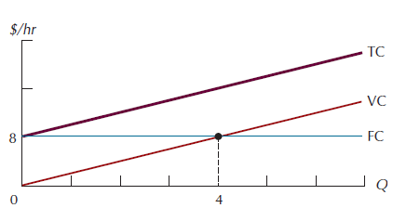
Figure 9.4: The Total, Variable, and Fixed Cost Curves for the Production Function Q – 3KL

Slide 8
Other Short-Run Costs
Average fixed cost (AFC): fixed cost divided by the quantity of output.
Average variable cost (AVC): variable cost divided by the quantity of output.
Average total cost (ATC): total cost divided by the quantity of output.
Marginal cost (MC): change in total cost that results from a 1-unit change in output.

Slide 9
Graphing the Short-run Average and Marginal Cost Curves
Geometrically, average variable cost at any level of output Q may be interpreted as the slope of a ray from the origin to the variable cost curve at Q.
Geometrically, marginal cost at any level of output may be interpreted as the slope of the total cost curve at that level of output.
And since the total cost and variable cost curves are parallel, is also equal to the slope of the variable cost curve.
Marginal cost is the most important of the cost curves.

Slide 10
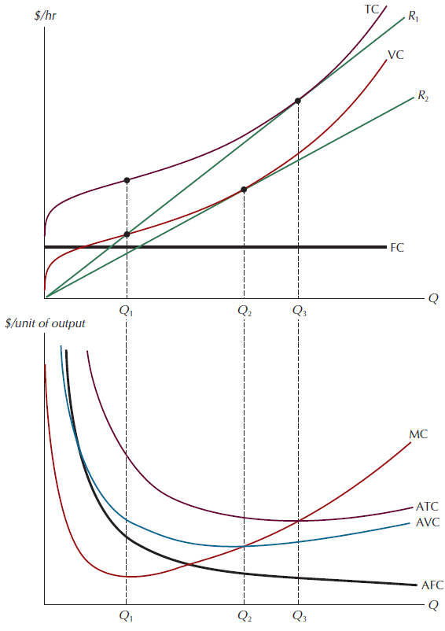
Figure 9.5: The Marginal, Average Total, Average Variable, and Average Fixed Cost Curves

Slide 11
Marginal and Average Costs
When MC is less than average cost (either ATC or AVC), the average cost curve must be decreasing with output; and when MC is greater than average cost, average cost must be increasing with output.

Slide 12
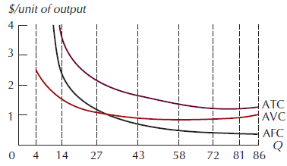
Figure 9.6: Quantity vs. Average Costs

Slide 13
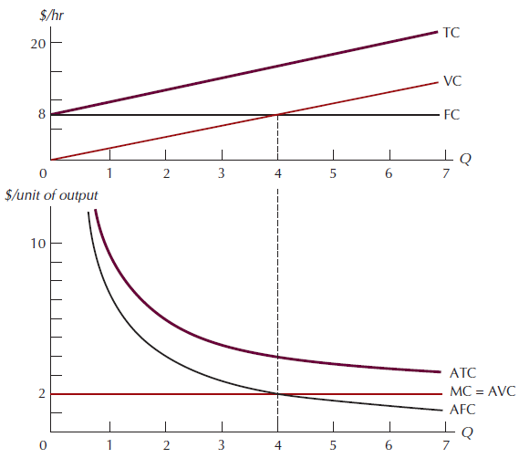
Figure 9.7: Cost Curves for a Specific Production Process

Slide 14
Allocating Production Between Two Processes
Let Q_{T} be the total amount to be produced, and let Q₁ and Q₂ be the amounts produced in the first and second processes, respectively. And suppose the marginal cost in either process at very low levels of output is lower than the marginal cost at Q_{T} units of output in the other (which ensures that both processes will be used).
The values of Q₁and Q₂ that solve this problem will then be the ones that result in equal marginal costs for the two processes.

Slide 15
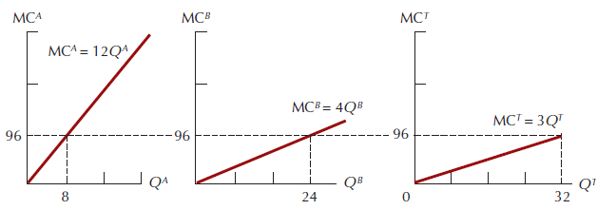
Figure 9.8: The Minimum Cost Production Allocation

Slide 16
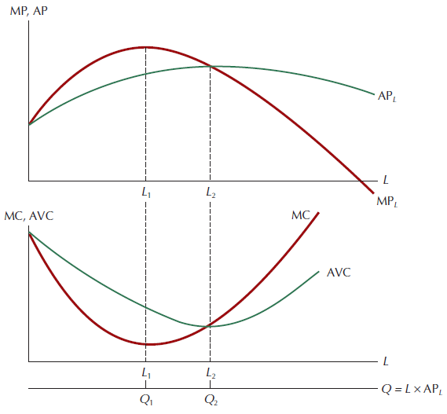
Figure 9.9: The Relationship Among MP, AP, MC, and AVC

Slide 17
Costs in the Long Run
Isocost line: a set of input bundles each of which costs the same amount.
To find the minimum cost point we begin with a specific isoquant then superimpose a map of isocost lines, each corresponding to a different cost level.
The least-cost input bundle corresponds to the point of tangency between an isocost line and the specified isoquant.

Slide 18
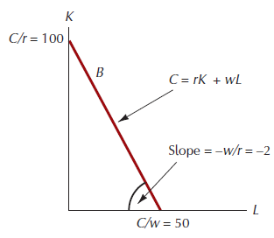
Figure 9.10: The Isocost Line

Slide 19
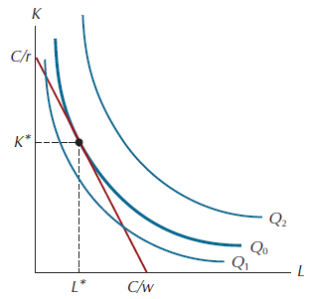
Figure 9.11: The Maximum Output for a Given Expenditure

Slide 20
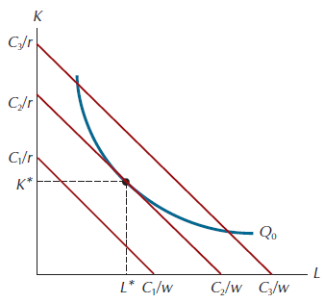
Figure 9.12: The Minimum Cost for a Given Level of Output

Slide 21
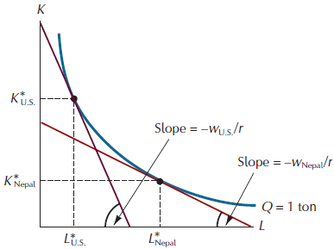
Figure 9.13: Different Ways of Producing 1 Ton of Gravel

Slide 22
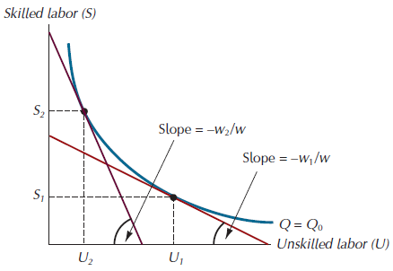
Figure 9.14: The Effect of a Minimum Wage Law on Unemployment of Skilled Labor

Slide 23
The Relationship Between Optimal Input Choice and Long-Run Costs
Output expansion path: the locus of tangencies (minimumcost input combinations) traced out by an isocost line of given slope as it shifts outward into the isoquant map for a production process.

Slide 24
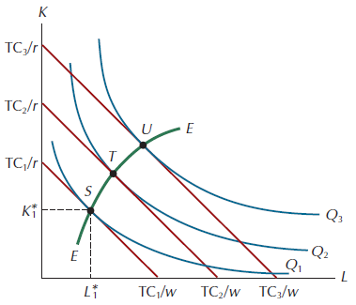
Figure 9.15: The Long-Run Expansion Path

Slide 25
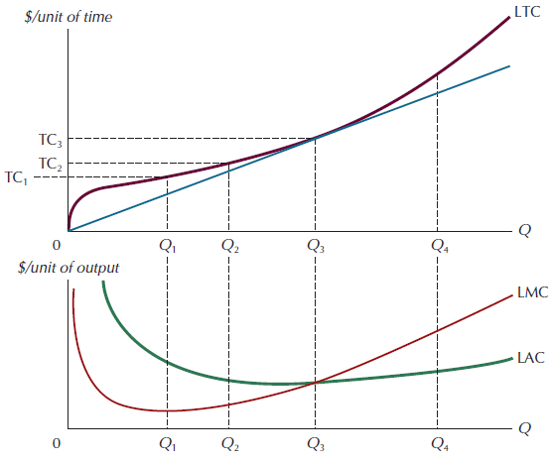
Figure 9.16: The Long-Run Total, Average, and Marginal Cost Curves

Slide 26
The Relationship Between Optimal Input Choice and Long-Run Costs
Constant returns to scale - long-run total costs are thus exactly proportional to output.
Decreasing returns to scale - a given proportional increase in output requires a greater proportional increase in all inputs and hence a greater proportional increase in costs.
Increasing returns to scale - long-run total cost rises less than in proportion to increases in output.

Slide 27
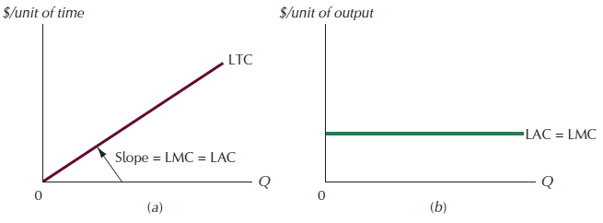
Figure 9.17: The LTC, LMC and LAC Curves with Constant Returns to Scale

Slide 28
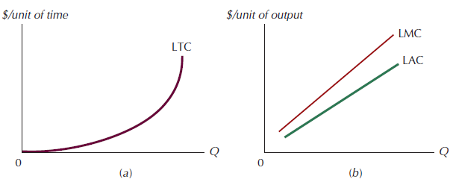
Figure 9.18: The LTC, LAC and LMC Curves for a Production Process with Decreasing Returns to Scale

Slide 29
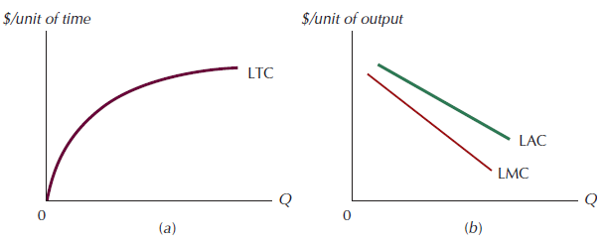
Figure 9.19: The LTC, LAC and LMC Curves for a Production Process with Increasing Returns to Scale

Slide 30
Long-Run Costs and the Structure of Industry
Natural monopoly: an industry whose market output is produced at the lowest cost when production is concentrated in the hands of a single firm.
Minimum efficient scale: the level of production required for LAC to reach its minimum level.

Slide 31
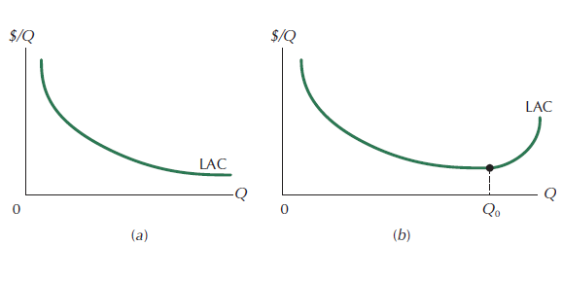
Figure 9.20: LAC Curves Characteristic of Highly Concentrated Industrial Structures

Slide 32
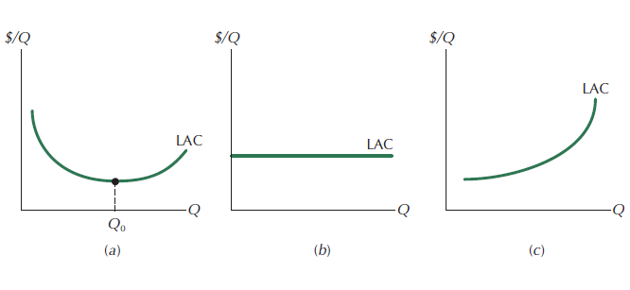
Figure 9.21: LAC Curves Characteristic of Unconcentrated Industry Structures

Slide 33
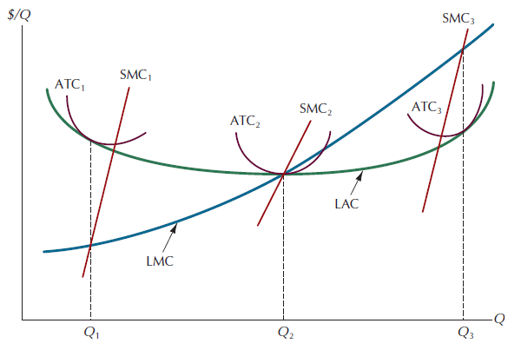
Figure 9.22: The Family of Cost Curves Associated with a U-Shaped LAC

Slide 34
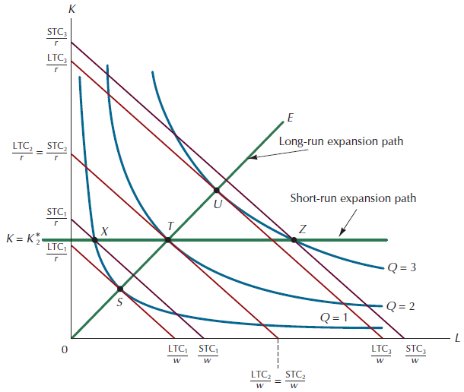
Figure A9.1: The Short-run and Long-Run Expansion Paths

Slide 35
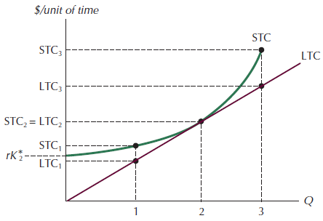
Figure A9.2: The LTC and STC Curves Associated with the Isoquant Map in Figure A.9.1

Slide 36
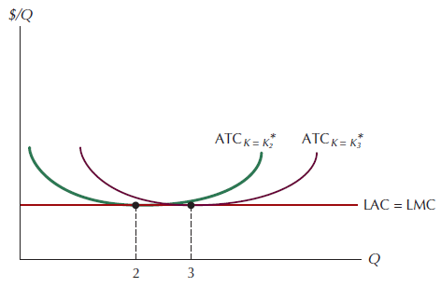
Figure A9.3: The LAC, LMC, and Two ATC Curves Associated with the Cost Curves from Figure A.9.2

Slide 37
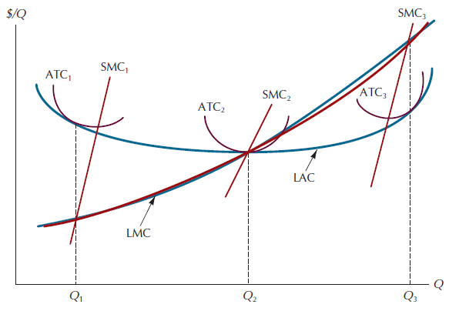
Figure A9.4: The Family of Cost Curves Associated with a U-Shaped LAC

