Slide 1
Chapter 10
Perfect Competition

Slide 2
Chapter Outline
The Goal Of Profit Maximization
The Four Conditions For Perfect Competition
The Short-run Condition For Profit Maximization
The Short-run Competitive Industry Supply
Short-run Competitive Equilibrium
The Efficiency Of Short-run Competitive Equilibrium
Producer Surplus
Adjustments In The Long Run
The Invisible Hand
Application: The Cost Of Extraordinary Inputs
The Long-run Competitive Industry Supply Curve
The Elasticity Of Supply
Applying The Competitive Model

Slide 3
The Goal of Profit Maximization
Economic profit: the difference between total revenue and total cost, where total cost includes all costs—both explicit and implicit—associated with resources used by the firm.
Accounting profit is simply total revenue less all explicit costs incurred.
  does not subtract the implicit costs.
Economists assume that the goal of firms is to maximize economic profit.

Slide 4
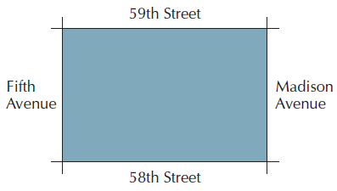
Figure 10.1: Potential Site for Manhattan Miniature Golf Course

Slide 5
The Four Conditions For Perfect
Competition
Firms Sell a Standardized Product
  The product sold by one firm is assumed to be a perfect substitute for the product sold by any other.
Firms Are Price Takers
  This means that the individual firm treats the market price of the product as given.
Free Entry and Exit
  With Perfectly Mobile Factors of Production in the Long Run
Firms and Consumers Have Perfect Information

Slide 6
The Short-Run Condition For
Profit Maximization
To maximize profit the firm will choose that level of output for which the difference between total revenue and total cost is largest.
Marginal revenue: the change in total revenue that occurs as a result of a 1-unit change in sales.
To maximize profits the firm should produce a level of output for which marginal revenue is equal to marginal cost on the rising portion of the MC curve.

Slide 7
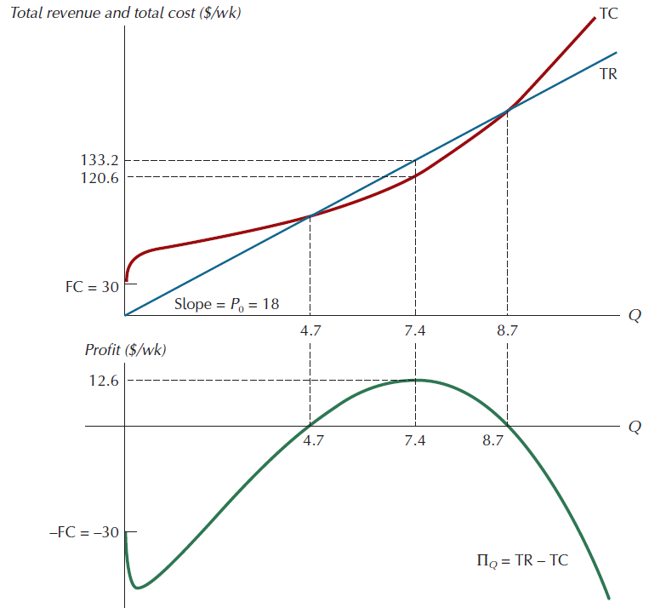
Figure 10.2: Revenue, Cost, and Economic Profit

Slide 8
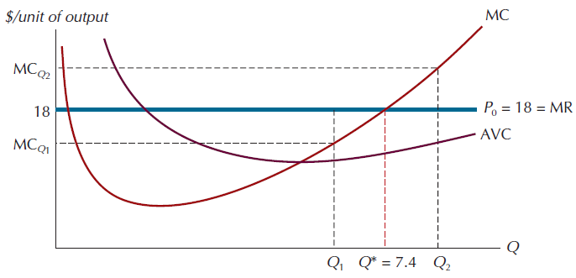
Figure 10.3: The Profit-Maximizing Output Level in the Short Run

Slide 9
The Shutdown Condition
Shutdown condition: if price falls below the minimum of average variable cost, the firm should shut down in the short run.
The short-run supply curve of the perfectly competitive firm is the rising portion of the short-run marginal cost curve that lies above the minimum value of the average variable cost curve

Slide 10
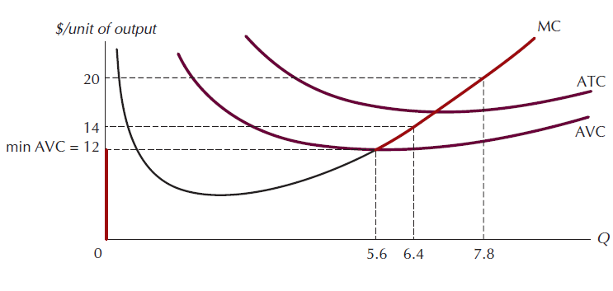
Figure 10.4: The Short-Run Supply Curve of a Perfectly Competitive Firm

Slide 11
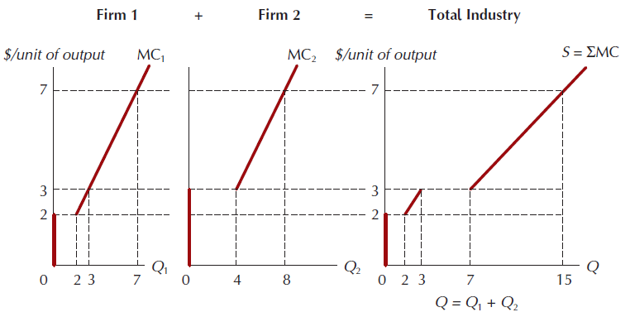
Figure 10.5: The Short-Run Competitive Industry Supply Curve

Slide 12
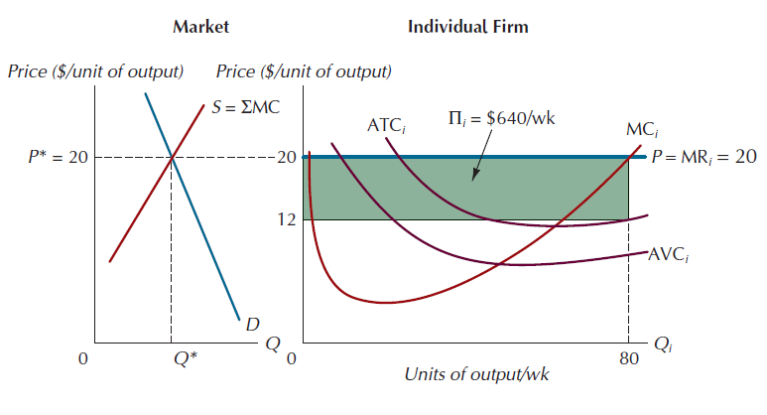
Figure 10.6: Short-Run Price and Output Determination under Pure Competition

Slide 13
Short-Run Competitive Equilibrium
Even though the market demand curve is downward sloping, the demand curve facing the individual firm is perfectly elastic.
Breakeven point: the point at which price equal to the minimum of average total cost.
  The lowest price at which the firm will not suffer negative profits in the short run.

Slide 14
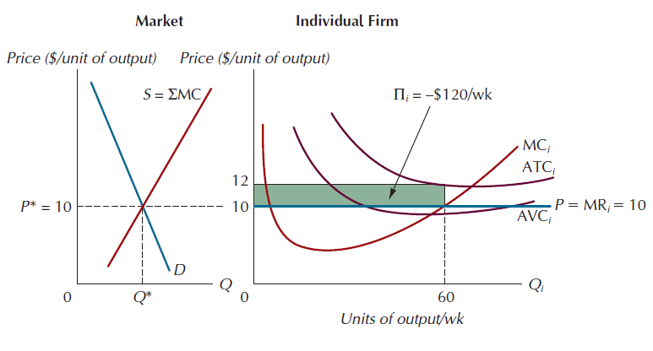
Figure 10.7: A Short-Run Equilibrium Price that Results in Economic Losses

Slide 15
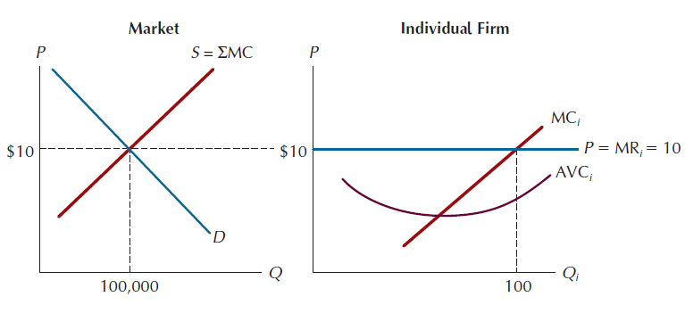
Figure 10.8: The Efficiency Of Short-run Competitive Equilibrium
Allocative efficiency: a condition in which all possible gains from exchange are realized.

Slide 16
Producer Surplus
A competitive market is efficient when it maximizes the net benefits to its participants.
Producer surplus: the dollar amount by which a firm benefits by producing a profit-maximizing level of output.

Slide 17
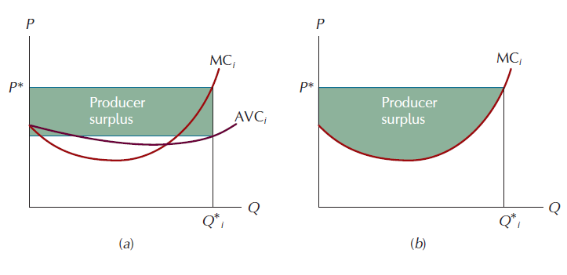
Figure 10.9: Two Equivalent Measures of Producer Surplus

Slide 18
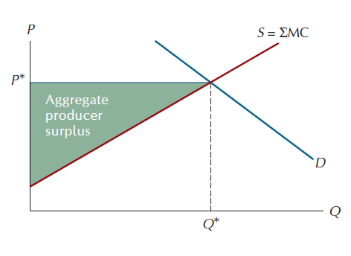
Figure 10.10: Aggregate Producer Surplus When Individual Marginal Cost Curves are Upward Sloping Throughout

Slide 19
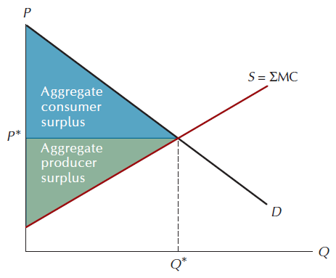
Figure 10.11: The Total Benefit from Exchange in a Market

Slide 20
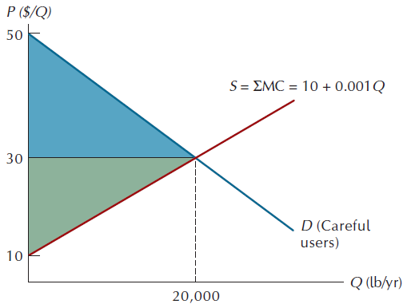
Figure 10.12: Producer and Consumer Surplus in a Market Consisting of Careful Fireworks Users

Slide 21
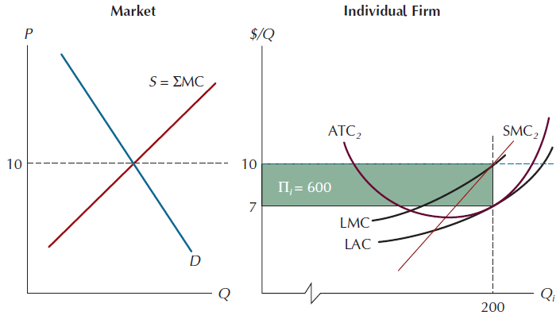
Figure 10.13: A Price Level that Generates Economic Profit

Slide 22
Adjustments In The Long Run
Positive economic profit creates an incentive for outsiders to enter the industry.
As additional firms enter the industry the industry supply curve to the right.
This adjustment will continue until these two conditions are met:
  (1) Price reaches the minimum point on the LAC curve
  (2) All firms have moved to the capital stock size that gives rise to a short-run average total cost curve that is tangent to the LAC curve at its minimum point.

Slide 23
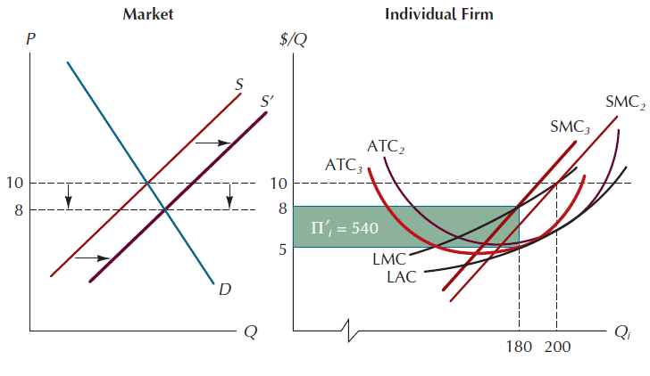
Figure 10.14: A Step along the Path Toward Long-Run Equilibrium

Slide 24
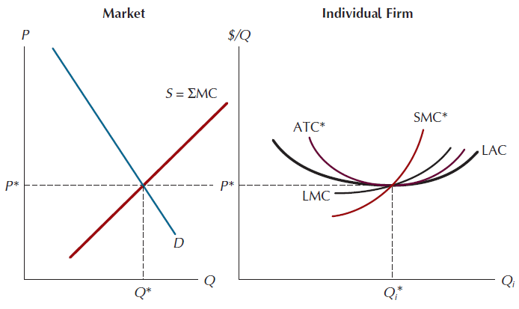
Figure 10.15: The Long-Run Equilibrium under Perfect Competition

Slide 25
The Invisible Hand
Why are competitive markets attractive from the perspective of society as a whole?
  Price is equal to Marginal Cost.
    The last unit of output consumed is worth exactly the same to the buyer as the resources required to produce it.
  Price is equal to the minimum point on the long-run average cost curve.
    There is no less costly way of producing the product.
  All producers earn only a normal rate of profit.
    The public pays not a penny more than what it cost the firms to serve them.

Slide 26
The Long-Run Competitive Industry
Supply Curve
Constant cost Industries: long-run supply curve is a horizontal line at the minimum value of the LAC curve.
Increasing cost industries: long-run supply curve is upward sloping.
Decreasing cost industries: long-run supply curve is downward-sloping.

Slide 27
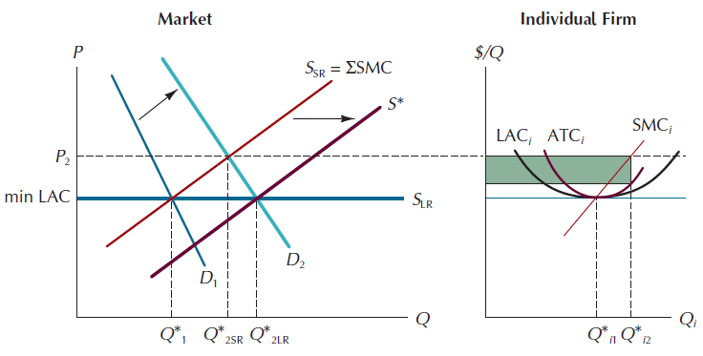
Figure 10.16: The Long-Run Competitive Industry Supply Curve

Slide 28
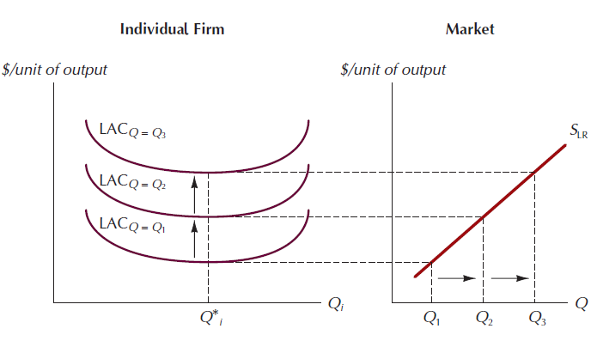
Figure 10.17: Long-Run Supply Curve for an Increasing Cost Industry

Slide 29
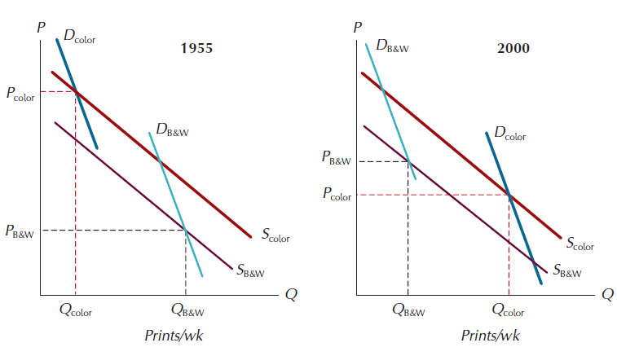
Figure 10.18: Pecuniary Economies and the Price of Color and Black-and-White Photos

Slide 30
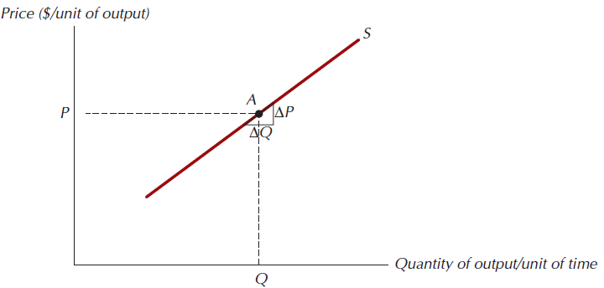
Figure 10.19: The Elasticity Of Supply
Price elasticity of supply: the percentage change in quantity supplied that occurs in response to a 1 percent change in product price.

Slide 31
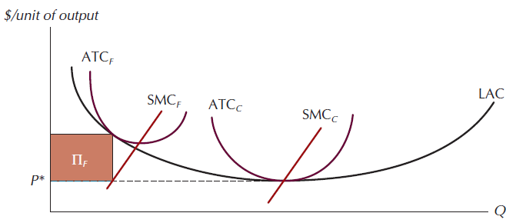
Figure 10.20: Cost Curves for Family and Corporate Farms

Slide 32
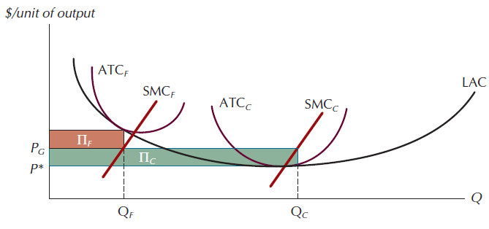
Figure 10.21: The Short-Run Effect of Agricultural Price Supports

Slide 33
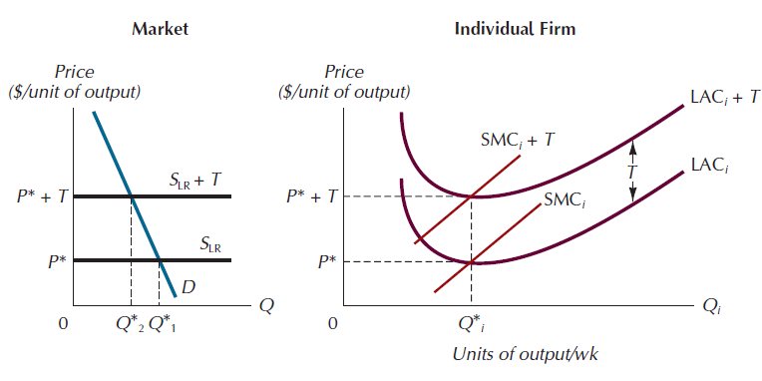
Figure 10.22: The Effect of a Tax on the Output of a Perfectly Competitive Industry

