Slide 1
Chapter 11
Monopoly

Slide 2
Chapter Outline
Defining Monopoly
Five Sources Of Monopoly
The Profit-maximizing Monopolist
A Monopolist Has No Supply Curve
Adjustments In The Long Run
Price Discrimination
The Efficiency Loss From Monopoly
Public Policy Toward Natural Monopoly

Slide 3
Defining Monopoly
Monopoly: a market structure in which a single seller of a product with no close substitutes serves the entire market.
A monopoly has significant control over the price it charges.

Slide 4
Five Sources Of Monopoly
Exclusive Control over Important Inputs
Economies of Scale
Patents
Network Economies
Government Licenses or Franchises

Slide 5
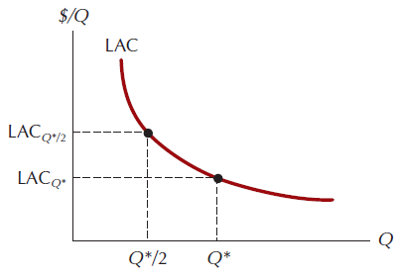
Figure 11.1: Natural Monopoly

Slide 6
The Profit-Maximizing Monopolist
The monopolist’s goal is to maximize economic profit.
In the short run this means to choose the level of output for which the difference between total revenue and short-run total cost is greatest.

Slide 7
The Monopolist’s Total Revenue Curve
As price falls, total revenue for the monopolist does not rise linearly with output.
Instead, it reaches a maximum value at the quantity corresponding to the midpoint of the demand curve after which it again begins to fall.
Total revenue reaches its maximum value when the price elasticity of demand is unity.

Slide 8
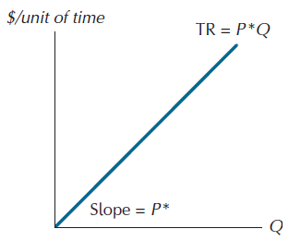
Figure 11.2: The Total Revenue Curve for a Perfect Competitor

Slide 9
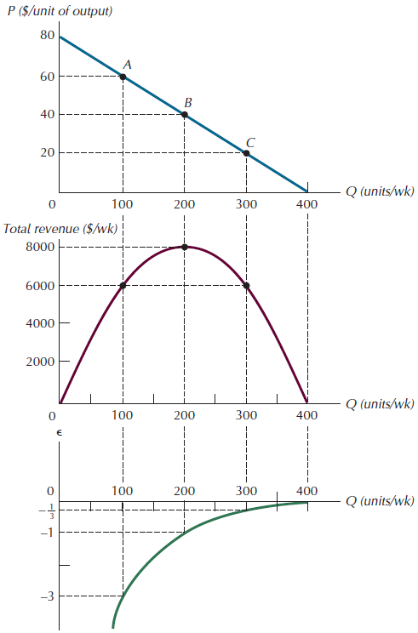
Figure 11.3 Demand, Total Revenue, and Elasticity

Slide 10
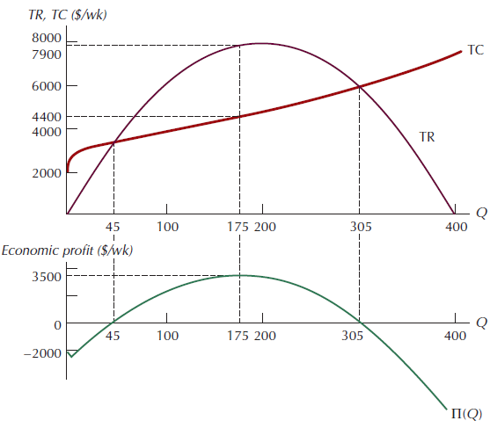
Figure 11.4: Total Cost, Revenue, and Profit Curves for a Monopolist

Slide 11
Marginal Revenue
Optimality condition for a monopolist: a monopolist maximizes profit by choosing the level of output where marginal revenue equals marginal cost.

Slide 12
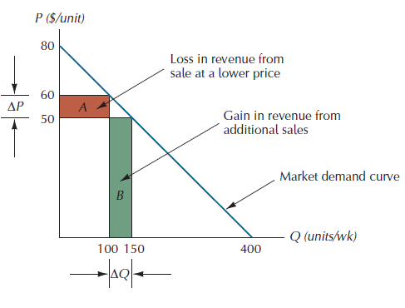
Figure 11.5: Changes in Total Revenue Resulting from a Price Cut

Slide 13
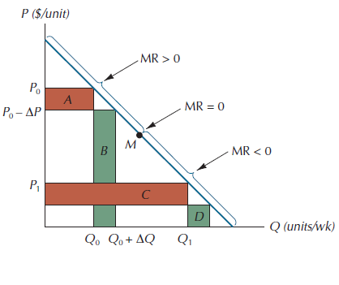
Figure 11.6: Marginal Revenue and Position on the Demand Curve

Slide 14
Marginal Revenue And Elasticity
The less elastic demand is with respect to price, the more price will exceed marginal revenue.
For all elasticity values less than 1 in absolute value marginal revenue will be negative.
For all elasticity values larger than 1 in absolute value marginal revenue will be positive.

Slide 15
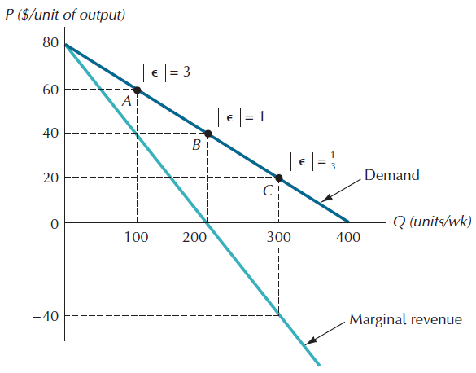
Figure 11.7: The Demand Curve and Corresponding Marginal Revenue Curve

Slide 16
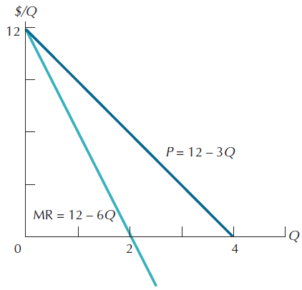
Figure 11.8: A Specific Linear Demand Curve and the Corresponding Marginal Revenue Curve

Slide 17
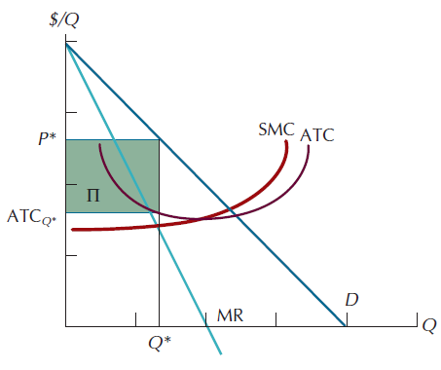
Figure 11.9: The Profit-Maximizing Price and Quantity for a Monopolist

Slide 18
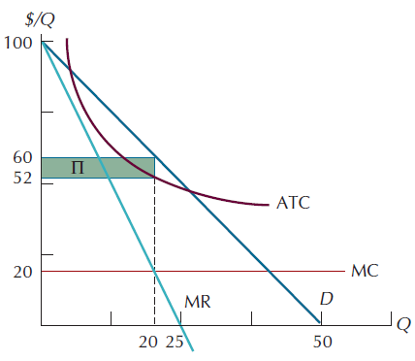
Figure 11.10: The Profit-Maximizing Price and Quantity for Specific Cost and Demand Functions

Slide 19
The Profit-Maximizing Monopolist
If a monopolist’s goal is to maximize profits, she will never produce an output level on the inelastic portion of her demand curve.
The profit-maximizing level of output must lie on the elastic portion of the demand curve.

Slide 20
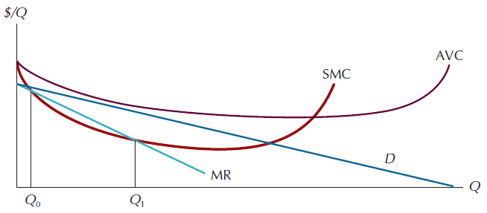
Figure 11.11: When Should a Monopolist Shutdown?
Shutdown condition for a monopolist: cease production whenever average revenue is less than average variable cost at every level of output.

Slide 21
A Monopolist Has No Supply Curve
The monopolist is a price maker.
When demand shifts rightward elasticity at a given price may either increase or decrease, and vice-versa.
So there can be no unique correspondence between the price a monopolist charges and the amount she chooses to produce.
Monopoly has a supply rule, which is to equate marginal revenue and marginal cost.

Slide 22
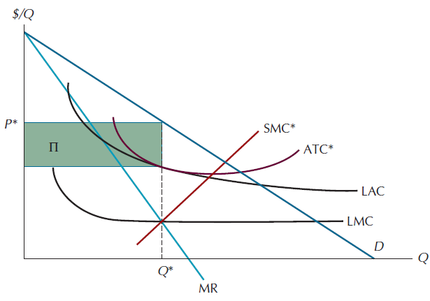
Figure 11.12: Long-Run Equilibrium for a Profit-Maximizing Monopolist

Slide 23
Price Discrimination
Price discrimination: a practice where the monopolist charge different prices to different buyers.
Third-degree price discrimination: charging different prices to buyers in completely separate markets.
First-degree price discrimination: is the term used to describe the largest possible extent of market segmentation.

Slide 24
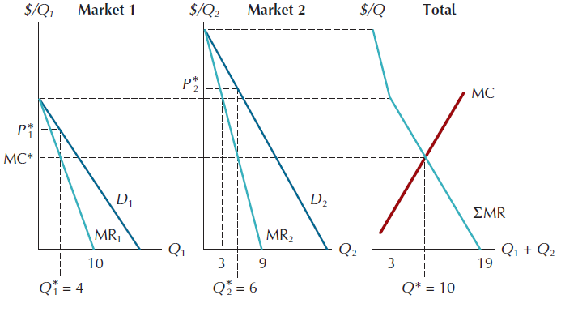
Figure 11.13: The Profit-Maximizing Monopolist Who Sells in Two Markets

Slide 25
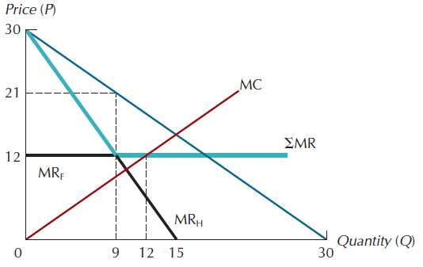
Figure 11.14: A Monopolist with a Perfectly Elastic Foreign Market

Slide 26
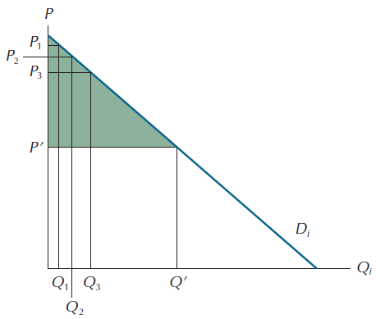
Figure 11.15: Perfect Price Discrimination

Slide 27
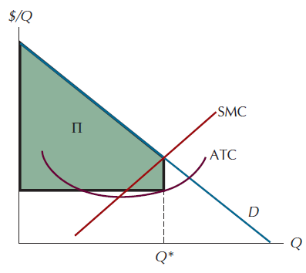
Figure 11.16: The Perfectly Discriminating Monopolist

Slide 28
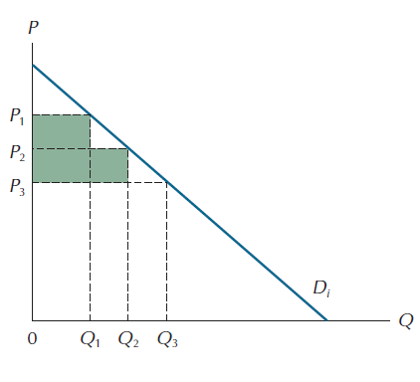
Figure 11.17: Second-Degree Price Discrimination

Slide 29
Second-Degree Price Discrimination
Second-degree price discrimination: price discrimination where the same rate structure is available to every consumer and the limited number of rate categories tends to limit the amount of consumer surplus that can be captured.

Slide 30
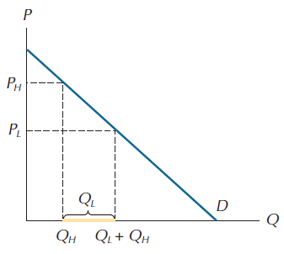
Figure 11.18: A Perfect Hurdle

Slide 31
The Efficiency Loss From Monopoly
Deadweight loss from monopoly: the loss of efficiency due to the presence of a Monopoly.
Is the result of failure to price discriminate perfectly.

Slide 32
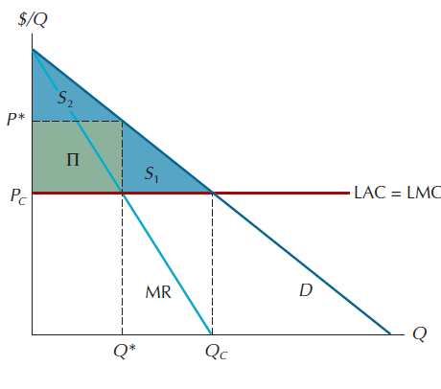
Figure 11.19: The Welfare Loss from a Single-Price Monopoly

Slide 33
Public Policy Toward Natural Monopoly
State Ownership And Management
State Regulation Of Private Monopolies
Exclusive Contracting For Natural Monopoly
Vigorous Enforcement Of Antitrust Laws
A Laissez-faire Policy Toward Natural Monopoly

Slide 34
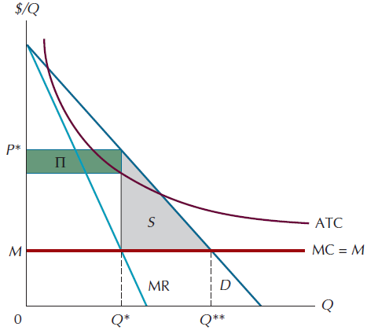
Figure 11.20: A Natural Monopoly

Slide 35
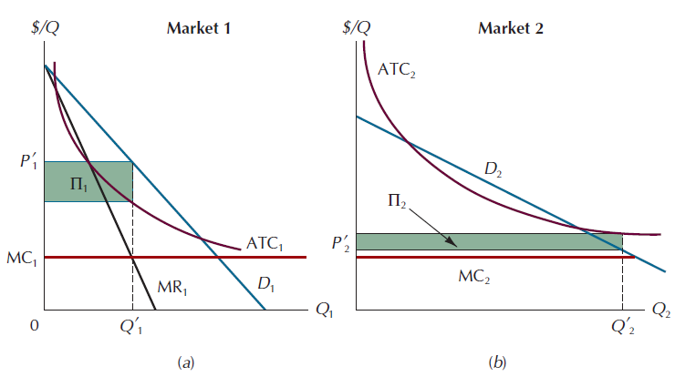
Figure 11.21: Cross-Subsidization to Boost Total Output

Slide 36
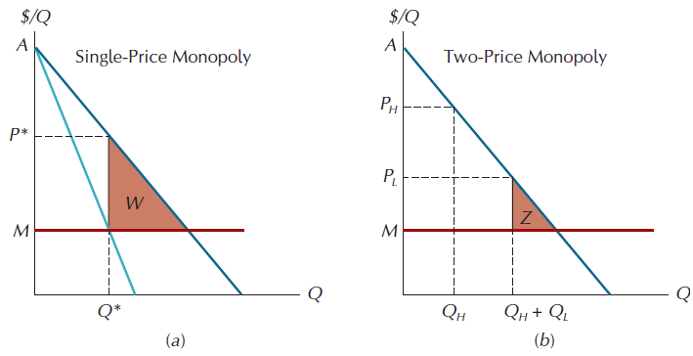
Figure 11.22: The Efficiency Losses from Single-Price and Two-Price Monopoly

Slide 37
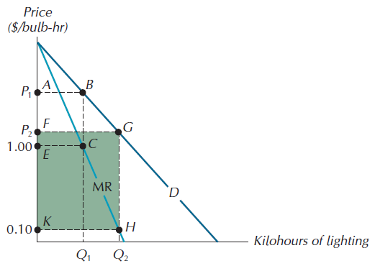
Figure 11.23: Does Monopoly Suppress Innovation?

