Slide 1
Chapter 13
Oligopoly and Monopolistic Competition

Slide 2
Chapter Outline
Some Specific Oligopoly Models
Competition When There are Increasing Returns to Scale
Monopolistic Competition
A Spatial Interpretation of Monopolistic Competition
Historical Note: Hotelling’s Hot Dog Vendors
Consumer Preferences and Advertising

Slide 3
The Cournot Model
Cournot model: oligopoly model in which each firm assumes that rivals will continue producing their current output levels.
  Main assumption - each duopolist treats the other’s quantity as a fixed number, one that will not respond to its own production decisions.

Slide 4
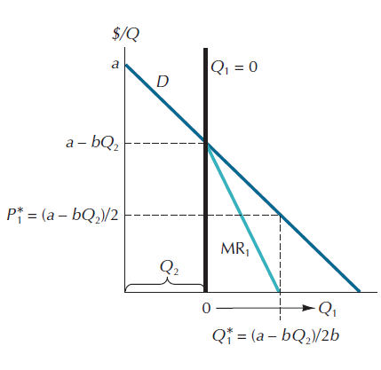
Figure 13.1: The Profit-Maximizing Cournot Duopolist

Slide 5
The Cournot Model
Reaction function: a curve that tells the profit-maximizing level of output for one oligopolist for each amount supplied by another.

Slide 6
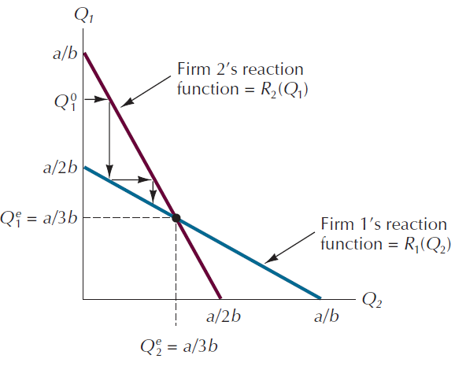
Figure 13.2: Reaction Functions for the Cournot Duopolists

Slide 7
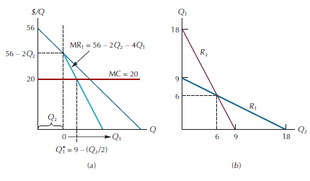
Figure 13.3: Deriving the Reaction Functions for Specific Duopolists

Slide 8
The Bertrand Model
Bertrand model: oligopoly model in which each firm assumes that rivals will continue charging their current prices.

Slide 9
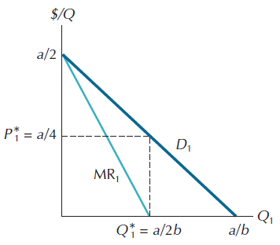
Figure 13.4: The Stackelberg Leader’s Demand and Marginal Revenue Curves

Slide 10
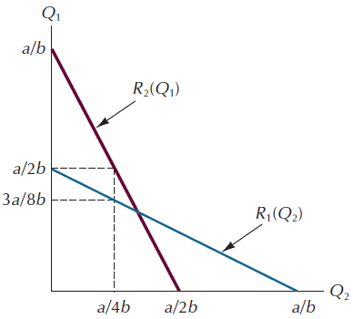
Figure 13.5: The Stackelberg Equilibrium

Slide 11
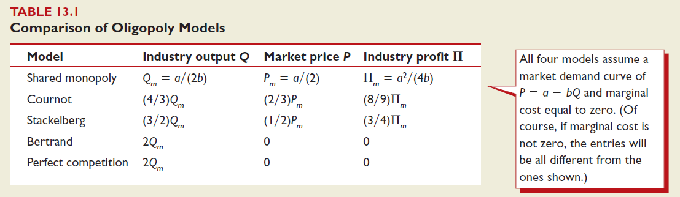
Table 13.1: Comparison Of Outcomes

Slide 12
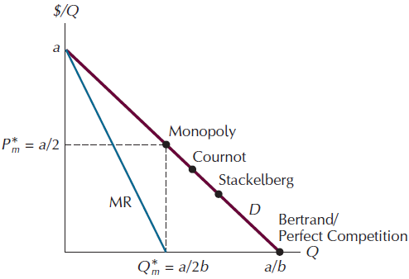
Figure 13.6: Comparing Equilibrium Price and Quantity

Slide 13
Competition When There Are Increasing
Returns To Scale
In markets for privately sold goods, buyers are often too numerous to organize themselves to act collectively.
  Where it is impractical for buyers to organize direct collective action, it may nonetheless be possible for private agents to accomplish much the same objective on their behalf.

Slide 14
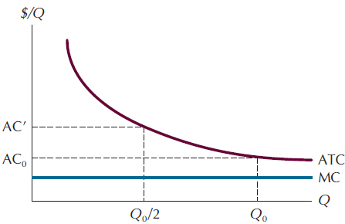
Figure 13.7: Sharing a Market with Increasing Returns to Scale

Slide 15
The Chamberlin Model
Assumption: a clearly defined “industry group,” which consists of a large number of producers of products that are close, but imperfect, substitutes for one another.
Two implications:
  Because the products are viewed as close substitutes, each firm will confront a downward-sloping demand schedule.
  Each firm will act as if its own price and quantity decisions have no effect on the behavior of other firms in the industry.

Slide 16
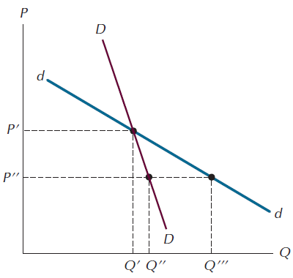
Figure 13.8: The Monopolistic Competitor’s Two Demand Curves

Slide 17
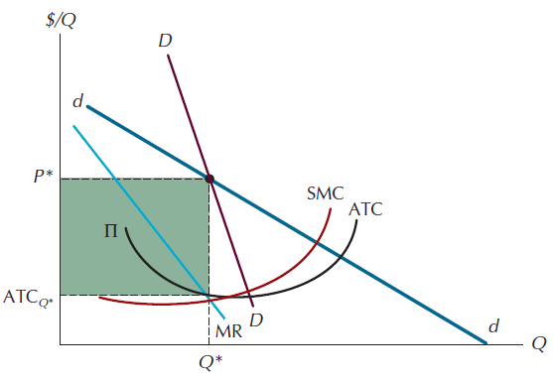
Figure 13.9: Short-Run Equilibrium for the Chamberlinian Firm

Slide 18
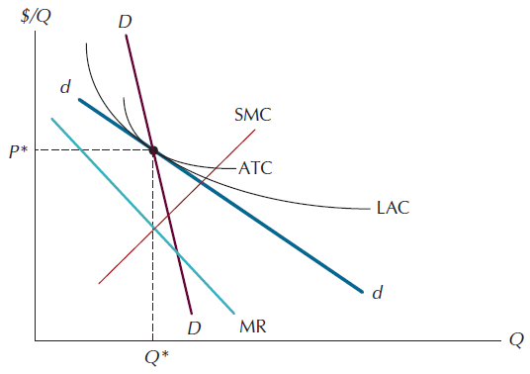
Figure 13.10: Long-Run Equilibrium in the Chamberlin Model

Slide 19
Perfect Competition Versus Chamberlinian
Monopolistic Competition
Competition meets the test of allocative efficiency, while monopolistic competition does not.
Monopolistic competition is less efficient than perfect competition because in the former case firms do not produce at the minimum points of their long-run average cost (LAC) curves.
In terms of long-run profitability the equilibrium positions of both the perfect competitor and the Chamberlinian monopolistic competitor are precisely the same.

Slide 20
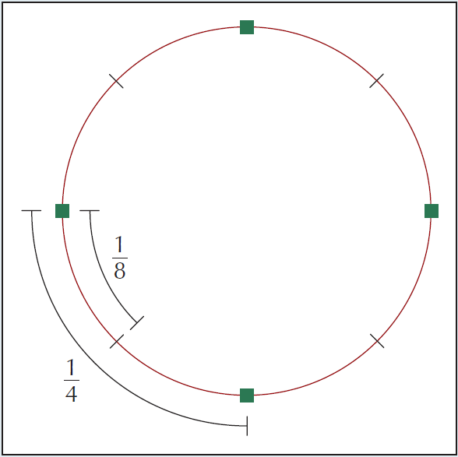
Figure 13.11: An Industry in Which Location is the Important Differentiating Feature

Slide 21
The Optimal Number of Locations
The number of outlets that emerges from the independent actions of profit-seeking firms will in general be related to the optimal number of outlets in the following simple way:
  Any environmental change that leads to a change in the optimal number of outlets (here, any change in population density, transportation cost, or fixed cost) will lead to a change in the same direction in the equilibrium number of outlets.

Slide 22
Figure 13.12: Distances with N Outlets

Slide 23
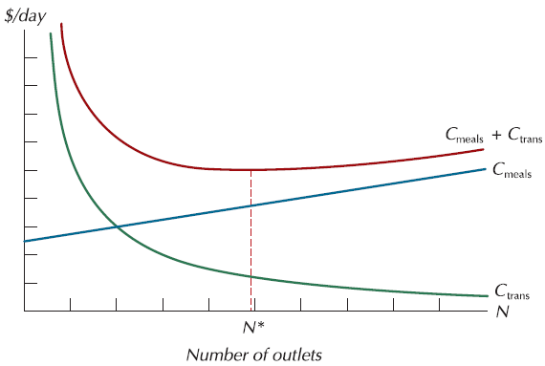
Figure 13.13: The Optimal Number of Outlets

Slide 24
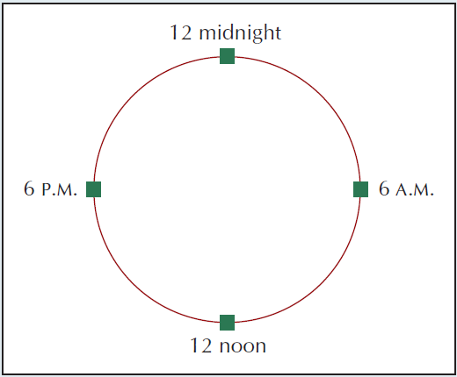
Figure 13.14: A Spatial Interpretation of Airline Scheduling
Why not have a flight leaving every 5 minutes, so that no one would be forced to travel at an inconvenient time?
The larger an aircraft is, the lower its average cost per seat is.
If people want frequent flights, airlines are forced to use smaller planes and charge higher fares.

Slide 25
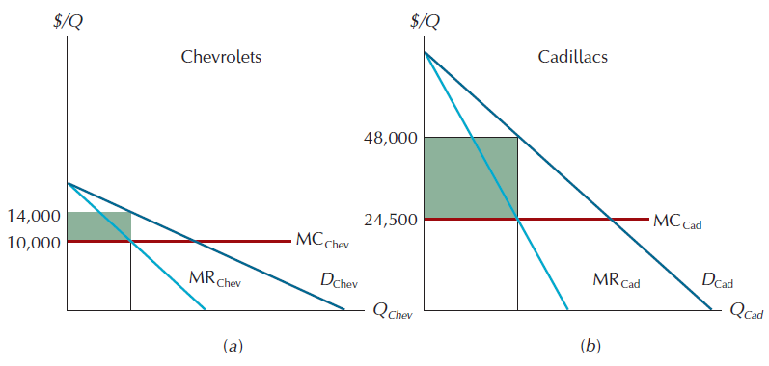
Figure 13.15: Distributing the Cost of Variety

Slide 26
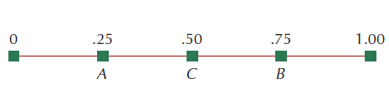
Figure 13.16: The Hot Dog Vendor Location Problem

Slide 27
Consumer Preferences And Advertising
Because products are differentiated, producers can often shift their demand curves outward significantly by advertising.
The revised sequence: the corporation decides which products are cheapest and most convenient to produce, and then uses advertising and other promotional devices to create demand for them.

