Slide 1
Chapter 14
Labor

Slide 2
Chapter Outline
The Perfectly Competitive Firm’s Short-Run Demand for Labor
The Perfectly Competitive Firm’s Long-Run Demand for Labor
The Market Demand Curve for Labor
An Imperfect Competitor’s Demand for Labor
The Supply of Labor
The Noneconomist’s Reaction to the Labor Supply Model
The Market Supply Curve
Monopsony
Minimum Wage Laws
Labor Unions
Discrimination in the Labor Market
Statistical Discrimination
The Internal Wage Structure
Winner-Take-All Markets

Slide 3
A Perfectly Competitive Firm’s Demand for Labor
Value of marginal product (VMP): the value, at current market price, of the extra output produced by an additional unit of input.
The hiring rule for the firm is to choose that amount of labor for which the wage rate is equal to the VMP

Slide 4
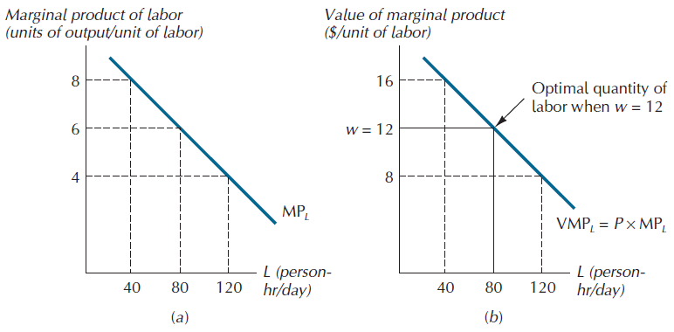
Figure 14.1: The Competitive Firm’s Short-Run Demand for Labor

Slide 5
Labor Demand in the Long-Run
The firm’s demand for labor will tend to be more elastic the more elastic the demand is for its product.
The firm’s demand for labor will tend to be more elastic the more it is able to substitute the services of labor for those of other inputs.

Slide 6
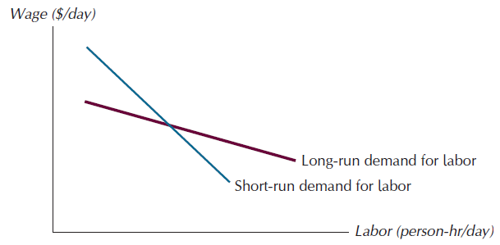
Figure 14.2: Short and Long-Run Demand Curves for Labor

Slide 7
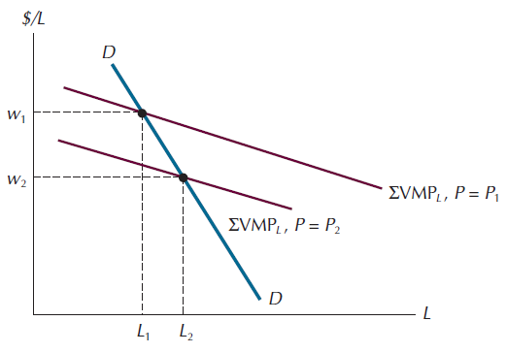
Figure 14.3: The Market Demand Curve for Labor

Slide 8
An Imperfect Competitor’s Demand for Labor
Marginal revenue product (MRP): the amount by which total revenue increases with the employment of an additional unit of input.
The firm will hire that quantity for which the wage rate and MRP^{L} are equal.

Slide 9
The Supply Of Labor
Leisure activities: which here include play, sleep, eating, and any other activity besides paid work in the labor market.
The choice is between two goods we may call “income” and “leisure.” As in the standard consumer choice problem, the individual is assumed to have preferences over the two goods that can be summarized in the form of an indifference map.

Slide 10
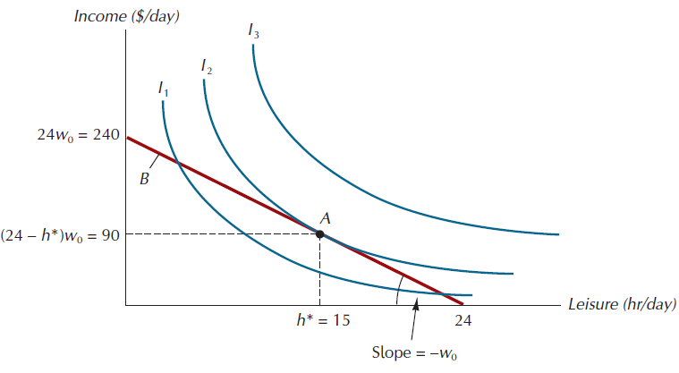
Figure 14.4: The Optimal Choice of Leisure and Income

Slide 11
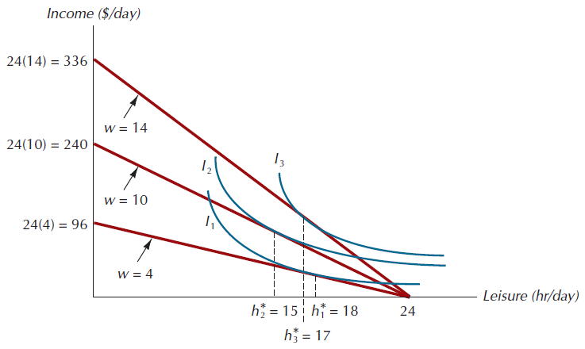
Figure 14.5: Optimal Leisure Choices for Different Wage Rates

Slide 12
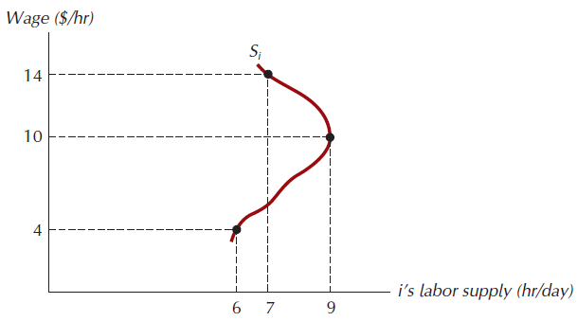
Figure 14.6: The Labor Supply Curve for the ith Worker

Slide 13
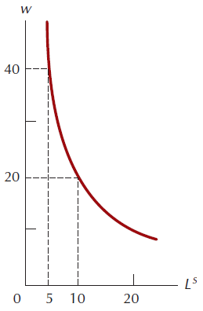
Figure 14.7: The Labor Supply Curve for a Worker Seeking a Target Level of Income

Slide 14
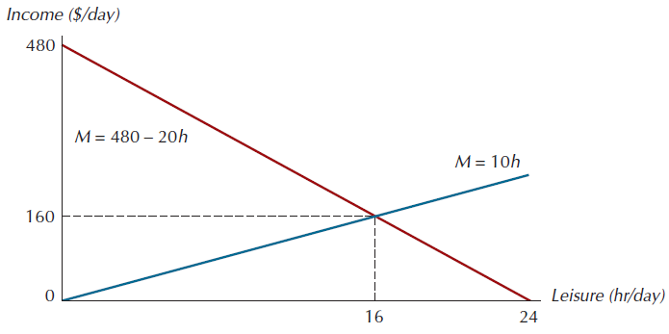
Figure 14.8: When Leisure and Income are Perfect Complements

Slide 15
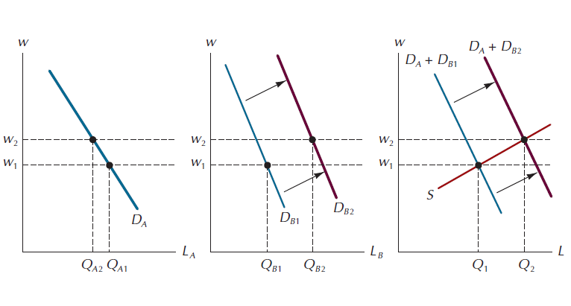
Figure 14.9: An Increase in Demand by One Category of Employer

Slide 16
Monopsony
Average factor cost (AFC): another name for the supply curve for an input.
Total factor cost (TFC): the product of the employment level of an input and its average factor cost.
Marginal factor cost (MFC): the amount by which total factor cost changes with the employment of an additional unit of input.

Slide 17
Monopsony
The optimal level of employment for a monopsonist is the level for which MFC and the demand for labor are equal.
For the monopsony firm wages will be lower than under competition.

Slide 18
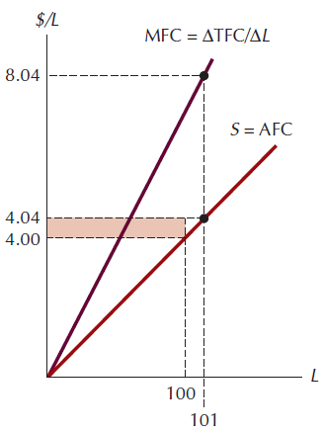
Figure 14.10: Average and Marginal Factor Cost

Slide 19
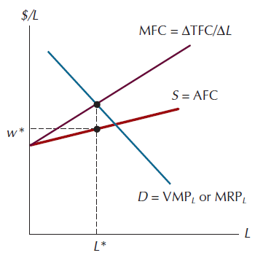
Figure 14.11: The Profit-Maximizing Wage and Employment Levels for a Monopsonist

Slide 20
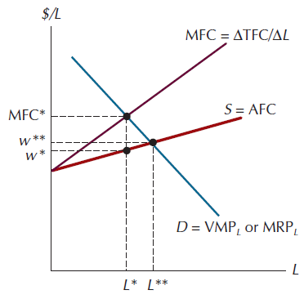
Figure 14.12: Comparing Monopsony and Competition in the Labor Market

Slide 21
Minimum Wage Laws
In 1938 Congress passed the Fair Labor Standards Act.
One of whose provisions established a minimum wage for all covered employees.
Whether the net effect of the minimum wage is to increase the amount of income earned by unskilled workers depends on the elasticity of demand for that category of labor.

Slide 22
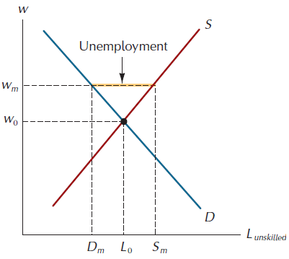
Figure 14.13: A Statutory Minimum Wage

Slide 23
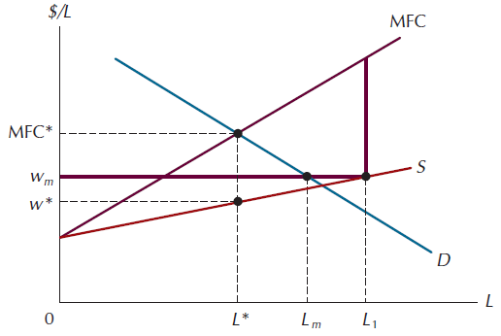
Figure 14.14: The Minimum Wage Law in the Case of Monopsony

Slide 24
Labor Unions
About one in six workers in the nonfarm sector of the U.S. economy is a member of a labor union.
Unionized workers bargain collectively over the terms and conditions of employment.
Unions may also facilitate communication between labor and management.

Slide 25
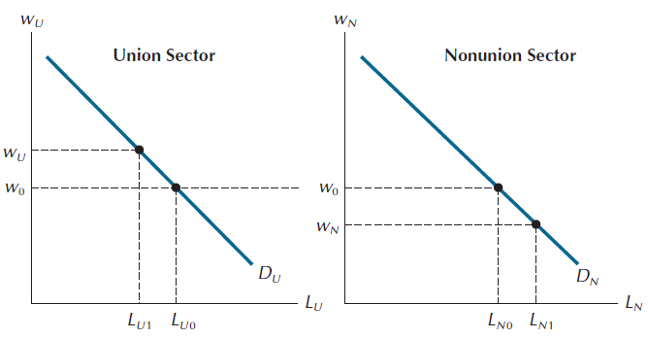
Figure 14.15: The Allocative Effects of Collective Bargaining

Slide 26
Discrimination In The Labor Market
From any individual employer’s point of view examples of different wages across various population groups are examples of nonmarket discrimination— effects that lower productivity before job applicants even make contact with the employer.

Slide 27
Discrimination In The Labor Market
Customer discrimination: the firm’s customers do not wish to deal with minority employees.
Coworker discrimination: when some type of worker (i.e white workers) feel uneasy about working with other type of workers (i.e. blacks) and may prefer employment in firms that hire only their type.
Employer discrimination: wage differentials that arise from an arbitrary preference by the employer for one group of worker over another.

Slide 28
Statistical Discrimination
Statistical discrimination is the result, not the cause, of average productivity differences between groups. Its sole effect is to reduce wage variation within each group.

Slide 29
Figure 14.16: A Hypothetical Uniform Productivity Distribution

Slide 30
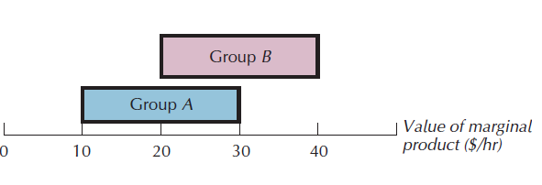
Figure 14.17: Productivity Distributions for Two Groups

Slide 31
The Internal Wage Structure
The wage structure within many private firms seems much more egalitarian than would be warranted under our marginal productivity theory of wages.
Most people prefer high-ranked to low-ranked positions among their coworkers;
No one can be forced to remain in a firm against his wishes.

Slide 32
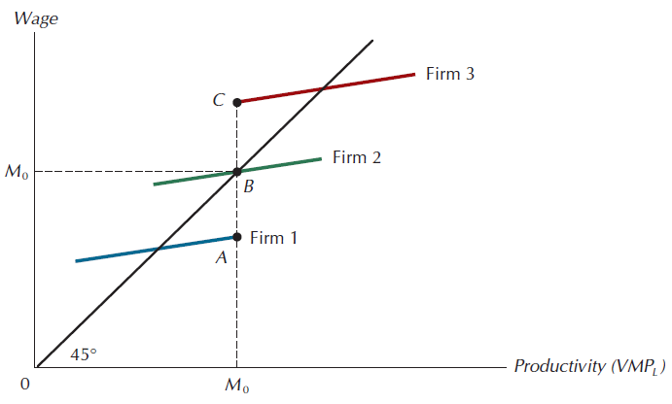
Figure 14.18: The Wage Structure when Local Status Matters

Slide 33
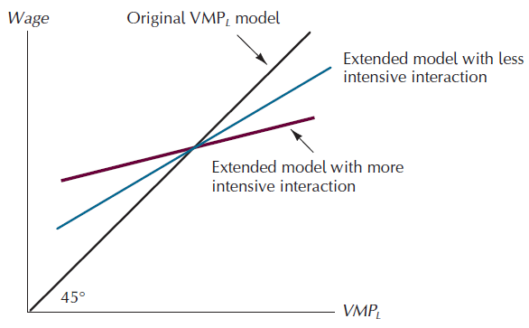
Figure 14.19: Wage Schedules and the Intensity of Interaction

Slide 34
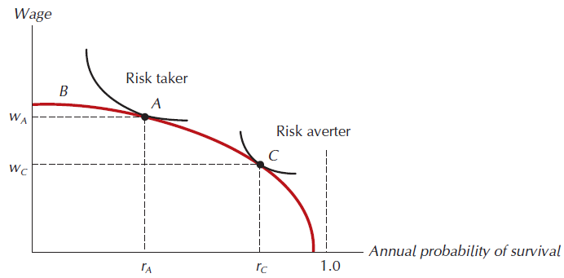
Figure A14.1: The Optimal Wage-Safety Combination

Slide 35
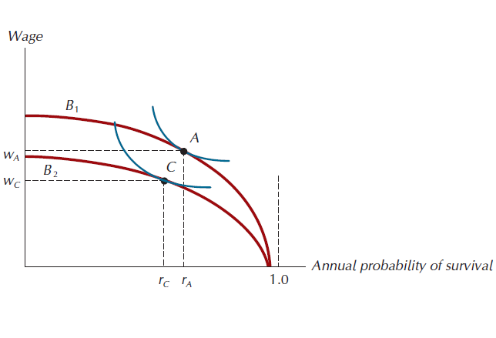
Figure A14.2: The Effect of Productivity on the Optimal Safety Choice

Slide 36
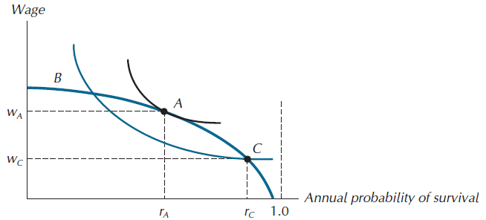
Figure A14.3: A Safety Requirement that Reduces Utility

