Slide 1
Chapter 16
Externalities, Property Rights, and the Coase Theorem

Slide 2
Chapter Outline
The Reciprocal Nature of Externalities
Application: External Effects from Nuclear Power Plants
Property Rights
Positive Externalities
Positional Externalities
Taxing Externalities

Slide 3
The Reciprocal Nature of Externalities
Suppose the benefit to the confectioner of continuing to make noise is 40, while the cost of the noise to the doctor is 60 If the confectioner’s only alternative to making the noise is to produce nothing, what will happen if he is made liable for the noise damage?

Slide 4
The Coase Theorem
The Coase Theorem: when the parties affected by externalities can negotiate costlessly with one another, an efficient outcome results no matter how the law assigns responsibility for damages.

Slide 5
Property Rights
No free-market economy can function successfully without laws that govern the use of private property.

Slide 6
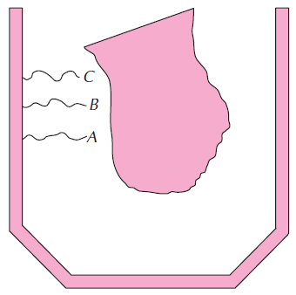
Figure 16.1: Lakeshore Property and the Law of Trespass

Slide 7
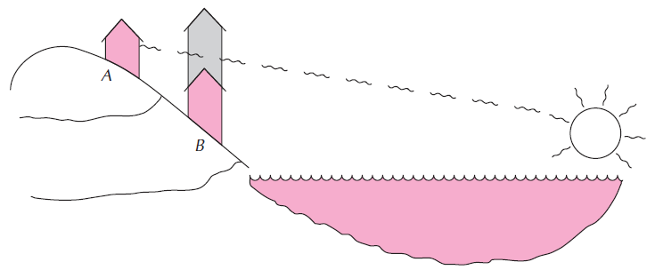
Figure 16.2: The Value of an Unobstructed View

Slide 8
The Tragedy of the Commons
Example: A village has six residents, each of whom has wealth of 100. Each resident may either invest his money in a government bond, which pays 12 percent per year, or use it to buy a year-old steer, which will graze on the village commons (there being no individually owned grazing land in this village). Year-old steers and government bonds each cost exactly 100. Steers require no effort to tend and can be sold for a price that depends on the amount of weight they gain during the year. Yearly weight gain, in turn, depends on the number of steers that graze on the commons. If village residents make their investment decisions independently, how many steers will graze on the commons?

Slide 9
The Tragedy of the Commons
The invisible hand fails to produce the best social result here because individual villagers took no account of the fact that sending an extra steer would cause existing cattle to gain less weight.
Pastureland is a scarce resource in this example, and the villagers failed to allocate it efficiently because they were allowed to use it for free.

Slide 10
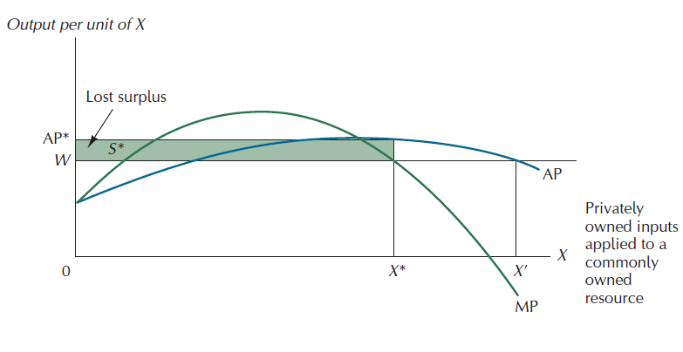
Figure 16.3: The Tragedy of the Commons

Slide 11
The Tragedy of the Commons in the Real World
One of the continuing sources of inefficiency in modern economies involves the allocation of resources that no single nation’s property laws can govern.
Several species of whales have been hunted to near extinction because no international laws of property exist to restrain individual incentives to kill whales.
Global Warming

Slide 12
Externalities, Efficiency, and Free Speech
The First Amendment to the U.S. Constitution protects most forms of speech and expression, even those that cause intensely painful effects on others.

Slide 13
Smoking Rules, Public and Private
Research studies show that exposure to cigarette smoke exhaled by others can be harmful to one’s health.
Laws that ban smoking in public places are based on two assumptions:
(1) negotiating with strangers in public places is generally impractical
(2) the harm to nonsmokers from undesired exposure to smoke is more important than the harm to smokers from not being able to smoke in public places.

Slide 14
Positional Externalities
In many areas of endeavor, rewards are determined not by our absolute performance, but by how we perform relative to others.
Positional externalities: if A and B are competing for a prize that only one of them can attain, anything that helps A will necessarily harm B.

Slide 15
Positional Externalities
Some social institutions that restrain the positional arms race among families:
Limiting The Workweek
Savings
Workplace Safety

Slide 16
Taxing Externalities
If A carries out an activity that imposes a cost on B, then taxing A by the amount of that cost will provide him with the proper incentive to consider the externality in his production decisions.
Nevertheless, taxation will not always be inefficient.
If negotiation is costless, taxing will always lead to an efficient outcome.

Slide 17
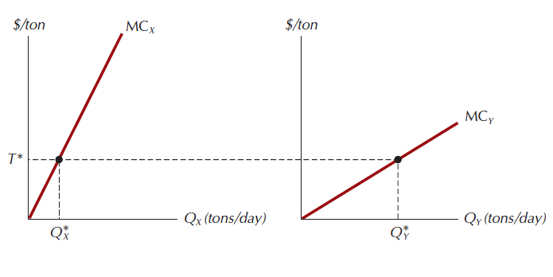
Figure 16.4: The Tax Approach to Pollution Reduction

