Slide 1
Principles of Macroeconomics Fall 2019
Dr. Andrew L. H. Parkes
“A Macroeconomic Understanding for use in Business”
卜安吉

Slide 2
Money

Slide 3
The Fed
What are the three components of the Fed organization?
The Governors
The Federal Reserve Banks
The Federal Open Market Committee
“The Fed” is the Central Bank (CB) of the U.S.A.

Slide 4
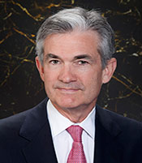
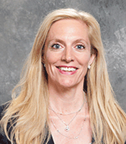
Three Tools of the Fed (CB)
Powell, Chair
Clarida, Vice Chair
Open Market Operations
Discount Rate
Reserve Requirement
Currently there are 5 of 7 Federal Reserve Board Governors:
Quarles, Vice Chair of Supervision
Baird
Bowman
http://www.federalreserve.gov/aboutthefed/default.htm

Slide 5
1. Open Market Operations
Federal Open Market Committee (FOMC)
The 7 Board of Governors (usually)
New York Fed Bank President
4 other Presidents of the 11 other Fed Banks
Buy and Sell U.S. Treasury Bills (Notes and Bonds too but mostly Bills)
Their actions decrease/increase the interest rate (respectively). – called open market operations

Slide 6
2. Required Reserve Ratio
Set by the Governors –
the Reserve Ratio is the percentage of checkable deposits that must be kept at the Federal Reserve District Bank in their District as cash.
The effect is that the cash is not available for banks to loan out.

Slide 7
3. Discount Window
The Discount Window is not a physical place but means that commercial banks may borrow from the Fed at the Discount Rate.

Slide 8
3. Discount Window
The “lender of last resort” function.
The legislation in 1913 created the Fed in 1914, not in the constitution.
Lending to banks was the central bank’s only role.

Slide 9
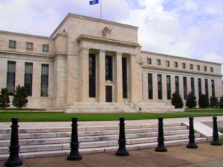
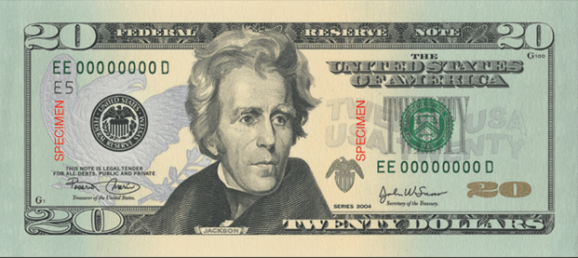
The Federal Reserve System
The Board of Governors
The Fed Banks
The Federal Open Market Committee (FOMC)

Slide 10
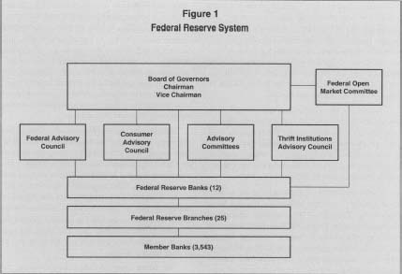
The Fed: The Board of Governors

Slide 11
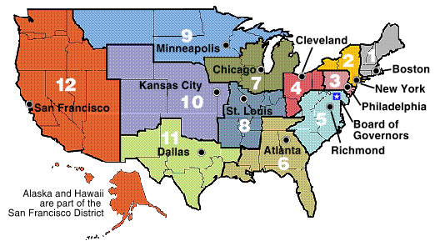
The Fed: The Fed Banks
The Twelve Federal Reserve Districts – The Fed Banks

Slide 12
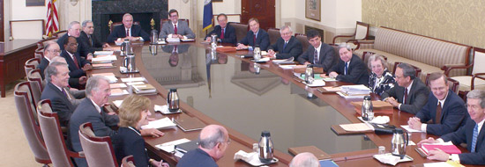
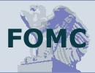
The Fed: The FOMC
The FOMC:
The Seven Governors, New York Fed President and 4 other Fed Presidents – 12 total members
Set Monetary Policy for the United States
In other words, the FOMC sets the “Federal Funds Rate” – The interest rate that banks borrow funds from each other
The “Fed Funds” rate determines the “Prime” rate or the interest rate that banks charge their “best” corporate customers
An Increase in the fed funds rate means borrowing is more “expensive.”
A decrease?

Slide 13
The Fed: The FOMC
2017 Committee Members
Janet L. Yellen, Board of Governors, Chair
William C. Dudley, New York, Vice Chairman
Lael Brainard, Board of Governors
Charles L. Evans, Chicago
Patrick Harker, Philadelphia
Robert S. Kaplan, Dallas
Neel Kashkari, Minneapolis
Jerome H. Powell, Board of Governors
Randal K. Quarles, Board of Governors
Alternate Members
Raphael W. Bostic, Atlanta
Loretta J. Mester, Cleveland
Mark L. Mullinix, First Vice President, Richmond
Michael Strine, First Vice President, New York
John C. Williams, San Francisco
Next Meeting: Oct 31- Nov 1, 2017 still
1.00 - 1.25% ff rate?
https://www.federalreserve.gov/monetarypolicy/fomc.htm

Slide 14
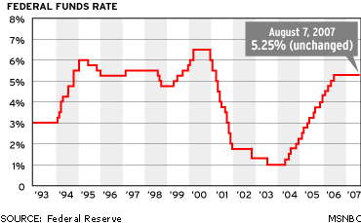
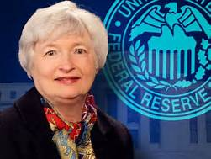
The Fed: The Chair
Where is it today?
Janet Yellen

Slide 15
Fed’s quote from the minutes:
“Effective June 15, 2017, the Federal Open Market Committee directs the Desk to undertake open market operations as necessary to maintain the federal funds rate in a target range of 1 to 1¼ percent, including overnight reverse repurchase operations (and reverse repurchase operations …“
https://www.federalreserve.gov/monetarypolicy/files/fomcminutes20170614.pdf

Slide 16
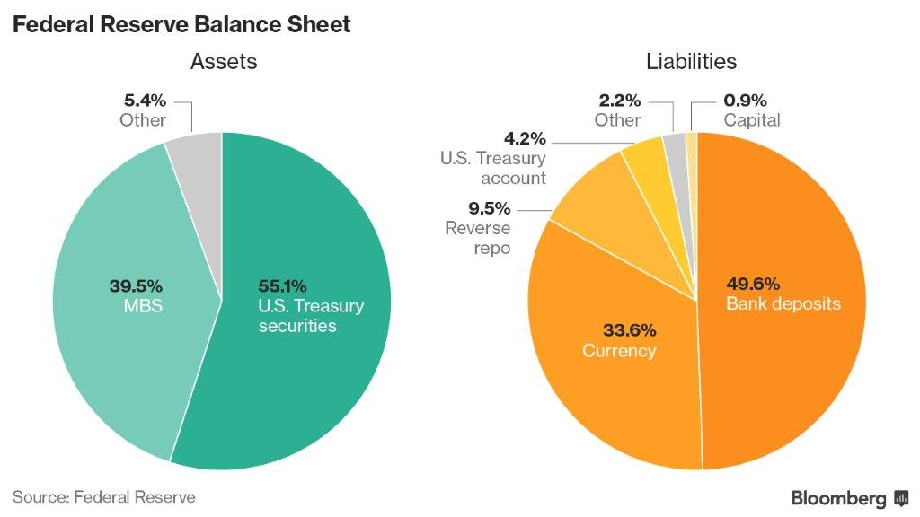

Slide 17
http://www.nytimes.com/2010/11/02/business/economy/02fed.html?_r=1&nl=&emc=a25

Slide 18
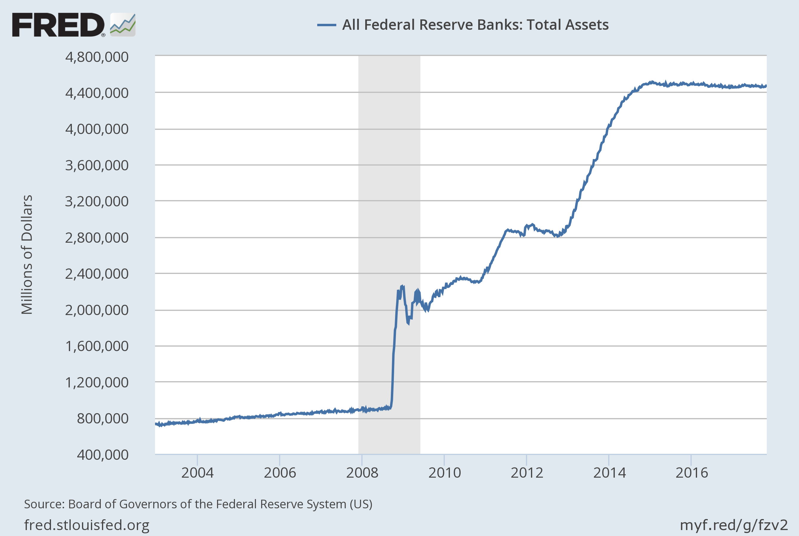
https://fred.stlouisfed.org/series/WALCL

