Slide 1
CHAPTER
24
Measuring the
Cost of Living
Notes:
Most instructors are able to cover this chapter in one or two class sessions.
This presentation contains in-class exercises requiring calculators.

Slide 2
Look for the answers to these questions:
What is the Consumer Price Index (CPI)? How is it calculated? What’s it used for?
What are the problems with the CPI? How serious are they?
How does the CPI differ from the GDP deflator?
How can we use the CPI to compare dollar amounts from different years? Why would we want to do this, anyway?
How can we correct interest rates for inflation?

Slide 3
The Consumer Price Index
Consumer price index (CPI)
Measure of the overall level of prices
Measure of the overall cost of goods and services
Bought by a typical consumer
Computed and reported every month by the Bureau of Labor Statistics
Notes:
The CPI measures the typical consumer’s cost of living; is the basis of cost of living adjustments (COLAs) in many contracts and in Social Security

Slide 4
Calculating CPI
Fix the basket
The Bureau of Labor Statistics (BLS) surveys consumers to determine what’s in the typical consumer’s “shopping basket.”
Find the prices
The BLS collects data on the prices of all the goods in the basket.
Compute the basket’s cost
Use the prices to compute the total cost of the basket

Slide 5
Calculating CPI
Chose a base year and compute the CPI
Cost of basket of goods and services in current year divided by cost of basket in base year
Times 100
Compute the inflation rate
The percentage change in the CPI from the preceding period
$$\text{Inflation} \text{rate}=\frac{\text{CPI} \text{this} \text{year}\text{−}\text{CPI} \text{last} \text{year}}{\text{CPI} \text{last} \text{year}}×100$$
Notes:
Base year = benchmark

Slide 6
EXAMPLE: basket: {4 pizzas, 10 lattes}
0
year
price of pizza
price of latte
cost of basket
2014
$10
$2.00
$10 x 4 + $2 x 10 = $60
2015
$11
$2.50
$11 x 4 + $2.5 x 10 = $69
2016
$12
$3.00
$12 x 4 + $3 x 10 = $78
Compute CPI in each year (2014 base year)
2014: 100 x ($60/$60) = 100
2015: 100 x ($69/$60) = 115
2016: 100 x ($78/$60) = 130
Inflation rate:
15%
115 – 100
=
x 100%
100
13%
130 – 115
=
x 100%
115
Notes:
6
Suggestion: Show students the data in the first three columns of the table. Before showing them the cost of basket calculations, tell them to take three minutes to compute the cost of the basket in each of the three years, and use those results to compute the value of the CPI in each of the three years. Then, show the rest of the slide.
Or, you can just cruise through this example, but tell them to pay close attention because in a few moments they will have to compute a similar example.

Slide 7
Active Learning 1 Calculating the CPI
CPI basket: {10 lbs beef, 20 lbs chicken}
The CPI basket
cost $120 in 2014,
the base year.
Compute the CPI in 2015.
What was the CPI inflation rate from 2015–2016?
 | price of beef | price of chicken
2014 | $4 | $4
2015 | $5 | $5
2016 | $9 | $6
Notes:
Part A is not difficult but requires an intermediate step: students must compute the cost of the basket in 2015 to find the CPI in 2015.
Part B has two intermediate steps: computing the cost of the basket in 2016, then computing the CPI in 2016.

Slide 8
Active Learning 1 Answers
CPI basket: {10 lbs beef, 20 lbs chicken}
The CPI basket
cost $120 in 2014,
the base year.
Compute the CPI in 2015.
Cost of CPI basket in 2015=($5x10)+($5x20)= $150
CPI in 2015 = 100 x ($150/$120) = 125
 | price of beef | price of chicken
2014 | $4 | $4
2015 | $5 | $5
2016 | $9 | $6

Slide 9
Active Learning 1 Answers
CPI basket: {10 lbs beef, 20 lbs chicken}
The CPI basket
cost $120 in 2014,
the base year.
What was the CPI inflation rate from 2015–2016?
Cost of CPI basket in 2016=($9 x10)+($6 x20)= $210
CPI in 2016 = 100 x ($210/$120) = 175
CPI inflation rate = (175 – 125)/125 = 40%
 | price of beef | price of chicken
2014 | $4 | $4
2015 | $5 | $5
2016 | $9 | $6

Slide 10
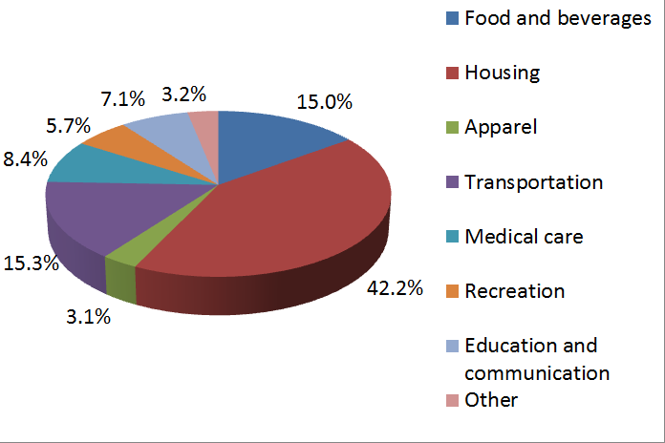
What’s in the CPI’s Basket?
Notes:
Each number is the percent of the “typical” household’s total expenditure.
Ask students for examples of how the breakdown of their own expenditure differs from that of the typical household shown here. Then, ask students how the typical elderly person’s expenditure might differ from that shown here. (This is relevant because the CPI is used to give Social Security COLAs to the elderly; however, the elderly spend a much larger fraction of their income on medical care, a category in which prices grow much faster than the CPI.)
The Web site listed below also gives a very fine disaggregation of each category, which enables students to compare their own spending on individual goods to that of the “typical” household.
Source: Bureau of Labor Statistics, http://www.bls.gov/cpi/usri_2015.txt
U.S. city average, CPI-U. Data in this graph from December 2015.

Slide 11
Active Learning 2 Substitution bias
CPI basket: {10 lbs beef, 20 lbs chicken}
In 2014 and 2015, households bought CPI basket.
In 2016, households bought {5 lbs beef, 25 lbs chicken}.
Compute cost of the 2016 household basket.
Compute % increase in cost of household basket over 2015–2016, compare to CPI inflation rate.
 | beef | chicken | cost of CPI basket
2014 | $4 | $4 | $120
2015 | $5 | $5 | $150
2016 | $9 | $6 | $210
Notes:
Students understand substitution bias better if they work a concrete example like the one on this slide.
You might want to ask your class why households bought different quantities of beef and chicken in 2016 than they did in 2015.
Or if that seems too easy, just mention before displaying questions A and B that households are responding to the change in relative prices: beef has become a lot more expensive relative to chicken, so households buy less beef and more chicken.

Slide 12
Active Learning 2 Answers
CPI basket: {10 lbs beef, 20 lbs chicken}
In 2014 and 2015, households bought CPI basket.
In 2016, households bought {5 lbs beef, 25 lbs chicken}.
Compute cost of the 2016 household basket.
($9 x 5) + ($6 x 25) = $195
 | beef | chicken | cost of CPI basket
2014 | $4 | $4 | $120
2015 | $5 | $5 | $150
2016 | $9 | $6 | $210
Notes:
This is just a straightforward calculation.

Slide 13
Active Learning 2 Answers
CPI basket: {10 lbs beef, 20 lbs chicken}
In 2014 and 2015, households bought CPI basket.
In 2016, households bought {5 lbs beef, 25 lbs chicken}.
Compute % increase in cost of household basket over 2015–2016, compare to CPI inflation rate.
Rate of increase: ($195 – $150)/$150 = 30%
CPI inflation rate from previous problem = 40%
 | beef | chicken | cost of CPI basket
2014 | $4 | $4 | $120
2015 | $5 | $5 | $150
2016 | $9 | $6 | $210
Notes:
Ask students which inflation rate (30% or 40%) they think more accurately measures the true increase in the cost of living for this example.
Most students will correctly say “30%.” Ask them to explain their reasoning. You are guiding them to figure out substitution bias and why it’s a problem.

Slide 14
Problems with the CPI
Substitution Bias
Over time, some prices rise faster than others
Consumers substitute toward goods that become relatively cheaper, mitigating the effects of price increases.
The CPI misses this substitution because it uses a fixed basket of goods.
Thus, the CPI overstates increases in the cost of living.
Notes:
If you spent a few minutes of class time on the preceding exercise, you can go through this slide fairly quickly.

Slide 15
Problems with the CPI
Introduction of New Goods
The introduction of new goods increases variety, allows consumers to find products that more closely meet their needs.
In effect, dollars become more valuable.
The CPI misses this effect because it uses a fixed basket of goods.
Thus, the CPI overstates increases in the cost of living.
Notes:
The textbook explains this problem using a great example: the introduction of the iPod in 2001.

Slide 16
Problems with the CPI
Unmeasured Quality Change
Improvements in the quality of goods in the basket increase the value of each dollar.
The BLS tries to account for quality changes but probably misses some, as quality is hard to measure.
Thus, the CPI overstates increases in the cost of living.

Slide 17
Problems with the CPI
It’s an AVERAGE!
The “average urban market basket”
Does that apply equally to students and seniors?
Especially the Social Security COLA (cost of living allowance)
What do seniors spend most of their income on?

Slide 18
Problems with the CPI
Each of these problems causes the CPI to overstate cost of living increases.
The BLS has made technical adjustments, but the CPI probably still overstates inflation by about 0.5 percent per year.
This is important because Social Security payments and many contracts have COLAs tied to the CPI.
Notes:
In the 1990s, it was estimated that the CPI’s bias cost taxpayers $1 trillion every 12 years in unnecessary COLAs in Social Security and government pension payments!!!

Slide 19
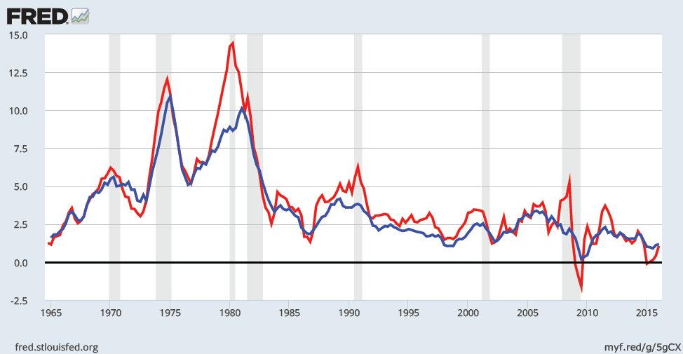
Two Measures of Inflation, 1965–2016
GDP deflator
CPI
Percent change per year
Notes:
This figure shows the inflation rate—the percentage change in the level of prices—as measured by the GDP deflator and the Consumer Price Index.
Notice that the two measures of inflation generally move together. There are a few years when they diverge a bit. The reasons for this are on the next two slides.
Sources:
GDP deflator – Bureau of Economic Analysis, U.S. Dept. of Commerce
CPI – Bureau of Labor Statistics, U.S. Dept. of Labor
Both series are quarterly and the inflation rate is calculated as the percentage change from one year earlier. The monthly CPI is aggregated into quarters by averaging monthly values.
I used the series CPIAUCSL and GDPDEF (percentage change) from the Federal Reserve Bank of St. Louis “Fred” database:
http://research.stlouisfed.org/fred2/

Slide 20
Contrasting the CPI and GDP Deflator
Imported consumer goods:
Included in CPI
Excluded from GDP deflator
Capital goods:
Excluded from CPI
Included in GDP deflator (if produced domestically)

Slide 21
Contrasting the CPI and GDP Deflator
The basket:
CPI uses fixed basket
GDP deflator uses basket of currently produced goods & services
This matters if different prices are changing by different amounts.

Slide 22
Active Learning 3 CPI vs. GDP deflator
In each scenario, determine the effects on the CPI and the GDP deflator.
Starbucks raises the price of Frappuccinos.
Caterpillar raises the price of the industrial tractors it manufactures at its Illinois factory.
Armani raises the price of the Italian jeans it sells in the U.S.
Notes:
To make this exercise more challenging, move the preceding two slides so that they appear immediately after the answers to this exercise.
If you are outside the U.S., please make the following changes:
In (b), change the example to “A local manufacturer raises the price on industrial tractors it produces.”
In (c), change “U.S.” to your country’s name, unless your country is Italy. In that case, change the example to something involving an imported consumer good.

Slide 23
Active Learning 3 Answers
Starbucks raises the price of Frappuccinos.
The CPI and GDP deflator both rise.
Caterpillar raises the price of the industrial tractors it manufactures at its Illinois factory.
The GDP deflator rises, the CPI does not.
Armani raises the price of the Italian jeans it sells in the U.S.
The CPI rises, the GDP deflator does not.
Notes:
Explanations:
A. Frappuccinos are produced in the U.S., so their prices are part of the GDP deflator. They are purchased by consumers, so their prices are part of the CPI. Hence, an increase in the price of Frappuccinos causes both the CPI and GDP deflator to increase.
B. Since the tractors are produced here in the U.S., the price increase causes the GDP deflator to rise. However, industrial tractors are a capital good, not a consumer good, so the CPI is unaffected.
Italian jeans appear in the U.S. consumer’s shopping basket, and hence the increase in their price causes the CPI to rise. However, the GDP deflator is unchanged because it only includes prices of domestically produced goods and excludes the prices of imports.

Slide 24
Correcting Variables for Inflation
Comparing dollar figures from different times
Inflation makes it harder to compare dollar amounts from different times.
Example: the minimum wage
$1.25 in Dec 1963
$7.25 in Dec 2013
Did min wage have more purchasing power in Dec 1963 or Dec 2013?
To compare, use CPI to convert 1963 figure into “2013 dollars”…

Slide 25
Correcting Variables for Inflation
Dollar figures from different times
$$\begin{matrix}\text{Amount} \text{in} \text{today}\text{′}\text{s} \text{dollars}= \\ =\text{Amount} \text{in} \text{year} \text{T} \text{dollars}×\frac{\text{Price} \text{level} \text{today}}{\text{Price} \text{level} \text{in} \text{year} \text{T}}\end{matrix}$$
In our example:
“year T ” is 1963, “today” is 2013
Min wage was $1.25 in year T
CPI = 30.9 in year T, CPI = 234.6 today
The minimum wage in 1963 was”
$1.25 x 234.6/30.9 = $9.49 in 2013 dollars.
Notes:
Note: the ratio of price levels = 234.6/30.9 = 7.6. This means that the cost of living has increased by a factor of 7.6. We multiply this factor by the 1963 wage figure to convert the latter into “today’s dollars.”
Interpreting the result: The $1.25 minimum wage in December 1963 could have purchased $9.49 worth of goods and services if prices in 1963 were the same as they were in December 2013.
Source of data: Bureau of Labor Statistics, www.bls.gov

Slide 26
Correcting Variables for Inflation
Comparing dollar figures from different times
Researchers, business analysts, and policymakers often use this technique to convert a time series of current-dollar (nominal) figures into constant-dollar (real) figures.
They can then see how a variable has changed over time after correcting for inflation.
Example: the minimum wage…
Notes:
DISCLAIMER: The material on this slide is not supported with test bank or study guide questions.

Slide 27
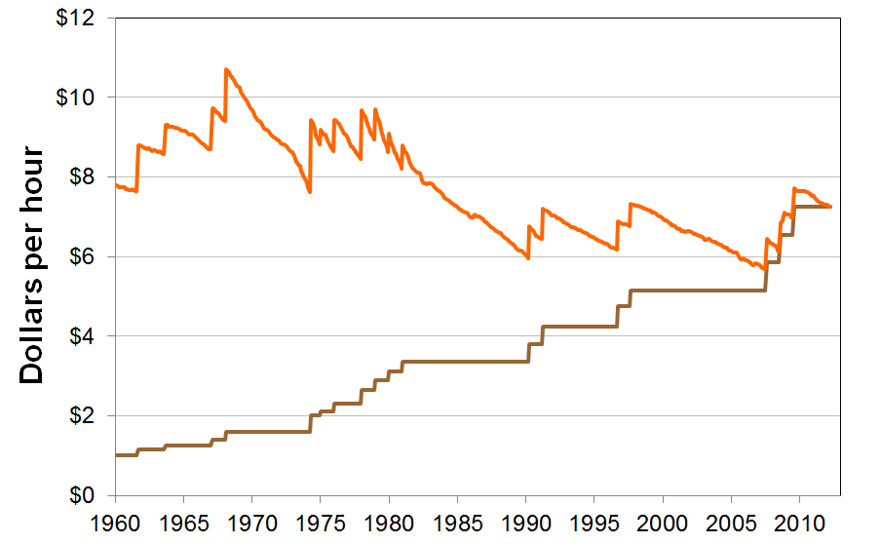
The U.S. Minimum Wage in Current Dollars and Today’s Dollars, 1960–2013
2013 dollars
current dollars
Notes:
DISCLAIMER: The material on this slide is not supported with test bank or study guide questions.
The sawtooth pattern of the real minimum wage series arises because the nominal minimum wage is raised, then remains constant until it’s raised again. During the time between minimum wage hikes, inflation erodes the purchasing power of the minimum wage.
The long-run trend in the real minimum wage:
Rising during the 1960s, then begins a long, slow fall from the 1970s to the mid-2000s. A series of increases in the late 2000s lift the real minimum wage. But, as of December 2010, the real minimum wage is still lower than it was in the 1960s to the early 1980s.
Source of minimum wage data:
http://www.dol.gov/whd/minwage/chart.htm
Source of CPI data:
http://www.bls.gov,
retrieved from FRED

Slide 28
Active Learning 4 Comparing tuition increases
Tuition and Fees at U.S. Colleges and Universities
 | 1990 | 2015
Private non-profit 4-year | $9,340 | $32,405
Public 4-year | $1,908 | $9,410
Public 2-year | $906 | $3,435
CPI | 130.7 | 237.7
Express the 1990 tuition figures in 2015 dollars, then compute the percentage increase in real terms for all three types of schools.
Which type experienced the largest increase in real tuition costs?
Notes:
Sources:
Tuition data from Table 4a of
http://trends.collegeboard.org/college_pricing/
CPI data from http://bls.gov

Slide 29
Active Learning 4 Answers
 | 1990 | 2015 | % change
CPI | 130.7 | 237.7 | 81.9%
Private non-profit 4-year (current $) | $9,340 | $32,405
Private non-profit 4-year (in 2015 $) | $16,986 | $32,405 | 90.8%
Public 4-year (current $) | $1,908 | $9,410
Public 4-year (in 2015 $) | $3,470 | $9,410 | 171.2%
Public 2-year (current $) | $906 | $3,435
Public 2-year (in 2015 $) | $1,648 | $3,435 | 108.4%
Notes:
If prices in 1990 were as high as they were in 2015, the average private 4-year college would have cost $16,986, the average public 4-year school would have cost $3,470, and the average public 2-year college would have cost $1,648.
The category with the largest real increase is public 4-year colleges and universities.
Sources:
http://trends.collegeboard.org/college_pricing/
http://bls.gov

Slide 30
Correcting Variables for Inflation
Indexation
A dollar amount is indexed for inflation if it is automatically corrected for inflation by law or in a contract.
The increase in CPI automatically determines:
The COLA in many multi-year labor contracts.
Adjustments in Social Security payments and federal income tax brackets.

Slide 31
Correcting Variables for Inflation
Real vs. Nominal Interest Rates
The nominal interest rate:
Interest rate not corrected for inflation
Rate of growth in the dollar value of a deposit or debt
The real interest rate:
Corrected for inflation
Rate of growth in the purchasing power of a deposit or debt
Real interest rate=(nominal interest rate)–(inflation rate)

Slide 32
Real vs. Nominal Interest Rates
Example:
Deposit $1,000 for one year.
Nominal interest rate is 9%.
During that year, inflation is 3.5%.
Real interest rate = Nominal interest rate – Inflation
= 9.0% – 3.5% = 5.5%
The purchasing power of the $1000 deposit has grown 5.5%.

Slide 33
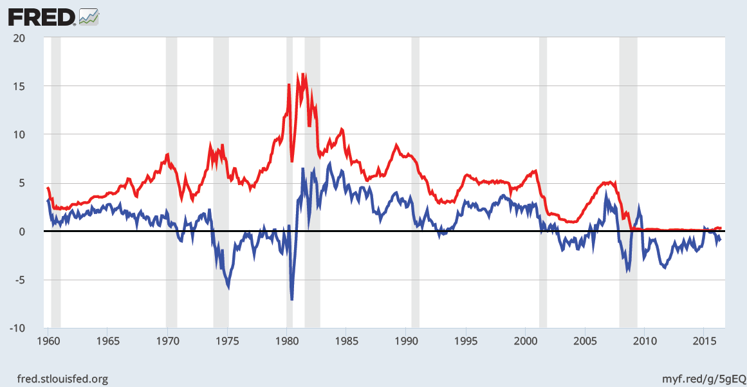
Real and Nominal Interest Rates in the U.S., 1960–2015
Real
Nominal
Interest rate (percent per year)
Notes:
This graph replicates Figure 4 from this chapter.
The nominal interest rate is the rate on a three-month Treasury Bill. The real interest rate is this rate minus the inflation rate as measured by the percentage change in the CPI.
Notice that the nominal and real interest rates often do not move together, due to variation in the inflation rate.
Sources:
CPI – Bureau of Labor Statistics (CPIAUCSL)
Treasury bill rate – Board of Governors of the Federal Reserve System. (DBT3)
I obtained both from the Federal Reserve Bank of St. Louis “Fred” database:
http://research.stlouisfed.org/fred2/

Slide 34
Summary
The Consumer Price Index is a measure of the cost of living. The CPI tracks the cost of the typical consumer’s “basket” of goods & services.
The CPI is used to make Cost of Living Adjustments and to correct economic variables for the effects of inflation.
The real interest rate is corrected for inflation and is computed by subtracting the inflation rate from the nominal interest rate.

