Slide 1
CHAPTER
17
Money Growth and Inflation
Notes:
For most students, the hardest concepts to grasp in this chapter are the most theoretical ones: the classical dichotomy and monetary neutrality. Most of the other material in the chapter is fairly straightforward.
In the last section of the chapter, “The Costs of Inflation,” the Shoeleather cost is not difficult for students to understand, but it’s difficult for them to relate to, due to the ready availability of ATMs and Internet access to bank accounts. Most students have a harder time learning about the arbitrary redistributions of wealth that arise when inflation is different from expected.
This chapter is longer than average. To get through it more quickly, you might consider skipping or moving fairly quickly through some of the easier concepts, telling students to learn them from the textbook. Such concepts might include:
some of the costs of inflation (menu costs, confusion and inconvenience)
the inflation tax
hyperinflation

Slide 2
Look for the answers to these questions:
How does the money supply affect inflation and nominal interest rates?
Does the money supply affect real variables like real GDP or the real interest rate?
How is inflation like a tax?
What are the costs of inflation? How serious are they?

Slide 3
Introduction
This chapter introduces the quantity theory of money to explain one of the Ten Principles of Economics from Chapter 1:
Prices rise when the government prints too much money.
  Most economists believe the quantity theory is a good explanation of the long run behavior of inflation.

Slide 4
The Value of Money
P = the price level (e.g., the CPI or GDP deflator)
  P is the price of a basket of goods, measured in money.
1/P is the value of $1, measured in goods.
  Example: basket contains one candy bar.
    If P = $2, value of $1 is 1/2 candy bar
    If P = $3, value of $1 is 1/3 candy bar
Inflation drives up prices and drives down the value of money.

Slide 5
The Quantity Theory of Money
  Developed by 18th century philosopher
  David Hume and the classical economists.
  Advocated more recently by Nobel Prize Laureate Milton Friedman.
  Asserts that the quantity of money determines the value of money
  We study this theory using two approaches:
    A supply-demand diagram
    An equation

Slide 6
Money Supply (MS)
Money supply in the real world
  Determined by the Fed, the banking system, and consumers.
Money supply in this model
  We assume the Fed precisely controls MS and sets it at some fixed amount.

Slide 7
Money Demand (MD)
Money demand
  Refers to how much wealth people want to hold in liquid form.
  Depends on P: an increase in P reduces the value of money, so more money is required to buy goods and services.
Quantity of money demanded
  Is negatively related to the value of money
  And positively related to P, other things equal.
Notes:
Some students may think that money demand is negatively related to P, reasoning that an increase in P reduces the demand for goods and services, so less money is required to buy goods and services. However, the relationship between P and money demand holds real income constant. Thus, “other things equal” means that an increase in P does NOT reduce real income, and therefore does not reduce the demand for goods and services.
Here’s a handy way to explain it:
Real income determines the quantity of g&s people demand.
P determines how many dollars will be needed to buy this quantity of g&s.
Some of the “other things” include real income, interest rates, availability of ATMs.

Slide 8
The Money Supply-Demand Diagram
0
Value of Money, 1/P
Price
Level, P
As the value of money rises, the price level falls.
1
1
¾
1.33
½
2
¼
4
Quantity of Money
Notes:
8

Slide 9
The Money Supply-Demand Diagram
0
Value of Money, 1/P
Price
Level, P
MS₁
1
1
¾
1.33
The Fed sets MS
at some fixed value, regardless of P.
½
2
¼
4
$1000
Quantity of Money
Notes:
9

Slide 10
The Money Supply-Demand Diagram
0
Value of Money, 1/P
A fall in value of money (or increase in P) increases the quantity of money demanded:
Price
Level, P
1
1
¾
1.33
½
2
¼
4
MD₁
Quantity of Money
Notes:
10

Slide 11
The Money Supply-Demand Diagram
0
Value of Money, 1/P
P adjusts to equate quantity of money demanded with money supply.
Price
Level, P
MS₁
1
1
¾
1.33
eq’m
value
of money
eq’m
price
level
A
½
2
¼
4
MD₁
$1000
Quantity of Money
Notes:
11
Eq’m = equilibrium

Slide 12
The Effects of a Monetary Injection
0
Value of Money, 1/P
Price
Level, P
MS₁
MS₂
Suppose the Fed increases the money supply.
1
1
Then the value of money falls,
and P rises.
¾
1.33
A
½
2
eq’m
value
of money
eq’m
price
level
B
¼
4
MD₁
$1000
$2000
Quantity of Money
Notes:
12

Slide 13
A Brief Look at the Adjustment Process
From graph: Increasing MS causes P to rise.
How does this work? Short version:
  At the initial P, an increase in MS causes an
  excess supply of money.
  People get rid of their excess money by spending it on goods and services or by loaning it to others, who spend it. Result: increased demand for goods.
  But supply of goods does not increase,
  so prices must rise.
Notes:
Other things happen in the short run, which we will study in later chapters.

Slide 14
Real vs. Nominal Variables
Nominal variables
  Are measured in monetary units.
    Examples: nominal GDP, nominal interest rate (rate of return measured in $), nominal wage ($ per hour worked)
Real variables
  Are measured in physical units.
    Examples: real GDP, real interest rate (measured in output), real wage (measured in output)
Notes:
Students seem to readily understand that the real wage is the purchasing power of the wage, or that the real wage is corrected for inflation. From either of these interpretations of the real wage, it is just a small step to understand that the real wage is measured in units of output.
What does “the purchasing power of the wage” mean? If students think about it, they will grasp that it means the quantity of output workers can buy with their wage. Hence, the real wage is measured in units of output.
What does “corrected for inflation” mean? A simple example helps. Suppose the nominal wage rises 20% and the price level also rises 20%. Students will immediately understand that the wage—corrected for inflation—is unchanged. Which is to say, it can buy the same quantity of output as before.
The next slide discusses relative prices, demonstrating that they, too, are measured in physical units, which makes them real variables. The following slide returns to the real wage, showing that it is a relative price, and demonstrating that it is measured in units of output.
How is it that the real interest rate is measured in output? Suppose we measure the value of a deposit in terms of how much output the deposit can buy (i.e., the purchasing power of the deposit). Then, think of the real interest rate as the rate at which the purchasing power of the deposit grows. Thinking in these terms, students should begin to grasp that the real interest rate is the amount of output earned on the deposit (as a % of the deposit).

Slide 15
Real vs. Nominal Variables
Prices are normally measured in terms of money:
  Price of a compact disc: $15/cd
  Price of a pepperoni pizza: $10/pizza
A relative price
  Is the price of one good relative to (divided by) another
  Relative price of CDs in terms of pizza:
price of cd
$15/cd
=
= 1.5 pizzas per cd
price of pizza
$10/pizza
Notes:
Relative prices are measured in physical units, so they are real variables.

Slide 16
Real vs. Nominal Wage
An important relative price is the real wage:
  W = nominal wage = price of labor, e.g., $15/hour
  P = price level = price of goods and services, e.g., $5/unit of output
Real wage
  Is the price of labor relative to the price of output:
W
$15/hour
=
= 3 units output per hour
P
$5/unit of output

Slide 17
The Classical Dichotomy
Classical dichotomy:
  Theoretical separation of nominal and real variables
  Hume and the classical economists: monetary developments affect nominal variables but not real variables:
    If central bank doubles the money supply:
    Then all nominal variables—including prices—will double
    But all real variables—including relative prices—will remain unchanged.

Slide 18
The Neutrality of Money
Monetary neutrality:
  The proposition that changes in the money supply do not affect real variables
Doubling money supply
  Causes all nominal prices to double
  What happens to relative prices?

Slide 19
The Neutrality of Money
Initially, relative price of cd in terms of pizza is
price of cd
$15/cd
=
= 1.5 pizzas per cd
price of pizza
$10/pizza
The relative price is unchanged.
After nominal prices double,
price of cd
$30/cd
=
= 1.5 pizzas per cd
price of pizza
$20/pizza
Notes:
This result is important because relative prices, not nominal prices, determine the economy’s allocation of resources.

Slide 20
The Neutrality of Money
Similarly, the real wage W/P remains unchanged, so
  Quantity of labor supplied does not change
  Quantity of labor demanded does not change
  Total employment of labor does not change
The same applies to employment of capital and other resources.
  Since employment of all resources is unchanged, total output is also unchanged by the money supply.
Notes:
Monetary neutrality: the proposition that changes in the money supply do not affect real variables.
The material on this slide does not appear explicitly in this chapter, but it helps explain how money can be neutral.

Slide 21
The Neutrality of Money
Most economists believe
  The classical dichotomy and neutrality of money describe the economy in the long run.
In later chapters
  We will see that monetary changes can have important short-run effects on real variables.

Slide 22
The Velocity of Money
Velocity of money:
  The rate at which money changes hands
Notation:
  P x Y= nominal GDP = (price level) x (real GDP)
  M = money supply
  V = velocity
Velocity formula:
P x Y
V =
M
Notes:
The textbook’s definition of velocity appears on this slide. You may prefer a more precise definition: The number of transactions in which the average dollar is used.
The following slide provides a simple example to clarify the meaning of velocity.

Slide 23
The Velocity of Money
Velocity formula V = P x Y / M
Example with one good: pizza. In 2015:
Y = real GDP = 3000 pizzas
P = price level = price of pizza = $10
P x Y= nominal GDP = value of pizzas = $30,000
M = money supply = $10,000
V = velocity = $30,000/$10,000 = 3
The average dollar was used in 3 transactions.
Notes:
If $10,000 worth of money purchases $30,000 worth of pizza, it must be true that the average dollar is used three times.

Slide 24
Active Learning 1 Velocity of money
One good: corn.
The economy has enough labor, capital, and land to produce Y = 800 bushels of corn.
V is constant.
In 2014, MS = $2000, P = $5/bushel.
Compute nominal GDP and velocity in 2014.
Answers
Nominal GDP = P x Y = $5 x 800 = $4000
velocity V = P x Y / M = $4000 / $2000 = 2

Slide 25
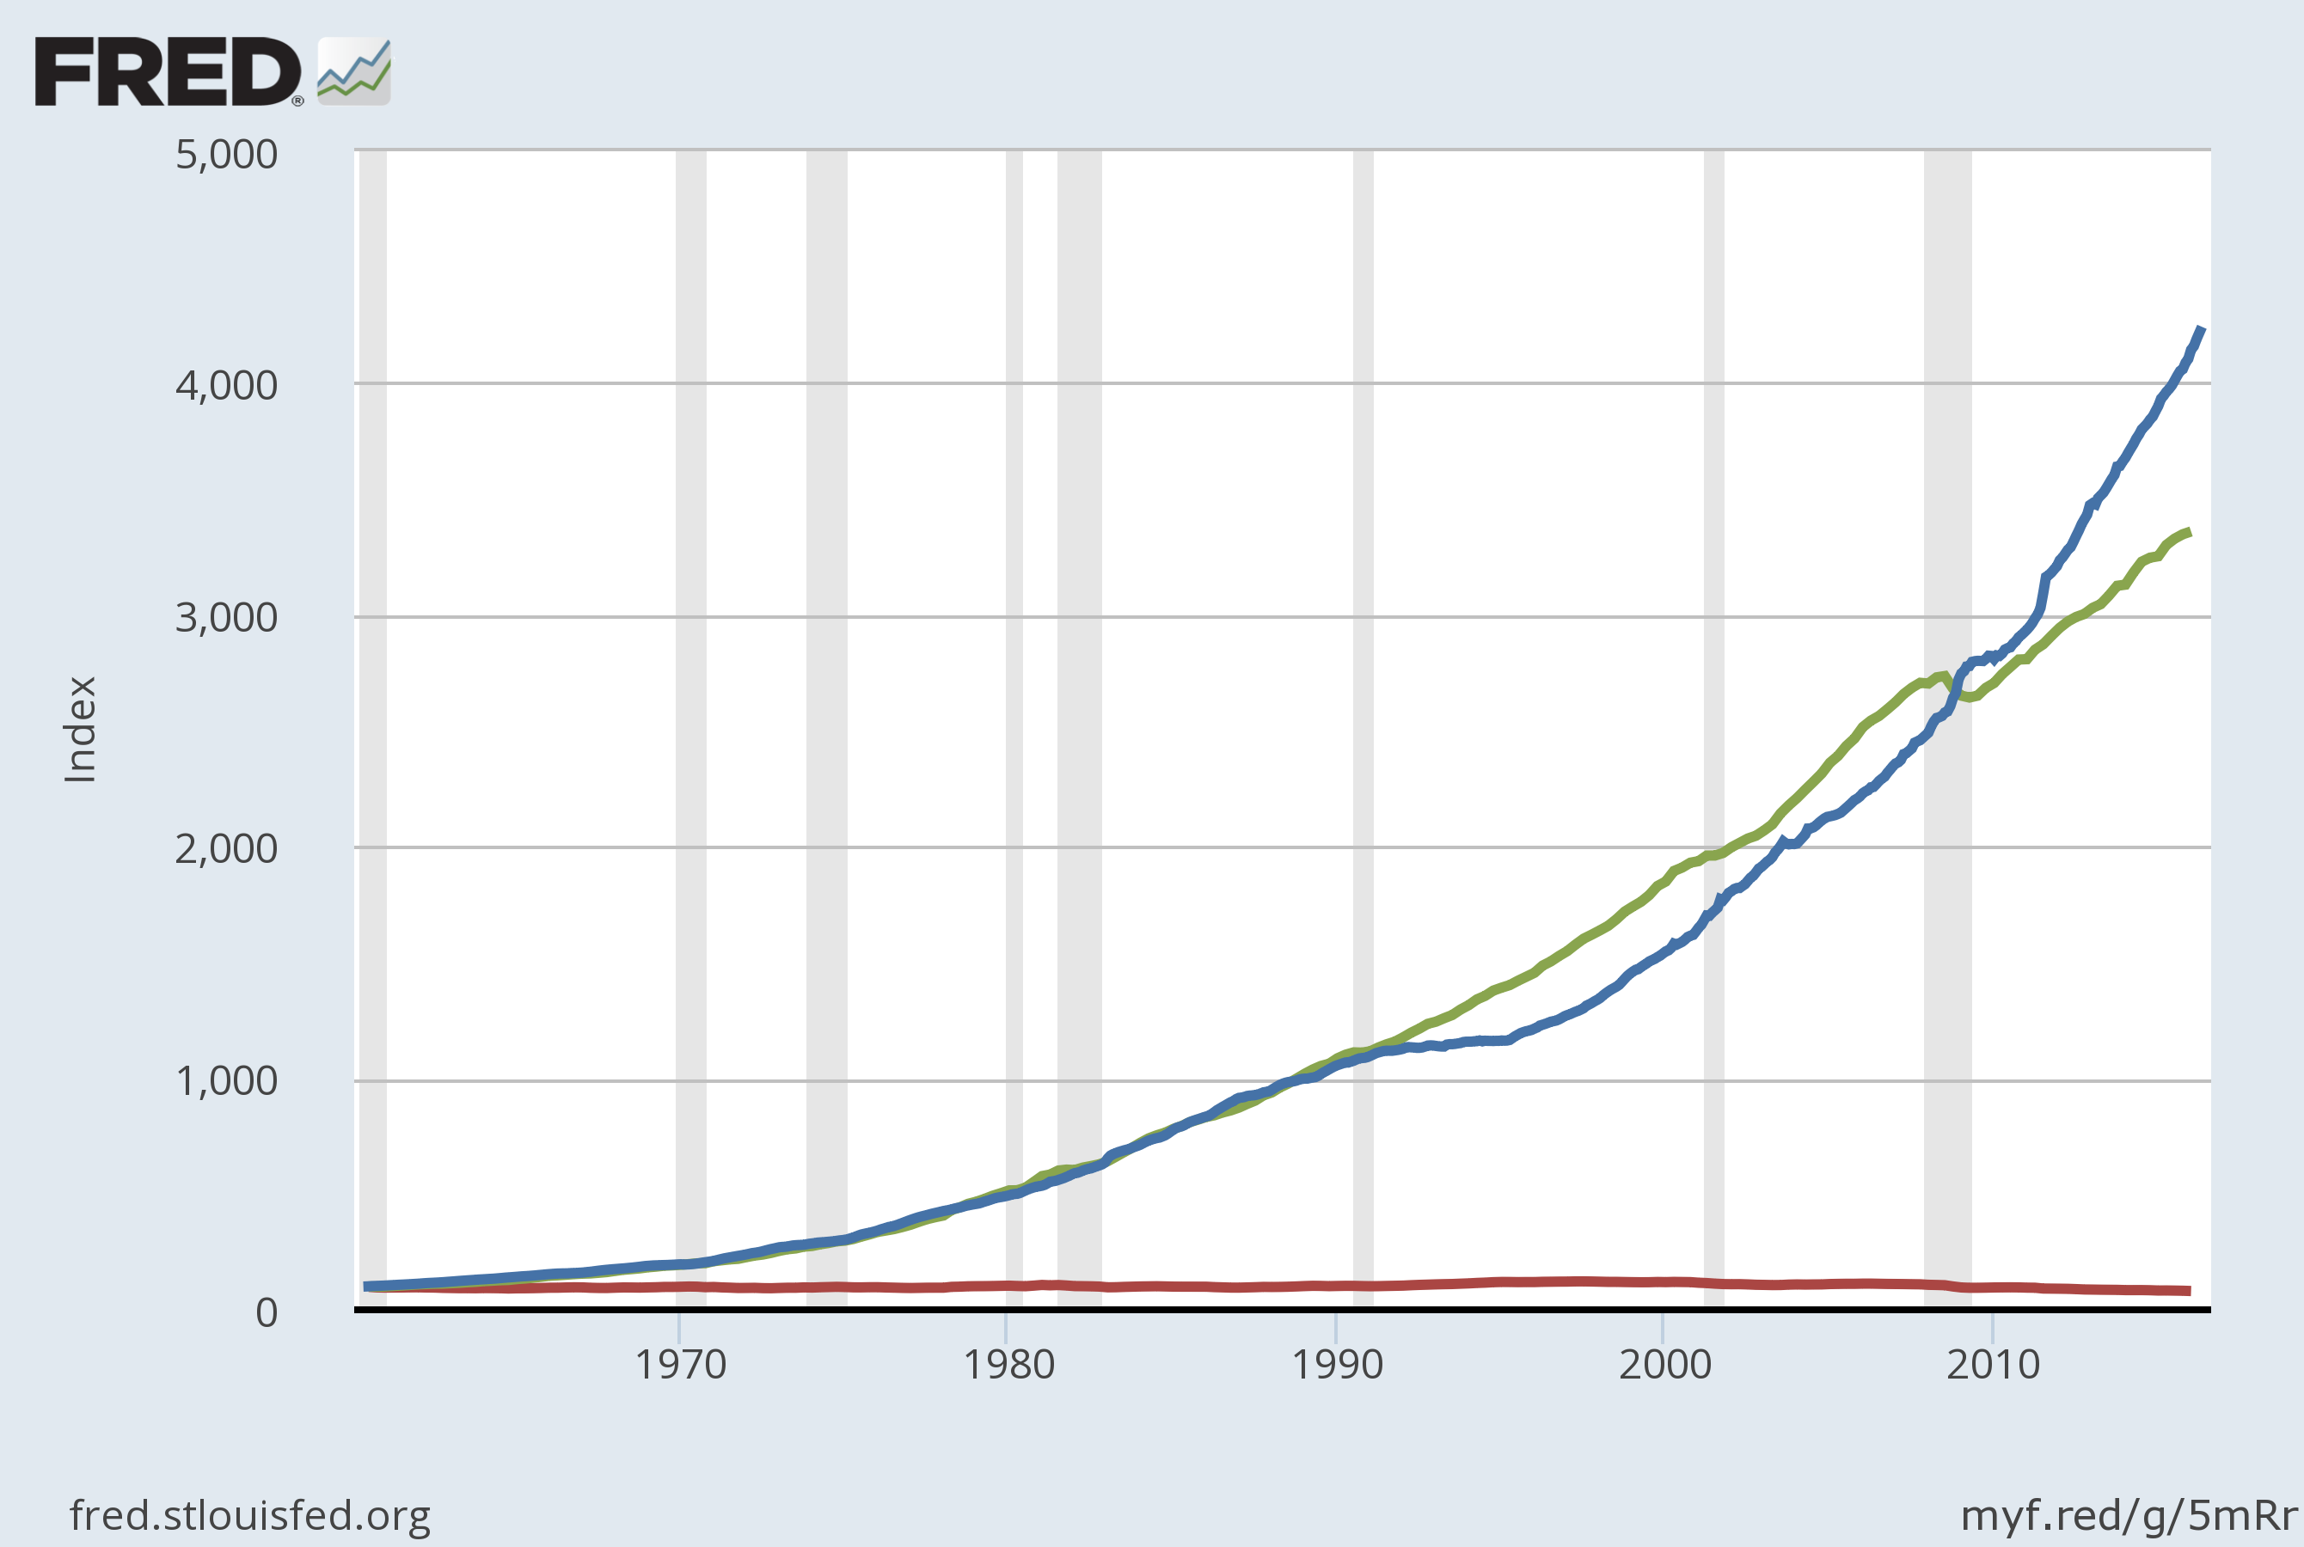
U.S. Nominal GDP, M2, and Velocity 1960–2016
Velocity is fairly stable over the long run.
Nominal GDP
M2
1960=100
Velocity
Notes:
Note: Each variable has been scaled to equal 100 to make variables comparable.
This graph replicates Figure 3 in the textbook. Its purpose is to demonstrate that velocity is fairly stable over time. This observation justifies the assumption of constant velocity in the quantity theory of money.
Original sources:
M2 is from Board of Governors, Federal Reserve Board
GDP is from U.S. Department of Commerce, Bureau of Economic Analysis.
I obtained all data from FRED database, Federal Reserve Bank of St. Louis, at:
http://research.stlouisfed.org/fred2/
Board of Governors of the Federal Reserve System (US), M2 Money Stock [M2], retrieved from FRED, Federal Reserve Bank of St. Louis; https://fred.stlouisfed.org/series/M2, July 11, 2016.
Federal Reserve Bank of St. Louis, Velocity of M2 Money Stock [M2V], retrieved from FRED, Federal Reserve Bank of St. Louis; https://fred.stlouisfed.org/series/M2V, July 11, 2016.
US. Bureau of Economic Analysis, Gross Domestic Product [GDP], retrieved from FRED, Federal Reserve Bank of St. Louis; https://fred.stlouisfed.org/series/GDP, July 11, 2016.

Slide 26
The Quantity Theory
The quantity equation: M x V = P x Y
  V is stable.
  A change in M causes nominal GDP (P x Y) to change by the same percentage.
  A change in M does not affect Y: money is neutral, Y is determined by technology & resources
  So, P changes by same percentage as
  P x Y and M.
  Rapid money supply growth causes rapid inflation.
Notes:
Velocity V = P x Y / M

Slide 27
Active Learning 2 Quantity Theory of Money
One good: corn. The economy has enough labor, capital, and land to produce Y = 800 bushels of corn. V is constant. In 2014, MS = $2000, P = $5/bushel.
For 2015, the Fed increases MS by 5%, to $2100.
Compute the 2015 values of nominal GDP and P. Compute the inflation rate for 2014–2015.
Suppose tech. progress causes Y to increase to 824 in 2015. Compute 2014–2015 inflation rate.
Notes:
This exercise makes the quantity theory more concrete for students.
If you’re pressed for time, you can delete part b or ask students to do it on their own.

Slide 28
Active Learning 2 Answers
Y = 800, V is constant.
In 2014, MS = $2000, P = $5/bushel.
For 2015, the Fed increases MS by 5%, to $2100.
Compute the 2015 values of nominal GDP and P. Compute the inflation rate for 2014–2015.
  2014: P x Y = M x V, so V= 2
  2015: nominal GDP = P x Y = M x V = 2100 x 2 = $4200
  2015: P = M x V / Y = 4200/800 = $5.25
  Inflation rate 2014-2015 = (5.25 – 5.00)/5.00 = 5% (same as MS!)

Slide 29
Active Learning 2 Answers
Y = 800, V is constant.
In 2014, MS = $2000, P = $5/bushel.
For 2015, the Fed increases MS by 5%, to $2100.
Suppose tech. progress causes Y to increase to 824 in 2015. Compute 2014–2015 inflation rate.
  2015: P = M x V / Y = 4200/824 = $5.10
  Inflation rate 2014-2015 = (5.10 – 5.00)/5.00 = 2%

Slide 30
Lessons about the quantity theory of money
If real GDP is constant,
  Then inflation rate = money growth rate.
If real GDP is growing,
  Then inflation rate < money growth rate.
The bottom line:
  Economic growth increases # of transactions.
  Some money growth is needed for these extra transactions.
  Excessive money growth causes inflation.
Notes:
From Active Learning 2 we can draw some conclusions.

Slide 31
Hyperinflation
Hyperinflation
  Inflation exceeding 50% per month.
Prices rise when the government prints too much money.
  Excessive growth in the money supply always causes hyperinflation.

Slide 32

Hyperinflation in Zimbabwe
Large government budget deficits
  Led to the creation of large quantities of money and high inflation rates.
Sign posted in public restroom
date | Zim$ per US$
Aug 2007 | 245
Apr 2008 | 29,401
May 2008 | 207,209,688
June 2008 | 4,470,828,401
July 2008 | 26,421,447,043
Feb 2009 | 37,410,030
Sept 2009 | 355
Notes:
Source of exchange rate data on this slide:
http://www.oanda.com/currency/historical-rates/

Slide 33
The Inflation Tax
The inflation tax
  Revenue the government raises by creating (printing) money
  Like a tax on everyone who holds money
    When the government prints money
    The price level rises
    And the dollars in your wallet are less valuable
  In the U.S., the inflation tax today accounts for less than 3% of total revenue
Notes:
When tax revenue is inadequate and ability to borrow is limited, government may print money to pay for its spending.
Almost all hyperinflations start this way.
The revenue from printing money is the inflation tax: printing money causes inflation, which is like a tax on everyone who holds money.

Slide 34
The Fisher Effect
Principle of monetary neutrality
  An increase in the rate of money growth raises the rate of inflation but does not affect any real variable
Because
  Real interest rate = Nominal interest rate – Inflation rate
We get
  Nominal interest rate = Real interest rate + Inflation rate
Notes:
The real interest rate is determined by saving & investment in the loanable funds market.
Money supply growth determines inflation rate.
Rearranging the definition of the real interest rate we get Nominal interest rate.

Slide 35
The Fisher Effect
Fisher effect
  One-for-one adjustment of nominal interest rate to inflation rate
  When the Fed increases the rate of money growth
  Long-run result
    Higher inflation rate
    Higher nominal interest rate
Notes:
In the long run, money is neutral: a change in the money growth rate affects the inflation rate but not the real interest rate.
So, the nominal interest rate adjusts one-for-one with changes in the inflation rate:
Nominal interest rate = Real interest rate + Inflation rate. This relationship is called the Fisher effect after Irving Fisher, who studied it.
The inflation tax applies to people’s holdings of money, not their holdings of wealth.
The Fisher effect: an increase in inflation causes an equal increase in the nominal interest rate, so the real interest rate (on wealth) is unchanged.

Slide 36
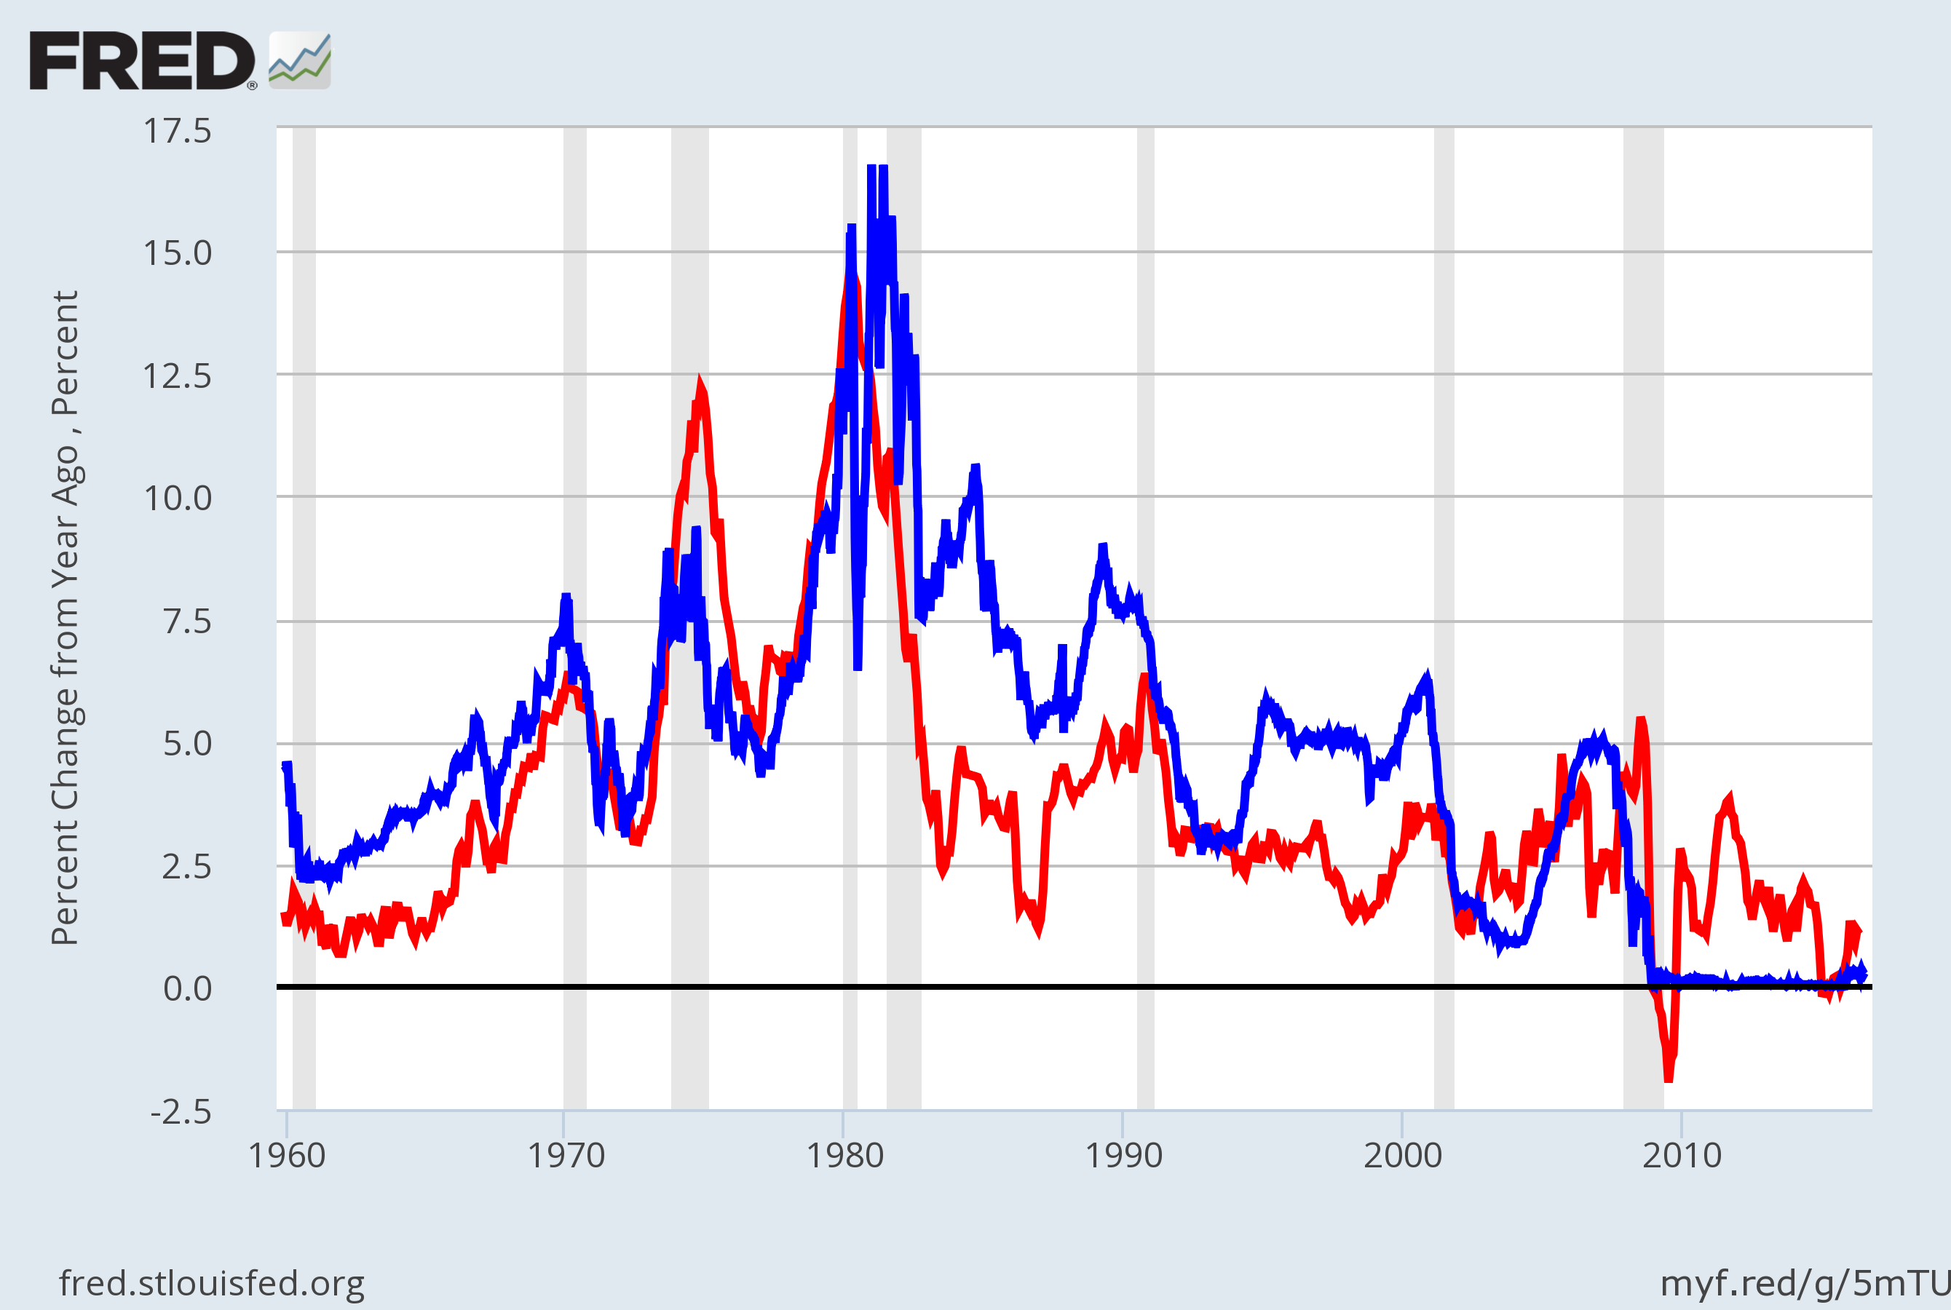
U.S. Nominal Interest & Inflation Rates, 1960–2016
The close relation between these variables is evidence for the Fisher effect.
Nominal interest rate
Inflation rate
Notes:
The nominal interest rate is the 3-month Treasury Bill rate. The inflation rate is calculated as the percent change in the CPI from 12 months earlier.
Mostly, these two variables move very closely together: increases in inflation correspond to similar increases in the nominal interest rate.
When the two variables are not moving precisely together, the real interest rate is changing. This would occur if, for example, there were changes in the supply and/or demand for loanable funds. Starting in the early 1980s, the emergence of huge budget deficits caused the supply of loanable funds to fall, which increased the real interest rate. On this graph, the gap between the nominal interest rate and inflation rate clearly grows in the early 1980s.
Original sources:
CPI, not seasonally adjusted: Bureau of Labor Statistics, U.S. Department of Labor
Treasury Bill rate: Board of Governors of the Federal Reserve System
Where I obtained this data:
FRED database, Federal Reserve Bank of St. Louis
http://research.stlouisfed.org/fred2/
US. Bureau of Labor Statistics, Consumer Price Index for All Urban Consumers: All Items [CPIAUCSL], retrieved from FRED, Federal Reserve Bank of St. Louis; https://fred.stlouisfed.org/series/CPIAUCSL, July 11, 2016.
Board of Governors of the Federal Reserve System (US), 3-Month Treasury Bill: Secondary Market Rate [WTB3MS], retrieved from FRED, Federal Reserve Bank of St. Louis; https://fred.stlouisfed.org/series/WTB3MS, July 11, 2016.

Slide 37
The Costs of Inflation
Inflation fallacy
  “Inflation robs people of the purchasing power of his hard-earned dollars”
When prices rise
  Buyers pay more
  Sellers get more
Inflation does not in itself reduce people’s real purchasing power
Notes:
Inflation is a general increase in prices of the things people buy and the things they sell (e.g., their labor).
In the long run, real incomes are determined by real variables, not the inflation rate.

Slide 38
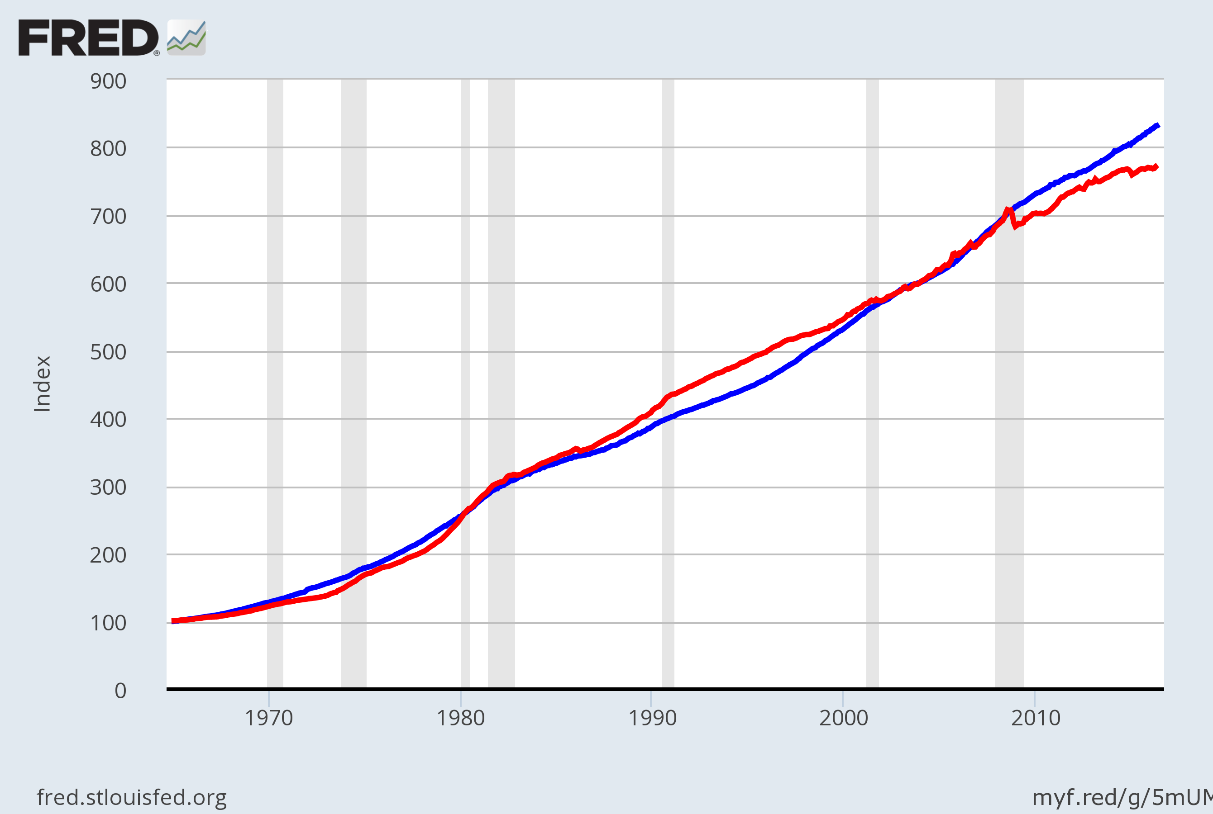
U.S. Average Hourly Earnings & the CPI 1965 - 2016
Inflation causes
the CPI and
nominal wages
to rise together over the long run.
Nominal wage
CPI
Notes:
This graph is not in the textbook, but it helps expose the inflation fallacy.
Both series are normalized to equal 100 in December 1964. The graph shows that the cost of living has risen dramatically since 1965—but the nominal wage has kept up with inflation. If the inflation fallacy were true, the nominal wage would have risen at a slower rate than the CPI.
Source: The nominal wage is average hourly earnings, total for private sector, seasonally adjusted, from the Bureau of Labor Statistics, U.S. Department of Labor. The CPI in this graph is seasonally adjusted, also from the BLS.
US. Bureau of Labor Statistics, Average Hourly Earnings of Production and Nonsupervisory Employees: Total Private [AHETPI], retrieved from FRED, Federal Reserve Bank of St. Louis; https://fred.stlouisfed.org/series/AHETPI, July 11, 2016.
US. Bureau of Labor Statistics, Consumer Price Index for All Urban Consumers: All Items [CPIAUCSL], retrieved from FRED, Federal Reserve Bank of St. Louis; https://fred.stlouisfed.org/series/CPIAUCSL, July 11, 2016.

Slide 39
The Costs of Inflation
Shoeleather costs
  Resources wasted when inflation encourages people to reduce their money holdings
  Can be substantial
Menu costs
  Costs of changing prices
  Inflation – increases menu costs that firms must bear
Notes:
Shoeleather costs: includes the time and transactions costs of more frequent bank withdrawals
Menu costs: printing new menus, mailing new catalogs, etc.

Slide 40
The Costs of Inflation
Misallocation of resources from relative-price variability:
  Firms don’t all raise prices at the same time, so relative prices can vary
    Distorts the allocation of resources
Confusion and inconvenience:
  Inflation changes the yardstick we use to measure transactions
    Complicates long-range planning and the comparison of dollar amounts over time

Slide 41
The Costs of Inflation
Tax distortions:
  Inflation makes nominal income grow faster than real income.
  Taxes are based on nominal income,
  and some are not adjusted for inflation.
  So, inflation causes people to pay more taxes even when their real incomes don’t increase.

Slide 42
Active Learning 3 Tax distortions
You deposit $1000 in the bank for one year.
CASE 1: inflation = 0%, nom. interest rate = 10%
CASE 2: inflation = 10%, nom. interest rate = 20%
In which case does the real value of your deposit grow the most?
Assume the tax rate is 25%.
In which case do you pay the most taxes?
Compute the after-tax nominal interest rate,
then subtract inflation to get the after-tax real interest rate for both cases.
Notes:
Most principles-level students have difficulty the first time they are asked to calculate the after-tax real interest rate because the calculation involves several intermediate steps. The intermediate steps are, at first, not obvious to most students. This exercise walks students through these steps.
The exercise leads students to see for themselves that inflation reduces the after-tax real interest rate.
Suggestion: Display this slide, and give students 3-4 minutes to work the problem on their own.

Slide 43
Active Learning 3 Answers
Deposit $1000.
CASE 1: inflation = 0%, nom. interest rate = 10%
CASE 2: inflation = 10%, nom. interest rate = 20%
In which case does the real value of your deposit grow the most?
In both cases, the real interest rate is 10%,
so the real value of the deposit grows 10% (before taxes).
Notes:
Suggestion: If you can spare the class time, ask students for the answers before you display them.

Slide 44
Active Learning 3 Answers
Deposit $1000. Tax rate =25%.
CASE 1: inflation = 0%, nom. interest rate = 10%
CASE 2: inflation = 10%, nom. interest rate = 20%
In which case do you pay the most taxes?
CASE 1: interest income = $100,
so you pay $25 in taxes.
CASE 2: interest income = $200,
so you pay $50 in taxes.

Slide 45
Active Learning 3 Answers
Deposit $1000. Tax rate =25%.
CASE 1: inflation = 0%, nom. interest rate = 10%
CASE 2: inflation = 10%, nom. interest rate = 20%
Compute the after-tax nominal interest rate,
then subtract inflation to get the after-tax real interest rate for both cases.
CASE 1: nominal = 0.75 x 10% = 7.5%
real = 7.5% – 0% = 7.5%
CASE 2: nominal = 0.75 x 20% = 15%
real = 15% – 10% = 5%

Slide 46
Active Learning 3 Summary and lessons
Deposit $1000. Tax rate =25%.
CASE 1: inflation = 0%, nom. interest rate = 10%
CASE 2: inflation = 10%, nom. interest rate = 20%
Inflation…
raises nominal interest rates (Fisher effect) but not real interest rates
increases savers’ tax burdens
lowers the after-tax real interest rate
Notes:
By lowering the after-tax interest rate, inflation reduces the incentive to save. Recall that saving is critically important for future productivity and living standards.

Slide 47
Arbitrary Redistributions of Wealth
Unexpected inflation
  Redistributes wealth among the population
    Not by merit
    Not by need
  Redistribute wealth among debtors and creditors
Inflation: volatile and uncertain
  When the average rate of inflation is high
Notes:
For many students, this is one of the harder concepts of the chapter. You might consider asking students to work through Problem 10 in the “Problems and Applications” at the end of this chapter for practice with this concept.
Higher-than-expected inflation transfers purchasing power from creditors to debtors: Debtors get to repay their debt with dollars that aren’t worth as much.
Lower-than-expected inflation transfers purchasing power from debtors to creditors.
High inflation is more variable and less predictable than low inflation. So, these arbitrary redistributions are frequent when inflation is high.

Slide 48
The Costs of Inflation
All these costs
  Are quite high for economies experiencing hyperinflation.
For economies with low inflation (< 10% per year),
  These costs are probably much smaller,
  though their exact size is open to debate.

Slide 49
Conclusion
Prices rise when the government prints too much money.
  We saw that money is neutral in the long run, affecting only nominal variables
In later chapters
  Money has important effects in the short run on real variables like output and employment
Notes:
The first sentence is one of the Ten Principles.

Slide 50
Summary
To explain inflation in the long run, economists use the quantity theory of money.
  The price level depends on the quantity of money, and the inflation rate depends on the money growth rate.
The classical dichotomy is the division of variables into real and nominal. The neutrality of money is the idea that changes in the money supply affect nominal variables but not real ones. Most economists believe these ideas describe the economy in the long run.

Slide 51
Summary
The inflation tax is the loss in the real value of people’s money holdings when the government causes inflation by printing money.
The Fisher effect is the one-for-one relation between changes in the inflation rate and changes in the nominal interest rate.
The costs of inflation include menu costs, shoeleather costs, confusion and inconvenience, distortions in relative prices and the allocation of resources, tax distortions, and arbitrary redistributions of wealth.

