Slide 1
Chapter 1
Introducing Economic Development:
A Global Perspective

Slide 2
1.1 How the Other Half Live
When one is poor, she has no say in public, she feels inferior. She has no food, so there is famine in her house; no clothing, and no progress in her family.
—A poor woman from Uganda
For a poor person everything is terrible—illness, humiliation, shame. We are cripples; we are afraid of everything; we depend on everyone. No one needs us. We are like garbage that everyone wants to get rid of.
—A blind woman from Tiraspol, Moldova
Life in the area is so precarious that the youth and every able person have to migrate to the towns or join the army at the war front in order to escape the hazards of hunger escalating over here.
—Participant in a discussion group in rural Ethiopia

Slide 3
1.1 How the Other Half Live
When food was in abundance, relatives used to share it. These days of hunger, however not even relatives would help you by giving you some food. —Young man in Nichimishi, Zambia
We have to line up for hours before it is our turn to draw water. —Mbwadzulu Village (Mangochi), Malawi
[Poverty is] . . . low salaries and lack of jobs. And it’s also not having medicine, food, and clothes. --Discussion group, Brazil
Don’t ask me what poverty is because you have met it outside my house. Look at the house and count the number of holes. Look at the utensils and the clothes I am wearing. Look at everything and write what you see. What you see is poverty. —Poor man in Kenya
A universal theme reflected in these seven quotes is that poverty is more than lack of income – it is inherently multidimensional, as is economic development.

Slide 4
1.2 Economics and Development Studies
  The Nature of Development Economics
    Greater scope than traditional neoclassical economics and political economy.
  Why Study Development Economics? Some Critical Questions
  The Important Role of Values in Development Economics

Slide 5
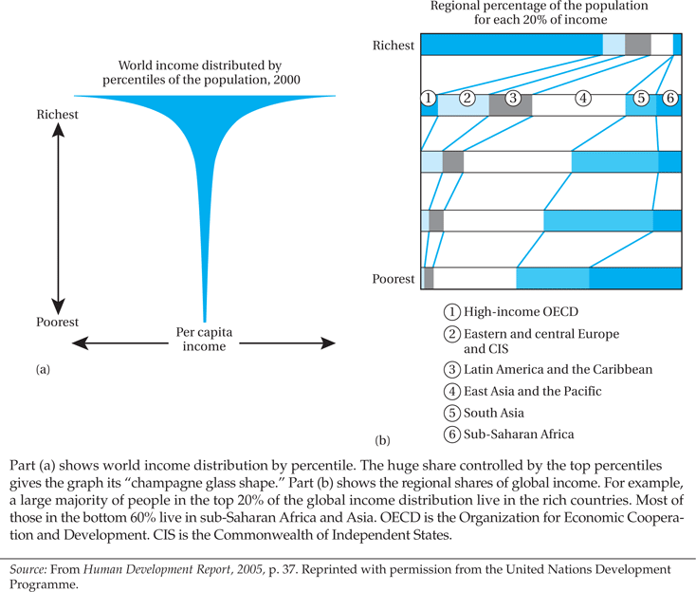
Figure 1.1 World Income Distribution

Slide 6
1.2 Economics and Development Studies
Economies as Social Systems: The Need to Go Beyond Simple Economics
Social Systems
  Interdependent relationships between economic and non-economic factors
Success or failure of development policy
  Importance of taking account of institutional and structural variables along with more traditional economic variables

Slide 7
1.3 What Do We Mean by Development?
Traditional Economic Measures
  Gross National Income (GNI)
  Income per capita
  Utility of that income?
The New Economic View of Development
  Leads to improvement in wellbeing, more broadly understood
Amartya Sen’s “Capability” Approach
  Functionings as an achievement
  Capabilities as freedoms enjoyed in terms of functionings
  Development and happiness
  Well being in terms of being well and having freedoms of choice
  “Beings and Doings”:

Slide 8
Some Key “Capabilities”
Some Important “Beings” and “Doings” in Capability to Function:
  Being able to live long
  Being well-nourished
  Being healthy
  Being literate
  Being well-clothed
  Being mobile
  Being able to take part in the life of the community
  Being happy – as a state of being - may be valued as a functioning

Slide 9
1.3 What Do We Mean by Development? (cont’d)
Three Core Values of Development
  Sustenance: The Ability to Meet Basic Needs
  Self-Esteem: To Be a Person
  Freedom from Servitude: To Be Able to Choose

Slide 10
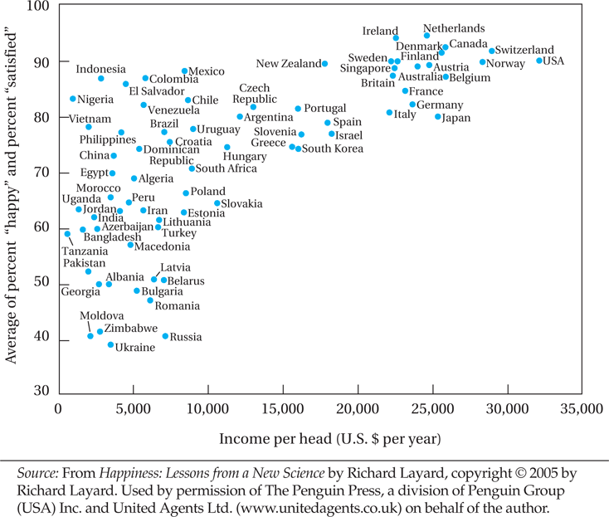
Figure 1.2 Income and Happiness: Comparing Countries

Slide 11
1.3 What Do We Mean by Development? (cont’d)
The Central Role of Women
  To make the biggest impact on development, societies must empower and invest in women
The Three Objectives of Development
  Increase availability of life-sustaining goods
  Raise levels of living
  Expand range of economic and social choices

Slide 12
1.4 The Millennium Development Goals
Millennium Development goals (MDGs)
  Eight goals adopted by the United Nations in 2000
    Eradicate extreme poverty and hunger
    Achieve universal primary education
    Promote gender equality and empower women
    Reduce child mortality
    Improve maternal health
    Combat HIV/AIDS, malaria, and other diseases
    Ensure environmental sustainability
    Develop a global partnership for development

Slide 13
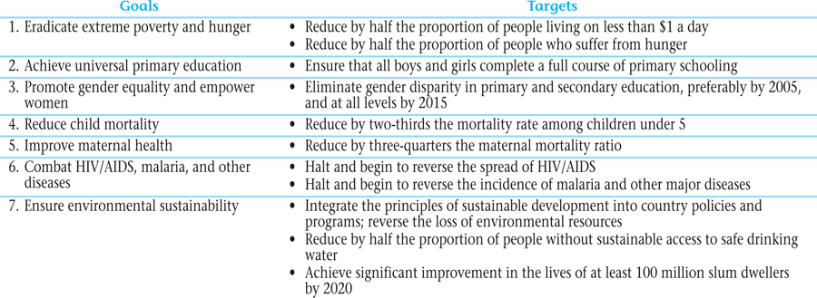
Table 1.1 Millennium Development Goals and Targets for 2015

Slide 14
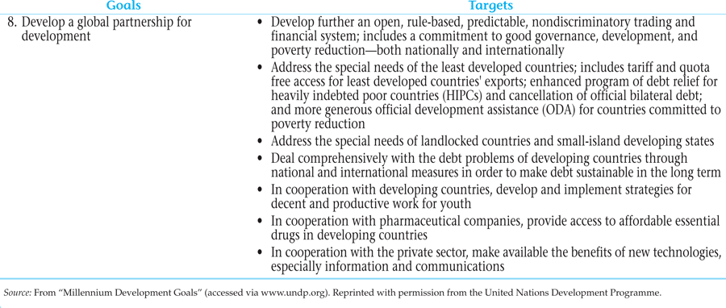
Table 1.1 Millennium Development Goals and Targets for 2015 (cont’d)

Slide 15
1.5 Conclusions
The importance of Development Economics
Inclusion of non-economic variables in designing development strategies
Achieving the Millennium Development Goals
“…One future-or none at all”

Slide 16
Concepts for Review
Absolute Poverty
Attitudes
Capabilities
Developing countries
Development
Development economics
Freedom
Functionings
Globalization
Gross domestic product
Gross national income (GNI)
Income per capita
Institutions
Less developed countries (LDCs)
Millennium Development Goals (MDGs)
More developed countries (MDCs)
Political economy

Slide 17
Concepts for Review (cont’d)
Self-esteem
Social system
Subsistence economy
Sustenance
Traditional economics
Values

