Slide 1
Chapter 2
Comparative Economic Development

Slide 2
2.1 Defining the Developing World
World Bank Scheme- ranks countries on GNP/capita
  LIC, LMC, UMC, OECD (see Table 2.1 and Figure 2.1)

Slide 3
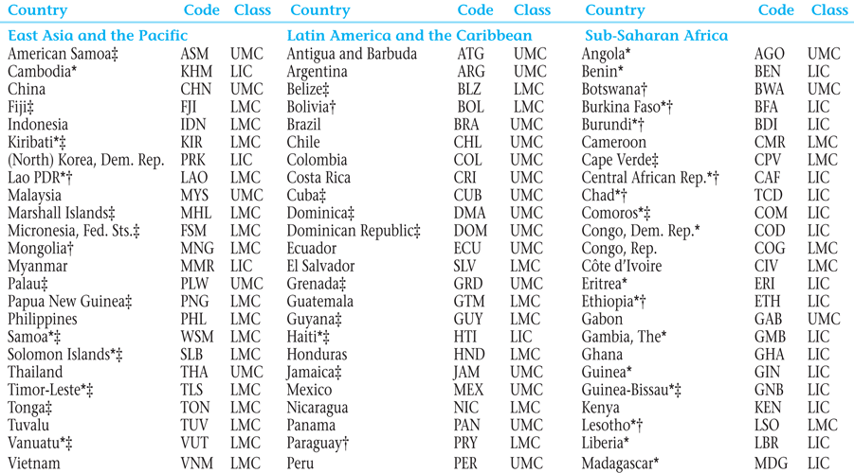
Table 2.1 Classification of Economies by Region and Income, 2013

Slide 4
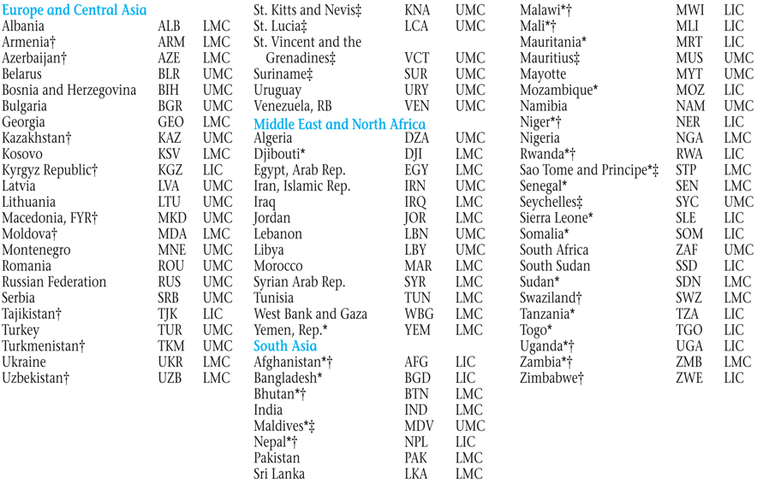
Table 2.1 Classification of Economies by Region and Income, 2013 (continued)

Slide 5
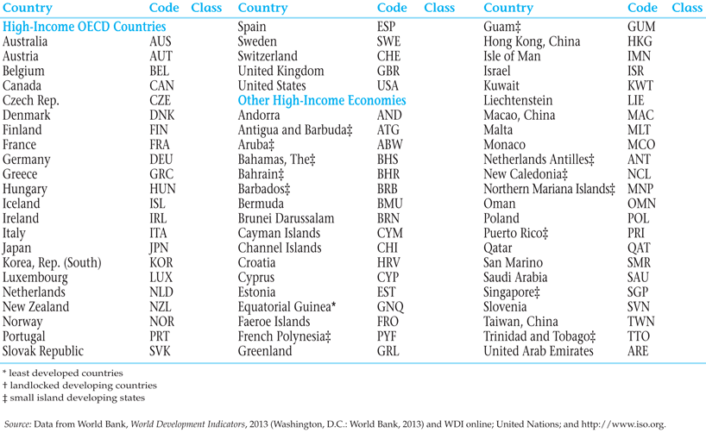
Table 2.1 Classification of Economies by Region and Income, 2013 (continued)

Slide 6
2.2 Basic Indicators of Development: Real Income, Health, and Education
Gross National Income (GNI)
Gross Domestic Product (GDP)
PPP method instead of exchange rates as conversion factors (see Figure 2.2)

Slide 7
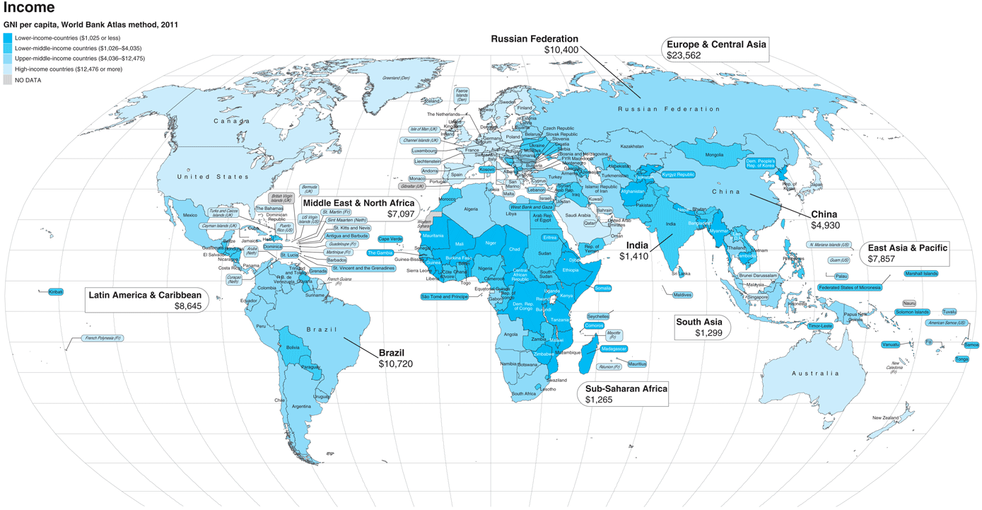
Figure 2.1 Nations of the World, Classified by GNI Per Capita
Source: Data from Atlas of Global Development, 4th ed., pp. 16-17: World Bank and Collins. 2013. ATLAS OF GLOBAL DEVELOPMENT: A VISUAL GUIDE TO THE WORLD’S GREATEST CHALLENGES, FOURTH EDITION. Washington, DC and Glasgow: World Bank and Collins. doi: 10.1596/978-0-8213-9757-2. License: Creative Commons Attribution CC BY 3.0

Slide 8
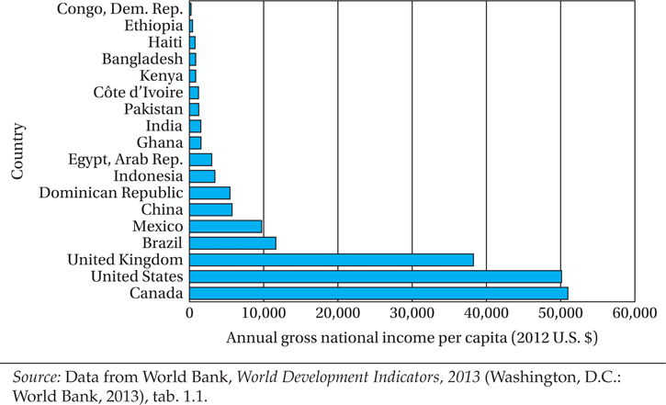
Figure 2.2 Income Per Capita in Selected Countries, 2011

Slide 9
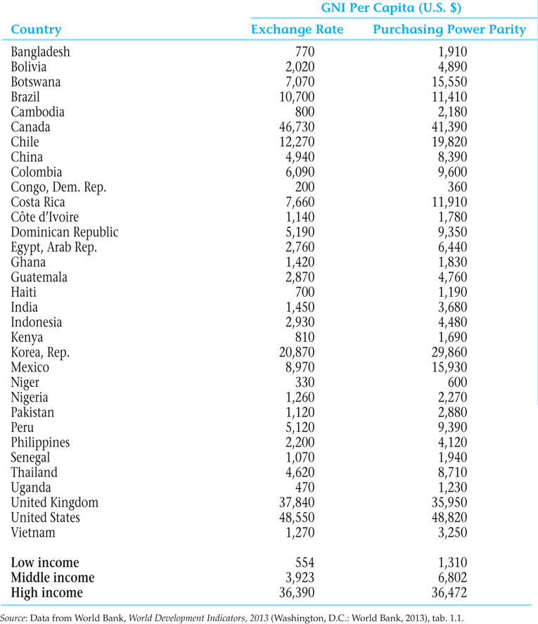
Table 2.2 A Comparison of Per Capita GNI in Selected Developing Countries, the United Kingdom, and the United States, Using Official Exchange-Rate and Purchasing Power Parity Conversions, 2011

Slide 10
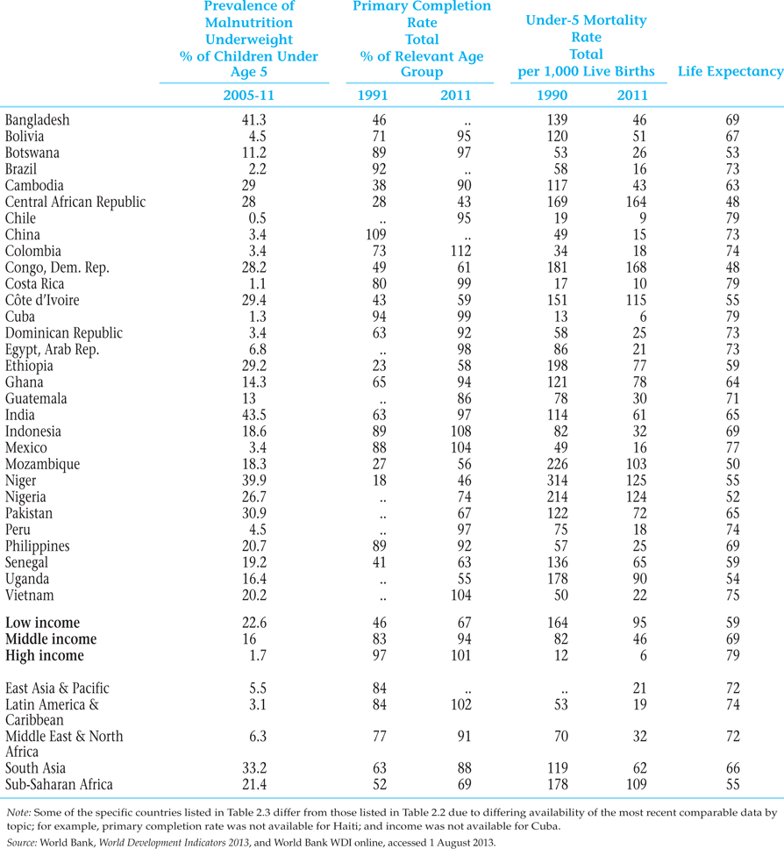
Table 2.3 Commonality and Diversity: Some Basic Indicators

Slide 11

2.3 Holistic Measures of Living Levels and Capabilities
Health
Life Expectancy
Education
HDI as a holistic measure of living levels
HDI can be calculated for groups and regions in a country
  HDI varies among groups within countries
  HDI varies across regions in a country
  HDI varies between rural and urban areas

Slide 12
2.3 Holistic Measures of Living Levels and Capabilities
The New Human Development Index
Introduced by UNDP in November 2010

Slide 13
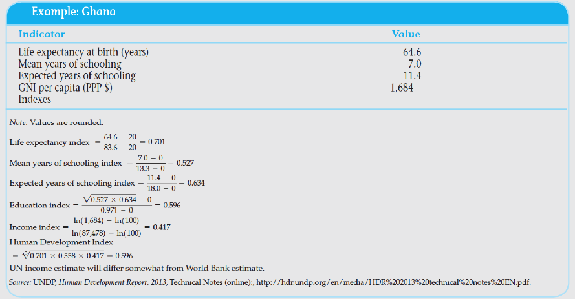
Box 2.1 Computing the New HDI: Ghana

Slide 14
What is new in the New HDI?
1. Calculating with a geometric mean
How does the New HDI compare with the better-known (but no longer active) Traditional HDI?
Probably most consequential: The index is now computed with a geometric mean, instead of an arithmetic mean
A geometric mean is also used to build up the overall education index from its two components
Traditional HDI added the three components and divided by 3
New HDI takes the cube root of the product of the three component indexes
The traditional HDI calculation assumed one component traded off against another as perfect substitutes, a strong assumption
The reformulation now allows for imperfect substitutability which development specialists widely consider a more plausible way to frame the tradeoffs.

Slide 15
What is new in the New HDI?
2. Other key changes:
Gross national income per capita replaces gross domestic product per capita
Revised education components: now using the average actual educational attainment of the whole population, and the expected attainment of today’s children
The maximum values in each dimension have been increased to the observed maximum rather than given a predefined cutoff
The lower goalpost for income has been reduced due to new evidence on lower possible income levels

Slide 16
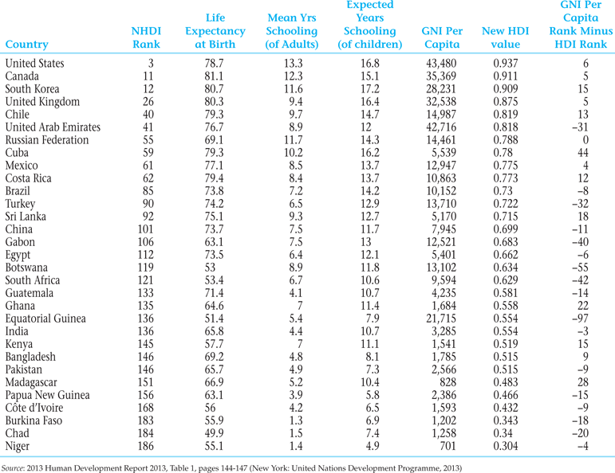
Table 2.4 2013 New Human Development Index and its Components for Selected Countries

Slide 17
2.4 Characteristics of the Developing World: Diversity within Commonality
These eight characteristics are common among developing countries – on average and with great diversity - in comparison with developed countries:
    1. Lower levels of living and productivity
    2. Lower levels of human capital (health, education, skills)
    3. Higher Levels of Inequality and Absolute Poverty
      Absolute Poverty
      World Poverty
    4. Higher Population Growth Rates
      Crude Birth rates

Slide 18
2.4 Characteristics of the Developing World: Diversity within Commonality
    5. Greater Social Fractionalization
    6. Larger Rural Populations but Rapid Rural-to-Urban Migration
    7. Lower Levels of Industrialization and Manufactured Exports
    8. Adverse Geography
      Resource endowments

Slide 19
2.4 Characteristics of the Developing World: Diversity within Commonality
9. Underdeveloped Financial and Other markets
  Imperfect markets
  Incomplete information
10. Colonial Legacy and External Dependence
  Institutions
  Private property
  Personal taxation
  Taxes in cash rather than in kind

Slide 20
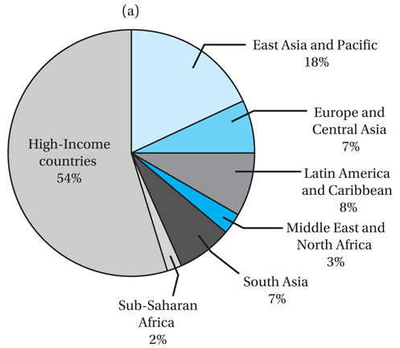
Figure 2.3a Shares of Global Income, 2008. (b) Developing regions lag far behind the developed world in productivity measured as output per worker.
Source: Figure 2.3a, Data from World Bank, World Development Indicators 2013 (Washington, D. C.: World Bank, 2013), p.24.

Slide 21
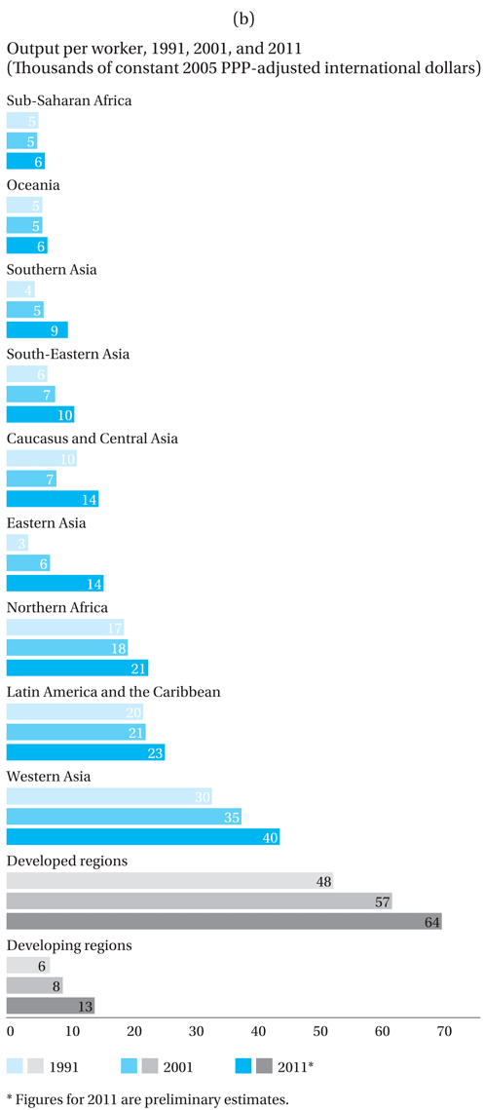
Figure 2.3b Developing regions lag far behind the developed world in productivity measured as output per worker.
Source: Figure 2.3b, United Nations, Millenium Development Goals Report 2012, p.9.

Slide 22
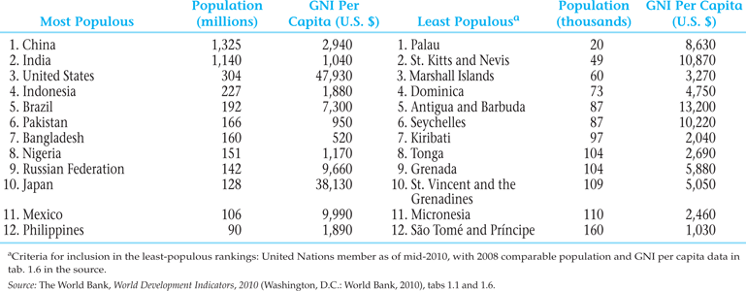
Table 2.5 The 12 Most and Least Populated Countries and Their Per Capita Income, 2008

Slide 23
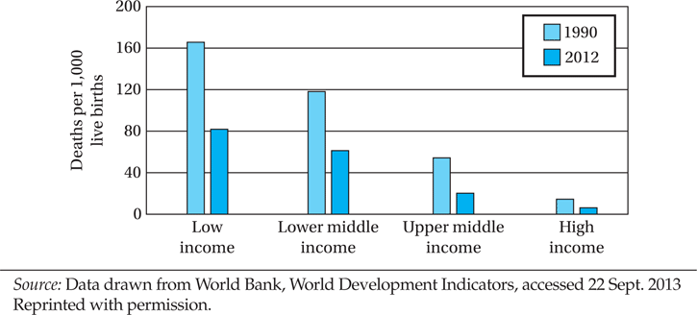
Figure 2.4 Under-5 Mortality Rates, 1990 and 2012

Slide 24
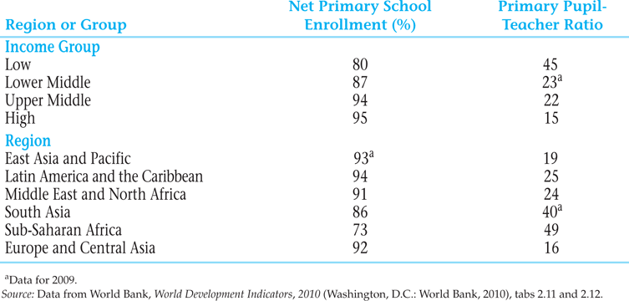
Table 2.6 Primary School Enrollment and Pupil-Teacher Ratios, 2010

Slide 25
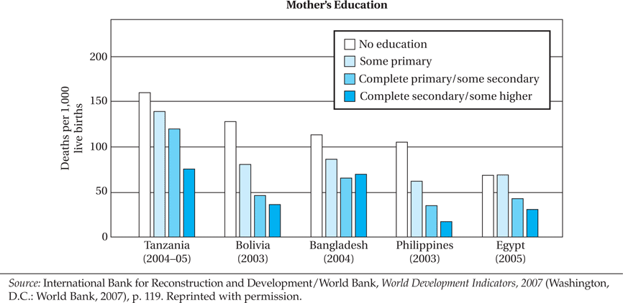
Figure 2.5 Correlation between Under-5 Mortality and Mother’s Education

Slide 26
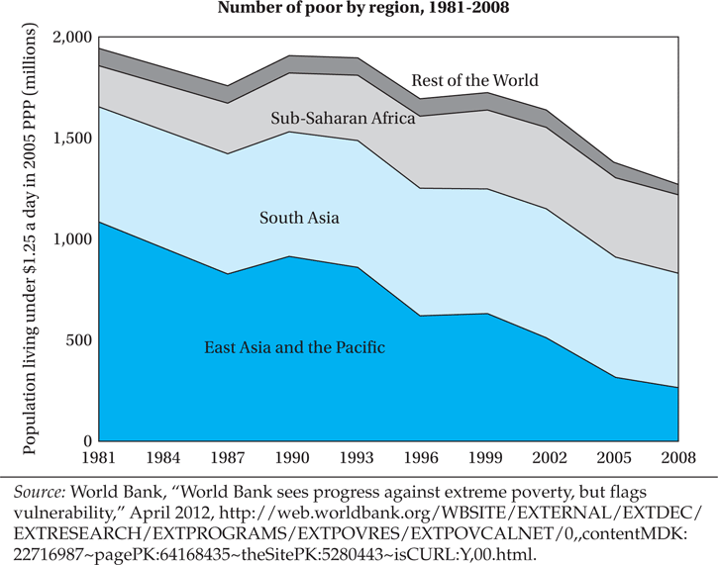
Figure 2.6 Number of People Living in Poverty by Region, 1981–2008

Slide 27
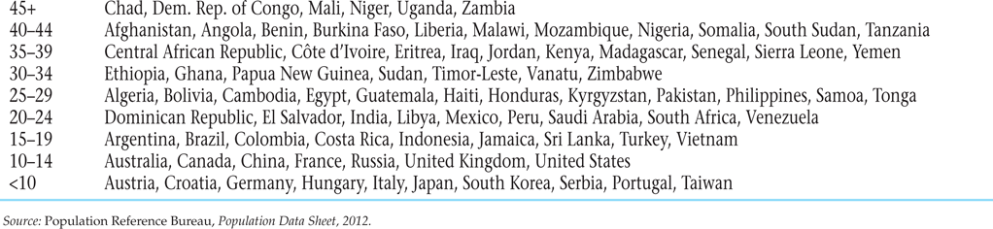
Table 2.7 Crude Birth Rates Around the World, 2012

Slide 28
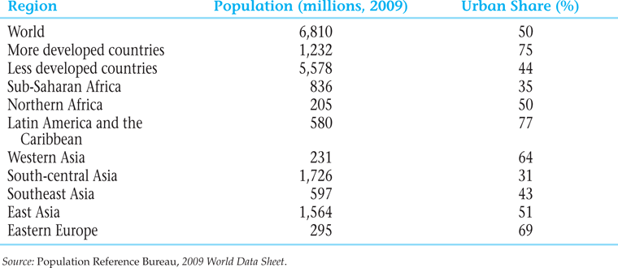
Table 2.8 The Urban Population in Developed Countries and Developing Regions

Slide 29
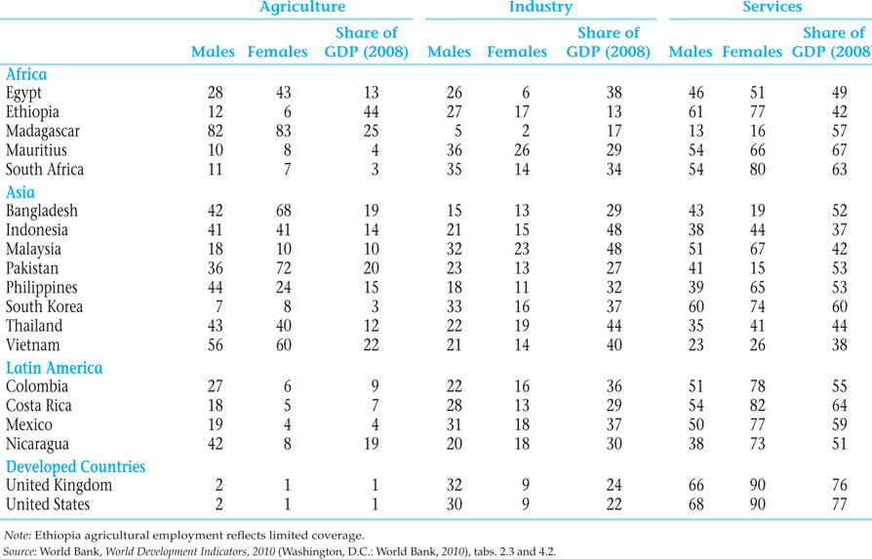
Table 2.9 Share of the Population Employed in the Agricultural, Industrial, and Service Sectors in Selected Countries, 2004–2008 (%)

Slide 30
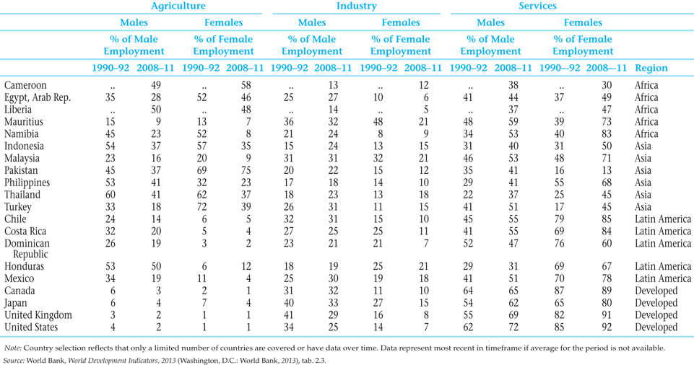
Table 2.10 Share of the Population Employed in the Agricultural, Industrial, and Service Sectors in Selected Countries, 1990–92 and 2008–2011 (%)

Slide 31
2.5 How Low-Income Countries Today Differ from Developed Countries in Their Earlier Stages
Eight differences
  Physical and human resource endowments
  Per capita incomes and levels of GDP in relation to the rest of the world
  Climate
  Population size, distribution, and growth
  Historic role of international migration
  International trade benefits
  Basic scientific/technological research and development capabilities
  Efficacy of domestic institutions

Slide 32
2.6 Are Living Standards of Developing and Devolved Nations Converging?
Evidence of unconditional convergence is hard to find
But there is increasing evidence of “per capita income convergence,” weighting changes in per capita income by population size
(Also, in chapter 3, we return to examine the concept of conditional convergence when we study the Solow model)

Slide 33
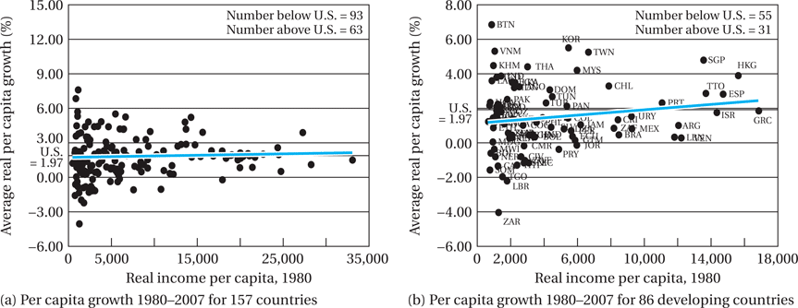
Figure 2.7 Relative Country Convergence: World, Developing Countries, and OECD (continued)

Slide 34
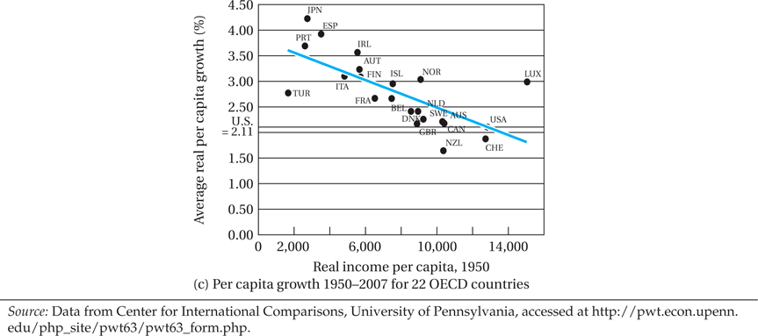
Figure 2.7 Relative Country Convergence: World, Developing Countries, and OECD

Slide 35
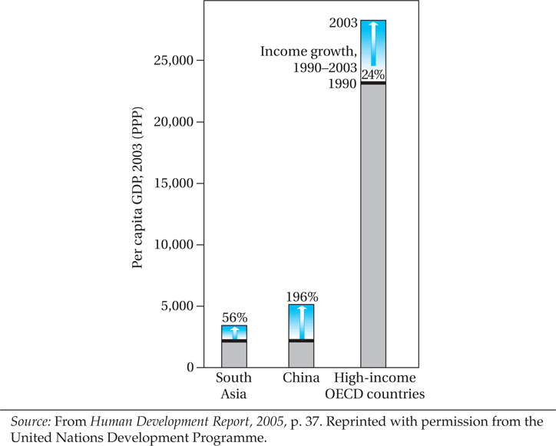
Figure 2.8 Growth Convergence versus Absolute Income Convergence

Slide 36
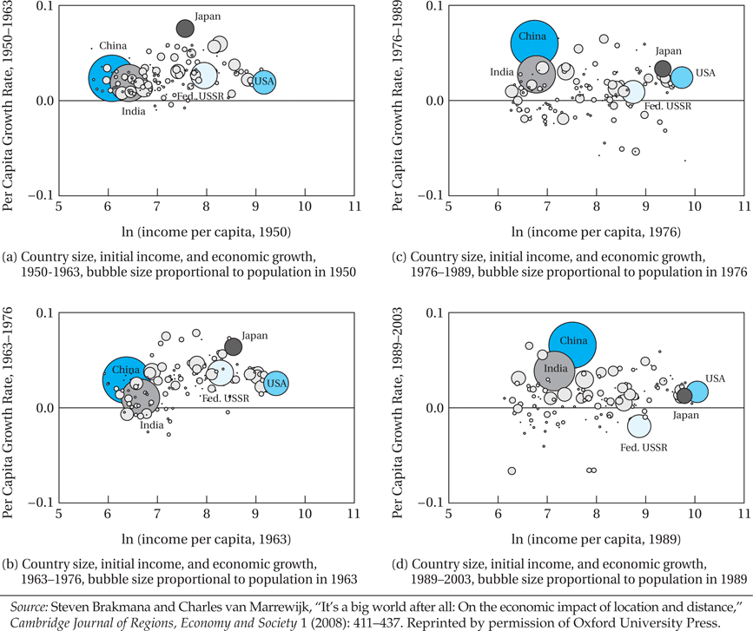
Figure 2.9 Country Size, Initial Income Level, and Economic Growth

Slide 37
2.7 Long-Run Causes of Comparative Development
Schematic Representation
  Geography
  Institutional quality- colonial and post-colonial
  Colonial legacy- pre colonial comparative advantage
  Evolution and timing of European development
  Inequality- human capital
  Type of colonial regime

Slide 38
Nature and Role of Economic Institutions
Institutions provide “rules of the game” of economic life
Provide underpinning of a market economy
Include property rights; contract enforcement
Can work for improving coordination,
Restricting coercive, fraudulent and anti-competitive behavior
Providing access to opportunities for the broad population-
Constraining the power of elites, and managing conflict
Provision of social insurance
Provision of predictable macroeconomic stability
Note: These institutions are correlated and it is not clear which of these institutions matter most; and “transitional institutions” may help in the development process

Slide 39
Role of Institutions
Acemoglu, Johnson, and Robinson’s “reversal of fortune” and extractive institutions
Bannerjee and Iyer, “property rights institutions.” Landlords versus cultivators

Slide 40
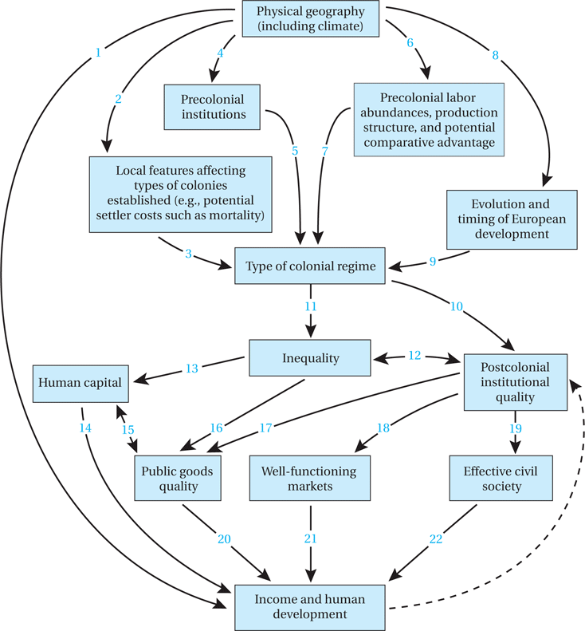
Figure 2.10 Schematic Representation of Leading Theories of Comparative Development

Slide 41
Concepts for Review
Absolute poverty
Brain drain
Capital stock
Convergence
Crude birth rate
Dependency burden
Depreciation (of the capital stock)
Diminishing Marginal Utility
Divergence
Economic Institutions
Fractionalization
Free trade
Gross domestic product (GDP)
Gross national income (GNI)
Human capital
Human Development Index (HDI)

Slide 42
Concepts for Review (cont’d)
Imperfect market
Incomplete information
Infrastructure
Least developed countries
Low-income countries (LICs)
Middle-income countries
Newly industrializing countries (NICs)
Purchasing power parity (PPP)
Research and development (R&D)
Resource endowment
Terms of trade
Value added
World Bank

Slide 43
Appendix 2.1 The Traditional Human Development Index (HDI)
Equation A2.6:

Slide 44
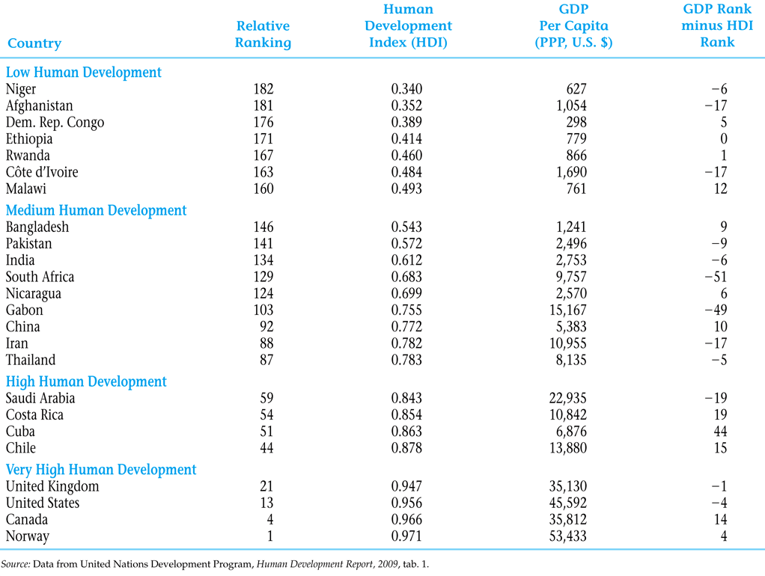
Table A2.1.1 2009 Traditional Human Development Index for 24 Selected Countries (2007 Data)

Slide 45
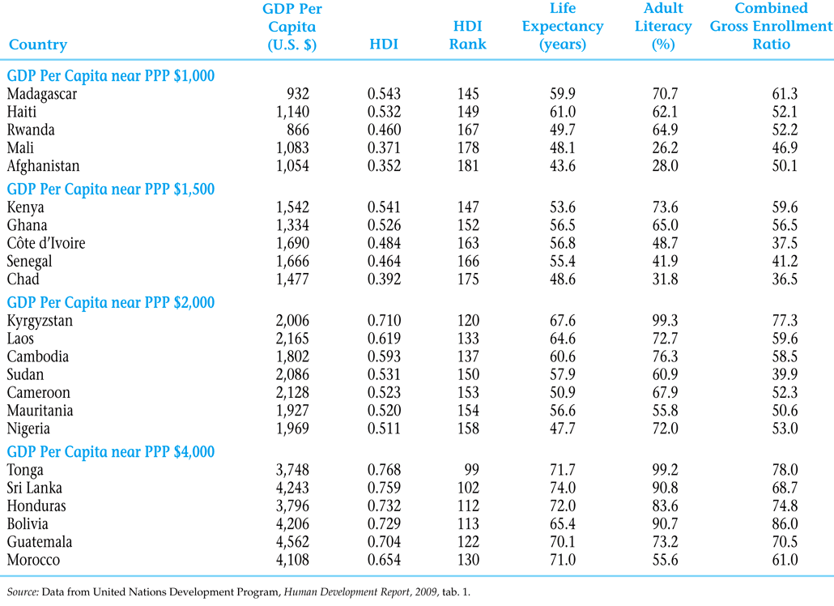
Table A2.1.2 2009 Human Development Index Variations for Similar Incomes (2007 Data)

Slide 46
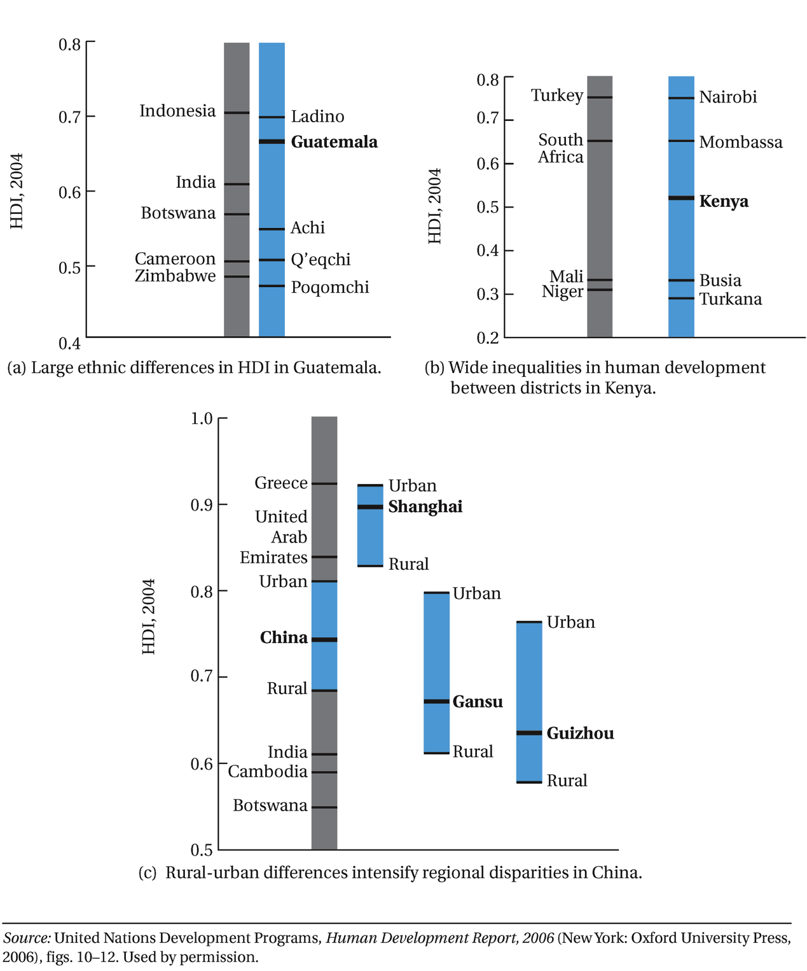
Figure A2.1.1 Human Development Disparities within Selected Countries

Slide 47
Figure A2.1.1 Human Development Disparities within Selected Countries (continued)

