Slide 1
Chapter 3
Classic Theories of Economic Growth and Development

Slide 2
3.1 Classic Theories of Economic Development: Four Approaches
Linear stages of growth model
Theories and Patterns of structural change
International-dependence revolution
Neoclassical, free market counterrevolution

Slide 3
3.2 Development as Growth and Linear-Stages Theories
A Classic Statement: Rostow’s Stages of Growth
Harrod-Domar Growth Model (sometimes referred to as the AK model)

Slide 4
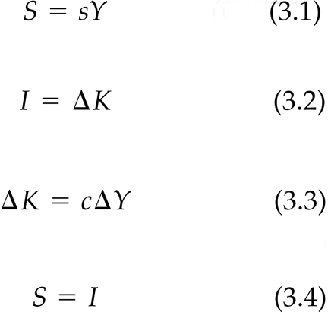
The Harrod-Domar Model - Simplified Version

Slide 5
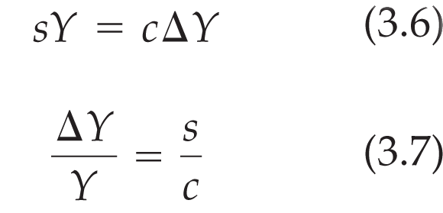
The Harrod-Domar Model - Simplified Version

Slide 6
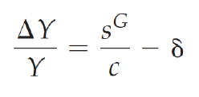
The Harrod-Domar Model – Incorporating Capital Depreciation
Equation 3.7 is also often expressed in terms of gross savings, in which case the growth rate is given by
  (3.7’)
  where δ is the rate of capital depreciation
But there is now growing evidence of “per capita income convergence,” weighting changes in per capita income by population size
(Also, in chapter 3, we return to examine the concept of conditional convergence when we study the Solow model)

Slide 7
Criticisms of the Stages Model
Necessary versus sufficient conditions

Slide 8
3.3 Structural-Change Models
The Lewis two-sector model

Slide 9
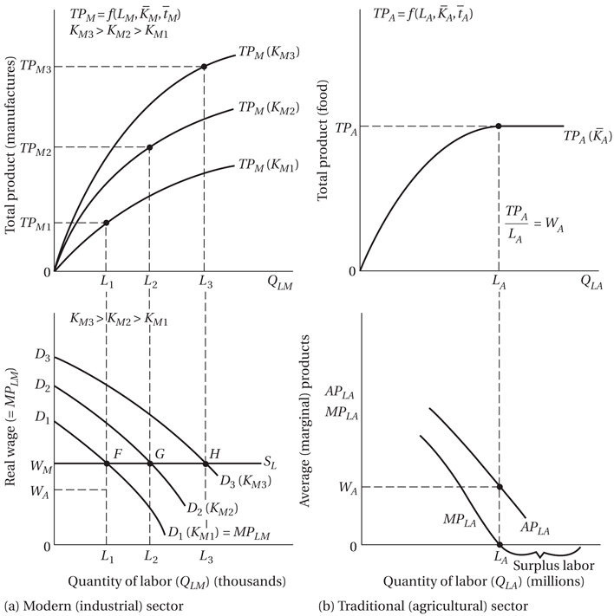
Figure 3.1 The Lewis Model of Modern-Sector Growth in a Two-Sector Surplus-Labor Economy

Slide 10
Criticisms of the Lewis Model
Rate of labor transfer and employment creation may not be proportional to rate of modern-sector capital accumulation
Surplus labor in rural areas and full employment in urban?
Institutional factors?
Assumption of diminishing returns in modern industrial sector

Slide 11
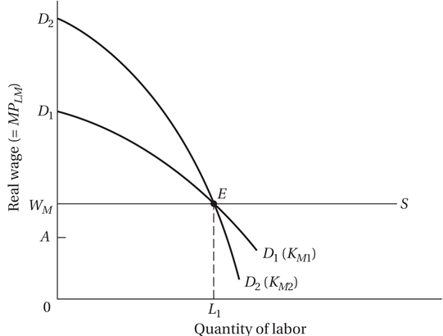
Figure 3.2 The Lewis Model Modified by Laborsaving Capital Accumulation: Employment Implications

Slide 12
Empirical Patterns of Development - Examples
Switch from agriculture to industry (and services)
Rural-urban migration and urbanization
Steady accumulation of physical and human capital
Population growth first increasing and then decreasing with decline in family size

Slide 13
3.4 The International-Dependence Revolution
The neocolonial dependence model
  Legacy of colonialism, Unequal power, Core-periphery
The false-paradigm model
  Pitfalls of using “expert” foreign advisors who misapply developed-country models
The dualistic-development thesis
  Superior and inferior elements can coexist; Prebisch-Singer Hypothesis
Criticisms and limitations
  Does little to show how to achieve development in a positive sense; accumulating counterexamples

Slide 14
3.5 The Neoclassical Counterrevolution: Market Fundamentalism
Challenging the Statist Model: Free Markets, Public Choice, and Market-Friendly Approaches
  Free market approach
  Public choice approach
  Market-friendly approach
Main Arguments
  Denies efficiency of intervention
  Points up state owned enterprise failures
  Stresses government failures
  Traditional neoclassical growth theory - with diminishing returns, cannot sustain growth by capital accumulation alone

Slide 15
3.6 Classic Theories of Development: Reconciling the Differences
  Governments do fail, but so do markets; a balance is needed
  Must attend to institutional and political realities in developing world
Development economics has no universally accepted paradigm
Insights and understandings are continually evolving
  Each theory has some strengths and some weaknesses

Slide 16
Concepts for Review
Autarky
Average product
Capital-labor ratio
Capital-output ratio
Center
Closed economy
Comprador groups
Dependence
Dominance
Dualism
False-paradigm model
Free market
Free-market analysis
Harrod-Domar growth model
Lewis two-sector model
Marginal product
Market failure

Slide 17
Concepts for Review (cont’d)
Market-friendly approach
Necessary condition
Neoclassical counterrevolution
Neocolonial dependence model
Net savings ratio
New political economy approach
Open economy
Patterns-of-development analysis
Periphery
Production function
Public-choice theory
Self-sustaining growth
Solow neoclassical growth model
Stages-of-growth model of development
Structural-change theory
Structural transformation
Sufficient condition
Surplus labor
Underdevelopment

Slide 18
Appendix 3.1: Components of Economic Growth
Capital Accumulation, investments in physical and human capital
  Increase capital stock
Growth in population and labor force
Technological progress
  Neutral, labor/capital-saving, labor/capital augmenting

Slide 19
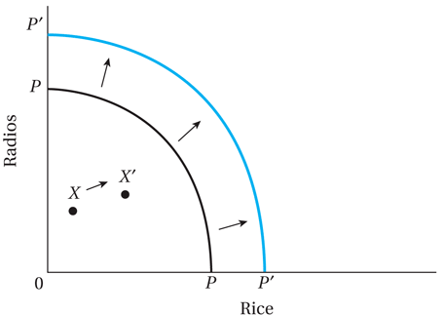
Figure A3.1.1 Effect of Increases in Physical and Human Resources on the Production Possibility Frontier

Slide 20
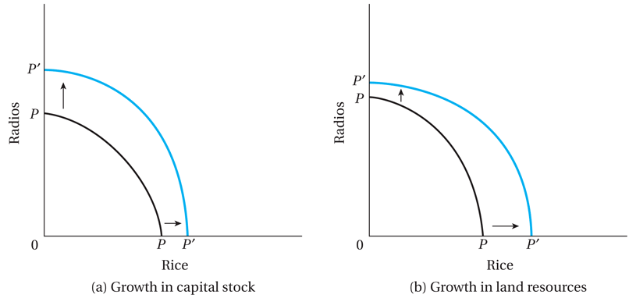
Figure A3.1.2 Effect of Growth of Capital Stock and Land on the Production Possibility Frontier

Slide 21
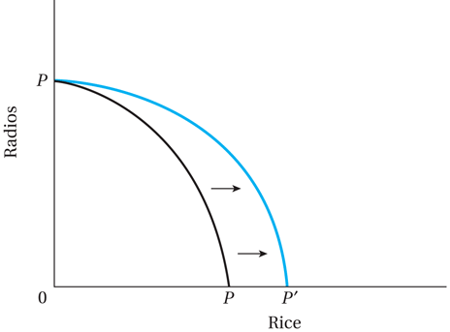
Figure A3.1.3 Effect of Technological Change in the Agricultural Sector on the Production Possibility Frontier

Slide 22
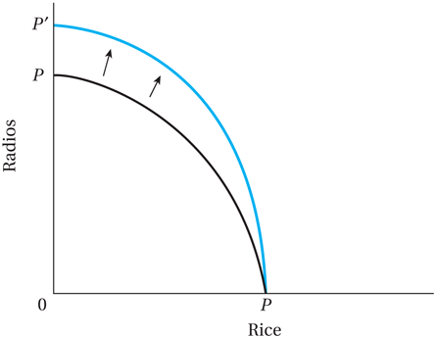
Figure A3.1.4 Effect of Technological Change in the Industrial Sector on the Production Possibility Frontier

Slide 23
Appendix 3.2 The Solow Neoclassical Growth Model

Slide 24
Appendix 3.2 The Solow Neoclassical Growth Model

Slide 25
Appendix 3.2 The Solow Neoclassical Growth Model

Slide 26
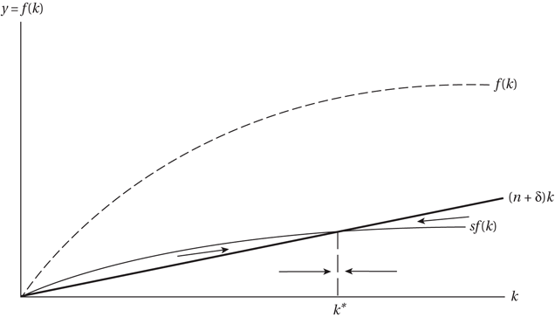
Figure A3.2.1 Equilibrium in the Solow Growth Model

Slide 27
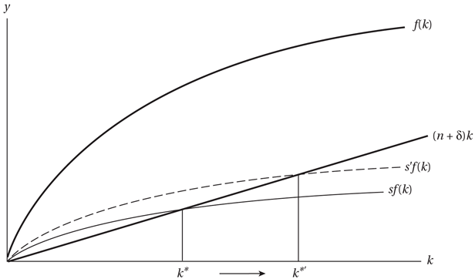
Figure A3.2.2 The Long-Run Effect of Changing the Saving Rate in the Solow Model

Slide 28
Appendix 3.3 Endogenous Growth Theory
Motivation for the new growth theory
The Romer model

