Slide 1
Chapter 6
Population Growth and Economic Development: Causes, Consequences, and Controversies

Slide 2
6.2 Population Growth: Past, Present, and Future
World population growth throughout history

Slide 3
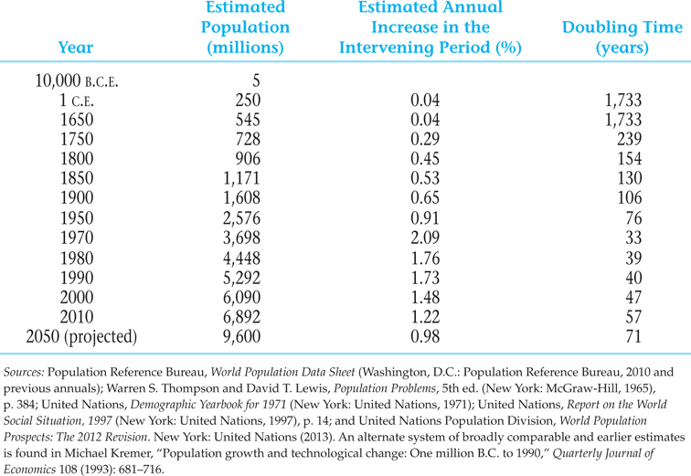
Table 6.1 Estimated World Population Growth

Slide 4
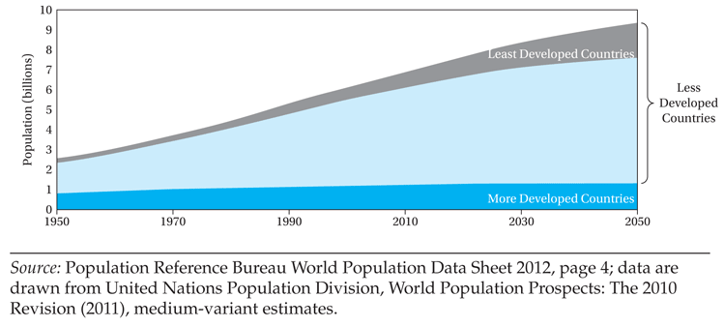
Figure 6.1 World Population Growth, 1950-2050

Slide 5
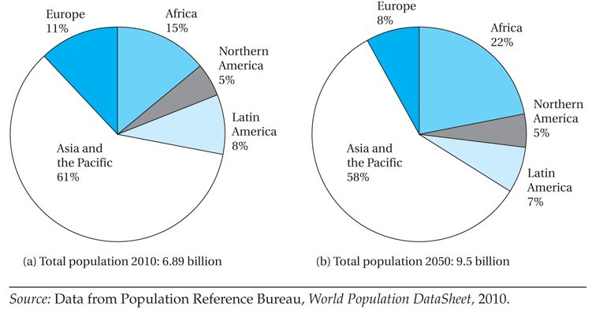
Figure 6.2 World Population Distribution by Region, 2010 and 2050

Slide 6
6.2 Population Growth: Past, Present, and Future
Structure of the world’s population
  Geographic region
  Fertility and Mortality Trends
  Rate of population increase
  Birth rates, death rates
  Total fertility rates
  Age Structure and dependency burdens

Slide 7
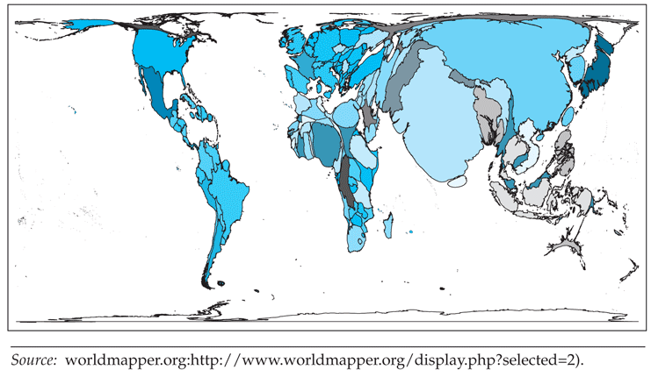
Figure 6.3 Map with Country Sizes Proportional to Their Fraction of World Population

Slide 8
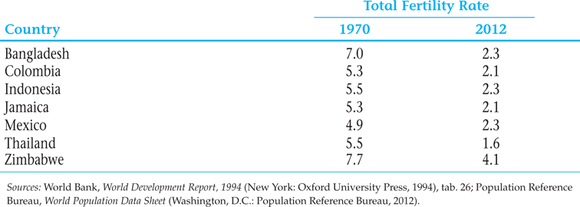
Table 6.2 Fertility Rate for Selected Countries, 1970 and 2009

Slide 9
6.2 Population Growth: Past, Present, and Future
The Hidden Momentum of Population Growth
  High birth rates cannot be altered overnight
  Age structure of developing country populations

Slide 10
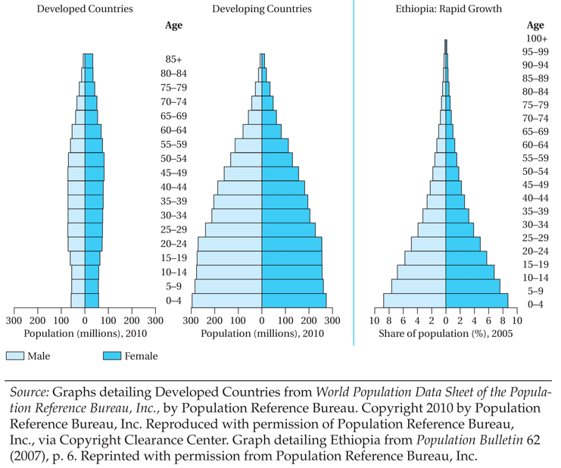
Figure 6.4 Population Pyramids: All Developed and Developing Countries and Case of Ethiopia

Slide 11
6.3 The Demographic Transition
Stage I: High birthrates and death rates
Stage II: Continued high birthrates, declining death rates
Stage III: Falling birthrates and death rates, eventually stabilizing

Slide 12
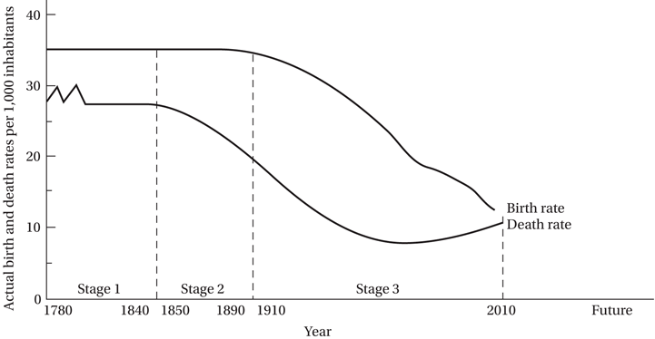
Figure 6.5 The Demographic Transition in Western Europe

Slide 13
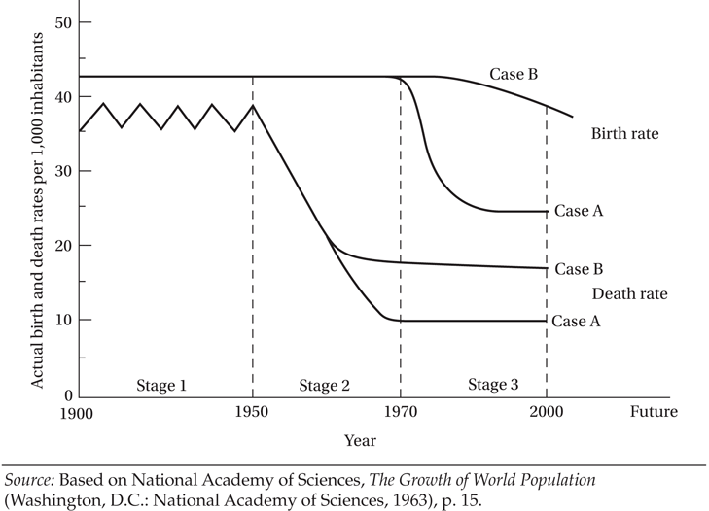
Figure 6.6 The Demographic Transition in Developing Countries

Slide 14
6.4 The Causes of High Fertility in Developing Countries: The Malthusian and Household Models
The Malthusian Population Trap
  The idea that rising population and diminishing returns to fixed factors result in a low levels of living (population trap)

Slide 15
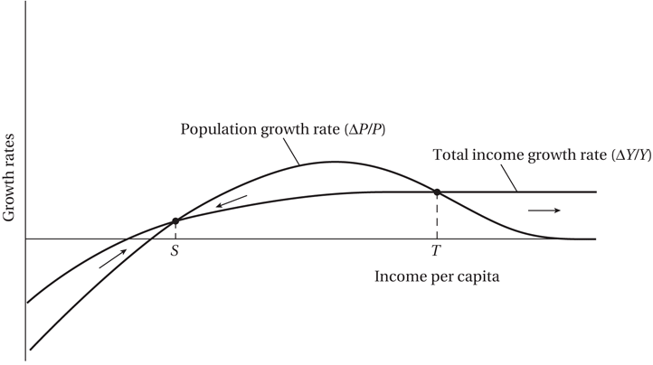
Figure 6.7 The Malthusian Population Trap

Slide 16
6.4 The Causes of High Fertility in Developing Countries: The Malthusian and Household Models (cont’d)
Criticisms of the Malthusian Model
  Impact of technological progress
  Currently no positive correlation between population growth and levels of per capita income in the data
Microeconomics of family size; turns focus to individual rather than aggregate variables

Slide 17
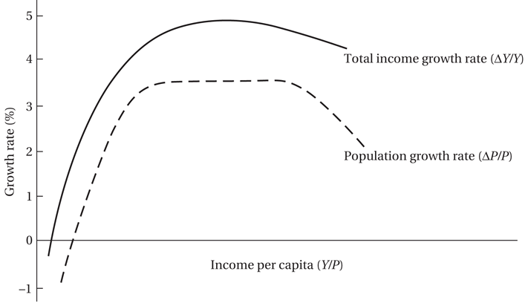
Figure 6.8 How Technological and Social Progress Allows Nations to Avoid the Population Trap

Slide 18
6.4 The Causes of High Fertility in Developing Countries: The Malthusian and Household Models (cont’d)
The Microeconomic Household Theory of Fertility
The Demand for Children in Developing Countries
  First two or three as “consumer goods”
  Additional children as “investment goods”:
  Work on family farm, microenterprise
  Old age security motivation

Slide 19
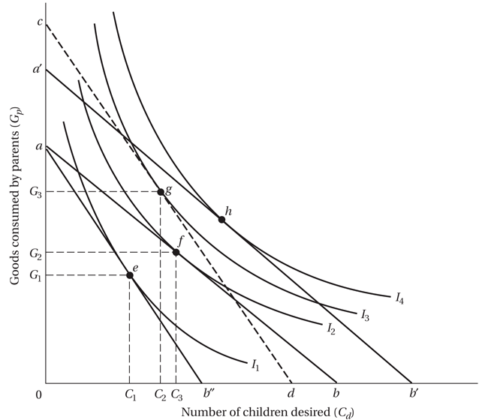
Figure 6.9 Microeconomic Theory of Fertility: An Illustration

Slide 20
6.4 The Causes of High Fertility in Developing Countries: The Malthusian and Household Models (cont’d)
Demand for Children Equation
Where
C_{d} is the demand for surviving children
Y is the level of household income
P_{c} is the “net” price of children
P_{x} is price of all other goods
t_{x} is the tastes for goods relative to children

Slide 21
6.4 The Causes of High Fertility in Developing Countries: The Malthusian and Household Models (cont’d)
Demand for Children Equation
The higher the household income, the greater the demand for children.
The higher the net price of children, the lower the quantity demanded.
The higher the prices of all other goods relative to children, the greater the quantity of children demanded.
The greater the strength of tastes for goods relative to children, the fewer children demanded.

Slide 22
6.4 The Causes of High Fertility in Developing Countries: The Malthusian and Household Models (cont’d)
In symbols, these relationships may be written as:

Slide 23
6.4 The Causes of High Fertility in Developing Countries: The Malthusian and Household Models (cont’d)
Causes of, and Policy Responses to, High Fertility in Developing Countries: Lessons from Microeconomic Household Models
Fertility may be lowered with:
  Improved women’s education, role, and status
  Female nonagricultural wage employment
  Rise in family income levels through shared growth
  Reduction in infant mortality, better health care
  Development of old-age and social security plans
  Expanded schooling opportunities, lowered real costs
  Lowered prices and better information on contraceptives
  Direct incentives such as subsidy benefits
  Policies that have the effect of reducing boy preference
The above list provides a framework for policy.

Slide 24
6.4 The Causes of High Fertility in Developing Countries: The Malthusian and Household Models (cont’d)
Implications. Fertility lower if
  Raise women’s education, role, and status
  More female nonagricultural wage employment
  Rise in family income levels
  Reduction in infant mortality
  Development of old-age and social security
  Expanded schooling opportunities

Slide 25
6.5 The Consequences of High Fertility: Some Conflicting Perspectives
Population growth: “It’s Not a Real Problem”:
  The real problem is not population growth but the following,
    Underdevelopment
    World resource depletion and environmental destruction
    Population Distribution
    Subordination of women
“Overpopulation is a Deliberately Contrived False Issue”
“Population Growth is a Desirable Phenomenon”

Slide 26
6.5 The Consequences of High Fertility: Some Conflicting Perspectives
“Population Growth Is a Real Problem”
  Extremist arguments
  Theoretical arguments
  Empirical arguments
    Lower economic growth
    Poverty
    Adverse impact on education
    Adverse impact on health
    Food constraints
    Impact on the environment
    Frictions over international migration

Slide 27
Goals and Objectives:
Toward a Consensus
Despite the conflicting opinions, there is some common ground on the following:
  Population is not the primary cause of lower living levels, but may be one factor
  Population growth is more a consequence than a cause of underdevelopment
  It’s not numbers but quality of life
  Market failures: potential negative social externalities
  Voluntary decreases in fertility is generally desirable for most developing countries with still-expanding populations

Slide 28
Goals and Objectives:
Toward a Consensus
Some Policy Approaches
  Attend to underlying socioeconomic conditions that impact development
  Family planning programs should provide education and technological means to regulate fertility
  Developed countries have responsibilities too
  Address gender bias, causes of boy preference

Slide 29
6.6 Some Policy Approaches
What Developing Countries Can Do
  Persuasion through education
  Family planning programs
  Address incentives and disincentives for having children through the principal variables influencing the demand for children
  Coercion is not a good option
  Raise the socioeconomic status of women
  Increase employment opportunities for women (increases opportunity cost of having more children, as in microeconomic household theory)
  Help facilitate genuine and faster development of developing countries that still have high fertility rates

Slide 30
6.6 Some Policy Approaches
What the Developed Countries Can Do Generally
  Address resources use inequities
  More open migration policies
How Developed Countries Can Help Developing Countries with Their Population Programs
  Research into technology of fertility control
  Financial assistance for family planning programs

Slide 31
Concepts for Review
Birth rate
Death rate
Demographic transition
Doubling time
Family-planning programs
Fertility rate
Hidden momentum of population growth
Life expectancy at birth
Malthusian population trap
Microeconomic theory of fertility
Mortality rate
Natural increase
Net international migration
Population-poverty cycle
Population pyramid
Rate of population increase

Slide 32
Concepts for Review (cont’d)
Reproductive choice
Total fertility rate (TFR)
Under-5 mortality rate
Youth dependency ratio

