Slide 1
Chapter 7
Urbanization and Rural-Urban Migration: Theory and Policy

Slide 2
7.1 Urbanization: Trends and Living Conditions
As a pattern of development, the more developed the economy, the more urbanized
But many argue developing countries are often excessively urbanized or too-rapidly urbanizing
This combination suggests the migration and urbanization dilemma
Urbanization: Trends and Projections

Slide 3
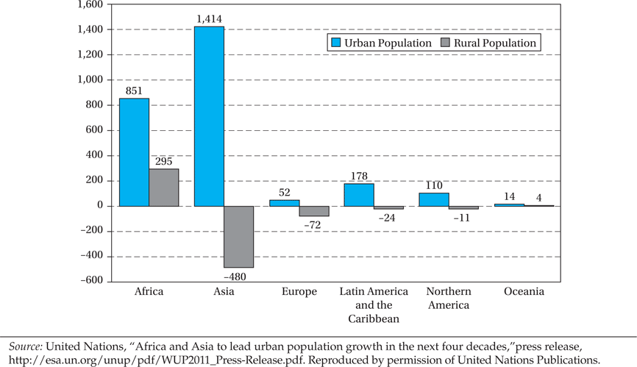
Figure 7.1 Changes in Urban and Rural Population by Major Areas between 2011 and
2050 (in millions)

Slide 4
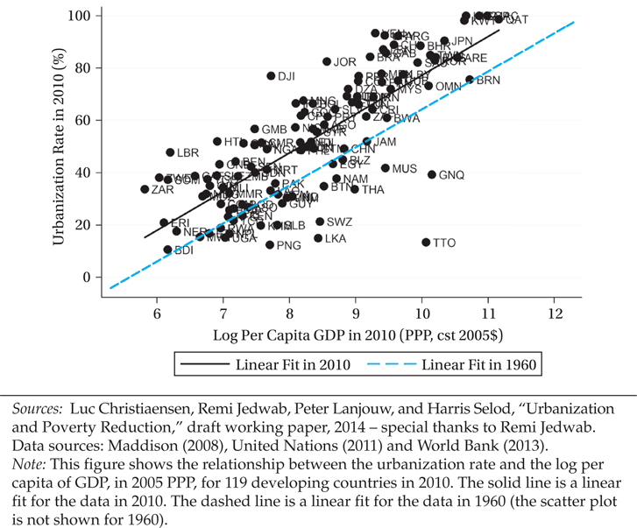
Figure 7.2 Relationship between Urbanization and Per Capita GDP, 2010 with Comparison to Relationship in 1960

Slide 5
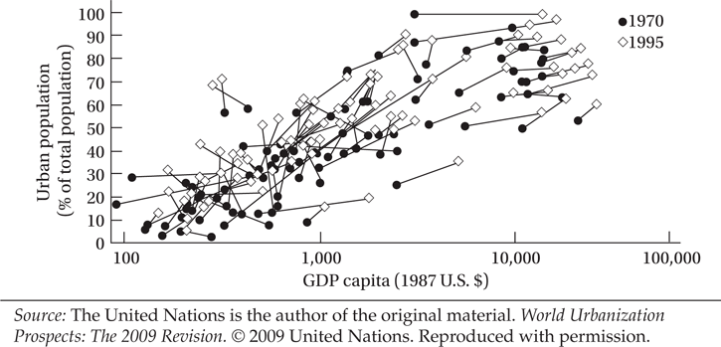
Figure 7.3 Proportion of Urban Population by Region, 1970–1995

Slide 6
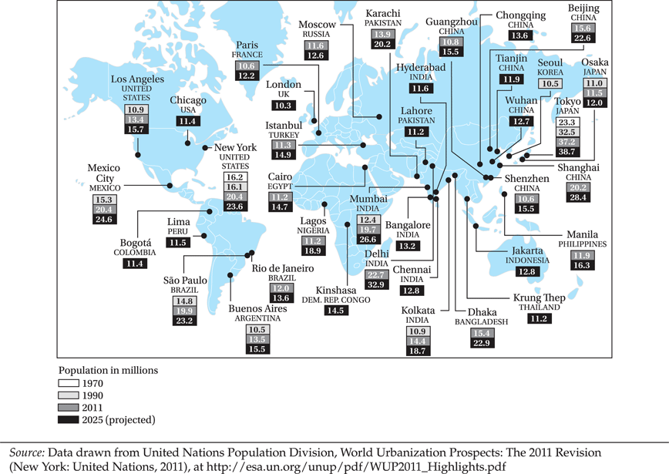
Figure 7.4 Megacities: Cities with 10 Million or More Inhabitants

Slide 7
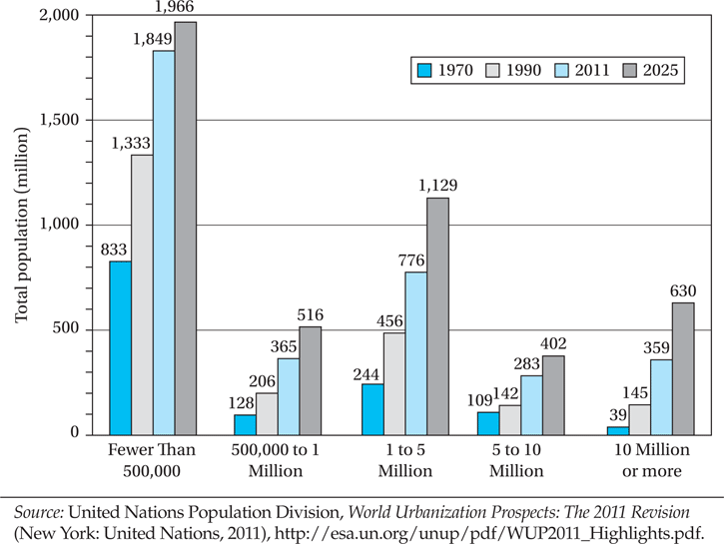
Figure 7.5 Total Population in Millions by City Size Class, 1970, 1990, 2011 and 2025

Slide 8
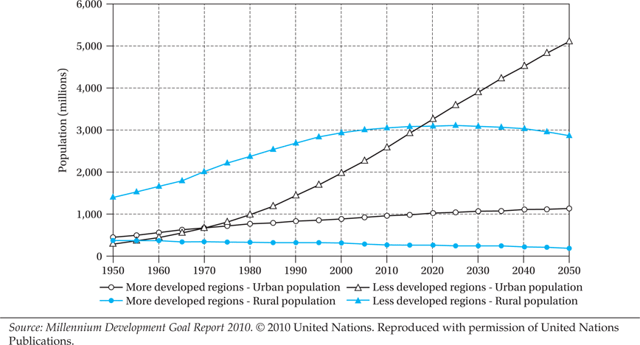
Figure 7.6 Estimated and Projected Urban and Rural Population of the More and Less Developed Regions, 1950–2050

Slide 9
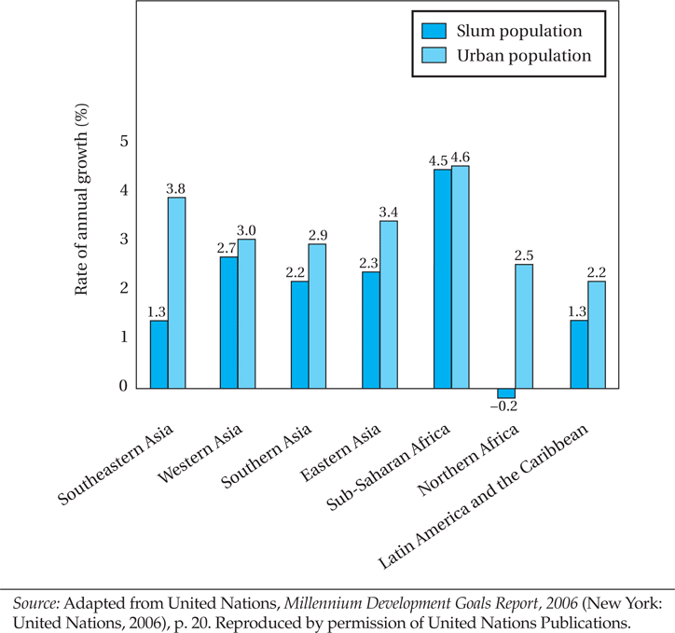
Figure 7.7 Annual Growth of Urban and Slum Populations, 1990–2001

Slide 10
7.2 The Role of Cities
Agglomeration economies: Urbanization (general) economies, localization (industry or sector) economies
Saving on firm-to-firm, firm-to-consumer transportation
Firms locating near workers with skills they need
Workers locating near firms that need their skills
Firms benefit from (perhaps specialized) infrastructure
Firms benefit from knowledge spillovers in their and related industries
(Also: consumers may benefit from urban amenities)

Slide 11
Industrial Districts and Clustering
Quality of clusters, or Industrial Districts, is a key to sectoral efficiency
Unfortunately a majority of developing countries have made only limited progress
China: a country that has made huge strides in generating industrial districts over the last decade (Findings Box 7.1)

Slide 12
Urbanization Costs, and Efficient Urban Scale
But, cities also entail “congestion costs”
Economically efficient urban scale (from point of view of productive efficiency) found where average costs for industries are lowest
Generally, differing efficient scales for different industrial specializations imply different city sizes
More extensive (expensive) capital, infrastructure required in urban areas
Smaller cities may be expected in labor-intensive developing countries

Slide 13
7.3 The Urban Giantism Problem
There may be general urban bias
Cities are capital intensive, so may expect that large cities are commonly located in developed countries
But urbanization in developing countries has taken place at unexpectedly rapid pace
Huge informal sectors in shantytowns, favelas
Large fraction of workers outside formal sector
Much urban growth is in mid-size cities, but urban bias remains a serious issue in many developing countries

Slide 14
7.3 The Urban Giantism Problem
There may be First-City Bias (favoring largest city)
Causes of Urban Giantism:
  Import substitution industrialization: less trade, incentive to concentrate in a single city largely to avoid transportation costs
  “Bread and circuses” to prevent unrest (evidence: stable democracies vs. unstable dictatorships)
  Hub and spoke transportation system (rather than web) makes transport costs high for small cities
  Compounding effect of locating the national capital in the largest city

Slide 15
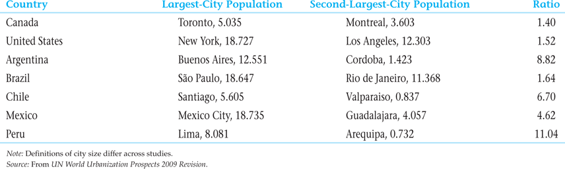
Table 7.1 Population of the Largest and Second-Largest Cities in Selected Countries (millions)

Slide 16
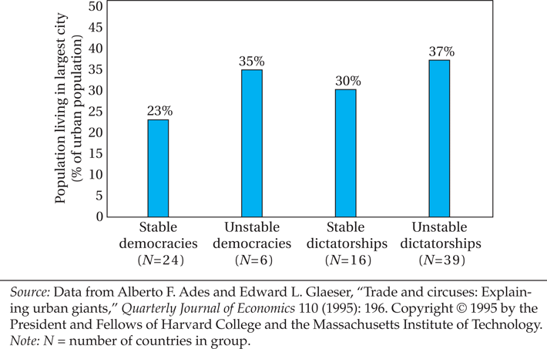
Figure 7.8 Politics and Urban Concentration

Slide 17
7.4 The Urban Informal Sector
Why promote the urban informal sector?
  Generates surplus despite hostile environment
  Creating jobs due to low capital intensivity
  Access to (informal) training, and apprenticeships
  Creates demand for less- or un- skilled workers
  Uses appropriate technologies, local resources
  Recycling of waste materials
  More benefits to poor, especially women who are concentrated in the informal sector

Slide 18
7.4 The Urban Informal Sector
Policies for the Urban Informal Sector
Women in the Informal Sector

Slide 19
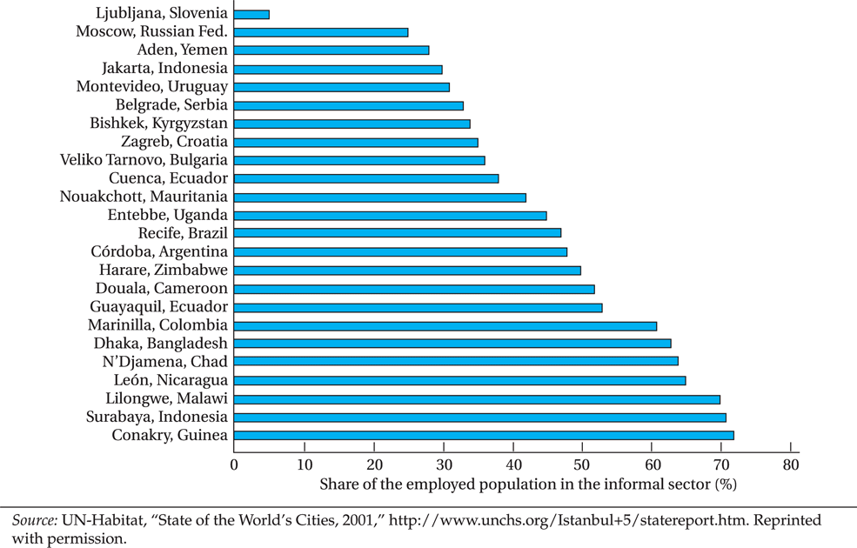
Figure 7.9 Importance of Informal Employment in Selected Cities

Slide 20
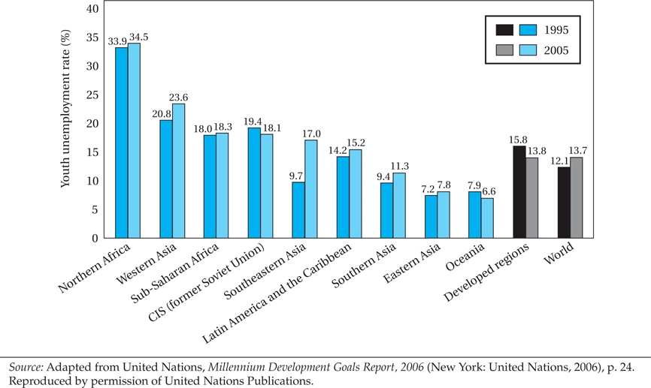
Figure 7.10 Youth Unemployment Rates, 1995 and 2005

Slide 21
7.5 Migration and Development
Rural-to-urban migration was viewed positively until recently
The current view is that this migration is greater than the urban areas’ abilities to
  Create jobs
  Provide social services

Slide 22
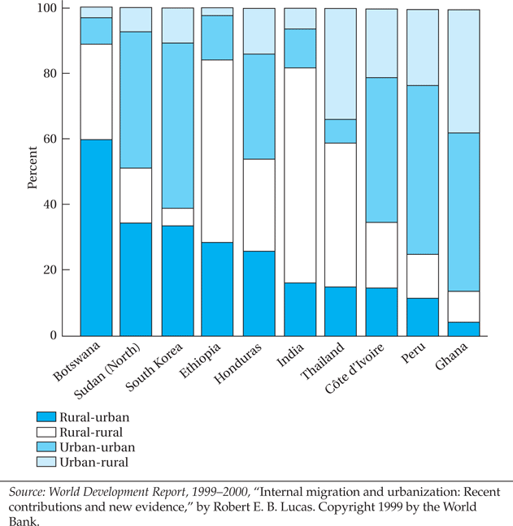
Figure 7.11 Components of Migration in Selected Countries

Slide 23
7.6 Toward an Economic Theory of Rural-Urban Migration
A Verbal Description of the Todaro Model
  Migration is a rational decision
  The decision depends on expected rather than actual wage differentials
  The probability of obtaining a city job is inversely related to the urban unemployment rate
  High rates of migration are outcomes of rural urban imbalances
A Diagrammatic Presentation

Slide 24
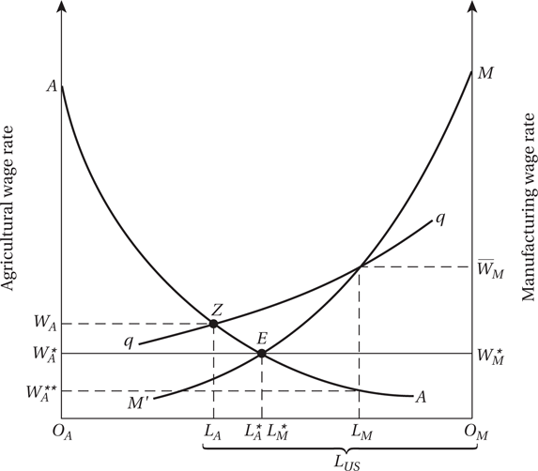
Figure 7.12 The Harris-Todaro Migration Model

Slide 25
7.6 Toward an Economic Theory of Rural-Urban Migration (cont’d)
Where
W_{A} is agricultural income,
L_{M} is employment in manufacturing
L_{US} is total urban labor pool
W_{M} is the urban minimum wage

Slide 26
7.6 Toward an Economic Theory of Rural-Urban Migration (cont’d)
Five Policy Implications
  Reduction of urban bias
  Imbalances in expected income opportunities is crucial
  Indiscriminate educational expansion fosters increased migration and unemployment
  Wage subsidies and scarcity factor pricing can be counterproductive
  Programs of integrated rural development should be encouraged

Slide 27
Generalizing the Harris-Todaro Model
If informal-sector income is greater than zero, we include it as a weighted component of expected urban income (on the right side of Equation 7.1), specifically we add (as in Endnote 30):
The informal-sector wage WUI times the probability of receiving it:
    WUI(1 - LM/LUS)
    where (1 - LM/LUS) is the probability of not receiving the preferred urban formal wage.
  We can further elaborate with other wages for different activities - and probabilities of receiving them - in this period; and, more generally, in future periods

Slide 28
Generalizing the Harris-Todaro Model

Slide 29
In-Class Example of the Harris-Todaro Model
Start with equation on the previous slide:
Rural wage = $1.50 per day
Urban modern wage = $3 per day
Urban traditional income = $.25 per day
Suppose there is a .5 probability of getting a modern job. Will there be migration?
Calculate expected urban income and compare to rural income. Important: you cannot work in two sectors at the same time!
E(Y^{URB}) = (.5)(3) + (.5)(.25)
= 1.50 + .125 = 1.625 > 1.50 = Y^{RUR}
So the individual migrates - even though half receives just a small fraction of the rural income.

Slide 30
7.7 Summary and Conclusions: A Comprehensive Migration and Employment Strategy
Create a urban-rural balance
Expand small-scale, labor intensive industries
Eliminate factor price distortions
Choose appropriate labor-intensive technologies of production
Modify the linkage between education and employment
Reduce population growth
Decentralize authority to cities and neighborhoods

Slide 31
Concepts for Review
Agglomeration economies
Congestion
Efficiency wage
Harris-Todaro model
Induced migration
Informal sector
Labor turnover
Localization economies
Present value
Rural-urban migration
Social capital
Todaro migration model
Urban bias
Urbanization economies
Wage subsidy

