Slide 1
Chapter 8
Human Capital: Education and Health in Economic Development

Slide 2
8.1 The Central Roles of Education and Health
Health and education are important objectives of development, as reflected in Amartya Sen’s capability approach, and in the core values of economic development
Health and education are also important components of growth and development – inputs in the aggregate production function

Slide 3
Education and Health as Joint Investments for Development
These are investments in the same individual
Greater health capital may improve the returns to investments in education
  Health is a factor in school attendance
  Healthier students learn more effectively
  A longer life raises the rate of return to education
  Healthier people have lower depreciation of education capital
Greater education capital may improve the returns to investments in health
  Public health programs need knowledge learned in school
  Basic hygiene and sanitation may be taught in school
  Education needed in training of health personnel

Slide 4
Improving Health and Education: Increasing Incomes Is Not Sufficient
Increases in income often do not lead to substantial increases in investment in children’s education and health
But better educated mothers tend to have healthier children at any income level
Significant market failures in education and health require policy action

Slide 5
8.2 Investing in Education and Health: The Human Capital Approach
Initial investments in health or education lead to a stream of higher future income
The present discounted value of this stream of future income is compared to the costs of the investment
Private returns to education are high, and may be higher than social returns, especially at higher educational levels

Slide 6
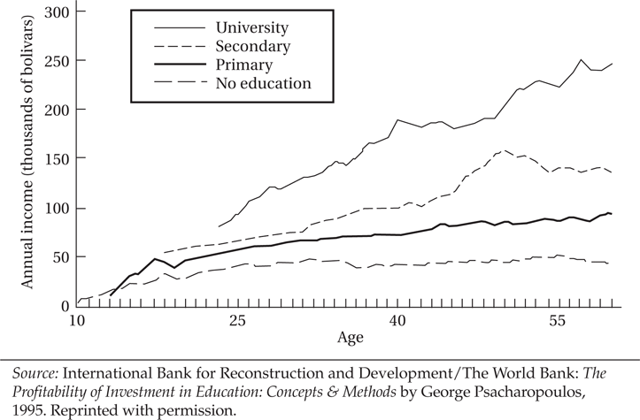
Figure 8.1 Age-Earnings Profiles by Level of Education: Venezuela

Slide 7
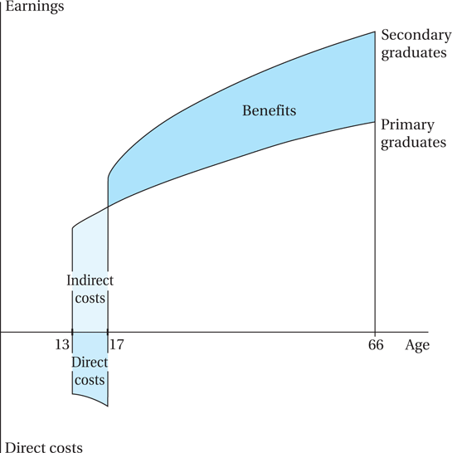
Figure 8.2 Financial Trade-Offs in the Decision to Continue in School

Slide 8
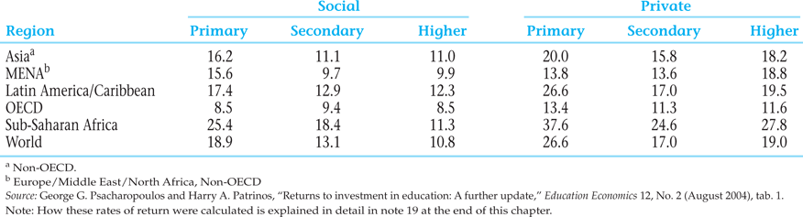
Table 8.1 Returns to Investment in Education by Level, Regional Averages (%)

Slide 9
8.3 Child Labor
Child labor is a widespread phenomenon
The problem may be modeled using the “multiple equilibria” approach
Government intervention may be called for to move to a ‘better’ equilibrium
Sometimes this shift can be self-enforcing, so active intervention is only needed at first

Slide 10
Assumptions of the Child Labor Multiple Equilibria Model
Luxury Axiom: A household with sufficiently high income would not send its children to work
Substitution Axiom: Adult and child labor are substitutes (perfect substitutes in this model), in which the quantity of output by a child is a given fraction of that of an adult: Q^{C} = γQ^{A}, 0 < γ < 1.

Slide 11
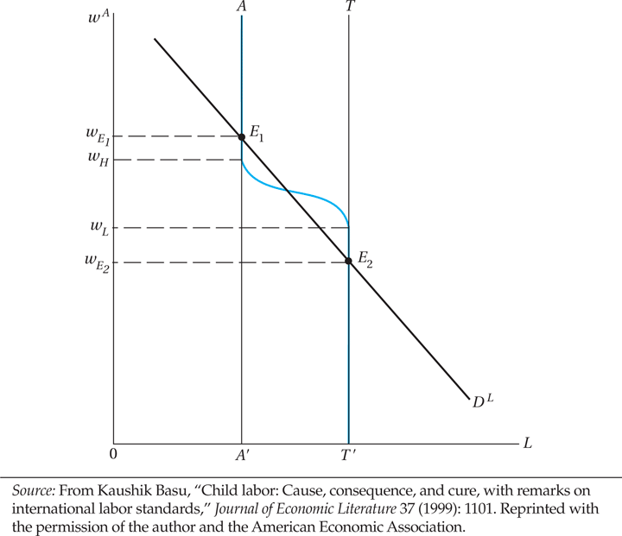
Figure 8.3 Child Labor as a Bad Equilibrium

Slide 12
Other approaches to child labor policy
The Chapter 8 Case Study: Get more children into school (as in Millennium Development Goals), e.g. new village schools; and enrollment incentives for parents such as in Progresa/ Oportunidades
Consider child labor an expression of poverty, so emphasize ending poverty generally (a traditional World Bank approach, now modified)
If child labor is inevitable in the short run, regulate it to prevent abuse and provide support services for working children (UNICEF approach)
Ban child labor; or if impossible, ban child labor in its most abusive forms (ILO strategy; “Worst Forms of Child Labor Convention”)
Activist approach: trade sanctions. Concerns: could backfire when children shift to informal sector; and if modern sector growth slows

Slide 13
8.4 The Gender Gap: Discrimination in Education and Health
Young females receive less education than young males in nearly every low and lower-middle income developing country
Closing the educational gender gap is important because:
  The social rate of return on women’s education is higher than that of men in developing countries
  Education for women increases productivity, lowers fertility
  Educated mothers have a multiplier impact on future generations
  Education can break the vicious cycle of poverty and inadequate schooling for women
  Good news: Millennium Development Goals on parity being approached, progress in every developing region

Slide 14
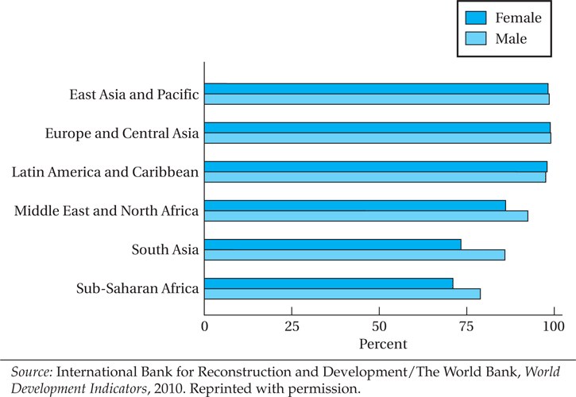
Figure 8.4 Youth Literacy Rate, 2008

Slide 15
8.4 The Gender Gap: Discrimination in Education and Health (cont’d)
Consequences of gender bias in health and education
  Economic incentives and their cultural setting
  “Missing Women” mystery in Asia

Slide 16
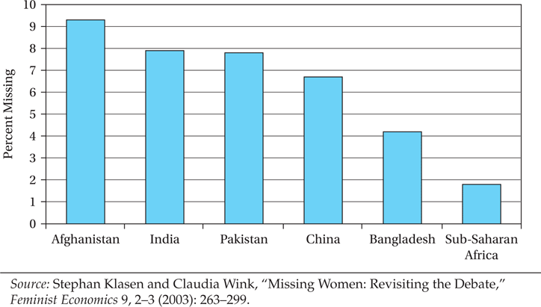
Figure 8.5 Estimated Percent of Women “Missing”

Slide 17
The “Missing Women” Crisis
Research has concluded that in Asia at least 100 million women or more are “missing”
If gender ratios were closer to normal levels based on biology, in comparison to other regions such as Europe, North America, or Latin America (or for that matter sub-Saharan Africa), that is the minimum number of additional women who would be alive in Asia alone
Some women are also missing in Africa, but a much smaller proportion
Reasons include inferior medical care for girls, and gender selective abortion or female infanticide

Slide 18
8.5 Educational Systems and Development
Educational supply and demand: the relationship between employment opportunities and educational demands
Social versus private benefits and costs
Distribution of education
Education, inequality, and poverty
Education, Internal Migration, and the Brain Drain

Slide 19
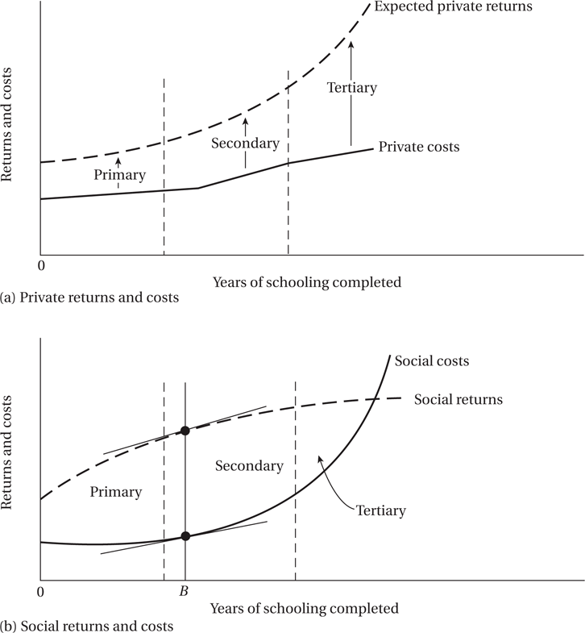
Figure 8.6 Private versus Social Benefits and Costs of Education: An Illustration

Slide 20
8.5 Educational Systems and Development (cont’d)
Distribution of Education
  Lorenz curves for the distribution of education
Education, Inequality, and Poverty

Slide 21
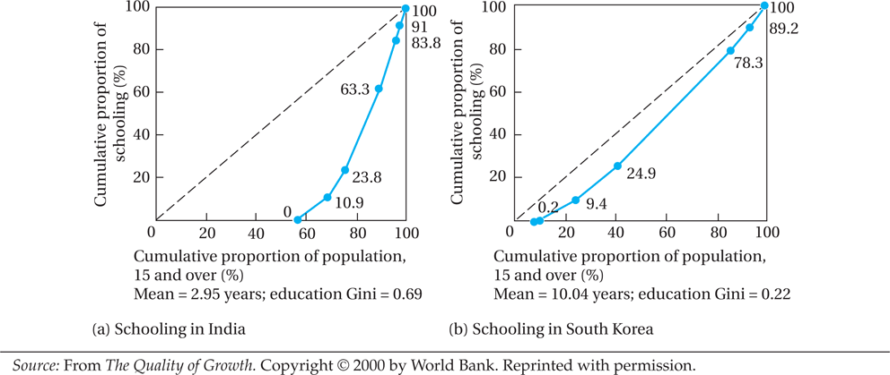
Figure 8.7 Lorenz Curves for Education in India and South Korea

Slide 22
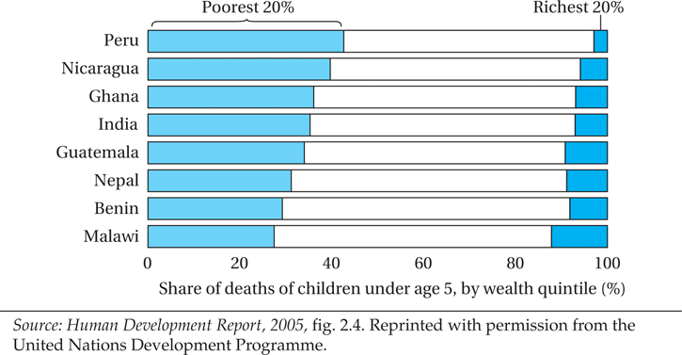
Figure 8.8 Children’s Likelihood to Die in Selected Countries

Slide 23
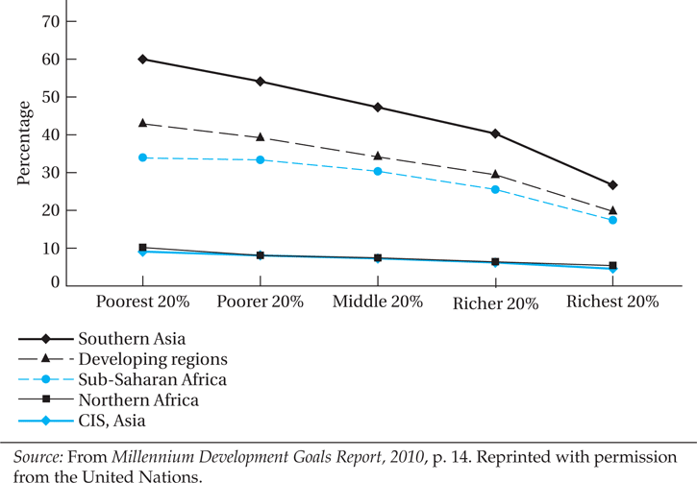
Figure 8.9 Proportion of Children under 5 Who Are Underweight, by Household Wealth, around 2008

Slide 24
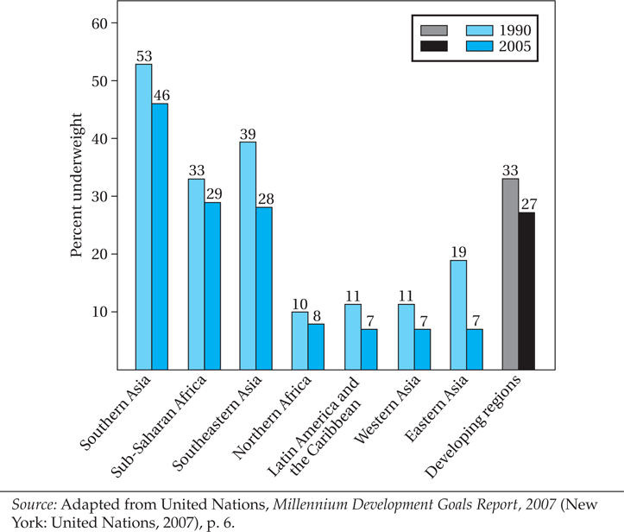
Figure 8.10 Proportion of Children under 5 Who Are Underweight, 1990 and 2005

Slide 25
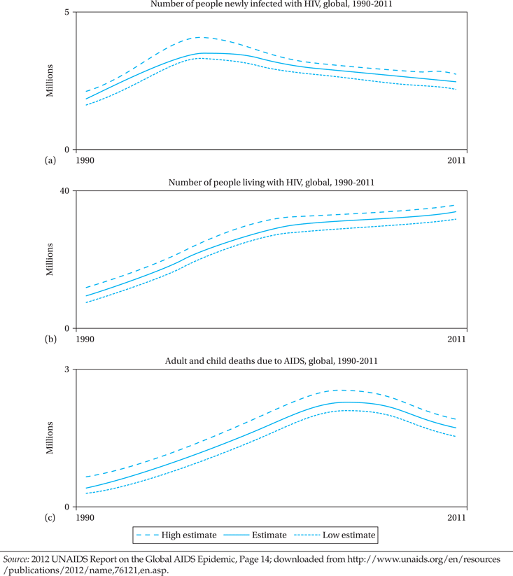
Figure 8.11 Global HIV Trends, 1990–2011

Slide 26
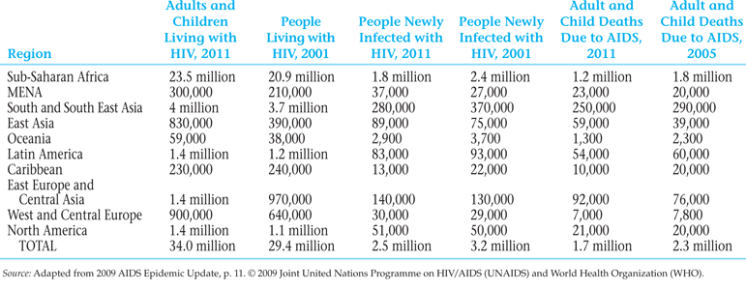
Table 8.2 Regional HIV and AIDS Statistics, a Decade of Bending the Curve, 2011 versus 2001

Slide 27
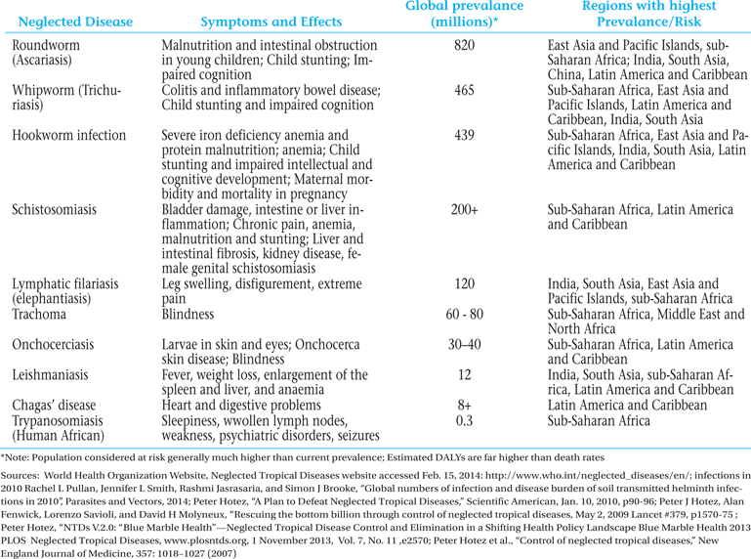
Table 8.3 Some Major Neglected Tropical Diseases

Slide 28
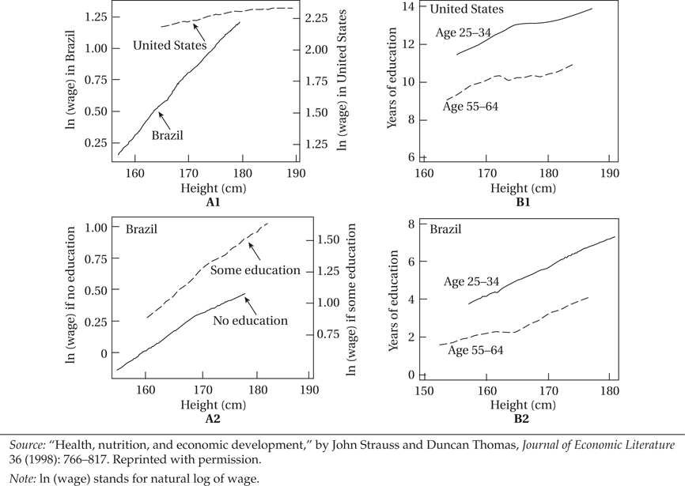
Figure 8.12 Wages, Education, and Height of Males in Brazil and the United States

Slide 29
Disease Burden
HIV/AIDS
Malaria
Parasitic Worms and Other “Neglected Tropical Diseases”

Slide 30
Mexican Program on Education, Health, and Nutrition (Progresa), Oportunidades Human Development Program
Some Basic Questions:
What is the Progresa/Oportunidades program and what does it try to accomplish?
How does it try to do so – what are the key program features?
Why make transfers conditional? Benefits? Drawbacks?
Specifically, how does Progresa work to improve nutrition?
Specifically, how does Progresa work to improve education?
What were the features of the original evaluation?

Slide 31
8.7 Health, Productivity, and Policy
Productivity
  Is there a connection with health?
Health Systems Policy
  Great variability in the performance of health systems at each country's average income level

Slide 32
Concepts for Review
Acquired immunodeficiency syndrome (AIDS)
Basic education
Brain drain
Conditional cash transfer (CCT) programs
Derived demand
Discount rate
Educational certification
Educational gender gap
Health system
Human capital
Human immunodeficiency virus (HIV)
Literacy
Neglected tropical diseases
Private benefits of education

Slide 33
Concepts for Review (cont’d)
Private costs of education
Social benefits of education
Social costs of education
World Health Organization (WHO)

Slide 34
Algebraic version of the schooling decision diagram
(Note: you can also do a rate of return calculation as in Endnote 19)
Net present value of Income Stream is given by
(Compare with Equation 11.10)
Where:
t is time (year) from present. (The present is time t = 0.)
Y_{t} is expected income from having gone to school, realized at time t
X_{t} is expected income from having NOT gone to school, at time t
C_{t} is the cost of going to school borne at time (if any)
r is the rate of discount used

