Slide 1
Chapter 9
Agricultural Transformation and Rural Development

Slide 2
9.1 The Imperative of Agricultural Progress and Rural Development
The heavy emphasis in the past on rapid industrialization may have been misplaced
Agricultural development is now seen as an important part of any development strategy
Three complementary elements of an agriculture – and employment-based strategy
  Accelerated output growth
  Rising domestic demand for agricultural output
  Non-agricultural labor intensive rural development activities that are supported by the farming community

Slide 3
9.2 Agricultural Growth: Past Progress and Current Challenges
Although agriculture employs the majority of the developing country labor force, it accounts for a much lower share of total output
Agricultural production is rising but unevenly

Slide 4
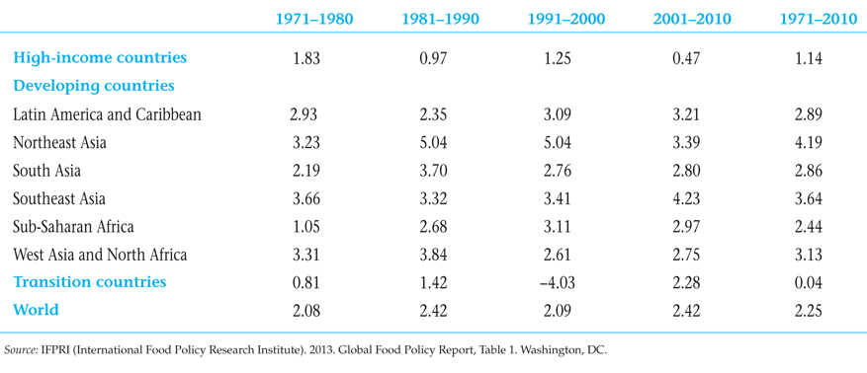
Table 9.1 Average Annual Growth Rates of Agriculture, by Region (%)

Slide 5
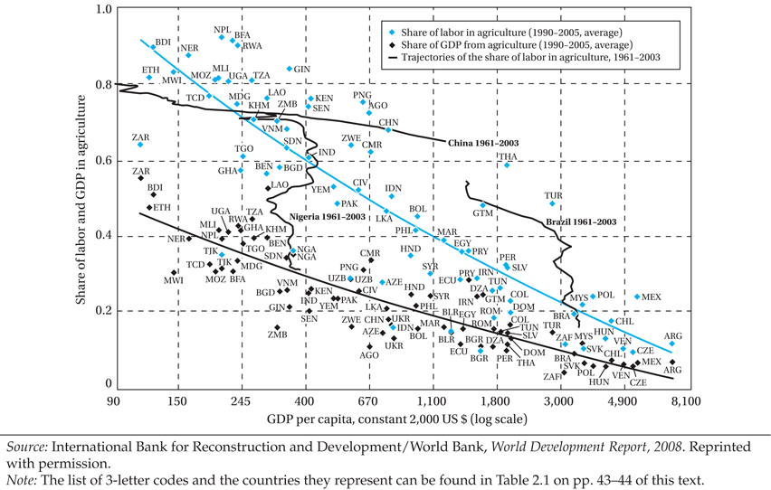
Figure 9.1 As Countries Develop, the Shares of GDP and Labor in Agriculture Tend to Decline, but with Many Idiosyncrasies

Slide 6
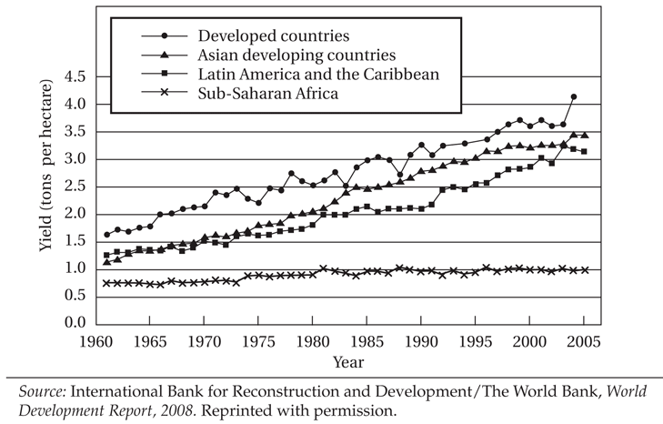
Figure 9.2 Cereal Yields by World Region, 1960-2005

Slide 7
9.2 Agricultural Growth: Past Progress and Current Challenges (cont’d)
Malnutrition and famine inspire calls for a new green revolution focused on Africa.
Food price spike of 2007-2008 partly due to short term factors but long term factors may herald return to persistently higher food prices in the years ahead.
New upward spike of prices by early 2011
The presence of market failures - and poverty alleviation goals – create need for constructive government role in agriculture

Slide 8
Roles for Government in Agricultural Development
Environmental externalities
Agricultural research and extension services
Helping create markets where they are missing
Addressing monopoly power in input supply
Economies of scale in marketing
Informational asymmetries in product quality
Providing institutions and infrastructure
Addressing poverty traps (merit goods)

Slide 9
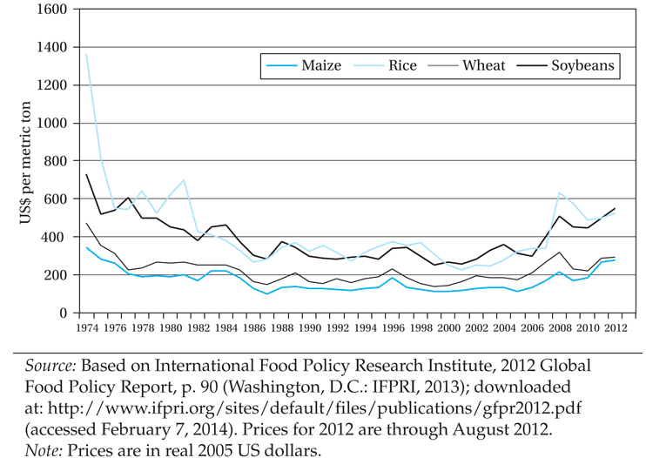
Figure 9.3 World Prices for Agricultural Commodities, 1974–2012

Slide 10
9.3 The Structure of Agrarian Systems in the Developing World
Three systems of agriculture
Agriculture based countries, often subsistence, but agriculture makes up large part of growth
Transforming countries, most of world’s rural people, large proportion of poverty incidence found there, low contribution of agriculture to growth
Urbanized countries, half or even more of the poor found in urban areas
The trend is from agriculture-based, to transforming, to urbanized economies as illustrated with the cases of India, China, Indonesia, and Brazil in Fig. 9.4

Slide 11
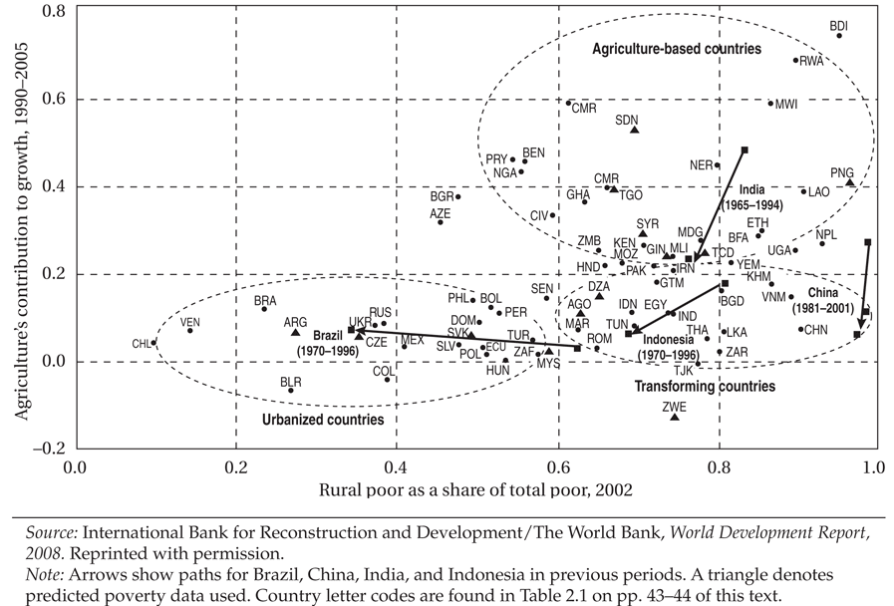
Figure 9.4 Agriculture’s Contribution to Growth and the Rural Share in Poverty in Three Types of Countries

Slide 12
9.3 The Structure of Agrarian Systems in the Developing World (cont’d)
Peasant Agriculture in Latin America, Asia, and Africa
  Latin America and Asia: similarities and differences
  The Latifundio–Minifundio dualistic pattern in Latin America
  The fragmented and heavily congested dwarf land holdings in Asia
  Africa: extensive cultivation patterns

Slide 13
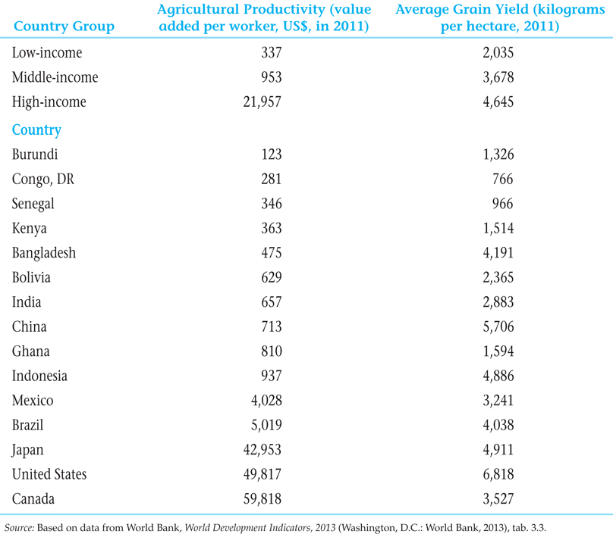
Table 9.2 Labor and Land Productivity in Developed and Developing Countries

Slide 14
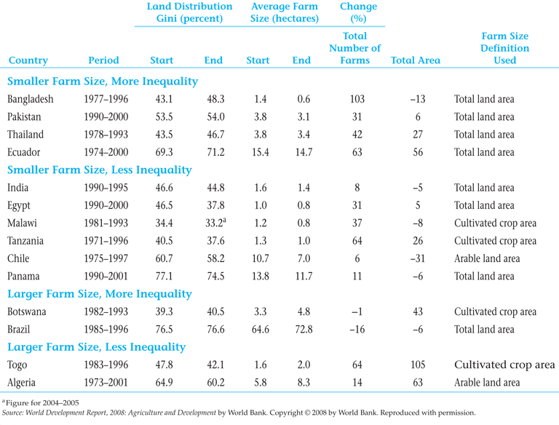
Table 9.3 Changes in Farm Size and Land Distribution

Slide 15
9.3 The Structure of Agrarian Systems in the Developing World (cont’d)
Transforming Economies: Problems of Fragmentation and Subdivision of Peasant Land in Asia
  Impact of colonial rule in strengthening land tenure systems of private property rights and the consequent rise of moneylenders
  Contemporary landlordism in India and Pakistan involves absentee landlordism and persistence of sharecroppers and tenant farmers
  Rapid population growth resulted in more fragmentation and peasant impoverishment

Slide 16
9.3 The Structure of Agrarian Systems in the Developing World (cont’d)
Agrarian Patterns in Latin America: Progress and Remaining Poverty Challenges
  Apart from latifundios (large holdings) and minifundios (small farms) much production occurs on family farms and medium sized farms.
  Latifundios (traditional ones, especially) are relatively inefficient; landlords/owners are sometimes less focused on the business of farming; and large farms typically entail higher transaction costs
  Overall the agricultural sector seems to be doing well in many Latin American countries. Two prominent examples: Chile (diversification), and Brazil (biofuels)
  Extreme rural inequalities still persist.

Slide 17
9.3 The Structure of Agrarian Systems in the Developing World (cont’d)
Subsistence Agriculture and Extensive Cultivation in Africa
  Low productivity due to lack of technology (such as improved seeds and irrigation)
  Shifting Cultivation
  Seasonal demand for labor depending on rainy season
  High dependence on unimproved seeds sown on unfertilized, rain-fed fields
  Relatively high fraction of underutilized land
  High concern about climate change impact
  Need for an African new green revolution, there are hopeful signs that it is getting underway

Slide 18
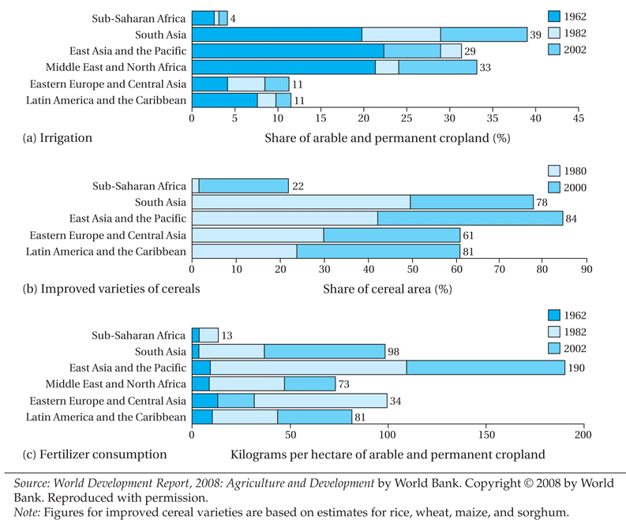
Figure 9.5 Expansion of Modern Inputs in the World’s Developing Regions

Slide 19
9.4 The Important Role of Women
Women provide 60% to 80% of agricultural labor in Africa and Asia, and 40% in Latin America
Women work longer hours than men
Government assistance programs tend to reach men, not women

Slide 20
9.5 The Microeconomics of Farmer Behavior and Agricultural Development
Subsistence farming: risk aversion, uncertainty, and survival
  Traditional neoclassical model of profit maximization with certainty is not adequate
  Price, weather, and other uncertainty, along with limited access to credit and insurance (and even savings vehicles), largely explains the extent of risk-averse behaviors observed
  Risk-averse subsistence farmers often (not irrationally) can prefer technologies that combine low mean-per-hectare with low variance to alternative high yielding but higher risk technologies
  Efforts to minimize risk and remove commercial and institutional obstacles to small farmer innovation are necessary

Slide 21
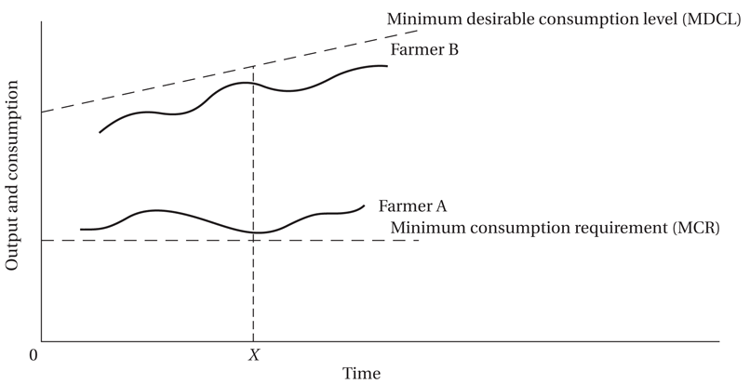
Figure 9.6 Small-Farmer Attitudes toward Risk: Why It Is Sometimes Rational to Resist Innovation and Change

Slide 22
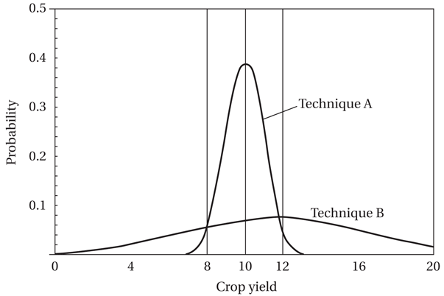
Figure 9.7 Crop Yield Probability Densities of Two Different Farming Techniques

Slide 23
9.5 The Microeconomics of Farmer Behavior and Agricultural Development (cont’d)
Issues in sharecropping: a long debate
  Intrinsically Inefficient due to poor incentives (Marshall)
  Monitoring approach (Cheung)
  Compromise between two types of risk (Stiglitz, others)
  Screening argument (if high ability then take pure rental)
  Empirical evidence for inefficiency from Ali Shaban (comparing same farmer, controlling for soil)
  Giving sharecroppers a larger share of the produce and security of tenure on land can increase efficiency
Issues in interlocking factor markets

Slide 24
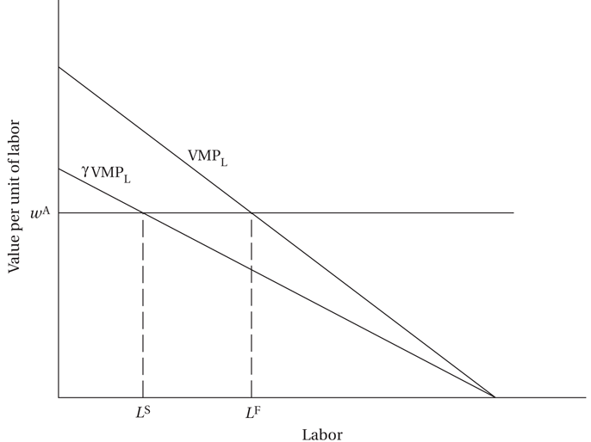
Figure 9.8 Incentives under Sharecropping

Slide 25
9.5 The Microeconomics of Farmer Behavior and Agricultural Development (cont’d)
The Transition to Mixed and Diversified Farming
From Divergence to Specialization: Modern Commercial Farming

Slide 26
9.6 Core Requirements of a Strategy of Agricultural and Rural Development
Improving Small-Scale Agriculture
  Technology and innovation
  Institutional and pricing policies: Providing necessary economic incentives
  Adapting to new opportunities and new constraints
Conditions for Rural Development
  Land reform
  Supportive polices
  Integrated development objectives

Slide 27
Concepts for Review
Agrarian systems
Cash crops
Diversified farming
Family farms
Green revolution
Integrated rural development
Interlocking factor markets
Landlord
Land reform
Latifundio
Medium-sized farms
Minifundio
Mixed farming
Moneylender
Scale-neutral
Sharecropper
Shifting cultivation
Specialized farming
Staple foods
Subsistence farming
Tenant farmer
Transactions costs

