Slide 1
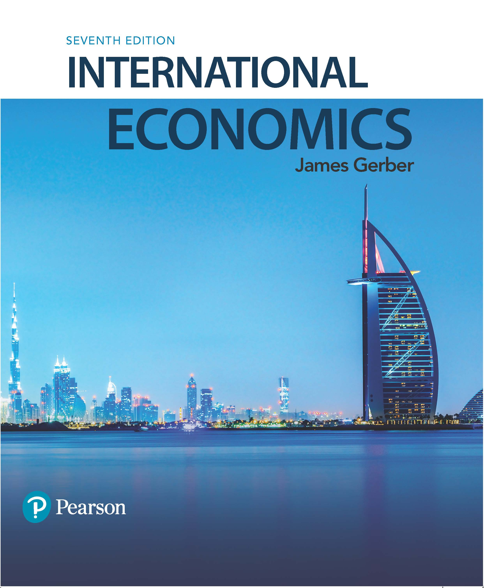
International Economics
Seventh Edition
Chapter 3
Comparative Advantage and the Gains from Trade
Copyright © 2018, 2014, 2011 Pearson Education, Inc. All Rights Reserved

Slide 2
Learning Objectives (1 of 2)
3.1 Analyze numerical examples of absolute and comparative advantage.
3.2 Draw a diagram showing gains from trade.
3.3 Numerically compare and contrast absolute and comparative advantage.

Slide 3
Learning Objectives (1 of 2)
3.4 Explain how a country with no absolute advantage can still gain from trade.
3.5 Contrast the concepts of comparative advantage and competitiveness.
3.6 Discuss the economic and ethical considerations of economic restructuring caused by international trade.

Slide 4
Adam Smith and The Wealth of Nations (1 of 3)
Smith published his great work in 1776: An Inquiry into the Nature and Causes of the Wealth of Nations.
He criticized the dominant school of thought, called mercantilism.
Mercantilism is sometimes called the politics and economics of nation building.
Mercantilists favored exports because they earned gold for a nation; they discouraged imports because they cost a nation its gold.
Gold could be used to pay for armies and navies.

Slide 5
Adam Smith and The Wealth of Nations (2 of 3)
Smith’s arguments against mercantilism:
Imports enable countries to live better;
Voluntary exchange is positive sum, not zero sum: both sides gain.
Trade extends the market and enables specialization and innovation and thereby creates wealth.
Trade barriers shrink the size of the market and limit innovation and specialization.

Slide 6
Adam Smith and The Wealth of Nations (3 of 3)
Economists today mostly accept Smith’s critique of mercantilism and trade barriers.
Smith thought that every nation would be able to produce something at lower cost than all other nations—due to their soil, climate, mineral resources, or some other unique factor.
David Ricardo, writing in the early 1800s, demonstrated that trade was beneficial even if a country had no special advantage—or even if they had an advantage in everything.

Slide 7
A Simple Model of Production and Trade (1 of 2)
Economists illustrate the ideas of Smith and Ricardo with a 2x2x1 model
2 countries
2 goods produced
1 input, call it “labor”
Initially, we assume:
Competitive markets: no firms have market power
No technological changes
Constant returns to scale in production: Double the inputs and you double the outputs.
No transportation or trade costs
No money: All trade is barter.

Slide 8
A Simple Model of Production and Trade (2 of 2)
Labor is the sole input. We assume:
Labor is completely mobile between the two sectors of production.
Labor is homogeneous: no skilled/unskilled or hard working/shirking distinctions.
Labor is fully employed: Everyone that wants a job has one.
Labor is immobile between the two countries.

Slide 9
Three Definitions
Productivity: The amount of output per unit of input.
Labor productivity: Output per unit of labor inputs = Units of output ÷ hours worked
Absolute productivity advantage: Higher output per hour worked than a competitor. More simply, this is called absolute advantage.

Slide 10
Table 3.2 Output Per Hour Worked
Each number is the units of output per hour worked.
Canada has an absolute advantage (= higher labor productivity) in bread.
The U.S. has an absolute advantage in steel.
Output | United States | Canada
Bread | 2 loaves | 3 loaves
Steel | 3 tons | 1 ton

Slide 11
Opportunity Costs
In the U.S., the opportunity cost of steel is 2/3 loaves of bread.
Labor can be used to produce bread or steel.
Every worker taken out of bread reduces production by 2 loaves but increases steel by 3 tons.
The opportunity cost is the domestic price of a good when there is no trade: give up 2 bread and obtain 3 tons of steel.

Slide 12
Opportunity Costs and Prices
We can write an algebraic expression for the price of steel in the U.S. when there is no trade:
Similarly, for Canada:
These are the opportunity costs of producing steel; the opportunity costs of bread are the inverses.

Slide 13
Opportunity Costs and the Gains from Trade
The U.S. is better off if Canada will pay it more than 0.67 bread for a ton of steel.
And Canada is better off if it can buy steel at less than 3 bread per ton.
As long as the trade price is less than the opportunity cost of producing a good, a country is better off buying it than making it.
The gains from trade are the increases in goods available through trade versus what a country can produce itself.

Slide 14
The Trade Price (1 of 2)
Trade prices will settle somewhere between the domestic costs of production in the two countries:
For steel :
For bread (the inverses):

Slide 15
The Trade Price (2 of 2)
What if the price of steel is greater than 3 loaves of bread per ton?
The U.S. benefits from specializing in steel and buying bread because it obtains more than 3 loaves for each ton.
Canada will decide to produce steel as well; the trade price is so much higher than its opportunity cost of producing it.
End result: Neither country produces bread, the price of bread rises, the price of steel falls, and we are back between the two opportunity costs.
There is a similar story if the price of steel is less than 0.67 loaves per ton.

Slide 16
The PPC (1 of 4)
The production possibilities curve (PPC) shows the tradeoffs between the two goods in our simple model.
It is a straight line because there is a constant tradeoff of bread for steel.
Production inside the PPC is inefficient (does not use all available resources);
Production outside is impossible;
Production along the curve is full employment.
Countries can produce anywhere on the curve, but they want to produce the output with the greatest value.
Greatest value is dependent on the trade price.

Slide 17
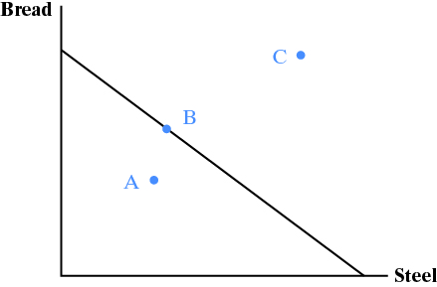
The PPC (2 of 4)

Slide 18
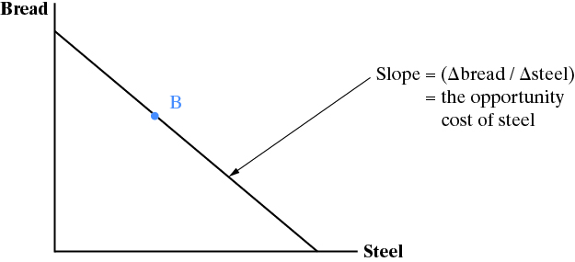
The PPC (3 of 4)

Slide 19
The PPC (4 of 4)
The slope of the PPC is the relative price of the good on the horizontal axis. It is also the opportunity cost.
In our example, the slope is the amount of bread given up per unit of steel.
A relative price is the price of one good in terms of another; the price of steel is measured in terms of bread.

Slide 20
The Situation Before Trade Begins
Autarky is the term given for countries that do not trade.
Can only consume what they produce.
The best they can do is to produce somewhere along their PPC.
The actual production point depends on the relative demands for bread and steel.
Countries that trade can consume outside their PPC….How?

Slide 21
The Gains from Trade (1 of 4 )
Suppose the world (trade) price of steel is somewhere between the opportunity costs for steel in the US and Canada:
Let’s say the world price of steel is 2 loaves per ton:

Slide 22
The Gains from Trade (2 of 4 )
The consumption possibilities curve (CPC) for the U.S. shows what the U.S. can consume when it produces at a point on its PPC and trades.
Its slope is –(Δ bread) ÷ (Δ steel) = -2.
The slope of the CPC is the world price of steel, which is the trade price.

Slide 23
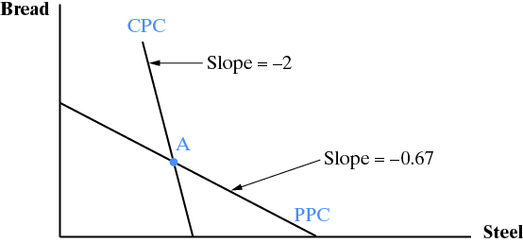
The Gains from Trade (3 of 4 )

Slide 24
The Gains from Trade (4 of 4 )
When the U.S. increases steel output by 1 ton, it loses 0.67 loaves of bread.
But it gains 2 loaves when it trades with Canada.
Net gains from trade are 2 – 0.67 = 1.33 loaves.
When Canada increases bread output by 2 loaves, it loses 0.67 tons of steel output.
But it trades 2 loaves for 1 ton of steel.
Net gains from trade are 1 – 0.67 = 0.33 tons of steel.

Slide 25
Maximizing the Value of Output (1 of 3)
Canada and the U.S. can produce anywhere on their PPCs.
What point on the PPC maximizes the consumption possibilities?
Consumption possibilities are maximized when we are on the CPC that is furthest out from the origin.
Maximizing the value of output maximizes the gains from trade.

Slide 26
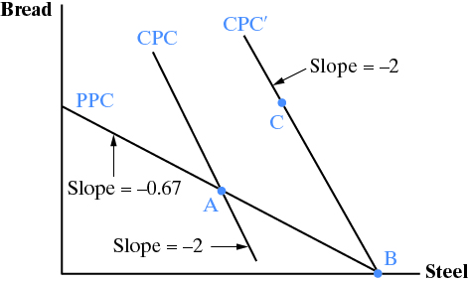
Maximizing the Value of Output (2 of 3)

Slide 27
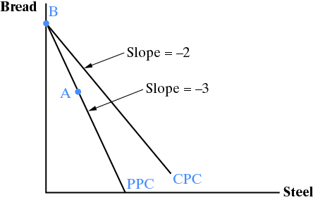
Maximizing the Value of Output (3 of 3)

Slide 28
Absolute Advantage versus Comparative Advantage
Absolute advantage means a country has greater labor productivity.
Comparative advantage means a country has a lower opportunity cost.
The U.S. has an absolute advantage in steel because 3 tons per hour > 1 ton per hour.
The U.S. also has a comparative advantage in steel because 0.67 loaves per ton < 3 loaves per ton.

Slide 29
Two Questions
Q: What if a country does not have an absolute advantage in anything?
A: It still benefits from trade.
Q: What if a country has an absolute advantage in everything?
A: It still benefits from trade.
Comparative advantage shows why.

Slide 30
What if a Country Has No Absolute Advantage? (1 of 2)
Blank | Japan | Malaysia
Cars | 2 cars | 0.5 cars
Steel | 2 tons | 1 ton
Japan has an absolute advantage in both goods, but a comparative advantage is cars:
1 ton per car < 2 tons per car.
Malaysia has an absolute advantage in nothing, but a comparative advantage in steel:
½ car per ton < 1 car per ton.

Slide 31
What if a Country Has No Absolute Advantage? (2 of 2)
The world price of cars will settle between 1 and 2 tons of steel per car. Let’s say 1.5.
Japan specializes in cars and trades 1 car for 1.5 tons of steel. It is better off because making steel costs 1 car per 1.0 tons.
Malaysia specializes in steel and trades 1.5 tons for a car. It is better off because making cars costs 2 tons per car.

Slide 32
Case Study: Republic of Korea
South Korea developed rapidly after the Korean War ended in 1953. It has one of the best growth records of any country.
It gradually increased its comparative advantage in higher and higher valued products.
Export industries played a key role.
Blank | 1960 | 1980 | 2000 | 2010
GDP per capita ($US, 2000) | 1,154 | 3,358 | 11,347 | 16,372
Trade-to-GDP ratio | 15.8 | 72.0 | 74.3 | 102.0

Slide 33
Comparative Advantage versus Competitive Advantage (1 of 2)
Competitive advantage means selling at a lower cost.
Comparative advantage means having a lower opportunity cost.
Comparative advantage = competitive advantage when markets are perfectly competitive and the prices of all inputs and outputs reflect their relative scarcity.
Comparative advantage ≠ competitive advantage when prices do not reflect the relative scarcity.

Slide 34
Comparative Advantage versus Competitive Advantage (2 of 2)
Comparative advantage ≠ competitive advantage when prices do not reflect the relative scarcity. When is that?
In trade, this occurs mostly when governments supply protection or subsidies.
Protection drives up the price of imports
Subsidies drives down the private cost of production.
Countries can be internationally competitive in industries where they do not have a comparative advantage if they receive subsidies.

Slide 35
Economic Restructuring (1 of 3)
When trade begins, economies move from one point to another on their PPC. In our simple model, the U.S. bread industry and the Canadian steel industry disappeared.
Both economies underwent economic restructuring: some industries grew, others shrank.
Both Canada and the U.S. benefitted, but not necessarily every individual—bread workers in the U.S. and steel workers in Canada must change jobs.

Slide 36
Economic Restructuring (2 of 3)
In our simple model, everyone is employed, workers are equally adept at both industries, and there are no costs associated with changing jobs.
In the real world:
Not everyone can easily find a job.
We are not equally adept at any industry.
It costs money, time, and psychological resources to move from one place to another.

Slide 37
Economic Restructuring (3 of 3)
Most countries have programs to ease the burden of job losses caused by trade.
In the U.S., this is called trade adjustment assistance (TAA).
TAA is justified by several arguments:
Trade makes the nation better off; the winners can compensate the losers and still gain.
Fairness.
Not doing so creates a backlash that endangers trade and the gains from trade.

Slide 38
Copyright

