Slide 1
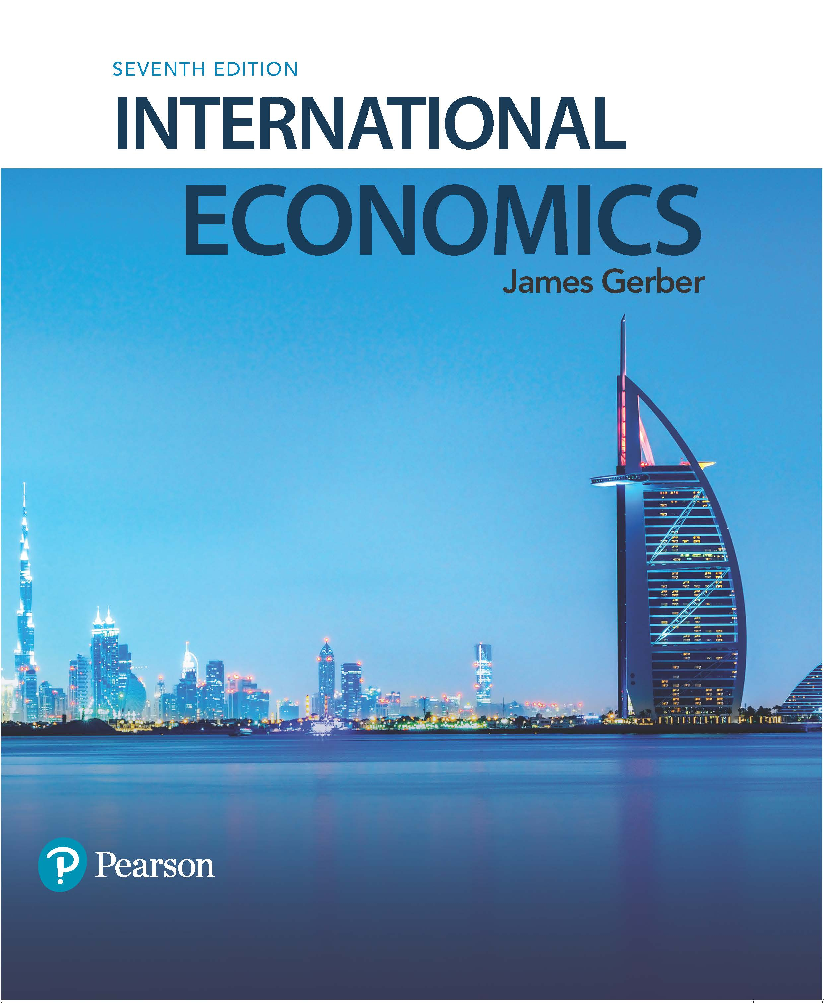
International Economics
Seventh Edition
Chapter 4
Comparative Advantage and Factor Endowments
Copyright © 2018, 2014, 2011 Pearson Education, Inc. All Rights Reserved

Slide 2
Learning Objectives (1 of 2)
4.1 Use the Heckscher-Ohlin Trade Model to analyze trade patterns between two countries with two inputs and two outputs.
4.2 Predict the impacts on different factors of production of trade opening.
4.3 Discuss the limits of the HO model.

Slide 3
Learning Objectives (2 of 2)
4.4 Explain the trade-offs for firms between trading and investing internationally.
4.5 Give examples of the determinants of international migration ad its impact on comparative advantage.
4.6 Describe the controversies surrounding the impact of international trade on wages and jobs.

Slide 4
The Heckscher-Ohlin Trade Model (1 of 6)
Eli Heckscher and Bertil Ohlin: 20th century Swedish economists.
Best known for their model explaining patterns of international trade.
Also called the factor proportions model.
HO Model idea: The relative abundance of different factors of production (inputs) determine which country has a comparative advantage in which goods.

Slide 5
The Heckscher-Ohlin Trade Model (2 of 6)
The HO Model: 2x2x2
2 inputs, called labor and capital.
2 outputs, called bread and steel.
2 countries, called the U.S. and Canada.
Relative factor endowments are the ratios of capital to labor.
Written: K/L

Slide 6
The Heckscher-Ohlin Trade Model (3 of 6)
Blank | United States | Canada
Capital | 50 machines | 2 machines
Labor | 150 workers | 10 workers
Factor abundance depends on the ratios of K to L.
K_{CA} / L_{CA} = 2 / 10 = 1/5.
K_{US} / L_{US} = 50 / 150 = 1/3.
Since K_{US} / L_{US} > K_{CA} / L_{CA} the US is capital abundant compared to Canada and Canada is labor abundant compared to the U.S.

Slide 7
The Heckscher-Ohlin Trade Model (4 of 6)
Relative factor abundance determines which goods a country will export and import.
Relative abundance means the input is relatively less expensive than the other input.
Relative scarcity means the opposite.
Capital is relatively cheap in the US, labor is relatively expensive. Vice versa for Canada.
HO Model: Countries will have a comparative advantage in the production of goods that intensively use their relatively abundant factor.

Slide 8
The Heckscher-Ohlin Trade Model (5 of 6)
In our model with bread and steel, assume the recipe for steel requires relatively more capital per unit of labor than bread.
Steel is capital intensive, bread is labor intensive.
The U.S. is capital abundant, it will have a comparative advantage in steel.
Canada is labor abundant, it will have a comparative advantage in bread.
The HO Model predicts that the U.S. exports steel, imports bread.
Unlike the Ricardian Model: Incomplete specialization.

Slide 9
The Heckscher-Ohlin Trade Model (6 of 6)
In the real world: The U.S., compared to other countries, is relatively abundant in:
Capital;
Certain natural resources such as agricultural land;
Skilled labor, particularly scientific, engineering, and managerial.
According to HO, the U.S. should export capital intensive goods (example: aircraft); agricultural products (example: grains); and technology (example: pharmaceuticals).

Slide 10
The PPC with Two Factors (1 of 3)
The Ricardian model of Chapter 3 assumed one homogenous input with a constant tradeoff between the two goods.
Complete specialization.
The HO Model assumes two inputs and different input requirements for each good.
Steel takes more capital, less labor.
Bread takes more labor, less capital.
This produces a PPC that is convex.
The opportunity cost increases when we produce more of one good because we are moving inputs that are less suited to the good with expanding output.
Incomplete specialization.

Slide 11
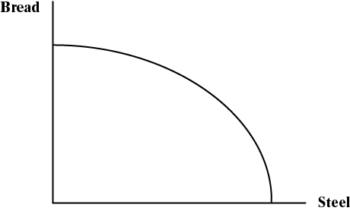
The PPC with Two Factors (2 of 3)

Slide 12
The PPC with Two Factors (3 of 3)

Slide 13
The Gains from Trade in the HO Model

Slide 14
Income Distribution Effects of Trade in the HO Model (1 of 3)
Ricardian Model: Every individual benefits from trade.
One input, labor.
Labor is homogeneous and moves without friction between sectors.
HO Model: Not every factor of production benefits.
Two inputs, labor and capital
Owners of labor or capital may be harmed, depending on which output shrinks when trade begins.

Slide 15
Income Distribution Effects of Trade in the HO Model (2 of 3)
Trade moves an economy along its PPC, increasing output of one good, shrinking output of the other.
Income for owners of capital and labor depends on how much demand there is for their services.
This is called derived demand.
The demand for their services depends on what is produced.
In the bread and steel example, the US increased output of steel which uses more capital, less labor.
The incomes of both factors will be affected.

Slide 16
Income Distribution Effects of Trade in the HO Model (3 of 3)
In our example, the price of steel increased in the US, bread fell. The opposite was true in Canada.
The Stolper-Samuelson Theorem:
An increase in the price of a good raises the income of the factor used intensively in its production.
A decrease in the price of a good lowers the income of the factor used intensively in its production.
US: returns on capital increase, wages fall.
Canada: returns on capital fall, wages rise.

Slide 17
Income Distribution in the Short Run (1 of 2)
The HO Model as presented describes the long run, after all changes have worked through the economy.
We assumed workers and capital owners could effortlessly move from bread to steel and back, as needed.
In the short run, however, they may be stuck.
The Specific Factors Model describes what happens.
Three factors: Land, Labor, and Capital.
Two outputs: bread and steel.
One factor is specific to each output:
Bread is made with labor and land.
Steel is made with labor and capital.

Slide 18
Income Distribution in the Short Run (2 of 2)
After trade begins:
US landowners see a decline in the demand for land, incomes fall. Owners of the specific factor used intensively in the declining industry are hurt.
US capital owners see an increase in demand for capital, incomes rise. Owners of the specific factor used intensively in the expanding industry are better off.
Labor?
Some move from bread to steel, but since steel is not labor intensive, their wages fall (same as HO).
However, bread is cheaper, they are better off in that way.
Steel is more expensive, they are worse off from that.
Net result is indeterminate.

Slide 19
Case Study: Comparative Advantage in a Single Natural Resource (1 of 2)
Country | Reserves (2015, billions of barrels) | (Fuel Exports / Total Exports) x 100 (2013)
Venezuela | 298 | 96.7
Saudi Arabia | 268 | 80.6
Canada | 172 | 27.0
Iran | 158 | 60.4
Iraq | 144 | 99.6
Kuwait | 104 | 90.7
UAE | 98 | 30.0
Russia | 80 | 63.6
Libya | 48 | 96.3
Nigeria | 37 | 79.3

Slide 20
Case Study: Comparative Advantage in a Single Natural Resource (2 of 2)
The resource curse: The abundant endowment of a single valuable resource can crowd out other economic activities.
Labor and capital become concentrated in the production of the resource because it is so valuable. It is hard to develop alternative industries.
In countries with weak institutions, fighting over the gains from the resource hinders economic development.
The resource curse is not inevitable: see Canada.

Slide 21
Empirical Tests of the Theory of Comparative Advantage
Tests of the Ricardian Model are relatively successful in predicting export patterns.
In this model trade is driven by productivity differences.
Tests of the factor endowment (HO) model of trade yield mixed results.
Empirical tests are difficult: How to measure factor endowments? Prices in autarky?
Trade is also affected by technological differences. We assumed the same technology in the two trading economies but in reality, different countries have different technologies.
Other factors are also important: economies of scale, corporate structures, economic policies.

Slide 22
Extensions of the HO Model: The Product Cycle (1 of 4)
The product cycle describes how production migrates from high income, advanced economies to middle income developing economies.
Early stage of production: Locate in high income country.
Need science and engineering skills to develop new product.
Need high income consumers to try it out, provide feedback.

Slide 23
Extensions of the HO Model: The Product Cycle (2 of 4)
Middle stage of production, location begins to shift.
Design and production processes beginning to be standardized.
Mass production beginning.
Labor costs begin to matter more.
Late stage:
Production moves where labor costs are low.
The product is completely standardized.

Slide 24
Extensions of the HO Model: The Product Cycle (3 of 4)

Slide 25
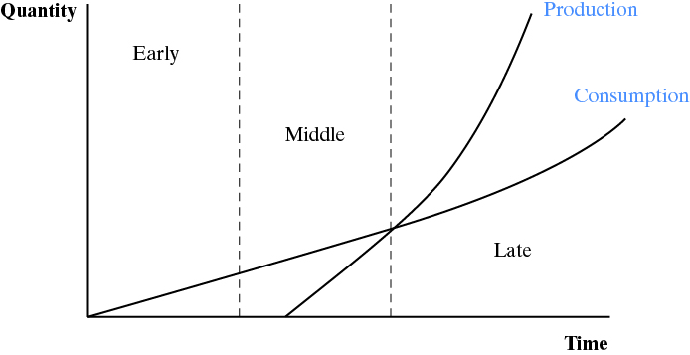
Extensions of the HO Model: The Product Cycle (4 of 4)

Slide 26
Case Study: China’s Top 10 Exports to the U.S. (1 of 2)
Item | Millions of $U.S.
Cell phones and other household goods | 64,074
Computers | 46,091
Computer accessories | 31,181
Toys, games, and sporting goods | 25,608
Apparel, textiles, nonwool or cotton | 22,957
Telecommunications equipment | 22,454
Furniture, household goods, etc. | 16,705
Apparel, household goods—cotton | 14,413
Footwear | 14,294
Other parts and accessories of vehicles | 13,392

Slide 27
Case Study: China’s Top 10 Exports to the U.S. (2 of 2)
The product cycle and China’s labor endowment explain many of their top exports to the U.S.
Standardized production: cell phones, computers, telecommunications equipment.
Labor intensive production: toys, games, sporting goods, furniture, apparel, footwear.
Over time, China moves up the ladder of comparative advantage, producing more capital intensive and skilled labor intensive goods.

Slide 28
Extension of the HO Model: Investing versus Trading (1 of 4)
In the HO Model, countries export one thing, import something different.
In the product cycle, firms invest abroad and some output may be sent back home.
A significant share of imports are intrafirm trade: Trade within one firm.
In the mid-1990s, around 1/3 of U.S. goods exports and 2/5ths of imports were intrafirm.

Slide 29
Extension of the HO Model: Investing versus Trading (2 of 4)
The OLI theory explains why firms choose to invest abroad instead of trading.
O: Ownership of an asset that makes a firm competitive, e.g., technology, trademark, reputation, etc.
L: Location abroad offers some advantage, such as proximity to markets, lower production costs, etc.
I: Internalization of the advantage instead of subcontracting or selling the right to produce the product.

Slide 30
Extension of the HO Model: Investing versus Trading (3 of 4)
Outsourcing refers to moving some part of production to another firm, either inside the home country or outside.
Off-shoring refers to moving some or all of production abroad.
If a firm off-shores but does not outsource, it is working with a foreign affiliate.
All combinations of off-shoring and outsourcing are possible.

Slide 31
Extension of the HO Model: Investing versus Trading (4 of 4)
Modern telecommunications and transportation make off-shoring easier today.
This heightens worries about the effects of off-shoring.
The loss of manufacturing jobs.
Technology theft (non-enforcement of patents, etc.)
Services might be next: medical services, accounting, IT, etc., delivered over the internet.

Slide 32
Extension of the HO Model: Internationally Mobile Labor (1 of 2)
The HO Model assumes that workers cannot move across international borders.
In 2013, there were an estimated 231 million international migrants.
20 percent were in the U.S.
Two-thirds were in high income countries.
In theory, labor inflows can influence comparative advantage by changing the labor endowment.
In the U.S. in the 1980s, the inflow of low skilled immigrants from Central America caused growth in California’s apparel sector.
U.S. agriculture relies on immigrant workers.
Immigrants in some countries work mainly in sectors producing non-traded goods—construction, nursing, etc.

Slide 33
Extension of the HO Model: Internationally Mobile Labor (1 of 2)
Economic analysis of migration relies on three dominant factors:
Demand pull factors: Pull migrants in (jobs, higher wages, promises of a better life, etc.)
Supply push factors: Push migrants out of their home country (poverty, wars, persecution, etc.)
Social networks: Determine where they settle in the receiving country (where there are family, friends, community members from home).

Slide 34
Trade, Wages, and Jobs (1 of 4)
The industry and location of jobs (kinds of jobs) may be affected by trade.
Moving along a PPC.
There may be short run effects on jobs in particular industries.
The overall number of jobs is not determined by trade; other factors are far more important.
Fiscal and monetary policies.
Labor market policies.

Slide 35
Trade, Wages, and Jobs (2 of 4)
Manufacturing is the most discussed case.
Productivity increases reduce the need for labor.
Services and manufactured goods production expand with income, but more and more labor ends up in services because its productivity does not rise as fast as in manufacturing.
Much more manufacturing production today is exposed to international competition.
Growth of China and other emerging economies.
Transportation and telecommunications revolutions.

Slide 36
Trade, Wages, and Jobs (3 of 4)
Q: Does trade with emerging markets cause wages to fall in high income economies?
A: Economists are not certain.
Trade may play some role in wage stagnation in advanced economies.
But it is also possible that it has little or no effect.
Many possibilities: For example, automation reduced the need for labor in manufacturing.
We need more research on this topic.

Slide 37
Trade, Wages, and Jobs (4 of 4)
Suppose trade causes jobs to be lost at home, wages to fall. What should we do?
Options:
Stop trading and block off-shoring;
Selectively block imports and off-shoring;
Keep trading and investing but assist workers.
Do nothing.
Each option has costs and benefits.

Slide 38
Copyright

