Slide 1

International Economics
Seventh Edition
Chapter 5
Beyond Comparative Advantage
Copyright © 2018, 2014, 2011 Pearson Education, Inc. All Rights Reserved

Slide 2
Learning Objectives (1 of 2)
5.1 Give examples of interindustry and intraindustry trade.
5.2 Compare and contrast internal and external economies of scale.
5.3 Analyze the effects of international trade in a monopolistically competitive industry.

Slide 3
Learning Objectives (2 of 2)
5.4 Describe the gains from intraindustry trade.
5.5 Explain how transportation costs and internal economies of scale help determine firm location decisions.
5.6 Present the pros and cons of industrial policies.

Slide 4
Introduction: More Reasons to Trade
The theory of comparative advantage is one of the foundations of trade theory.
  Nevertheless, it has a mixed record at explaining trade patterns.
  It is difficult to measure precisely.
A large proportion of world trade is not well described by comparative advantage alone.
  Most countries export the same or similar goods as the ones they import.
  Example: Auto trade between Canada, the United States, and Mexico.

Slide 5
Intraindustry Trade (1 of 8)
Definitions:
  Intraindustry trade: Exports and imports of the same products.
    The U.S. exports aircraft to the European Union and imports aircraft from them as well.
  Interindustry trade: Exports and imports of different products.
    China exports cell phones to the Latin America, imports copper and oil.

Slide 6
Intraindustry Trade (2 of 8)
Intraindustry trade is common between high income, advanced economies.
The measured importance of intraindustry trade varies, depending on how broadly we define an industry.
  For example, if we define an industry as “office machinery,” then computers and pencil sharpeners are in the same industry.
  The broader the definition of “industry,” the more trade appears to be intraindustry.

Slide 7
Intraindustry Trade (3 of 8)
Intraindustry trade is greater:
  Where there is more scope for product differentiation. Example: A country may import sports cars, export trucks.
  In high technology industries.
  In countries with larger amounts of foreign investment.
  In countries more open to trade.
Intraindustry trade is encouraged when there are internal economies of scale in production.

Slide 8
Intraindustry Trade (4 of 8)
Economists have extended trade theory beyond the Ricardian and HO models to account for the growth and importance of intraindustry trade.
New Trade Theory
  Not so new anymore: developed in the 1970s and 1980s.
  Models of trade based on economies of scale, both internal and external.

Slide 9
Intraindustry Trade (5 of 8)
Internal economies of scale: As a firm increases in size, its average cost of production falls.
  Examples: Autos, jet aircraft.
  The most efficient firms are large.
  Markets are not perfectly competitive.
External economies of scale: As an industry grows in size, the average cost of production falls for individual firms.
  Examples: Software, music, craft beer.
  Firms do not have an incentive to get large.
  Markets often remain perfectly competitive.

Slide 10
Intraindustry Trade (6 of 8)
Intraindustry trade often involves firms with internal economies of scale (EOS).
  We call it internal EOS because the scale economies depend on the size of the individual firm. As it grows, average cost falls.
Several types of market structures are possible:
  Oligopoly: A small number of firms, each formulates a strategy based on what it thinks the other will do.
  Monopolistic competition: Firms have brands that give them a monopoly, but they compete against other firms with different brands making close substitutes. Monopolistic competition relies on product differentiation.
  Monopoly: One firm.

Slide 11
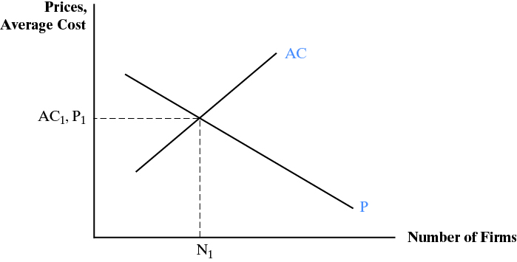
Intraindustry Trade (7 of 8)

Slide 12
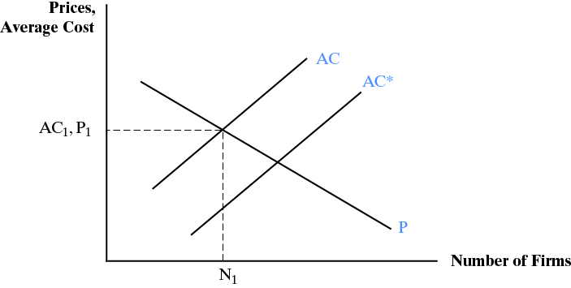
Intraindustry Trade (8 of 8)

Slide 13
The Gains from Intraindustry Trade
Lower costs and prices.
  A larger market means:
    More economies of scale and lower average costs
    More competition and lower prices.
An increase in consumer choices. There is more variety in the market.
An opportunity for domestic firms to expand. The market is larger and well-run firms will increase output.

Slide 14
Case Study: Intraindustry Trade Between the U.S. and Canada
Top 5 U.S. Exports | Dollars (Billions) | Top 5 U.S. Imports | Dollars (Billions)
Vehicle parts, not engines* | 23.2 | Crude oil | 83.1
Busses, trucks, other vehicles* | 15.0 | Passenger cars* | 42.7
Passenger cars* | 14.6 | Natural gas | 12.6
Other petroleum products | 12.9 | Vehicle parts, not engines* | 11.9
Industrial machines | 10.9 | Other petroleum products | 8.8
Vehicles and vehicle parts are the largest traded items.
Intraindustry trade is extremely important.

Slide 15
Transportation Costs and Internal Economies of Scale
Firms in general want to locate near their markets to reduce transportation costs.
  But if they have internal EOS they cannot build a plant in every market because they would have too many small firms.
  Solution: Locate near the largest market.
This helps explain why most foreign investment is directed to high income countries.
  High income markets have larger markets.
Avoiding high transportation costs also help explain why firms may locate where they incur higher labor or other costs.

Slide 16
Case Study: Mexico’s Changing Economic Geography
From the 1930s until the 1980s, Mexico focused its manufacturing on producing for its national market.
  Mexico City grew dramatically: Internal EOS and transportation costs partially explain its growth.
  Similar policies in other parts of Latin America, with similar results: Giant mega-cities.
In the 1960s, Mexico created an export processing zone (EPZ) policy.
  Plants are called maquiladoras.
  They can locate anywhere in the country; they can import inputs and pay no tariffs as long as they export the output.
  The market is the U.S.: Plants choose to locate in the border region and border manufacturing takes off in the 1980s.

Slide 17
Trade and External Economies of Scale (1 of 3)
External EOS:
  The scale economies are external to the firm, but internal to the industry.
  No incentive for a firm to get large.
  But average costs fall as the number of firms increases.
Three drivers of external EOS:
  Pooling of labor markets for specialized skills.
  Pooling of input markets for specialized inputs.
  Knowledge spillovers between firms.

Slide 18
Trade and External Economies of Scale (2 of 3)
External EOS leads to geographical concentration.
  There are self-reinforcing feedbacks from attracting specialized labor and input supplier
  Nashville (music); Silicon Valley (software, computer hardware); Hollywood (movies), etc.
Historical accident may play a role: circumstances cause a group of firms to locate in one area, they attract more firms, etc.
Learning curves also may play a role: Whoever learns first keeps that advantage by staying one step ahead.

Slide 19
Trade and External Economies of Scale (3 of 3)
Every trade model looked at so far shows gains from trade. Trade with external EOS may in some cases create losses.
Suppose the U.S. gains skill and experience in making widgets. Suppose also that other countries could do it better, but only after some years accumulating skills and learning.
  Trade lets the U.S. sell its lower price widgets to foreigners.
  Foreigners are not able to develop their industry because the low price of U.S. widgets makes foreign widgets unprofitable until they accumulate some years of experience.

Slide 20
Industrial Policies (1 of 9)
Industrial policies are used by governments that want to support the development of a particular industry.
  It may be a new industry or an existing one.
Most countries use industrial policies, either overtly or covertly, sometimes extensively and sometimes rarely.
  Examples in the U.S.: Support for the development of clean energy, new generations of motor vehicles, health care technologies and procedures, etc.

Slide 21
Industrial Policies (2 of 9)
The rationale for industrial policies (IP) is based on the fact that markets sometimes do not provide an optimal quantity of a good or service.
  For example, when there is a divergence between private returns (the benefit to the individual) and social returns (the benefit to society as a whole).
  Or, between private costs (the cost to an individual firm) and social costs (the net cost to society).

Slide 22
Industrial Policies (3 of 9)
If some of the costs or benefits are not included in the market transaction, there is an externality.
  Externalities are known as market failures.
  Examples: Vaccinations (private and social benefits differ); pollution (private and social costs differ).
Basic rules:
  When social returns are greater than private, markets produce too little at too high a cost.
  When social returns are less than private, markets produce too much at too low a cost.

Slide 23
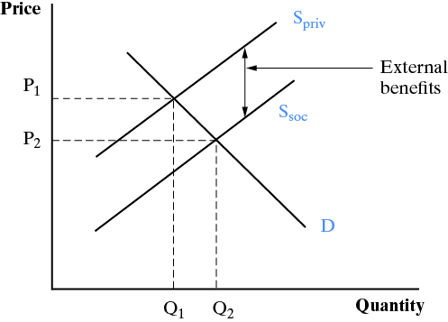
Industrial Policies (4 of 9)

Slide 24
Industrial Policies (5 of 9)
Why private and social returns might be different:
  Knowledge spillovers: A new product generates benefits for the producer (profits) and for others (the new knowledge that can be used in other areas). Example: personal computers.
  Coordination problems: For two products to be successful, they both have to be created at the same time. Example: Electric cars and plug-in stations.
  Capital market imperfections: A lack of information by banks and financial firms keeps financing out of the hands of people with profitable ideas.

Slide 25
Industrial Policies (6 of 9)
Industrial policy tools.
  Keep foreign products out of the domestic market.
  Provide information about foreign markets.
  Tax breaks and subsidies—to producers or to consumers of the product to encourage sales.
  Sell foreign currency at a low rate.
  Loans, loan guarantees, and subsidies.
  Government purchases to encourage production.
  Allow firms to collude to pool resources.

Slide 26
Industrial Policies (7 of 9)
Obstacles to industrial policies: WTO rules.
  WTO agreements limit their usage, although most countries find ways around the limits.
  WTO agreements allow governments to provide a financial benefit (subsidy) for precompetitive research and development, but not for commercial products. This distinction is difficult to make in practice.

Slide 27
Industrial Policies (8 of 9)
Obstacles to industrial policies: Practical.
  Measuring market failures is difficult, but necessary to determine the gap between private and social returns.
  Which industry to target?
  Industrial policies encourage rent seeking. Individuals and firms spend money to get a benefit rather than spending to become more productive.
  Opportunities for corruption.
  Downstream firms may be hurt; e.g., an industrial policy to build a steel industry may result in higher cost steel for domestic firms.

Slide 28
Industrial Policies (9 of 9)
Economists: The “con” side.
  IP cause rent seeking.
  We don’t know which industries to fund, the market may not be perfect but it is better than a government committee.
  The economic record is very mixed on their success.
Economists: The “pro” side:
  Information gaps and coordination problems means the market is sometimes ineffective or takes too long.
  All counties but particularly developing countries can benefit from a selective boost to key industries.
  Most countries have used these policies throughout their history, including the U.S. and other proponents of free markets.

Slide 29
Case Study: WTO Rules and Industrial Policies (1 of 2)
The Uruguay Round of trade negotiations created the WTO and extended several agreements that affect industrial policies.
Trade related investment measures (TRIMS)
  Designed to ensure national treatment for foreign investments.
  Restricts requirements to use local inputs or to reach export targets.
Subsidies and countervailing measures (SCM)
  Parallel to TRIMS.
  No subsidies allowed if they hurt firms in foreign markets.

Slide 30
Case Study: WTO Rules and Industrial Policies (1 of 2)
The Uruguay Round also set requirements for enforcement of intellectual property rights.
Trade-Related Aspects of Intellectual Property Rights (TRIPS)
  All countries must enforce intellectual property rights laws.
    Patents, copyrights, trademarks, geographical designations, blueprints, designs.
  Restrictions on reverse engineering.
  Limits on requirements that foreign firms transfer technology.
All these rules are controversial: Do they limit the ability of developing countries to support economic development?
Are they designed to protect the profits of multinational corporations at the expense of host country citizens?

Slide 31

Copyright

