Slide 1
International Economics
Seventh Edition
Chapter 6
The Theory of Tariffs and Quotas
Copyright © 2018, 2014, 2011 Pearson Education, Inc. All Rights Reserved

Slide 2
Learning Objectives (1 of 2)
6.1 Use supply and demand analysis to explain and illustrate consumer and producer surplus.
6.2 Graphically demonstrate the effects of tariffs and quotas on prices, output, and consumption for small and large countries.
6.3 Differentiate and explan the resource allocation and income distribution effects of tariffs and quotas.

Slide 3
Learning Objectives (1 of 2)
6.4 Use tariff data on inputs and outputs to compare effective and nominal rates of protection.
6.5 Compare and contrast quotas and tariffs.

Slide 4
Introduction to Tariffs and Quotas (1 of 3)
The analysis of tariffs and quotas is called commercial policy.
In this chapter we look mainly at single market effects of tariffs and quotas.
For example, the effect in the steel market of a tariff or quota on steel.
This is called partial equilibrium analysis.
Tariffs and quotas also have effects that spread through the economic system.

Slide 5
Introduction to Tariffs and Quotas (2 of 3)
A tariff is a tax on imports.
It may be a set amount: $5 per ton of steel.
Or, it may be a percentage: 10% of the import value.
A quota is a physical limit on import quantity.
Quotas come in many forms, for example import licensing requirements or voluntary export restraints.
The analysis is similar to a tariff, although the effects are slightly different.

Slide 6
Introduction to Tariffs and Quotas (3 of 3)
Tariffs and quotas cause changes in the production, consumption, and importation of the good on which they are levied.
Production at home increases.
Some consumption switches from foreign goods to domestic, but overall consumption decreases.
Imports decline.
There are changes in other industries and on the performance of the economy as a whole as the effects work through the system.

Slide 7
Analysis of Tariffs and Quotas (1 of 7)
Consumer surplus is the value of a good or service that is in excess of what a consumer has to pay.
Example: You are willing to pay $100 for a pair of shoes, but can buy them for $60. Your consumer surplus is $40.
Graphically, in a supply and demand system, it is the area under the demand curve and above the price.
Different consumers have different levels of consumer surplus.

Slide 8
Analysis of Tariffs and Quotas (2 of 7)
Producer surplus is the revenue received by producers that is in excess of the minimum they need to produce a given amount.
Example: You are willing to sell shoes you made for $40 a pair but you can get $60. Your producer surplus is $20.
Graphically, in a supply and demand system, it is the area above the supply curve and below the price.
Different producers have different levels of producer surplus.

Slide 9
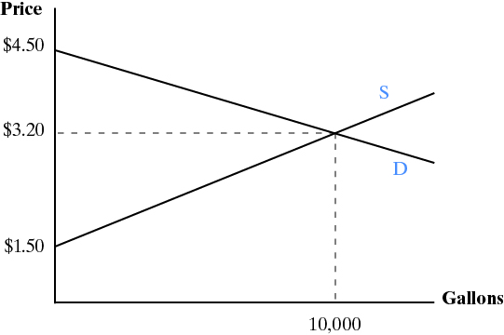
Analysis of Tariffs and Quotas (3 of 7)

Slide 10
Analysis of Tariffs and Quotas (4 of 7)
Assume the following:
There is perfect competition, so no tariffs or quotas.
There is one world price (setting aside transportation costs): P_{w} .
Foreign producers are willing to supply us with all we demand at P_{w} .
P_{w} is below the domestic equilibrium price.

Slide 11
Analysis of Tariffs and Quotas (5 of 7)

Slide 12
Analysis of Tariffs and Quotas (6 of 7)
The home country imposes a tariff.
The import price remains P_{w} but importers must pay a tariff to the government, amount t.
The domestic price rises to: P_{w} + t. Let’s call it P_{t}.
Domestic production increases.
Domestic producers can raise prices to P_{t}.
Domestic consumption falls.
Prices have gone up.
Imports fall.
More of the consumption is supplied by domestic firms.

Slide 13
Analysis of Tariffs and Quotas (7 of 7)

Slide 14
Resource Allocation and Income Distribution Effects (1 of 6)
Areas a through d in Figure 6.3 represents a shift in consumer and producer surplus.
Before the tariff was imposed:
Consumer surplus: a + b + c + d + e + f.
Producer surplus: g.
After the tariff:
Consumer surplus: e + f. This is a loss of a + b + c + d.
Producer surplus: a + g. This is a gain of a.

Slide 15
Resource Allocation and Income Distribution Effects (2 of 6)
The resource allocation effects can be broken down into losses on the production side and on the consumption side. Define:
Deadweight loss: A destruction of consumer or producer surplus that is not matched by a gain elsewhere in the system. Deadweight losses can be either consumption side or production side.
Efficiency loss: A deadweight loss on the production side.
The income distribution effects are changes caused by the redistribution of consumer and producer surplus.
Areas a through d marked in Figure 6.3 are either an income distribution effect or a resource allocation effect of the tariff.

Slide 16
Resource Allocation and Income Distribution Effects (3 of 6)
Consider each of the areas, a through g, in Figure 6.3;
Area a: Before the tariff it was part of consumer surplus; now it is part of producer surplus. It is an income distribution effect.
Area b: Consumer surplus before, completely eliminated after. It is a deadweight loss and a resource allocation effect.
Area c: Consumer surplus before, now it is government revenue from the tariff. It is an income distribution effect.

Slide 17
Resource Allocation and Income Distribution Effects (4 of 6)
Area d: Consumer surplus before, now it is a deadweight consumption loss. It is a resource allocation effect.
Area e: Consumer surplus before and after.
Area f: Consumer surplus before and after.
Area g: Producer surplus before and after.

Slide 18
Resource Allocation and Income Distribution Effects (5 of 6)
Variable | Free Trade | Post-Tariff
Price to consumers | P_{w} | P_{t}
Domestic consumption | Q₂ | Q₂*
Domestic production | Q₁ | Q₁*
Imports | Q₁Q₂ | Q₁*Q₂*
Consumer surplus | a + b + c + d + e + f | e + f
Producer surplus | g | g + a
Government revenue | 0 | c
Deadweight consumption loss | 0 | d
Deadweight production (efficiency) loss | 0 | b

Slide 19
Resource Allocation and Income Distribution Effects (6 of 6)
Why are areas b and d deadweight losses?
Area b:
The difference between producing the good at home and buying it from foreigners.
The added amount of domestic resources used that is above the income we’d give up to buy the same quantity.
Area d:
The loss in consumer surplus when higher prices cause people to leave the market.
Consumers value the good more than it costs but cannot buy it at the world price.

Slide 20
Other Costs of Tariffs
Retaliation by other countries.
Innovation:
Tariffs on imported machinery may slow the adoption of new techniques;
Protection reduces incentives to increase productivity, improve products.
Rent seeking: Firms spend time and money seeking protection rather than increasing productivity.

Slide 21
Case Study: A Comparison of Tariff Rates (1 of 2)
Over time, tariffs have fallen worldwide.
There are several patterns:
Generally, tariffs are lower in high income countries.
Tariffs tend to be higher in lower income countries partly because they rely on them for government revenue.
Tariffs are higher in agricultural products, apparel manufacturing, and textiles.

Slide 22
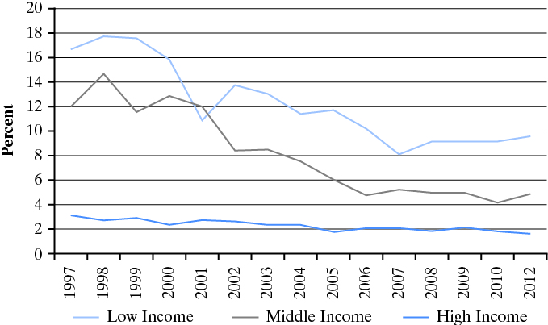
Case Study: A Comparison of Tariff Rates (2 of 2)

Slide 23
Tariffs and the Large Country Case (1 of 3)
We assumed that the country imposing the tariff does not affect the world price.
A large country may consume a large enough share of total output that it affects the world price.
In that case, foreign producers see a significant loss of demand and they may drop their price.
In theory, large countries can improve their welfare by using tariffs.
This assumes no retaliation.
The tariff cannot be too large.

Slide 24
Tariffs and the Large Country Case (2 of 3)

Slide 25
Tariffs and the Large Country Case (3 of 3)
The analysis is as before except that the tariff revenue, areas c + g, now includes some of the revenue, area g, that was paid to foreign producers when there was no tariff.
Areas c + g are government revenue.
Area g is a net gain to the importing country.
The net effects are analyzed the same as before.
For the large country to gain from the tariff, g must be greater than b + d.

Slide 26
Nominal and Effective Rates of Protection (1 of 4)
If tariffs are placed on imported inputs, it makes production more expensive.
Tariffs on inputs disadvantage users of the inputs.
For example, tariffs on steel hurt domestic car makers.
Tariffs on inputs counteract a tariff on the output product.
Historically, tariff systems evolved over time and countries often ended up with layers and layers of tariffs.
A high tariff on an imported input can even make the rate of protection on the output negative—i.e., it is more vulnerable to imports.

Slide 27
Nominal and Effective Rates of Protection (2 of 4)
The nominal rate of protection is the tariff rate.
The effective rate of protection is the percentage change in the value added after the tariff is levied.
Value added is the value of a good minus the costs of the intermediate inputs. It measures the contributions of labor and capital to production at a given stage.

Slide 28
Nominal and Effective Rates of Protection (3 of 4)
The effective rate of protection:
(VA* - VA) ÷ VA, where
VA is domestic value added with free trade;
VA* is domestic value added after all tariffs are taken into account.

Slide 29
Nominal and Effective Rates of Protection (4 of 4)
Blank | No tariff | Tariff = 20% on final product | Tariffs: 20% on final product and 50% on imported inputs
Price of a laptop | $1,000 | $1,200 | $1,200
Value of foreign inputs | $600 | $600 | $900
Domestic value added | $400 | $600 | $300
Effective rate of protection | 0 | 50% | -25%
The effective rate of protection is higher than the nominal rate if there are no tariffs on imported inputs.
Tariffs on imported inputs reduces the effective rate and can even turn it negative.

Slide 30
Quotas (1 of 5)
Quotas are physical limits on imports.
Differences between quotas and tariffs:
Quotas do not generate revenue for the government.
Increases in foreign productivity do not result in lower prices with a quota but they do with a tariff.
Quotas can increase foreign profits.
Similarities between quotas and tariffs:
Both reduce imports; for any quota, there is a tariff equivalent;
Both increase domestic prices, reduce domestic consumption, increase domestic production.

Slide 31
Quotas (2 of 5)
When a quota is imposed, the price increases due to the limits on availability.
All of the analysis is similar to the analysis for a tariff, except for government revenue.
With a tariff, consumers transfer to government an amount equal to the tariff times the quantity of imports.
With a quota there is no government revenue.
Foreign producers raise prices; the increase in the price times the imports is added revenue for them. These are called quota rents.
Some of the revenue may be captured by domestic distributors of the product.

Slide 32
Quotas (3 of 5)

Slide 33
Quotas (4 of 5)
When a tariff is imposed, foreign producers can still increase their share of the market by becoming more efficient.
Productivity increases by foreigners allow them to lower their prices and gain more of the market.
When a quota is imposed, no matter how efficient foreign producers become, they cannot increase their share of the market.
All future increases in the size of the market go to domestic producers.

Slide 34
Quotas (5 of 5)
Quotas come in several different forms. Two common ones are:
Voluntary export restraints (VER) are agreements between an importing and exporting countries to voluntarily limit exports.
Import licensing requirements are requirements that any importer must obtain a license; the number of licenses and amounts are limited.
Quotas and the WTO
When countries join the WTO, they agree to eventually convert quotas to tariffs.
Tariffs are more transparent and still allow competition between domestic and foreign firms.
The WTO does not allow VERs.

Slide 35
Other Forms of Protection (1 of 2)
Nontariff barriers: Quotas and nontariff measures.
Nontariff measures: Other measures that limit imports. They are sometimes nontransparent and even unintentional. For example:
Overly complicated customs procedures.
Health and safety measures.
Technical standards.
Government procurement rules.
Environmental rules.

Slide 36
Other Forms of Protection (2 of 2)
Sometimes nontariff measures are intended as a hidden form of protection.
But sometimes they may exist for reasons that have nothing to do with protectionism or to reduce imports.
Example: EU and US have a dispute over the use of hormones in animal feed. The EU prohibits it, the US allows it. The US says Europe is being protectionist; Europe says it is protecting consumer health and safety.

Slide 37
Case Study: Intellectual Property (1 of 2)
Intellectual property rights consist of:
Patents;
Copyrights and trademarks;
Industrial designs;
Geographical designations;
Integrated circuit layouts.
The Trade Related Aspects of Intellectual Property Rights Agreement (TRIPS) governs the rights and responsibilities of countries that are WTO members.

Slide 38
Case Study: Intellectual Property (2 of 2)
Lack of intellectual property rights enforcement is considered a nontariff measure because it limits trade flows.
Firms do not want to sell in a market where their intellectual property will be stolen or copied illegally.
Intellectual property rights are a controversial topic in trade discussions.
High income countries, in particular, want greater enforcement.
Some countries (U.S., for example) want longer, broader, patents.
Low and middle income countries want more access to technology.
In addition, the costs of implementing and enforcing intellectual property rights is a burden in many poor countries.
Example: Pharmaceuticals.
Should poor countries be allowed to copy pharmaceuticals (break the patent) that are life saving when they cannot afford to buy them from the companies that developed them?

Slide 39
Copyright

