Slide 1
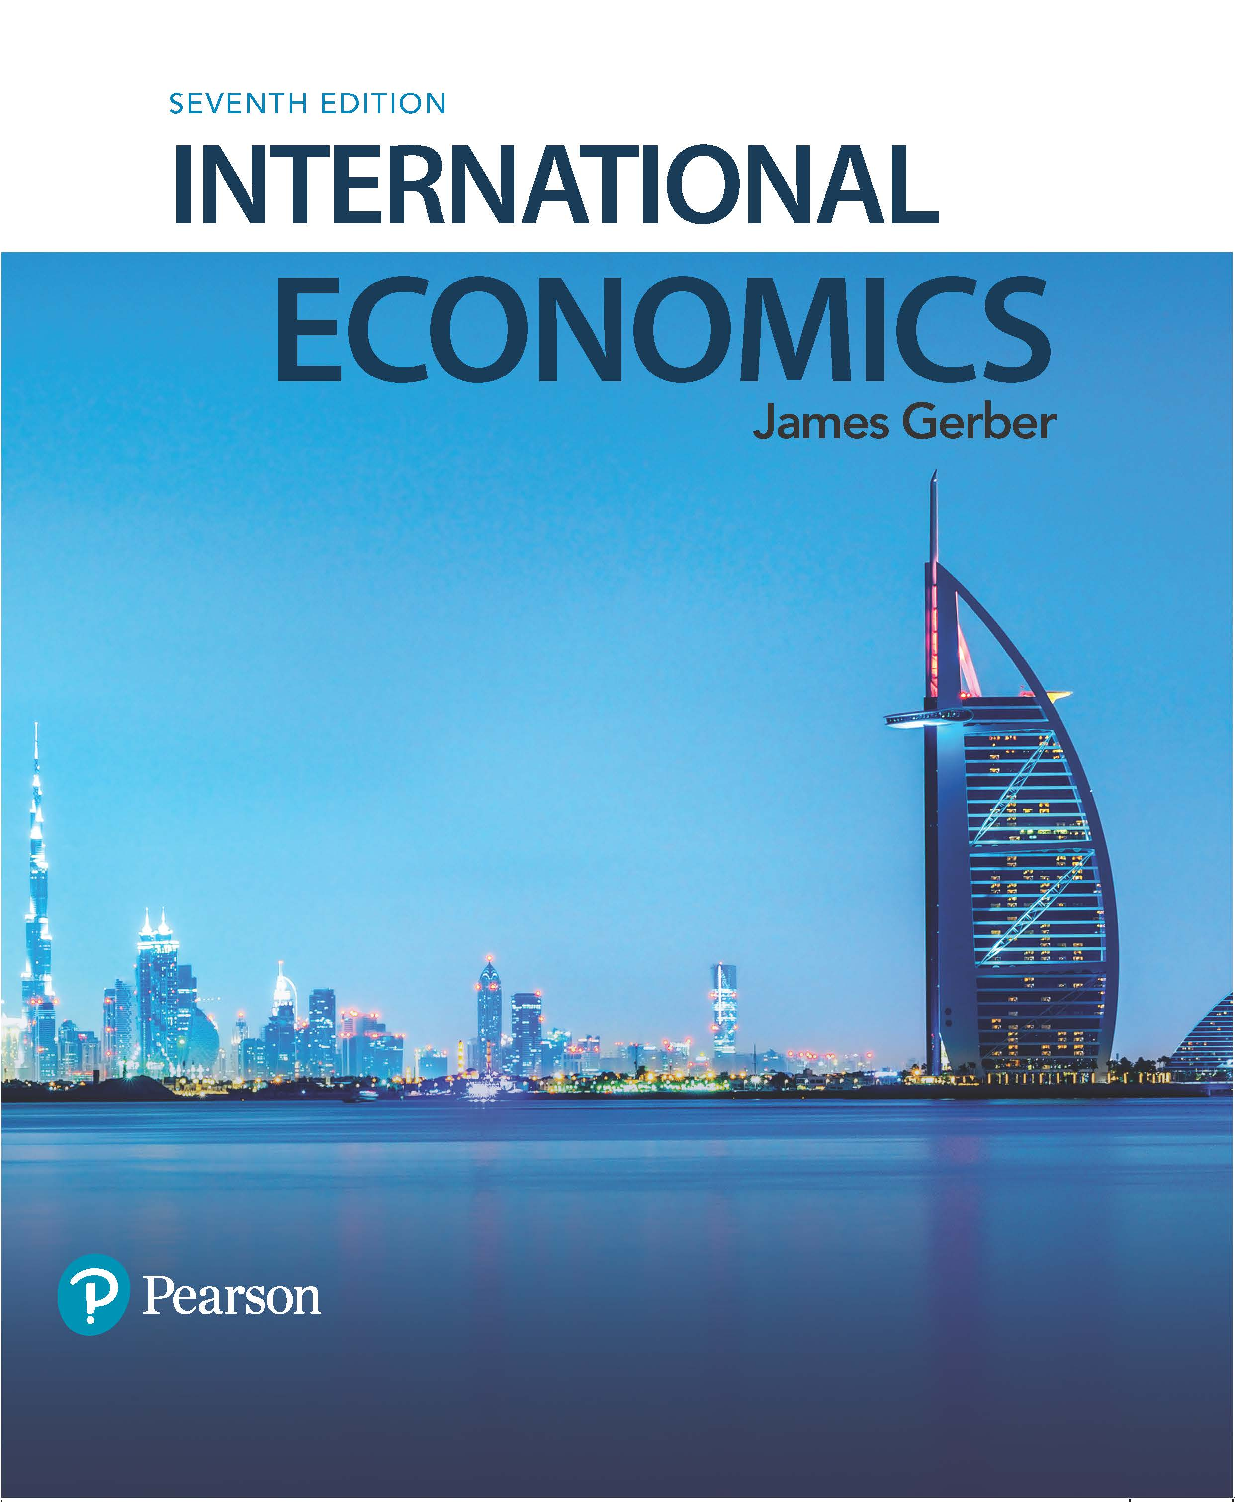
International Economics
Seventh Edition
Chapter 8
International Trade and Labor and Environmental Standards
Copyright © 2018, 2014, 2011 Pearson Education, Inc. All Rights Reserved

Slide 2
Learning Objectives (1 of 2)
8.1 Compare and contrast the three options for setting standards in trade rules.
8.2 Give examples of the relationship between income levels and environmental and labor problems.
8.3 Define labor standards.

Slide 3
Learning Objectives (2 of 2)
8.4 State four potential problems with using trade sanctions to enforce labor standards.
8.5 Compare and contrast transboundary and nontransboundary environmental problems.
8.6 Explain three alternatives to trade measures for enforcing labor and environmental standards.

Slide 4
Introduction: Income and Standards
As trade barriers have fallen, policies that are not trade measures act as limits to further increases in trade and integration.
Chapter 1 described the issue as deep integration versus shallow integration.
National laws sometimes unintentionally limit international commerce.
Differences in national standards affect trade flows and may unintentionally confer advantages or disadvantages.
Trade between low and high income countries experiences this, sometimes acutely.
Differences in wages, working conditions, environmental rules affect trade relations.
Differences in national standards can become sources of conflict.

Slide 5
Setting Standards (1 of 3)
There are three possibilities for recognizing standards:
Harmonization of standards.
Countries agree on a common set of standards.
Mutual recognition of standards.
Each country keeps its own standards but recognizes and accepts the standards of other countries.
Separate standards.
Each country keeps its own standards and does not recognize or accept the standards of other countries.

Slide 6
Setting Standards (2 of 3)
There are no general rules as to which is best.
Sometimes harmonization is useful if it leads to more efficiency in production, fewer regulatory issues
Example: Harmonization of product designs, technical standards.
But often, it is not clear which is the best standard; then experimentation is useful and mutual recognition is better.
Example: New products or processes such as driverless cars.
In some cases, a country may have a very good reason not to accept another country’s standards.
Example: pesticide or herbicide exposures, some professional certifications, many other cases.

Slide 7
Setting Standards (3 of 3)
Labor, environmental, health and safety, technical and other standards vary across countries. Several factors determine this:
Rich and poor countries have different preferences, needs, abilities.
Different cultures have different value systems, different traditions, particularly with respect to gender and work.
Rich countries worry about a race to the bottom in standards.
Poor countries worry about standards designed to eliminate their comparative advantages.

Slide 8
Case Study: Income, Environment and Society
Income level | Infant mortality per 1000 population, 2014 | Population (%) with access to safe drinking water, 2014 | CO₂ emissions, tons per person, 2011 | Decline in forested land, 2000-2012
Low | 78.8 | 65.0 | 0.3 | -0.60
Lower middle | 54.7 | 88.9 | 1.5 | -15.86
Upper middle | 19.8 | 94.5 | 5.7 | -7.08
High | 7.0 | 99.0 | 11.1 | -0.01
Some problems improve with income, e.g., infant mortality and safe water;
Some worsen, e.g., greenhouse gasses;
Some worsen, then improve, e.g., deforestation.

Slide 9
Labor Standards (1 of 10)
The International Labor Office (ILO) defines the following as basic rights:
Prohibition of forced labor;
Freedom of association;
The right to organize and bargain collectively;
Cessation of the exploitation of child labor;
Nondiscrimination in employment.

Slide 10
Labor Standards (2 of 10)
Other standards are more contentious and have less agreement:
Minimum wages;
Hours of work;
Health and safety.
Some standards seem obvious, but they are not:
Everyone opposes child labor, but when does childhood end?
The ILO says 18, but some exceptions for low income countries.
Everyone opposes discrimination, but what if a nation has gender based limits on participation in the workforce?
Should countries be allowed to force prisoners to work?
Should trade rules accept or oppose international differences ?

Slide 11
Labor Standards (3 of 10)
Should trade agreements be used to enforce labor standards?
Trade economists tend to oppose using trade rules in this way.
There are four main objections:
Lack of effectiveness;
The tendency to veer towards protectionism;
Disagreements over specific content of standards;
The potential for a trade war.

Slide 12
Labor Standards (4 of 10)
Trade rules are not an effective way to enforce labor standards.
Small countries do not have enough leverage to force changes by withholding trade;
The WTO does not have enough staff or expertise;
Sanctions may cause producers to move their activities into the informal economy where they are not monitored or inspected.

Slide 13
Labor Standards (5 of 10)
Trade rules to enforce labor standards cause concerns about protectionism.
High income countries can use trade sanctions to limit competition from low income countries.
Low income countries fear that the labor standards are a means to deprive them of their comparative advantages.

Slide 14
Labor Standards (6 of 10)
There is no agreement about the specific content for labor standards.
The ILO and other organizations identify a general set of principles but many issues remain ambiguous, e.g.,:
Health and safety standards;
Hours of work;
Minimum age of work.
Imposition of unwanted standards can create a loss of sovereignty and lead to conflict.

Slide 15
Labor Standards (7 of 10)
The potential for trade wars.
Trade sanctions violate the nondiscrimination clause of the WTO.
They would raise labor standards to the same level of concern as national security.
Unless the WTO rules change, a nation imposing sanctions is out of compliance with its WTO commitments and subject to retaliation by the country it has targeted.

Slide 16
Labor Standards (8 of 10)
Do low labor standards give countries a commercial advantage?
Low labor standards are often offset by factors that raise other costs of doing business.
Low labor standards are usually associated with several other country specific characteristics:
Low productivity of the labor force;
Low levels of training and literacy in the labor force;
Poor infrastructure, such as roads, communication, power systems, sanitation, etc.

Slide 17
Labor Standards (9 of 10)
Countries can reduce their costs through some reduction in labor standards, e.g., outlawing unions.
This may give a commercial advantage, but only with respect to other countries that have the same or similar comparative advantage.
There is no evidence that countries can alter their comparative advantage by lowering labor standards.
There is no evidence that low standards are a successful strategy for attracting foreign investment.

Slide 18
Labor Standards (10 of 10)
What if labor practices are abhorrent?
Soviet prison camps;
South African oppression of black Africans under apartheid;
These issues extend beyond economic analysis.
The analysis of sanctions in Chapter 7 is relevant.
In general, the more united the world is against such practices, the more likely sanctions are to have the desired effect.

Slide 19
Case Study: Child Labor (1 of 2)
The most common definition of a child is someone under 18.
Many children are economically active but not classified as child laborers;
Their work is light, hours are short;
And/or they work to supplement their training or education.
Frequently, child labor exists where there are no schools, poverty is dire, and families depend on the small earnings of children.
Child labor is in decline, but still a serious issue.

Slide 20
Case Study: Child Labor (2 of 2)
The Asia/Pacific region has the largest number of child laborers, but it is second in the percentage of children working, after Sub-Saharan Africa.

Slide 21
Trade and the Environment (1 of 4)
Issues related to trade and environmental standards are similar to trade and labor standards.
A key distinction is between transboundary problems and nontransboundary problems.
Transboundary cross borders, e.g., greenhouse gases.
Nontransboundary do not cross borders, e.g., pesticide contamination in a field.

Slide 22
Trade and the Environment (2 of 4)
Proponents of using trade sanctions to enforce environmental standards claim that:
Standards reduce competitiveness and give an unfair advantage to countries with low standards;
The lack of standards creates a race to the bottom;
Standards cause countries to move dirty industries to countries that are less likely to clean them up;
Countries with low standards become pollution havens, which is bad for everyone.

Slide 23
Trade and the Environment (3 of 4)
Environmental standards usually raise the costs of production.
At the same time, they force firms to internalize their external costs.
Internalizing costs is economically is a superior outcome and society is better off.
The benefits of the market require that inputs and outputs are correctly priced.

Slide 24
Trade and the Environment (4 of 4)
Environmental standards vary by income and geography.
Habitat and species preservation may be a top priority in one place, while clean water and soil conservation are first somewhere else.
In some cases, we do not know which standards are optimal; much of the science is relatively new.
Most of the potential problems of using trade sanctions to enforce labor standards apply to environmental standards.

Slide 25
Case Study: Trade and Endangered Species (1 of 2)
The GATT and the WTO have changed their stance on using trade barriers to protect endangered species.
The first important case was a complaint by Mexico against U.S. prohibitions on tuna imports.
The U.S. imposed the prohibitions because Mexican methods of catching tuna harmed dolphins, a protected species in the U.S.
GATT ruled that the U.S. prohibition were unlawful as long as tuna was legal in the U.S.
The general rule was countries cannot prohibit imports based solely on disagreements over the method of production (capture).

Slide 26
Case Study: Trade and Endangered Species (2 of 2)
The second important case was a complaint by several Asian and East Asian countries against U.S. prohibitions on shrimp imports.
Shrimp nets capture turtles, a protected species in the U.S., unless they have turtle excluder devices (TEDs).
The U.S. had previously helped Caribbean nations acquire the devices and given them ample time to learn to use them; Asian nations were not assisted and were given a short period to acquire and start using TEDs; they claimed discrimination.
The WTO agreed, but also made clear that the problem was not in protecting turtles, but in the different treatment given to two different groups of countries.
Countries may sanction imports if they are produced in ways that harm species, but they cannot treat countries differently.

Slide 27
Alternatives to Trade Measures (1 of 5)
These issues will evolve over time.
Need to separate production issues from trade issues:
Does trade cause the harm or does production or consumption?
Problems are more efficiently resolved at the source of the problem.
Using trade tools to solve a production or consumption problem is suboptimal: it is less likely to succeed and will impose unnecessary costs.

Slide 28
Alternatives to Trade Measures (2 of 5)
Economists offer three alternatives to trade measures for solving labor and environmental problems.
Labeling;
Use of home country standards when investing abroad;
Negotiations.
None of these are foolproof, but they at least go directly to the source of the problem and they avoid the conflicts that are possible with sanctions.

Slide 29
Alternatives to Trade Measures (3 of 5)
Labeling.
Labeling tries to certify that a product is made in an environmentally or labor friendly way.
It is a growing strategy and there are many types of labels in use;
e.g., Fair Trade coffee, Safer Choice household products, etc.
Key problem: How accurate are the labels?
Some countries/industries will resist labeling.

Slide 30
Alternatives to Trade Measures (4 of 5)
Home country standards.
Requires firms that move to another country to continue to meet the same standards as required in the home country.
The benefits of this are:
Avoids a race to the bottom;
Prevents firms from moving solely to avoid standards;
Allows a variation in standards across countries.
The costs are:
Producers based in low income countries are not encouraged to raise standards;
Firms that off-shore and outsource can get around the requirements.

Slide 31
Alternatives to Trade Measures (5 of 5)
Negotiations.
Can use existing international organizations, such as the ILO, or new ones, such as the talks on climate change.
The WTO does not have the expertise to serve as a forum for environmental or labor negotiations, unless it expands significantly.
This is the methods used to address global climate change, a major transboundary environmental problem.

Slide 32
Case Study: Global Climate Change (1 of 2)
Negotiations have been the preferred method of advancing cooperation on this issue.
A series of forums where targets for greenhouse gas reductions have been proposed.
Latest talks: United Nations Conference on Climate Change, Paris, November-December, 2015.
Ninety-five nations signed pledges to reduce their greenhouse gasses (GHG).
GHG are a byproduct of production processes; they are an externality unless firms are required to internalize the costs of putting them into the atmosphere.

Slide 33
Case Study: Global Climate Change (2 of 2)
One method of internalizing the external costs of GHG is to charge a carbon tax.
Gasoline, nonrenewable energy, would be taxed based on the amount of carbon generated.
A carbon tax tells consumers which goods use a lot of fossil fuel energy and lets them avoid those.
It tells entrepreneurs and businesses to look for alternatives.
International negotiations are the most obvious way to reduce GHG worldwide.

Slide 34
Copyright

