Slide 1
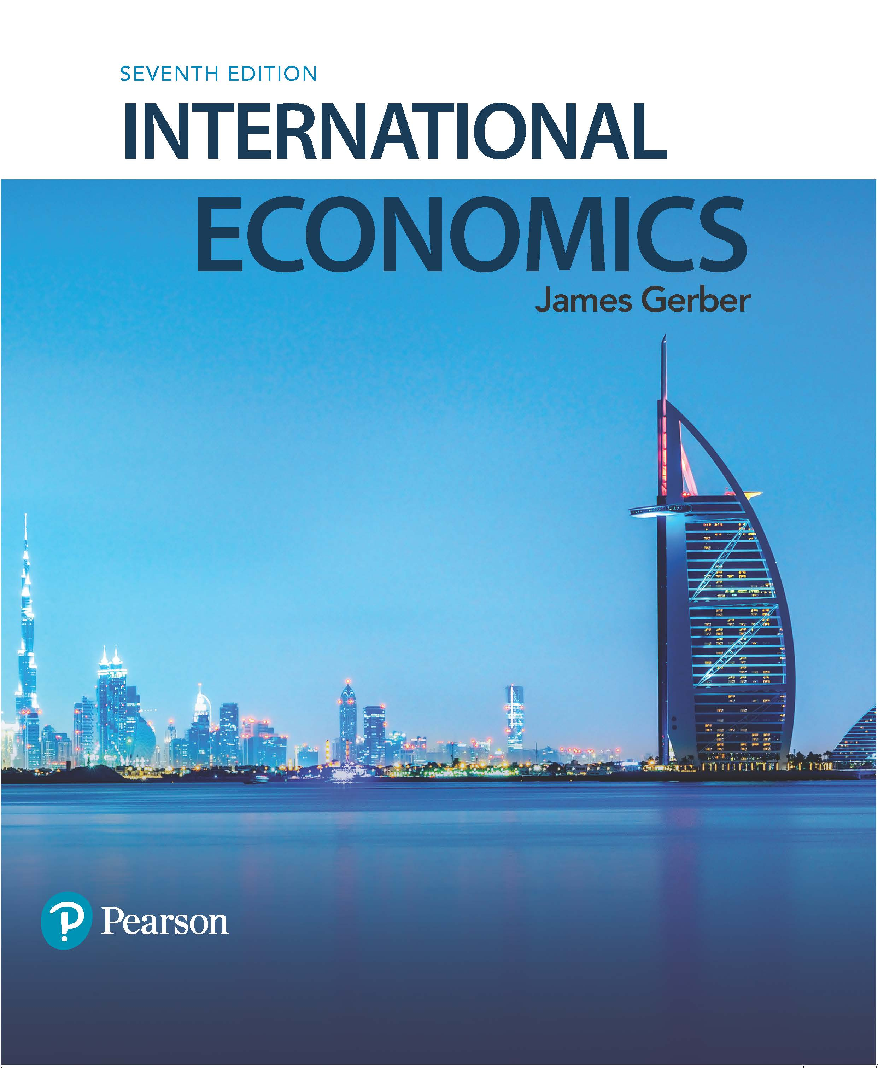
International Economics
Seventh Edition
Chapter 12
International Financial Crises
Copyright © 2018, 2014, 2011 Pearson Education, Inc. All Rights Reserved

Slide 2
Learning Objectives (1 of 2)
12.1 Define three types of crises.
12.2 Distinguish a crisis caused by economic imbalances from one caused by volatile capital flows.
12.3 List and explain three measures countries can take to reduce their exposure to financial crises.

Slide 3
Learning Objectives (2 of 2)
12.4 Explain the need for reforms in the architecture of international finance and international financial institutions.
12.5 Describe the main forces behind the global financial crisis that began in 2007.

Slide 4
The Challenge of Financial Integration
Economic integration has benefits but also risks.
Financial crises spread more easily from one country to another when economic linkages are present.
There are many recent examples: The European currency crisis in 1992; the Mexican peso crisis of 1994-95 that spread to South America; the Asian Crisis of 1997-1998; the recent global financial crisis, and others.
Financial crises are worth studying: they cause governments to collapse, they bankrupt businesses, and they ruin lives.

Slide 5
Definition of Financial Crises (1 of 4)
Economists have identified 3 main types of crises:
Banking crisis;
Currency crisis;
Debt crisis.
Each has its own set of characteristics.

Slide 6
Definition of Financial Crises (2 of 4)
Banking crises:
A crisis occurs when the banking system—or a significant number of banks--cannot perform its main functions and requires assistance.
Banks engage in intermediation between borrowers and savers; in a crisis there is disintermediation.
Households and businesses lose access to credit; consumption and investment decline.

Slide 7
Definition of Financial Crises (3 of 4)
Currency crises:
Also called an exchange rate crisis.
A sudden large depreciation in the exchange rate.
Currency crises have several negative effects.
Debt denominated in a foreign currency increases in real value.
A loss of confidence in the economy and the currency can cause further selling and a continued currency collapse.
A loss of outside financing and an immediate need to eliminate current account deficits.

Slide 8
Definition of Financial Crises (4 of 4)
Debt crises:
May be private debt or public;
A sovereign default is government that cannot pay its debt.
May be external or internal;
External debt is debt owed in a foreign currency and subject to rules set in a foreign jurisdiction.
Internal debt is owed in the domestic currency and is under domestic jurisdiction.
Debt crisis usually leads to restructuring of the debt rather than complete repudiation.
The debt maturity may be lengthened;
Interest rate may be lowered;
Partial debt forgiveness is common.

Slide 9
Vulnerabilities, Triggers, and Contagion (1 of 4)
Crisis vulnerabilities:
Economic conditions that make a country vulnerable to a crisis.
Two kinds are considered here:
Macroeconomic imbalances.
Volatile capital flows.
Crisis triggers:
Events that trigger a crisis.
These are unpredictable and without the vulnerabilities, would often not trigger a crisis.

Slide 10
Vulnerabilities, Triggers, and Contagion (2 of 4)
Vulnerability: Economic imbalances.
These take multiple forms.
Unsustainable government deficits;
Large private debt levels;
Large current account deficits;
Overvalued currencies.
The global crisis of 2007 had several of these, including excessive private debt and large current account deficits.

Slide 11
Vulnerabilities, Triggers, and Contagion (3 of 4)
Vulnerability: Volatile capital flows.
Financial capital can nearly instantaneously shift from one market to another, putting pressure on exchange rates, current accounts, and private and government borrowing.
The Asian Crisis of 1997-1998 is an example (see below).
Weak supervision and regulatory oversight can complicate this problem.
For example, banks with a lot of short term international loans.
When financial capital starts to move out of a country, it can become a stampede that leads to a crisis, or it may be limited if foreigners have confidence in the borrowing economy.
Multiple equilibria are possible, no way to determine whether a crisis will develop, or if conditions will return to normal.

Slide 12
Vulnerabilities, Triggers, and Contagion (4 of 4)
Contagion.
Most crises remain purely domestic, but some do spillover into other economies.
Sources of contagion:
Direct linkages; for example, banks and other economic interests purchased assets tied to the U.S. housing market before the recent financial crisis.
“Wake up calls”: When one country experiences problems, it signals that similar countries may have similar problems.
Common economic fundamentals: The factors affecting one country has a similar negative impact elsewhere because the economies share similar characteristics.

Slide 13
Case Study: The Mexican Peso Crisis of 1994-95 (1 of 3)
Both economic imbalances and volatile capital flows were involved.
Imbalances:
Overvalued exchange rate;
Low savings rates relative to investment led to large current account deficits.
Capital flows:
Were actively encouraged by government policy as a way to obtain investment funds;
The signing of NAFTA encouraged foreigners to invest in Mexico.

Slide 14
Case Study: The Mexican Peso Crisis of 1994-95 (2 of 3)
Triggers:
Rising interest rates in the U.S. increased the cost of Mexican borrowing.
Political events in Mexico caused nervous investors to reassess their exposure to the Mexican market;
Two political assassinations, a regional uprising in Southern Mexico (the Zapatista movement).
December, 1995, newly elected President Zedillo devalues the peso, but not by enough and more capital leaves the country.
Two days later, he switches the currency to a floating exchange rate from one that was pegged to the dollar.
The currency collapses, losing more than 50 percent of its value over the next 4 months.

Slide 15
Case Study: The Mexican Peso Crisis of 1994-95 (3 of 3)
In the short run, loans and lines of credit from the US, Canada, and the IMF help calm the outflow of capital.
To address longer term problems, Mexico implemented expenditure switching and expenditure reducing policies.
Devaluation followed by a switch to a floating exchange rate.
Contractionary fiscal policy, i.e., austerity.
GDP fell over 6 percent, and unemployment rose dramatically.

Slide 16
Domestic Issues in Crisis Avoidance (1 of 5)
Some policies to avoid crises are straightforward and easy to understand, if not always easy to follow:
Credible and sustainable monetary and fiscal policies, including sustainable levels of government debt;
Avoidance of overvalued exchange rates;
Active supervision and regulation of the financial system;
Provision of timely information of interest to international investors, such as reserve holdings of the central bank.
Other policy issues are more uncertain.

Slide 17
Domestic Issues in Crisis Avoidance (2 of 5)
Moral hazard problems:
During a crisis, there is a large incentive to keep credit flowing and avoid a collapse in the banking system;
Bailouts may encourage firms to take excessive risks and increase the probability of future crises;
But failure to bailout failing financial firms may increase the severity of the crisis by making it deeper and wider.

Slide 18
Domestic Issues in Crisis Avoidance (3 of 5)
Moral hazard problems and capital requirements:
Economists agree that banks should have more capital as the source of their operating funds.
Banks mostly use borrowed money; capital is the money of shareholders and bank owners and is an alternative to borrowing operating funds.
The Basel Accords are an international agreement among the world’s main central banks to increase capital requirements.
Most of the world’s advanced economies have increased bank capital requirements since the global financial crisis.
Economists are not in agreement about the theoretical optimum for capital requirements.

Slide 19
Domestic Issues in Crisis Avoidance (4 of 5)
Exchange rate policy: Exchange rates must be credible and sustainable.
Countries must avoid real appreciation due to inflation.
A number of crises have been caused when countries adopted crawling peg exchange rate systems as a mechanism to combat inflation.
Recall that R_{r} = R_{n}(P*/P); if a country fixes its exchange rate, then periodically devalues R_{n} to compensate for higher inflation at home, R_{r} does not change.
If ΔR_{n} is less than the difference in inflation rates, then R_{r} appreciates.

Slide 20
Domestic Issues in Crisis Avoidance (5 of 5)
Capital controls: restrictions on the movement of capital into and/or out of a country.
Economists are divided on this issue:
Con: Capital controls are sometimes easily avoidable, and therefore ineffective; they limit capital for investment that increases growth.
Pro: Capital controls can help avoid a sudden exit of capital; financial crises are more costly to growth than the benefits of free-flowing capital.
Restrictions on capital inflows are more effective than restrictions on outflows.

Slide 21
Case Study: The Asian Crisis of 1997-1998 (1 of 3)
The crisis began in Thailand in July, 1997.
Soon spread to other Asian economies, including Korea, Indonesia, Malaysia, and the Philippines.
Vulnerabilities:
Large current account deficits;
High growth rates for long periods enabled these countries to borrow easily to finance current account deficits.
Overvalued exchange rates;
Many pegged to the U.S. dollar; as the dollar appreciated, so did they.
Weak oversight supervision of banking and finance;
Maturity mismatches, politically motivated lending, and excessive borrowing from abroad.

Slide 22
Case Study: The Asian Crisis of 1997-1998 (2 of 3)
Triggers:
Falling values for the Chinese yuan and Japanese yen made Thailand’s baht overvalued.
A fall in computer chip prices hurt one of Thailand’s main export industries.
Investors lost faith that Thailand could remain pegged to the dollar.
Contagion: Uncertain why it spread so rapidly.
Possibly a “wake up call” for investors to look at other countries.

Slide 23
Case Study: The Asian Crisis of 1997-1998 (3 of 3)
Consequences of the crisis:
Currency collapses throughout the region as investors pulled out their money.
Bankruptcies increase, economic activity turns down and recessions take hold.
China and other emerging markets embark on campaigns to build up their reserves though export surpluses.
Three debates:
Did the IMF give bad advice to defend currencies instead of avoiding recession?
To what extent was moral hazard a problem?
Can capital controls stop capital flight once it begins?

Slide 24
Domestic Policies for Crisis Management (1 of 2)
Crisis problems are often intractable since any possible response may solve one problem but make something else worse.
Example, the Asian Crisis
The IMF pushed countries to raise interest rates to try to defend their currencies. This deepened the recessions brought on by the crisis.
The alternative was to fight the recession and let the currency fall; but a lot of debt was denominated in foreign currencies, and this would have increased bankruptcies.

Slide 25
Domestic Policies for Crisis Management (2 of 2)
Crises caused by government debt or other imbalances seem to have easy to understand but painful to implement solutions:
Cut spending, raise taxes.
But political obstacles or humanitarian concerns may make this difficult:
Spending cuts hit vulnerable populations;
Divided governments may not be able to implement recommended policies due to a lack of consensus.
In general, crises with an international dimension—foreign debts, capital flight, exchange rate overvaluation—are more difficult to resolve.

Slide 26
Reform of the International Financial Architecture (1 of 4)
The increased frequency of crises since the end of Bretton Woods has led to a search for new systems and rules for financial management that would reduce the frequency and severity of crises.
There are a wide variety of proposals, many of them at odds with each other.
Two issues stand out:
The need for and policies governing a lender of last resort;
The conditions a lender should impose on borrowing countries.

Slide 27
Reform of the International Financial Architecture (2 of 4)
Should there be an international lender of last resort?
Con: It increases moral hazard; supports excessive risk taking, particularly as failing firms engage in riskier activities to try to avoid collapse.
Pro: It avoids the worse meltdowns; financial regulation can reduce moral hazard problems.
How much should countries be allowed to borrow?
Current limits are 300% of quota, but often exceeded.
The IMF cannot support a moderately large economy as it lacks the resources necessary.

Slide 28
Reform of the International Financial Architecture (3 of 4)
What conditions should be imposed on borrowers?
Called conditionality; the IMF disburses loans in tranches, or “slices,” as borrowing countries make required reforms.
Questions:
Should the conditions address only immediate problems, such as fixing a current account deficit?
Or, should they address deeper problems that are obstacles to greater efficiency and competitiveness, such as requiring the privatization of heavily subsidized state owned firms?
And what if there is not a consensus about the best policies?

Slide 29
Reform of the International Financial Architecture (4 of 4)
Three more issues:
Standstills.
Should the IMF be able to call for a temporary stop to interest and principal payments to international lenders by countries in crisis?
Data dissemination.
There is widespread agreement that timely reporting of financial and economic data can help ameliorate or possible even avoid some crises.
Collective action clauses.
International lenders must agree to collective mediation at the time they make loans.

Slide 30
Case Study: The Global Financial Crisis of 2007 (1 of 2)
The crisis began in 2007, intensified in 2008, and gradually came to an end in 2009.
Vulnerability 1: Current account imbalances:
Large current account deficits in the U.S., U.K., Spain, Greece, and some other nations.
These were matched by large current account surpluses in China, Japan, Germany, and several oil exporters.
Vulnerability 2: Weak financial oversight.
Financial innovation created new financial instruments with poorly understood risks.
New types of firms entered financial markets with securitized debts and other new products.

Slide 31
Case Study: The Global Financial Crisis of 2007 (2 of 2)
Triggers:
Uncertain what the exact trigger was.
Nevertheless, the decline in housing prices in the U.S. set off a wave of defaults on home loans that undermined the value of securitized mortgages.
Contagion:
The crisis easily spread from the United States as European and other financial entities had purchased the securitized mortgages issued by U.S. financial firms.

Slide 32
Copyright

